Slide 1
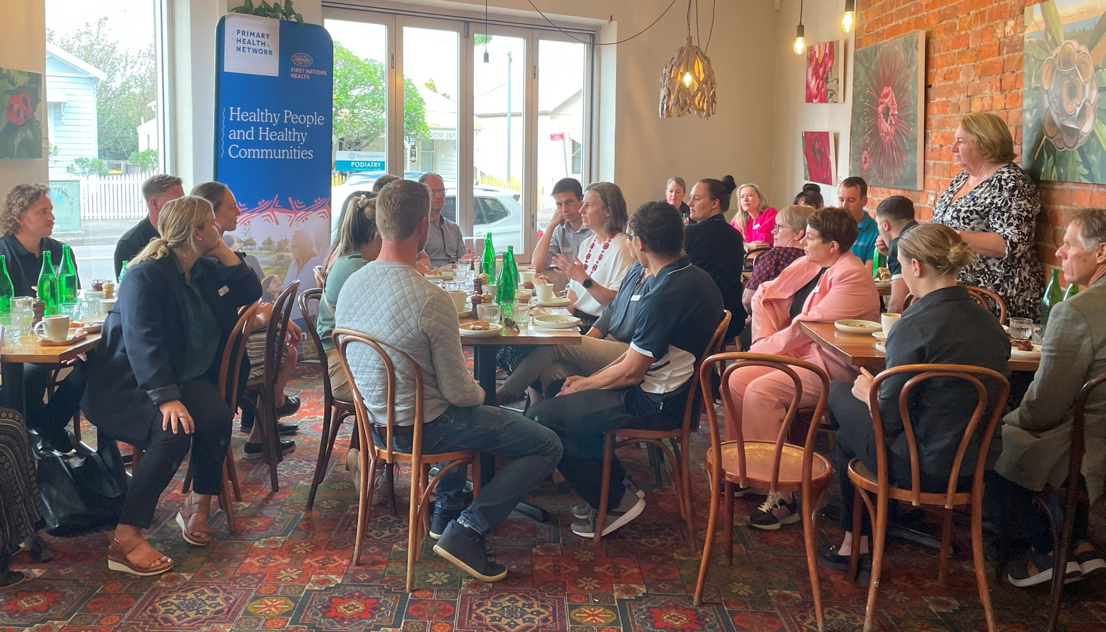
How PHN supports
Allied Health
  DR Trent Watson
    PHN Board member, Allied Health Reference Group member & Dietitian

Slide 2
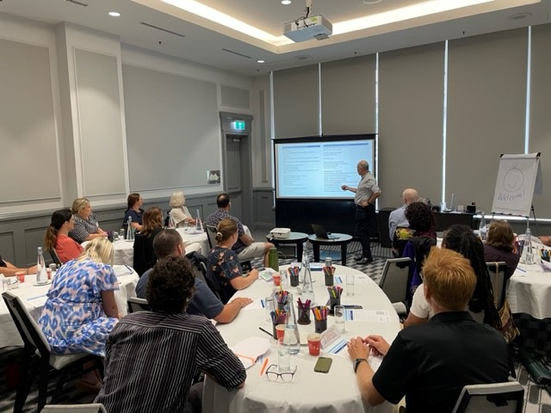
Agenda for today:
1
About the PHN
2
How the PHN support Allied Health
3
National Allied Health work
4
Current opportunities

Slide 3



Our purpose and our long – term goal
  The role of Primary Health Networks is to coordinate and fill gaps in primary care services, and to commission (or broker) primary care services. PHN’s do not provide health services to communities and do not receive funding to deliver acute care or workforce services.

Slide 4
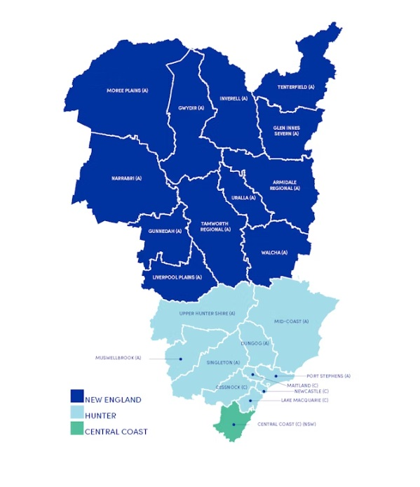
The Primary health Network
Hunter New England Central Coast Region
      23 Local Government areas
      2 Local Health Districts
      1.2 million people
      Diverse population
      Over 300 Allied Health Provider locations on the Central Coast and close to 700 in the Hunter New England Region
Notes:
Our Primary Health Network region is vast in geographical terms and diverse in terms of its communities. Covering 130, 000 square kilometres, it stretches from the QLD border in the north to Gosford in the south, and west past Narrabri and Gunnedah, and incorporates 23 Local Government Areas.
The region has a population of 1.2 million people who live in small rural and remote rural villages, in regional towns and in densely populated urban centres.
31 PHN nationally
Rural, regional towns and densely populated urban areas
More than 400 General Practices and 1,300 General Practitioners across the region

Slide 5
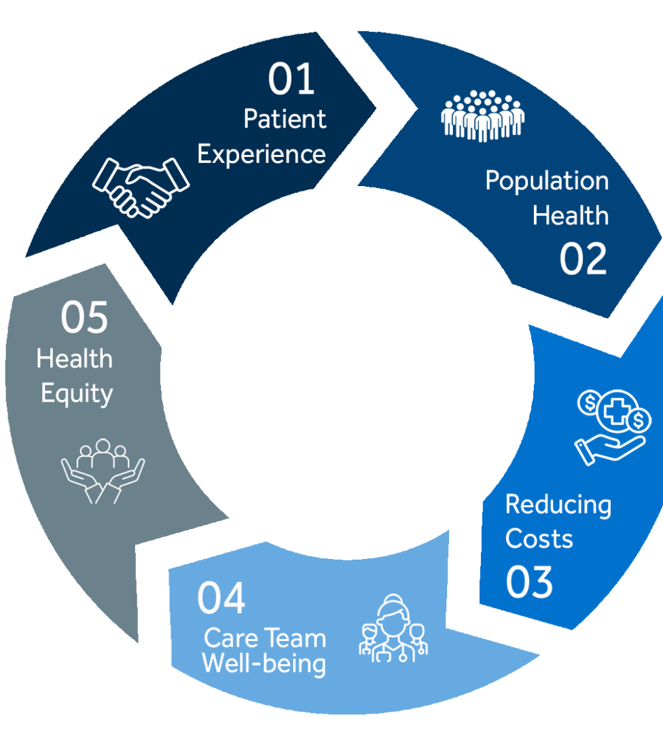
Commission services
  Health care commissioning is defined as the process of “planning and purchasing health services to meet the health needs of a local population”
  It is a continual cycle that involves planning, designing or procuring, monitoring and evaluating health services to make sure they are performing well and improving the health of the communities that they work within.
  Quintuple Aim approach had been adopted by the PHN to ensure Health Equity
Quintuple aim
Notes:
It is a continual cycle that involves planning, designing or procuring, monitoring and evaluating health services to make sure they are performing well and improving the health of the communities that they work within.
HNECC approach is to commissioning involves an ongoing collaborative relationship with service providers, clinicians, consumers and other stakeholders so that services are designed and delivered to meet community needs in key priority areas.
Health equity Quintuple Aim keeps this strategic focus in front of mind for all our work.

Slide 6
# AHRG
  Allied health reference Group
  Multidisciplinary advisory group
  Developed our PHN’s
# ALLIED HEALTH STRATEGY
  IN PARTNERSHIP WITH ALLIED HEALTH PROFESIONALS
  STRATEGY FOCUS
  Data, Quality & digital maturity
  Practice engagement & workforce
  Advocacy
  NATIONAL WORK
  national PHN Allied health in primary Care Engagement Framework
  Allied helath Practice Support toolkit
Notes:
AHRG supported the development of AH Strategy and oversea the work.
Why PHN supports Allied Health.
Allied health is the second-largest clinical workforce in Australia and demand for allied health over the next decade is expected to continue to grow, especially in rural areas. Allied Health plays a critical role in primary healthcare in helping people to lead healthier lives – and if they become unwell to receive the right care in the right place at the right time.
AHRG and Strategy development.
Key areas of strategic focus for allied health 1. Data, Quality & Digital Maturity 2. Practice Engagement & Workforces 3. Advocacy
National work
The HNECC PHN has been working with other PHNs at the national level to develop a National PHN Allied Health in Primary Care Engagement Framework. Launched in November 2022, this is a piece of work lead by HNECC PHN.
This Framework has been developed with the intention of strengthening engagement between PHNs and the Allied Health sector, serving as a roadmap for increased and collaborative ways of working.
There is an opportunity for PHNs to play a key role in supporting the Allied Health sector as an important part of an integrated health system (something Andrew may touch on too!)

Slide 7

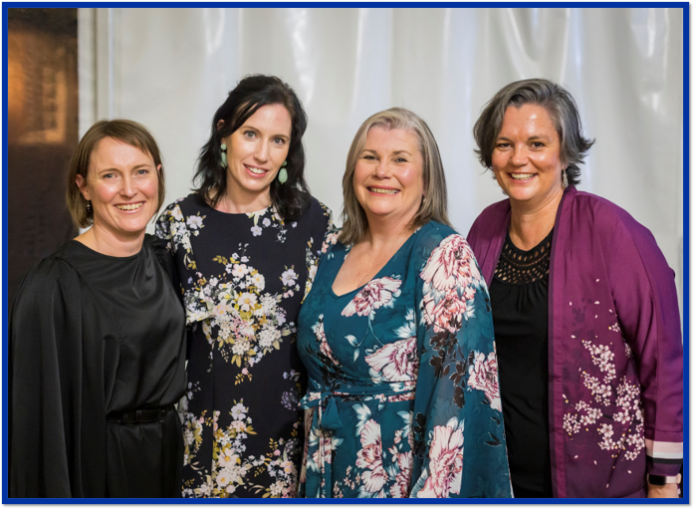
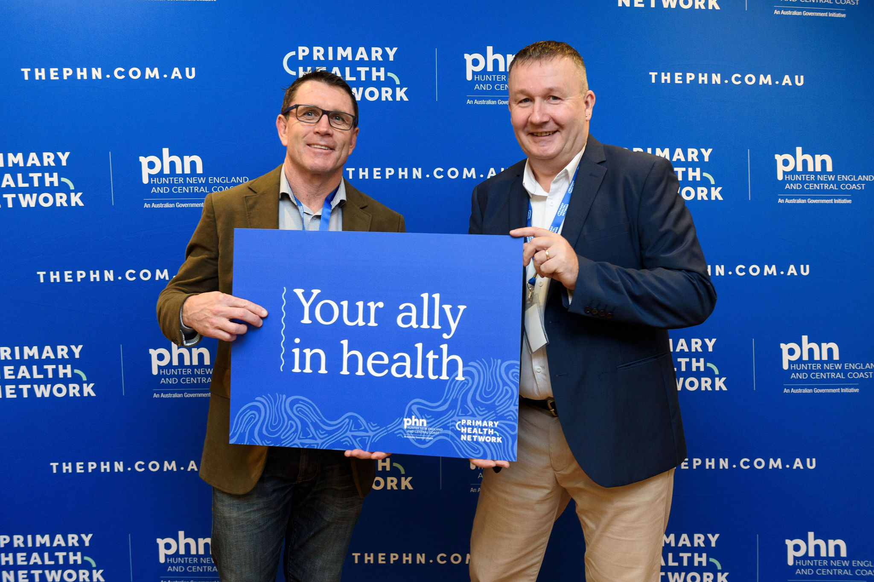
Introducing the PHN Team
Board Members who are Allied Health Professionals
  Trent Watson & Elizabeth Ward
PHN Integrated Care (Allied Health) Team Members
  Catherine Turner | Executive Manager Commissioning
  Joanna Coutts | Integrated Health Manager
  Joanne Dean | Senior Project Officer
  Sara James | Central Coast Integrated Care Health Officer
  Ellen Meinel | New England Integrated Health Officer
Allied Health Reference group and Clinical Council
  Multidisciplinary allied health professions are represented in both our Clinical Councils and our Allied Health Reference Group.
  A full list of members can be viewed via the flowing links;
  Clinical Council members – select here
  Allied Health Reference Group members – select here
Notes:
If you see any of the PHN team today, please introduce yourself they are always keen to hear how you would like the PHN to support you.
Representation on clinical councils from a diverse range of allied health professions for a full list see the PHN website or access the links, this presentation will be available on the Conference Resource webpage.

Slide 8

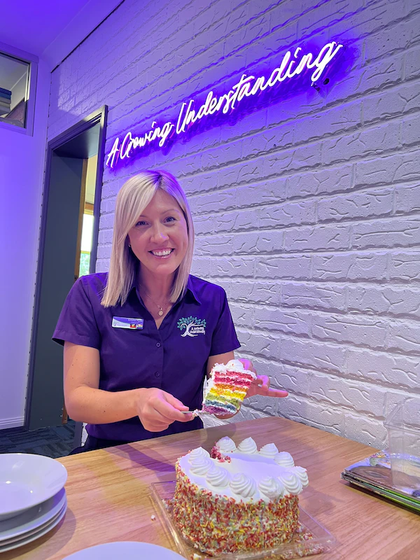
Education and engagement
Dave @
MoveAbout Therapy featured in
Occupational Therapist week – select here
  Communications and engagement plan
  Allied health Breakfast and practice visits
  Business Skills workshop
  Allied Health Conference’s 2022 and 2024
  Improving Patient Care with your Allied Health Assistants select to view short clip
  Education ATO, NDIS changes, clinician wellbeing , Chronic Pain, CALD Communities to name a few
  Inclusive Care training - LGBTQ+ Pride and Health and Wellbeing Membership
Emma @
A Growing Understanding featured in Inclusive Care good news – select here
Notes:
Communications & Engagement Plan - Articles for Allied health professional days can be viewed on the PHN website news examples OT, Speech Pathology, Dietitians to name a few upcoming Mental Health week and Exercise Right week 20 to 26 May 2024 . Plus Good news stories breakfast events, Inclusive Care membership outcomes, Business skills outcomes.
Allied Health Breakfast and practice visits over 150 face to face engagements since October 2023 last year
Business skills workshops across CC, Newcastle, Taree and Inverell 90 attendees in face-to-face full day workshops
Promotional video – allied health assistance featured in the conference
Conference 2022 – 120 attended in 3 locations and online. In 2024 ?? Numbers TBA
Education – Full education Library to view past event and Calander to view forward events on our website
Inclusive Care Training – To name a few outcomes - A Growing Understanding – winners of Excellence in Diversity and Inclusion in 2023 Lake Macquarie Business awards & published a book on pronous for children
Myrtle Ock Clinic – Internal Inclusivity working party expanded services designed to improve health outcomes for LGBTQ community

Slide 9


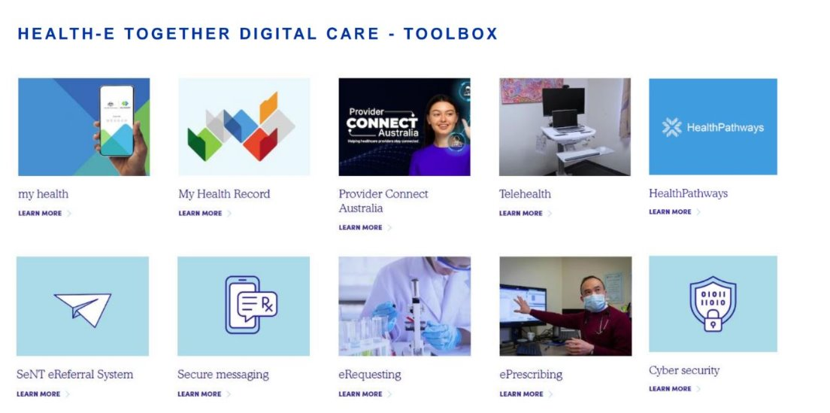
Data, quality & Digital Maturity
  Digital Health Maturity Assessment
  Health-e Together Digital Care Toolbox
  Funded Telehealth Software for allied health Video call with healthdirect Australia
Digital Health Training Champion Grants 2024 - Primary Health Network (thephn.com.au)
Notes:
Digital Health Maturity Assessment – Action plan under development
Health-e Together Digital Care Toolbox – Consultant report is under review
Digital Health Training Grants applicable to Allied Health - The PHN is implementing incentives and support to increase telehealth utilisation by general practice and allied health clinicians as part of the PHN Digital Health Strategy.
Train IT Medical has been funded by the PHN to provide eighty (80) education training places for eligible general practices and allied health providers located within the Hunter New England and Central Coast Primary Health Network (PHN) region to enable one (1) employee, the digital health champion, to participate. – CLOSE 10th May 2024
Funded Telehealth Software for Allied Health ​
The Commonwealth government has provided funding for healthdirect Video Call a comprehensive, secure and reliable video consulting service which follows the Australian Government cyber security guidelines and safeguards privacy.
Funded Telehealth Support ​The PHN in partnership with Brennan IT, have setup a dedicated Help Desk to troubleshoot and resolve any issues while Telehealth consultations are being conducted.

Slide 10

What is the National PHN Allied Health in Primary Care Engagement Framework?
Strengthen engagement between PHNs and the Allied Health sector
serving as a roadmap for increased and collaborative ways of working
THE Vision
Collaborate with key stakeholders- allied health peak bodies, State, Territory and Federal government and PHNs
Key stakeholders to play a crucial role in shaping Framework development

Slide 11

NATIONAL ALLIED HEALTH Practice toolkit Development
To Design and implement a National toolkit for Allied Health practice engagement by PHNs
THE Vision
support capability and development for Allied Health Professionals and improve quality of care
Strengthen integration and communication into primary care and referral systems
Include resources to improve business skills, funding mechanisms, orientation to PHNs, local needs and requirements

Slide 12

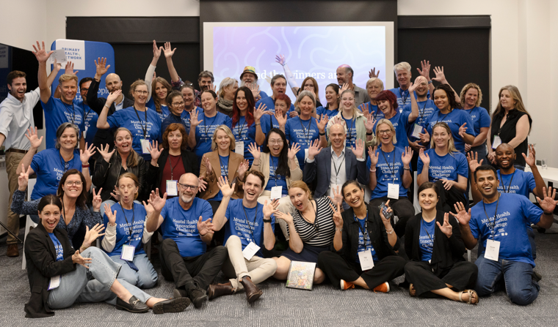
Other areas of support
  Grants and Tenders
  Health Pathways
  First Nations Cultural Training
  Recruitment and Retention Resources
  Mental Health Innovation Challenge
  The Lift Project
  MAP – Member Assist Program for allied health and families
Notes:
Each support area has a link within the presentation.
Grants and Tenders – Game Changer Technology grants closed on 22 April
Blue Sky Fund – Innovation Unsolicited Grants - Being a leader through innovation, the PHN acknowledges that many ideas that are novel and innovative fall outside the scope or timing of the PHN grant program. The PHN Blue Sky Fund is designed to provide flexibility in capturing these opportunities to trial projects that can deliver tangible positive health outcomes for the community.
Health Pathways – encourage AH to be listed as a referral pathway
First Nations Cultural Training – or advice book to meet the team
Recruitment and Retention resources – also a jobs board on the PHN website
Mental Health Innovation Challenge – Series of events with one main challenge event where teams create ideas and pitch to judges for prize money. The PHN is working to support teams who are interested in further developing ideas. Solutions from Songwriting, Mens circles, Boulder climbing, AI to access resources to name a few. A team member here at the conference I Am Awsome – design to connect with children to teach life lessons . Iam Awesome
Member Assist Program (MAP) for allied health and families (3) confidential counselling sessions

Slide 13
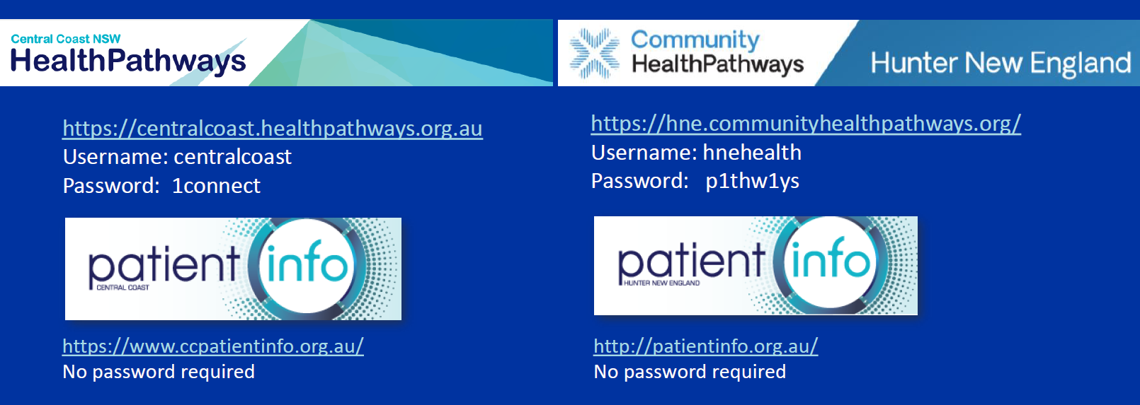

Is your practice listed on HealthPathways?
Select for Information about HealthPathways
Notes:
Passwords and URL

Slide 14
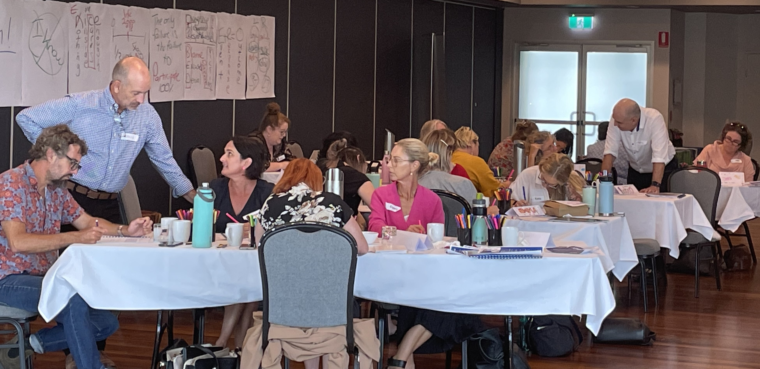

Current opportunities for allied health
  Program will run 2 May 2024 to 8 August 2024 with 8 participants
  8 x 2-hour fortnightly virtual group sessions with professional health coaches
  check-ins with a buddy on alternative fortnights
  3 x 45-minute individual virtual sessions with professional health coach
  Positions Full
Group Coaching Health & Wellness
          Program will run June to November 2024 in small groups
          12 x fortnightly 90-min virtual group sessions with professional business coaches
          some access to one-on-one phone calls with coaches
          downloadable course resources
          Free access to 3 self paced learning modules
          For more information select
Group Coaching Business Skills
Tailored Coaching LGBTQ+ Inclusive care
          Pride in Health + Wellbeing Membership
          Lite membership 10 available is suitable for practices new to LGBTQ+ inclusion work
          Standard Memberships -2 available is suitable for practices who have done some foundation LGBTQ+ inclusion work
          Valid for 12 months 1:1 mentor and support to implement change
          For more information select
Notes:
Group Coaching Health and Wellness is now full, it is the first time we have run this program. Let us know on our evaluation survey if this is something you are interested to see offered again.

Slide 15

You are invited

Slide 16
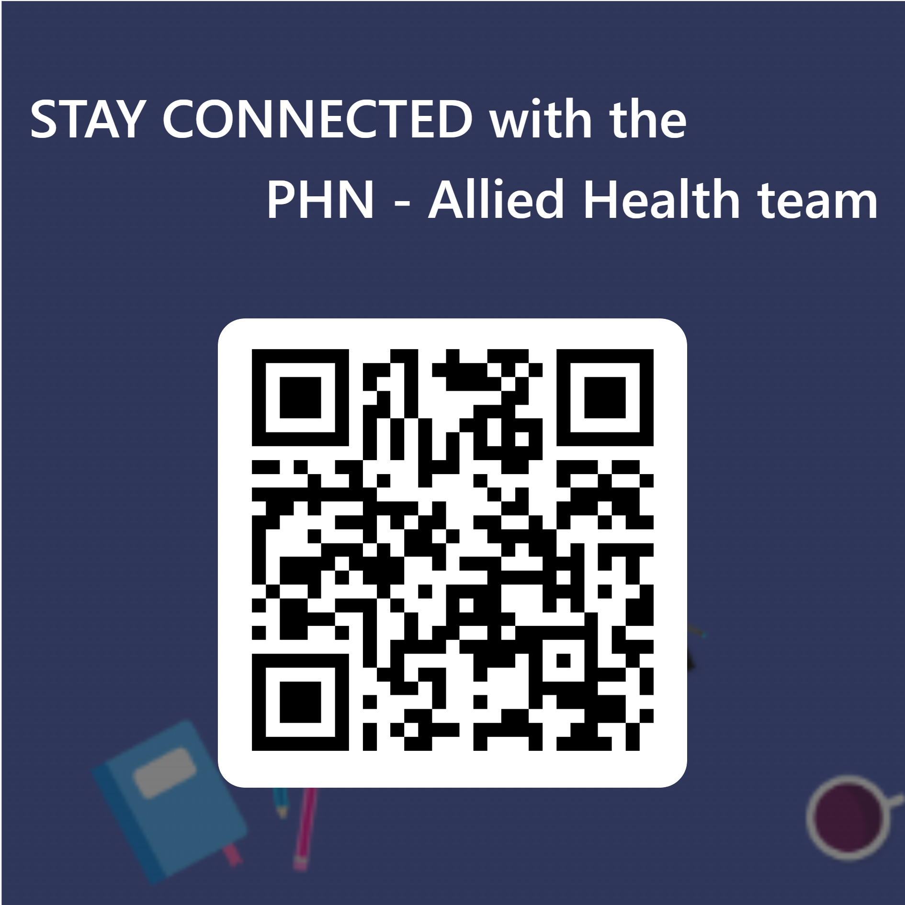
Stay Connected
  Scan the QR code to receive our weekly newsletter and the latest updates from across the primary care sector, set alerts for grants, education and more.
  Email us at alliedhealth@thephn.com.au
  Call us on 1300 859 028
  Follow us on social Media
Facebook​
​Youtube​
​LinkedIn

Slide 18

Questions?

