Slide 3
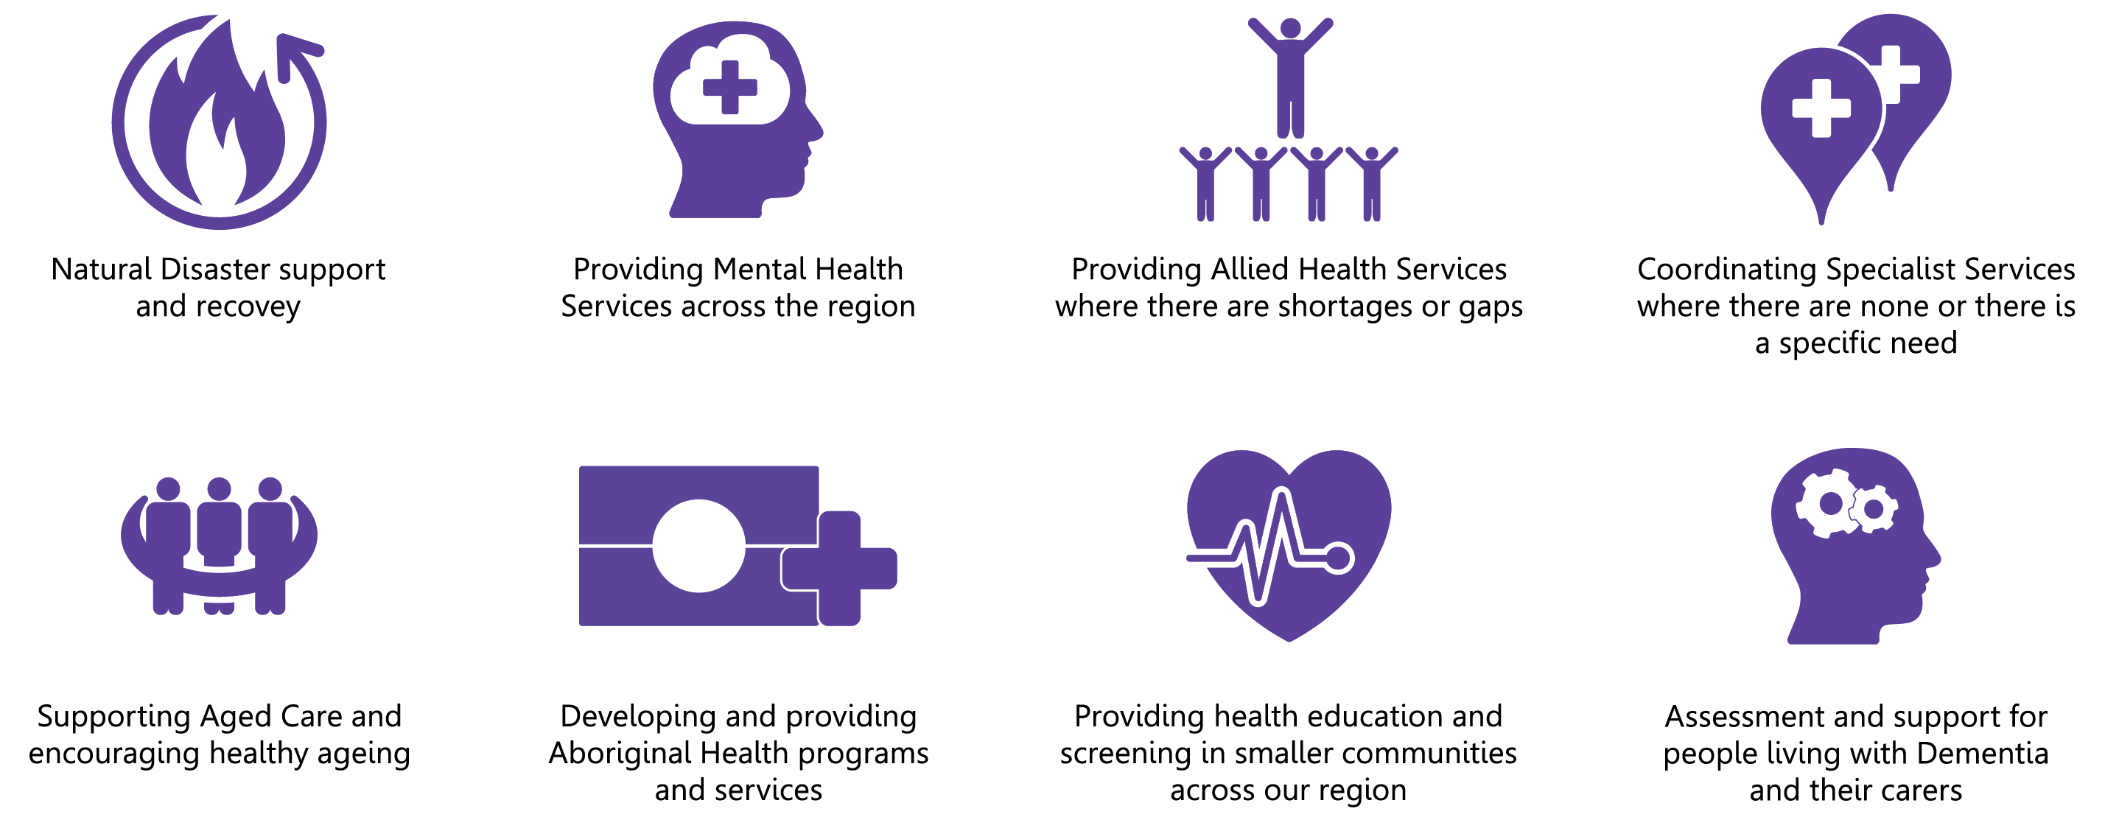
About Us
We provide a range of clinical services across New England North West and parts of South East Queensland, including:
In addition to our clinical services, we are focused on helping our communities and individuals take greater responsibility
for their health outcomes through health literacy and health promotion programs and partnerships

Slide 4
Our Footprint
Denotes HealthWISE office

Slide 7
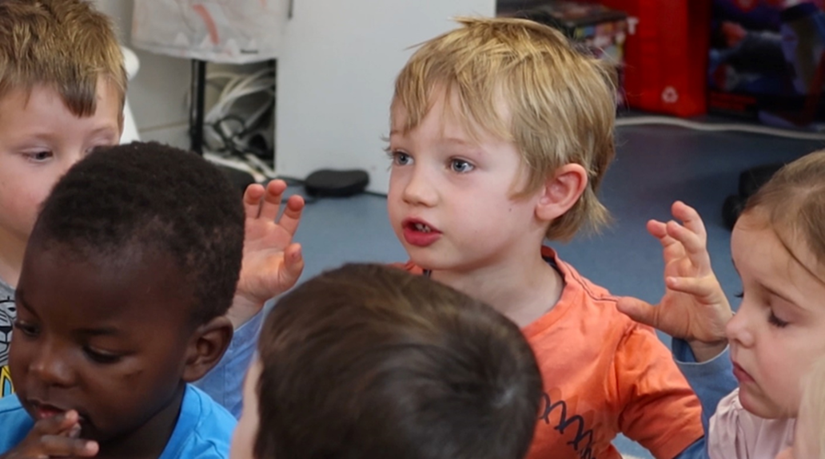

Slide 8
What is phonological awareness?
phonology = the sound system of a language
awareness = knowledge of, or interest in …

Slide 9
What is phonological awareness?
The awareness or knowledge of the sound system of a language

Slide 10
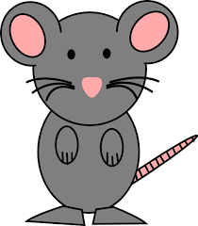
Early phonological awareness
Say rhyming words

Slide 11
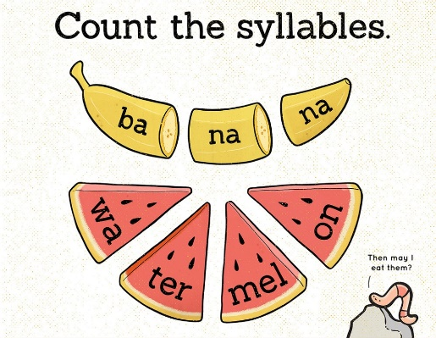
Words and syllables

Slide 12
Recognising sounds - Phonemic awareness
Beginning sounds in words
d-og

Slide 13
Phonemic awareness
Final and middle sounds in words
do-g m-u-m

Slide 14
Phonemic awareness
kiss kill

Slide 15
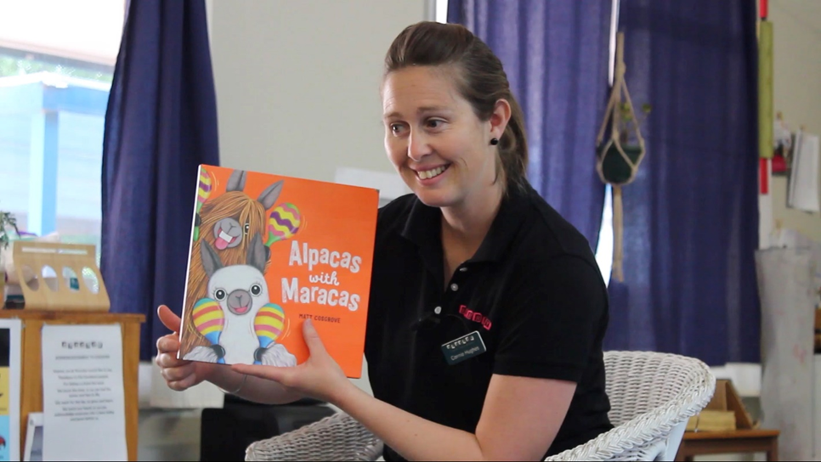

Slide 16
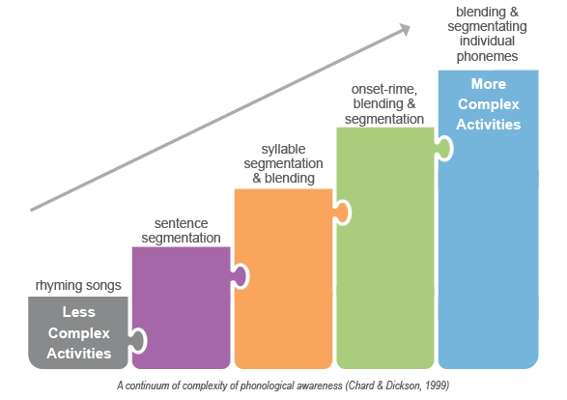

Slide 17
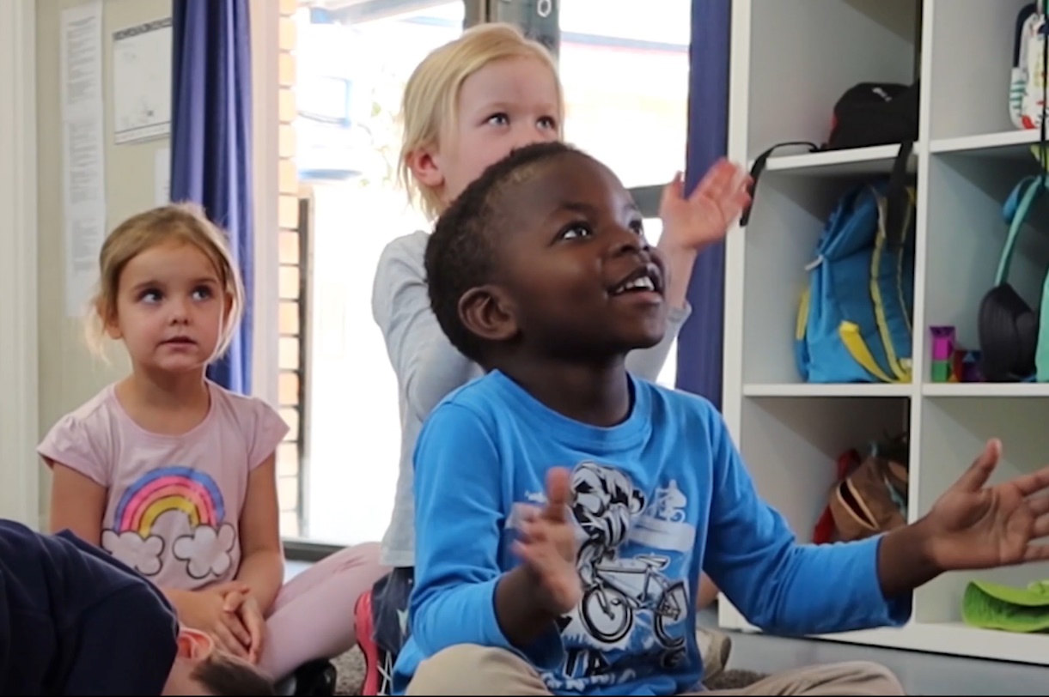
Notes:
.

Slide 18
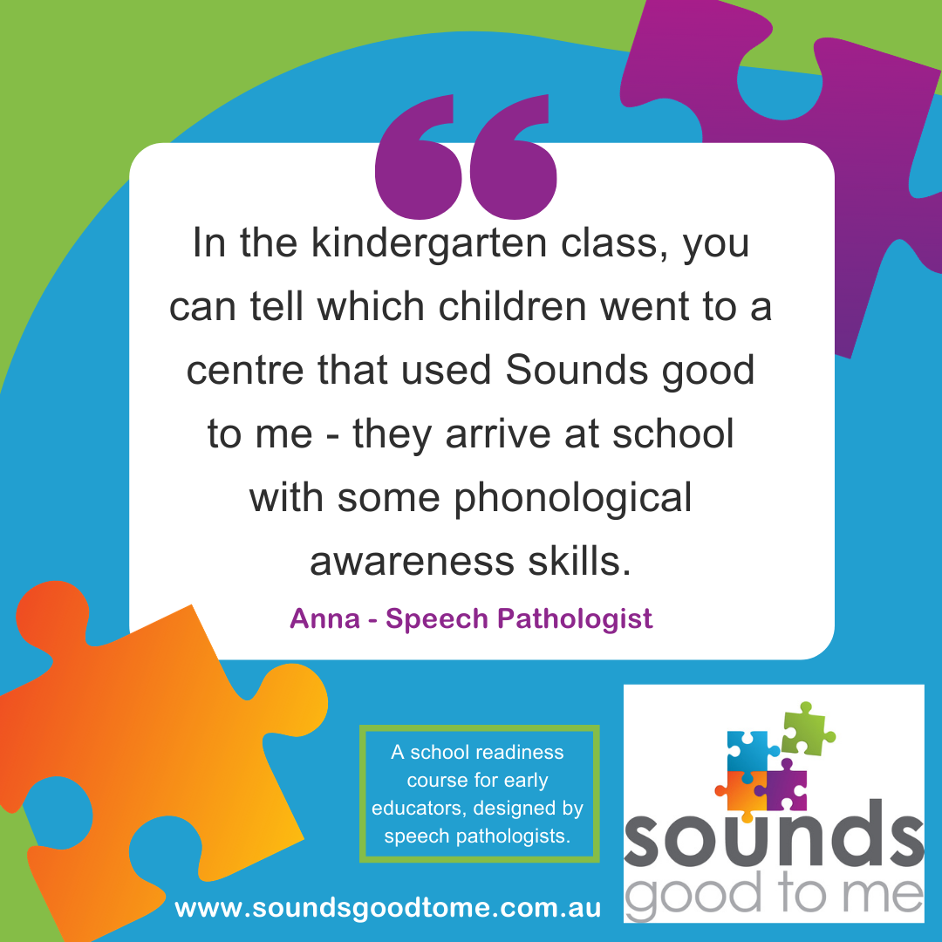
Sounds good to me program testimonial

Slide 20
https://soundsgoodtome.com.au/

Slide 21
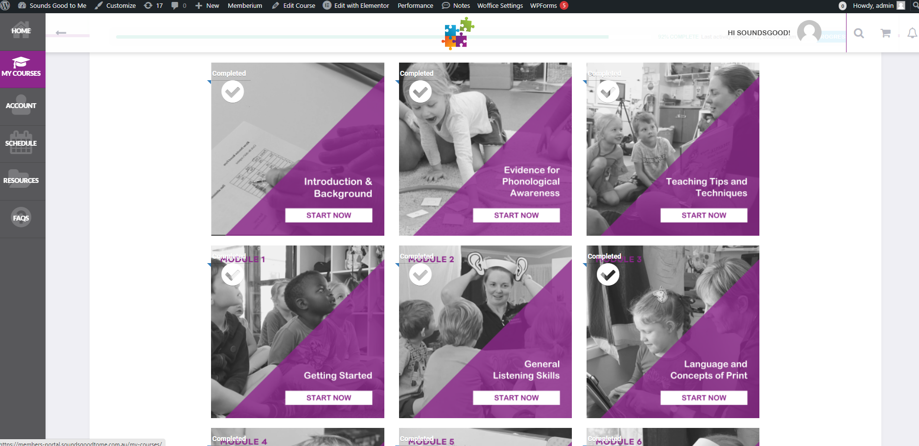

Slide 22
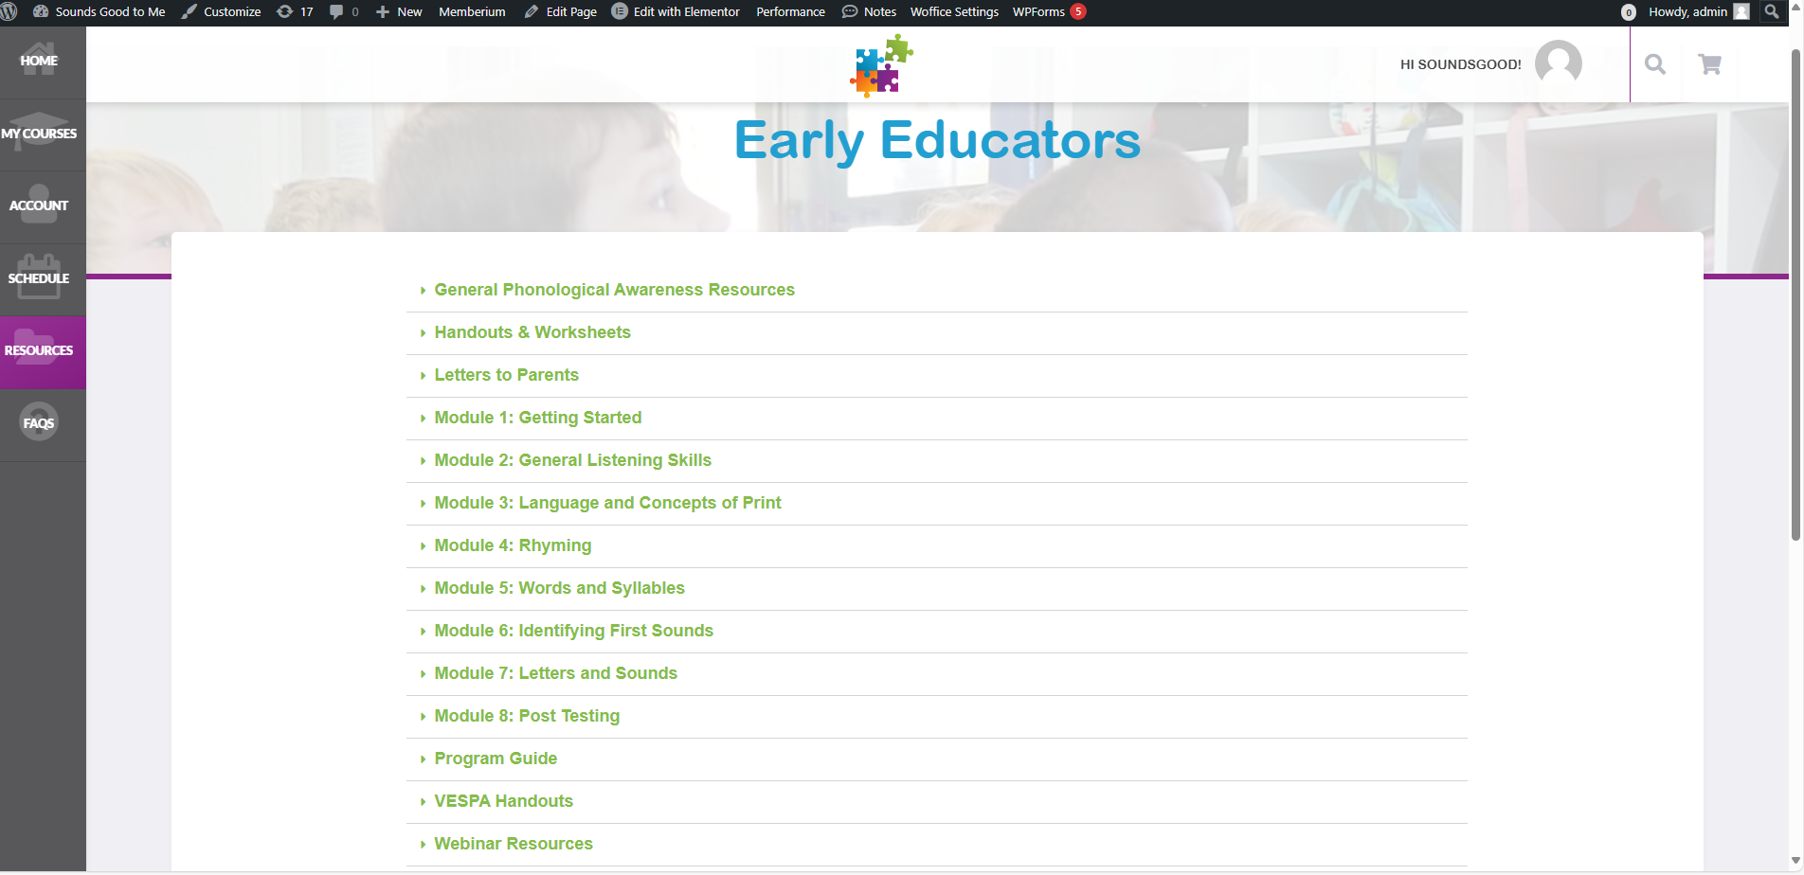

Slide 23
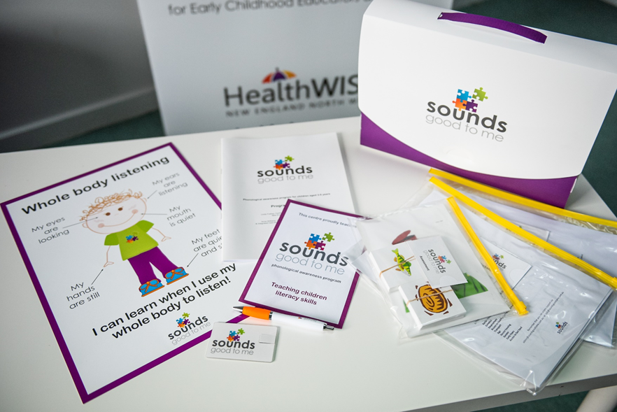
The resource kit

Slide 24
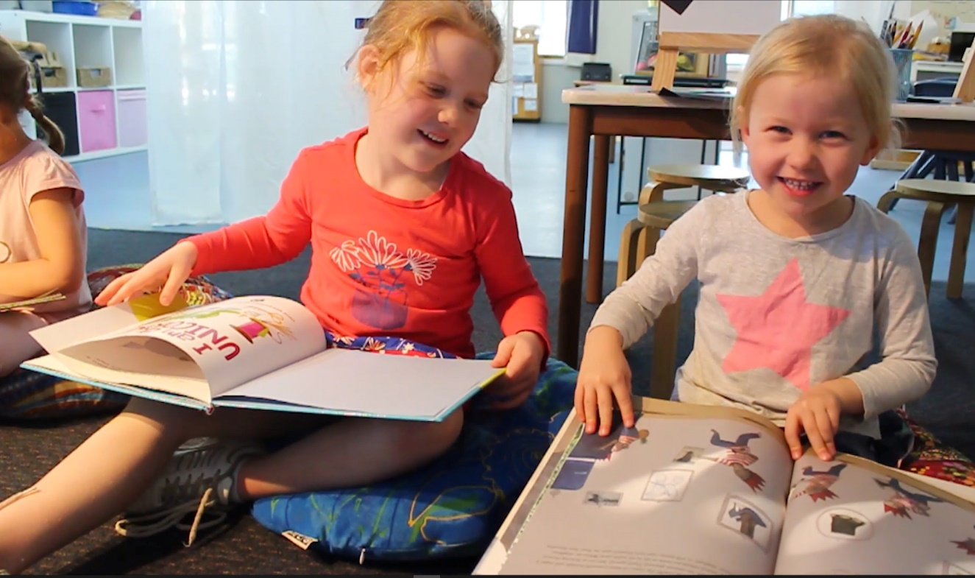

Slide 25
Sounds good to me program testimonial
Notes:
.

Slide 26
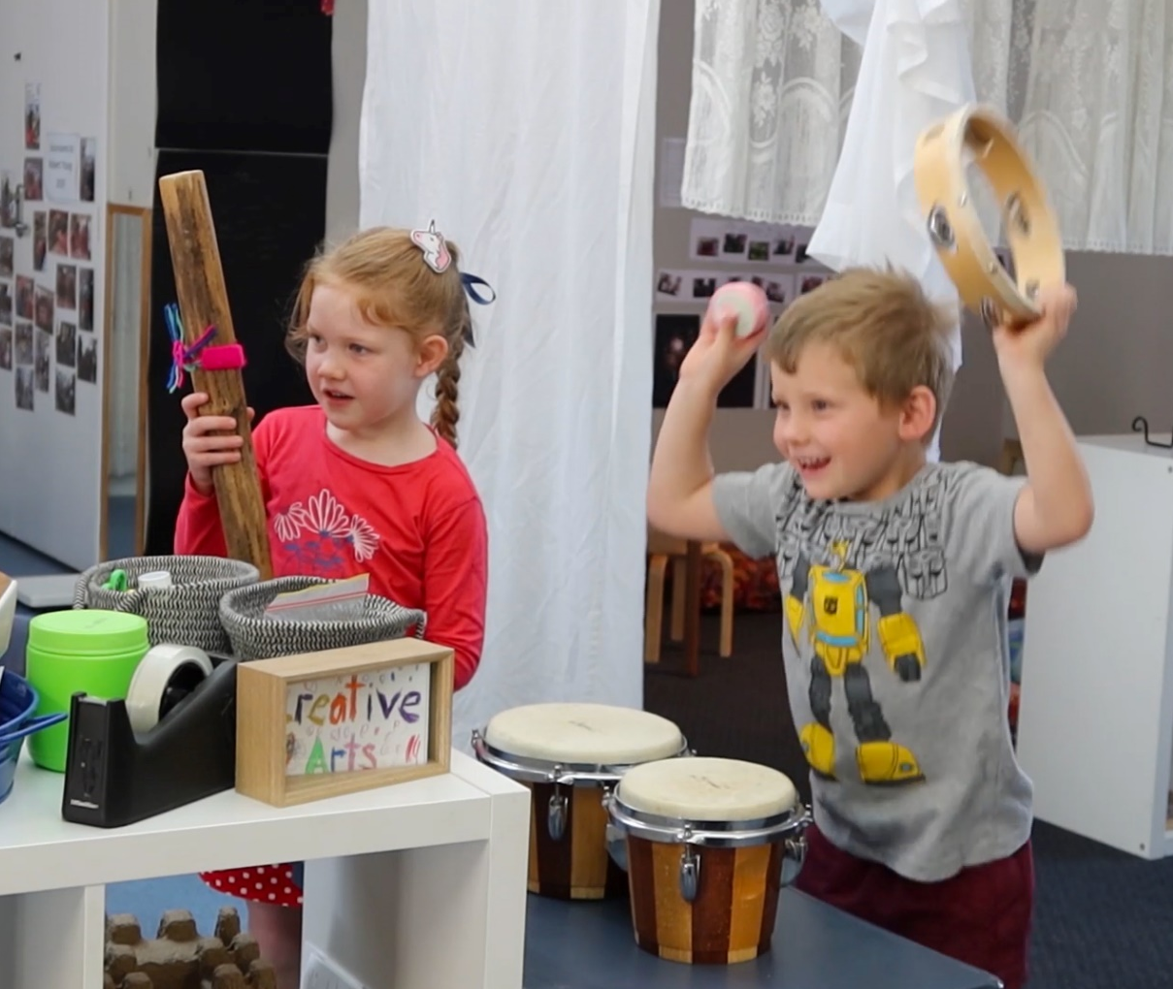

Slide 30
Want to know more?
Anne Williams
Speech Pathologist and Integrated Care Manager
info@soundsgoodtome.com.au

