Slide 1
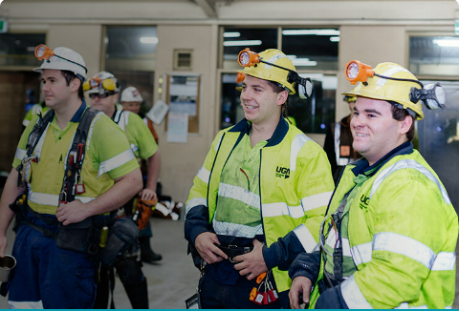
Fuelling healthy habits amongst NSW coal mine workers Emma McNamara Health Promotions Lead Emma.McNamara@coalservices.com.au

Slide 2
Health Profile of a NSW Coal Mine Worker
Health issues influenced by the nature of work and the work environment
87% overweight or obese
38,000 workers
92% male
Coal Mine Dust Lung Diseases
Industrial Deafness
Mental Health Issues
Obesity
Musculoskeletal Injuries
Long shifts, rotating rosters
Sedentary roles
Poor dietary choices

Slide 3
The Healthy Weight Initiative (HWI)
Developed by the HNE and CC PHN
Designed to support clients to lose weight, and reduce risk of chronic disease
12 sessions - nutrition, exercise and lifestyle
Motivational interviewing
Personalised goal setting
CS Health started delivery of HWI in 2020

Slide 4
Evaluation of HWI delivery and participant outcomes
Graph 1 – CS Health HWI Weight and Waist Loss Outcomes vs no. of sessions completed
Participant feedback
Largely positive from those who completed the program (~40%)
Difficult to commit to face-to-face appointments for 12 sessions
More ‘strategies’ required to support achievement of goals
More content to suit coal mine worker role: alcohol, shift work, sleep, mental health

Slide 5
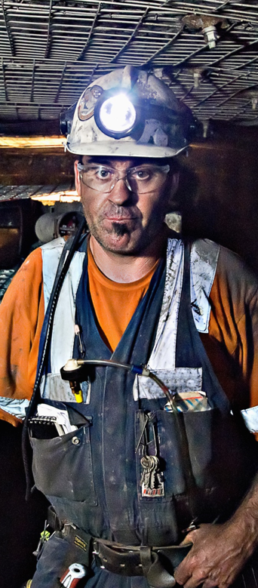
What changes were made? What were the outcomes?
Action | Outcomes
Commenced telehealth delivery | Increased accessibility to program Decreased barriers to attendance Greater potential to suit client needs
Increased flexibility in session frequency
Offered ‘onsite’ delivery option
Increased number and location of allied health professionals delivering program: Physiotherapists and occupational therapists in addition to EP’s. All geographical regions | Increased capacity to deliver the program across regional areas Diversification of clinical skills Upskilling of staff and greater job satisfaction Enhancement of team collaboration and utilisation of expertise
Additional training for allied health staff | Increased confidence, knowledge and skills in program delivery

Slide 6
Key Learnings
Need to promote earlier intervention in weight management for coal mine workers
Need for greater consideration of client suitability for program and support options after program completion
Importance of ongoing investment in staff training and professional development
Use of HWI champions
Identification of suitable training courses in motivational interviewing

Slide 7
Emma McNamara Health Promotions Lead Emma.McNamara@coalservices.com.au

