Slide 1
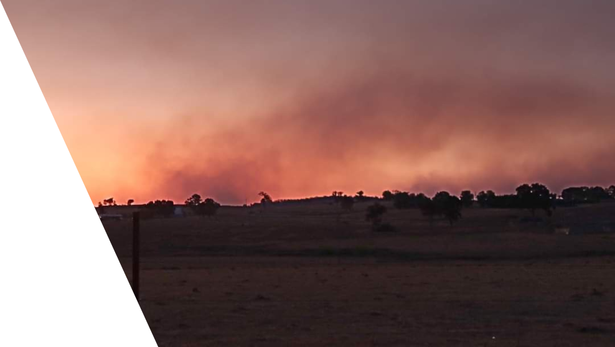
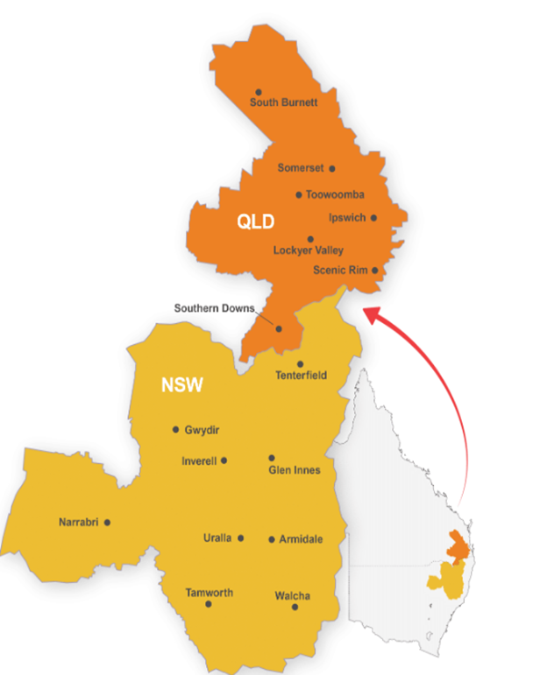
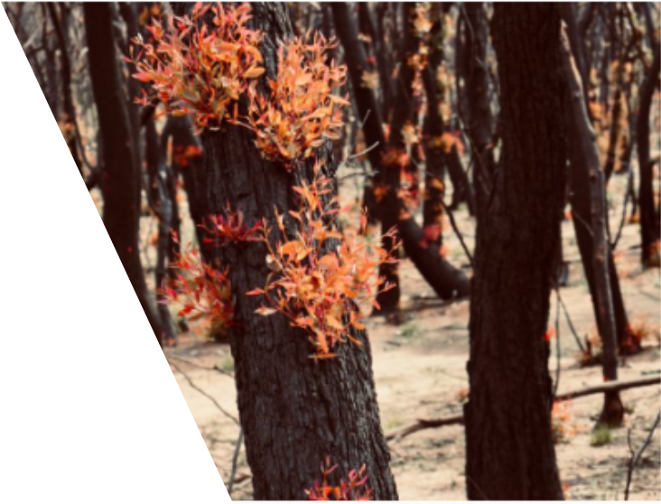
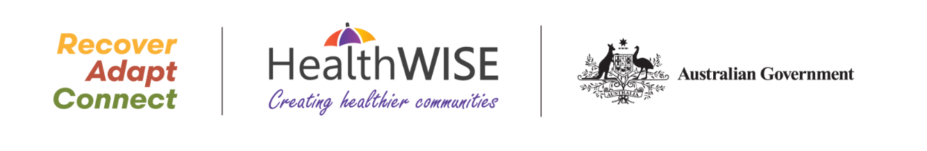
Knowing ahead of time how a disaster situation might be experienced, can help reduce anxiety levels and overall psychological responses to an event.
“Risk reduction and resilience aren’t just about infrastructure… the most critical ingredient in recovery and resilience is human relationships.”

Slide 2
Recover – 1121 individuals supported through care navigation, access to mental health and allied health services.
Adapt – 2,493 group events supporting ongoing recovery and psychological preparedness for future disasters, impacting 36,852 people.
Connect - 112 events to encourage individuals to reconnect in their communities, supporting 4,453 people. Community engagement in 16 LGAs.

