Slide 1
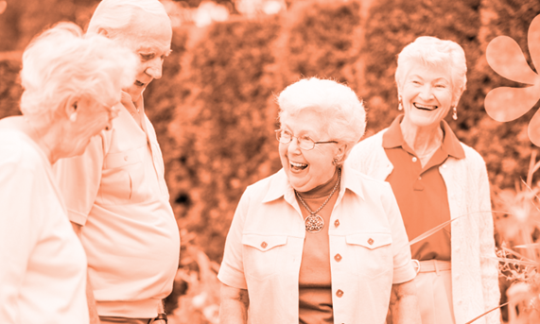
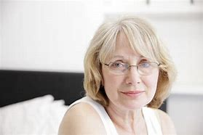
A Digital Health Solution
Deb Hunter –Physiotherapist
Notes:
I would like to acknowledge and pay respect to the traditional owners of the land on which we meet – the Darkinjung people (Wonnarua tribe). I would also like to pay my respects to Elders past, present and future. It is upon their ancestral lands that we come together today.
2. Deb Hunter - intro – physiotherapist
Live in Armidale NSW owner 2 allied-health private practices in rural and regional NSW (Armidale and Tamworth), Move better for Life. Previous worked in Katherine NT 11 years before Armidale
In Armidale enough work – but could not get enough staff.

Slide 2
PROBLEM | a generational healthcare crisis
01.
02.
03.
DECLINING PHYSICAL FUNCTION with people:
living longer
1:2 over 50 years chronic disease
Sedentary behaviours
POOR RURAL ACCESS & higher rates of chronic disease, overburdened health professionals – GP, allied health
INCREASED COSTS
and burden to society & government for health care
.
Notes:
My Patients: Aging population with their healthcare issues, 1:2 people over 50 with a chronic disease, sedentary behaviour only 47 % of Australians reaching the recommended activity levels ,
Exercise the cornerstone of preventative medicine and management of chronic diseases, escalating healthcare costs

Slide 3
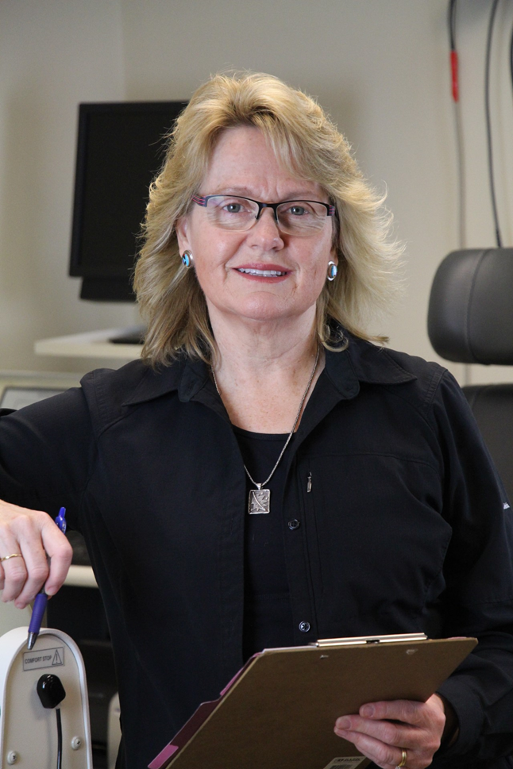
The Gap & Opportunity |medical exercise & allied health online treatment
It can’t be that hard to create a digital solution !
My patients were ready
My sister on board – Professor of Exercise Physiology in USA – researcher of ageing, diabetes, pain modulation
How hard could it be!
Notes:
I partnered with my twin sister Professor Sandra Hunter (exercise physiologist and research scientist) who studies exercise and ageing, pain modulation and chronic disease management (diabetes). We felt digital technology was an opportunity to deliver preventative and primary health services .This solution was timely because many older people (>50) are now familiar with digital technology and a growing prevalence of telehealth.
We recognize that in person treatment is optimal but an online solution was an opportunity to treat many conditions that do not require in person services and help quell and offset the tsunami of older adults and their often preventative chronic diseases
So let’s build that health platform, that app! How hard can it be . ...

Slide 4
The real world | what we did?
Set up the business - company, admin, communications, bank accounts​
Searched for an app developer​
Marketing and brand strategy​
Joined an incubator for startups- SRI UNE​
Find funds – self – funded the MVP​
MVP1 - My Age Fit 2022​
Rebranded and added a mobile app​
MVP2 Dec 2023
Partnerships

Slide 5
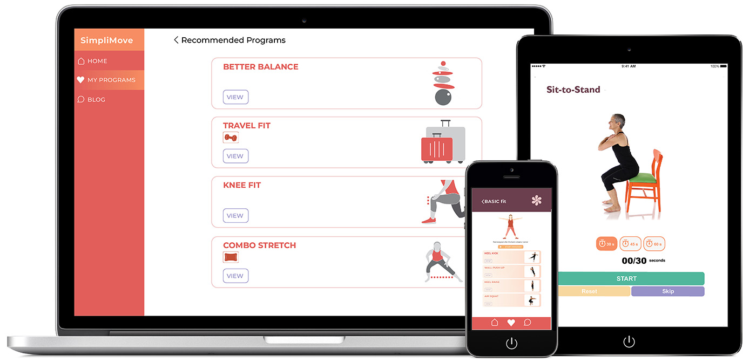
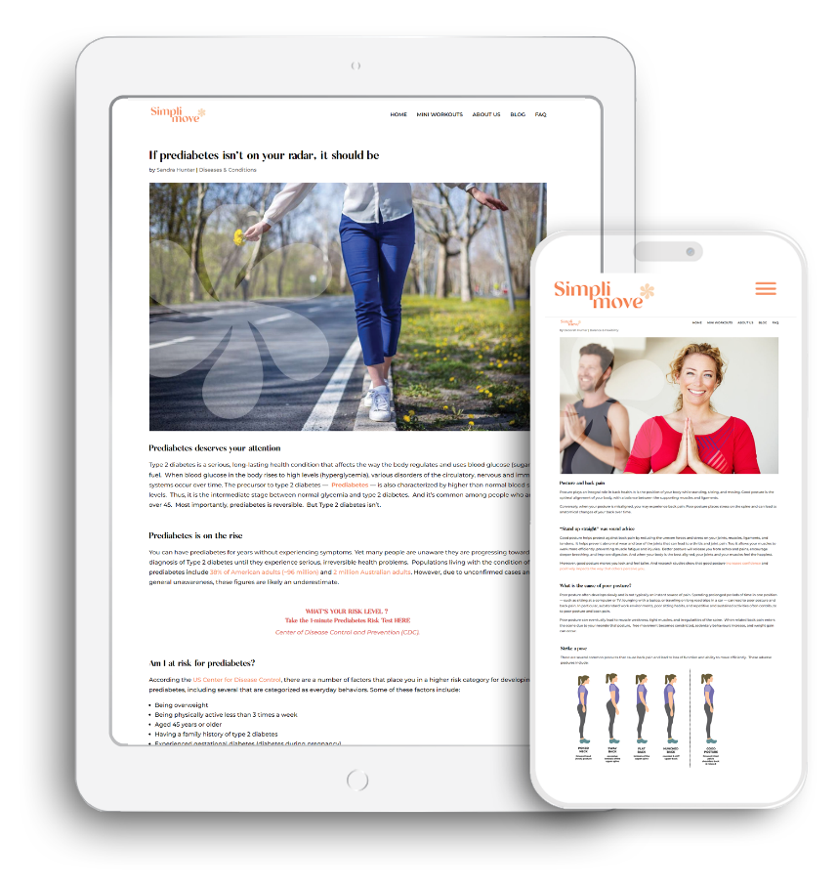
Our Solution
SIMPLIMOVE: A scalable, online health platform that integrates three components to provide instruction, strategies and support for improving health outcomes
01.
Medical Exercise and rehabilitation
02.
03.
Evidence-based
health education
Online telehealth
Notes:
An exercise-based app that educates and instructs adults how to improve their health through physical movement with online guidance from health professionals
ACCOMODATING to health goals and interests: e.g., Gardenfit, Travelfit, Officefit, Posturefit, Cyclefit
ADJUSTIBLE to pain levels and varied abilities of adults 50+
ACKNOWLEDGES and adapts to medical conditions & chronic disease: e.g., Shoulderfit, Backfit, Bonehealth, Knee Replacementrehab
AFFORDABLE health intervention compared to fee-for-service care
ACCESSIBLE via an online venue that maximizes convenience

Slide 6
Lessons | What next
01.
02.
Lessons
What next
Time
Cost
Partnerships are critical
Create pathways for rural allied health and GPs
Add other allied health
Add computer vision and AI learning
Find funding

Slide 7
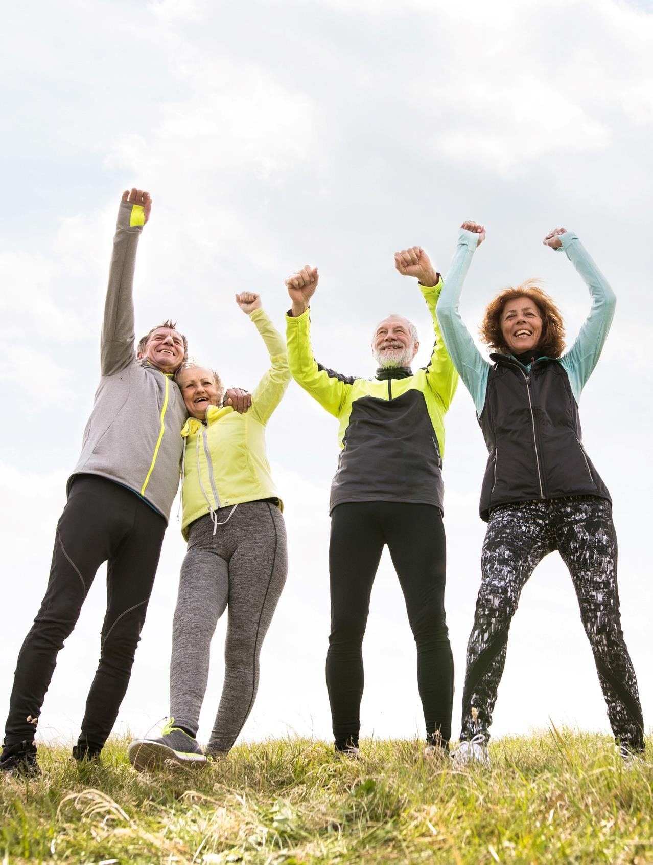
Thank You
Email
Website
deborah@simplimove.health
www.simplimove.health
Notes:
Contact

