Slide 1
Fostering a thriving community that embraces individual experiences

Slide 2
Acknowledgement
In the spirit of reconciliation, A Growing Understanding acknowledges the Traditional
Custodians of Country throughout Australia and their connections to land, sea and
community. We recognise that the health, social and emotional wellbeing of Aboriginal and
Torres Strait Islander Peoples are grounded in continued connection to culture, country,
language and community. We pay our respect to Elders past, present and emerging and extend that respect to all Aboriginal and Torres Strait Islander Peoples today.
We acknowledge that artwork utilised throughout this presentation was created by Alexa Elbourne and is entitled Djurumi Ngarra Dungga (Awabakal words for See Listen Learn). Alexa is a Worimi
woman & speech pathologist, currently living and working on the land of the Awabakal people.
Alexa is one of the community members working with A Growing Understanding to ensure
our services are accessible and meaningful.

Slide 3
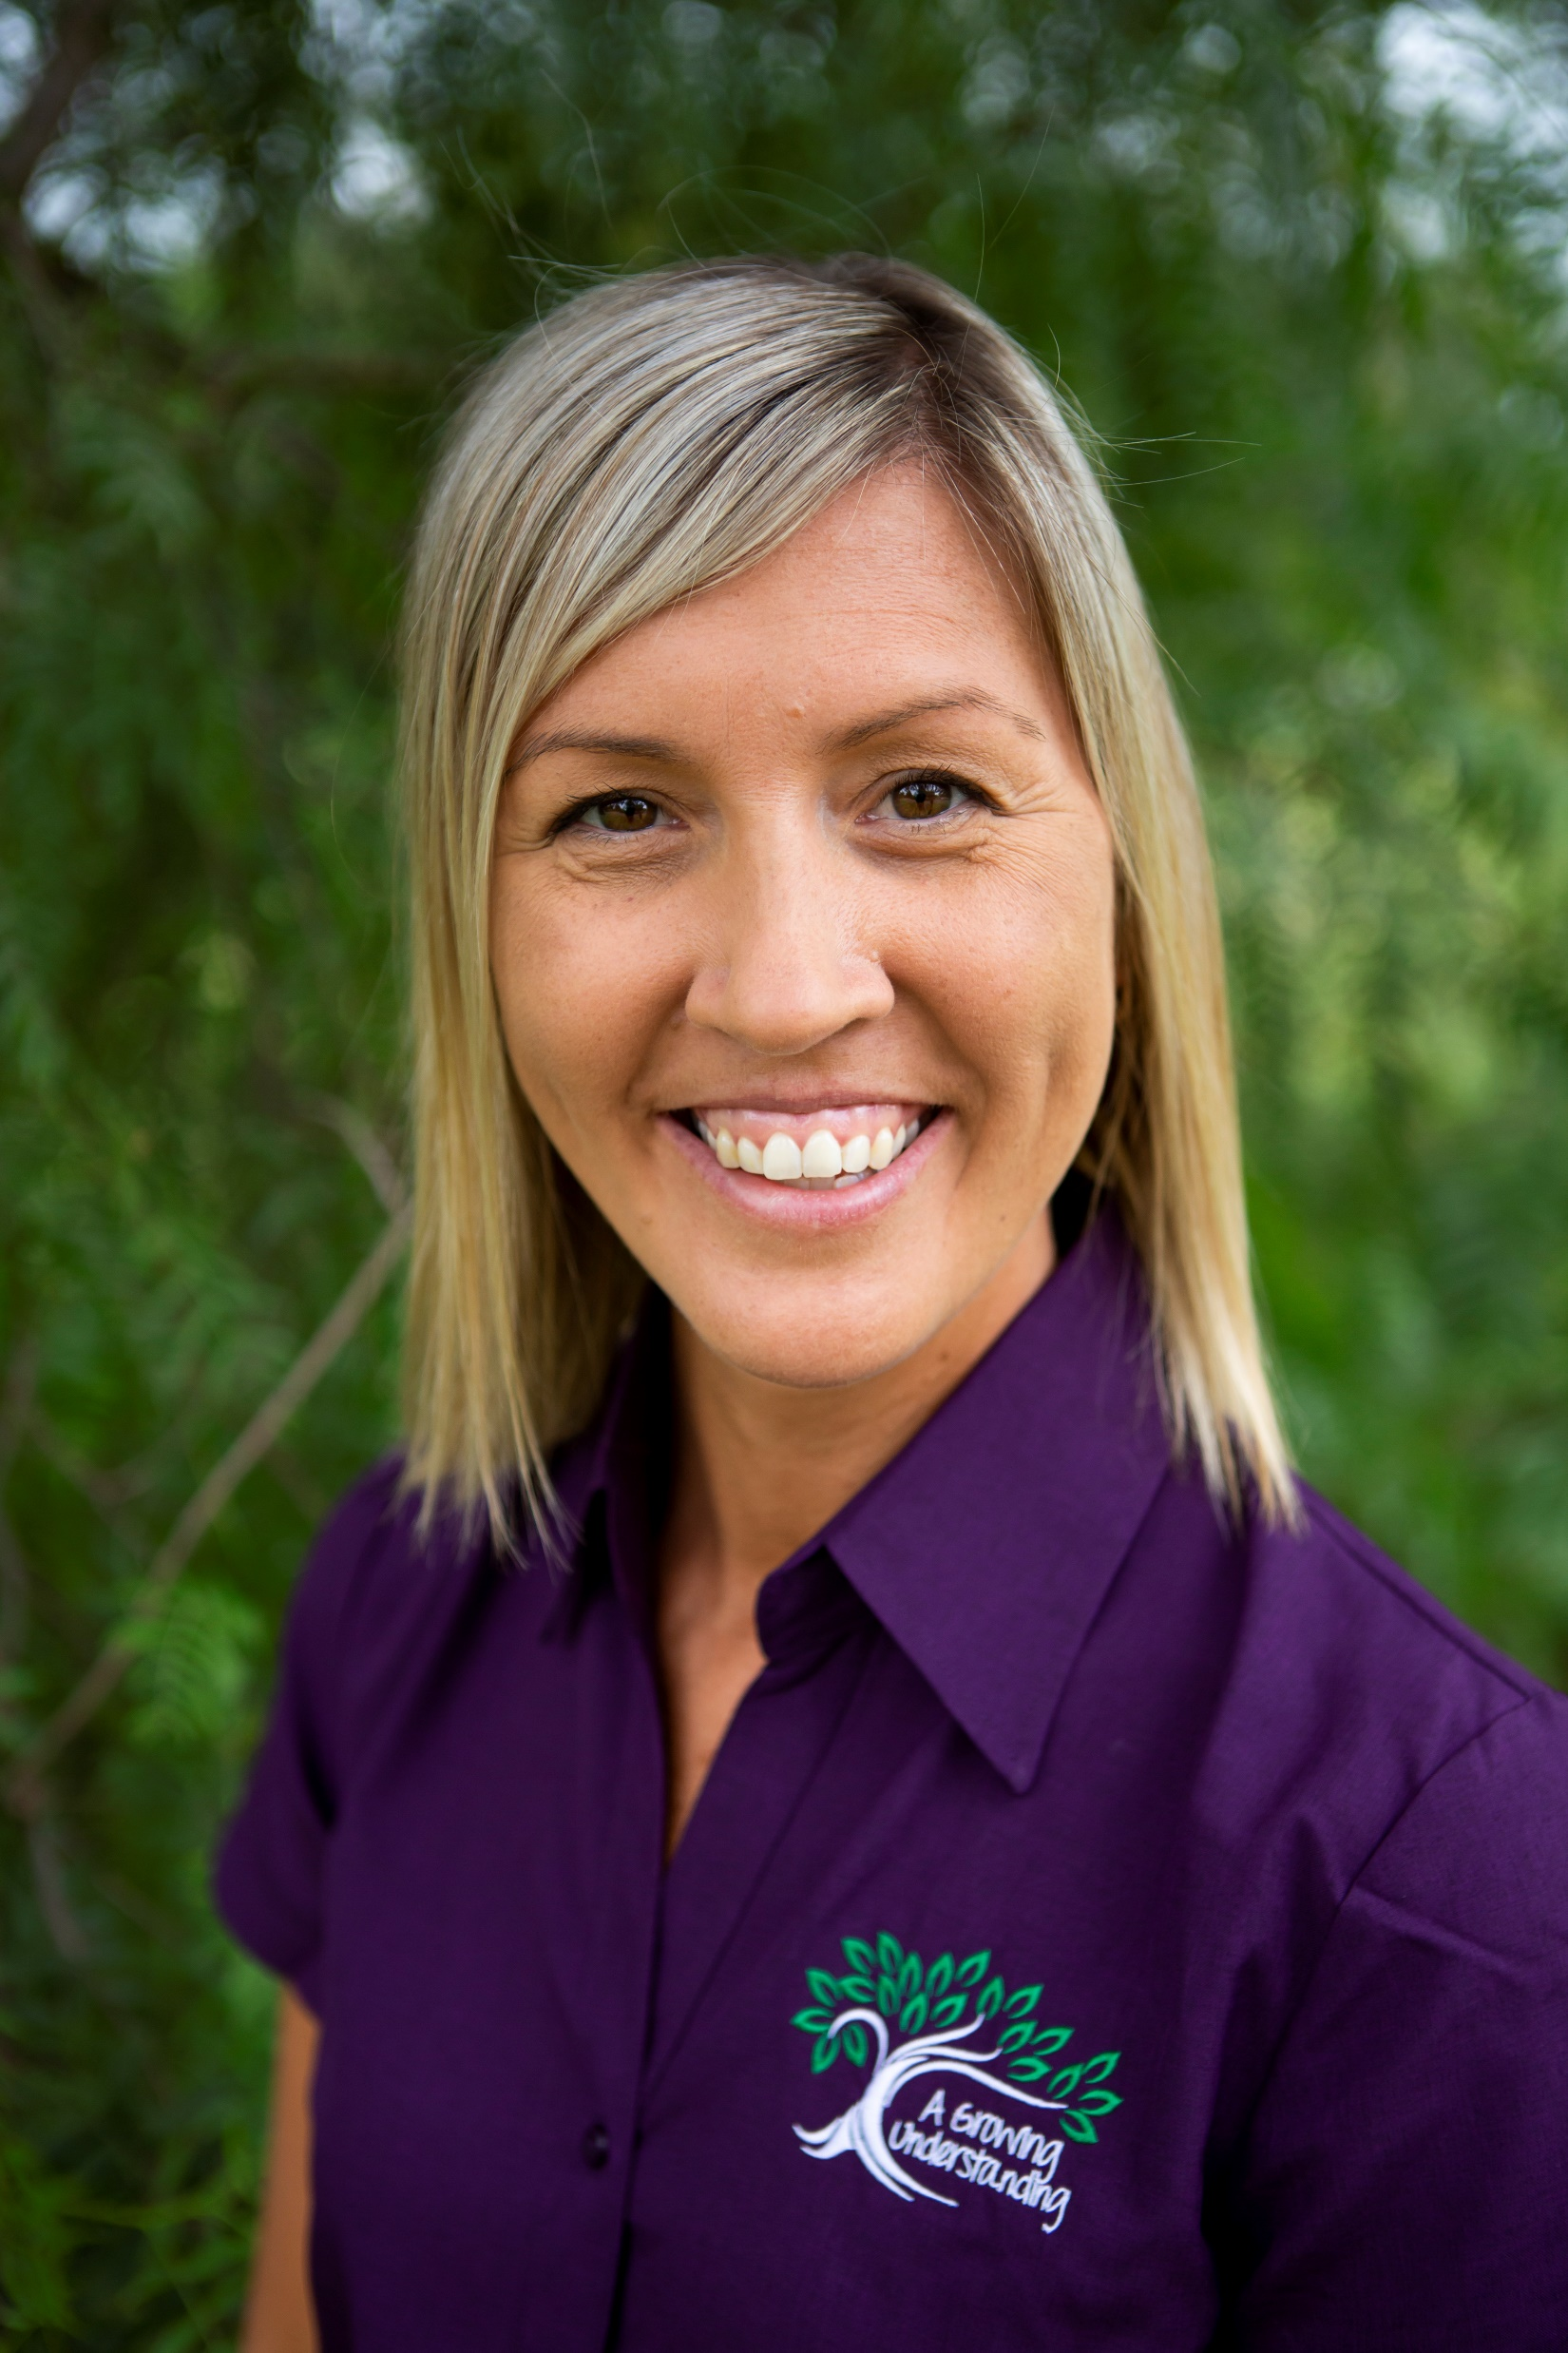
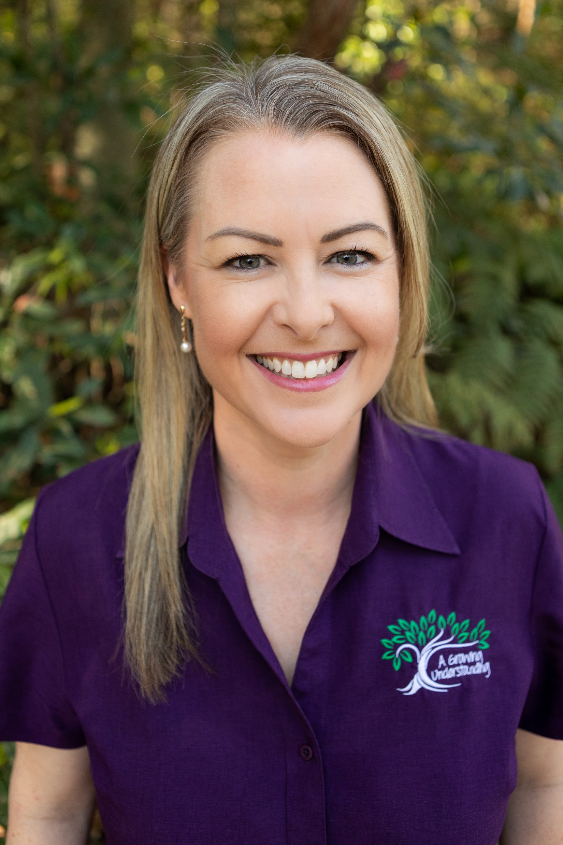
Introduction
Emma Hyde (she/her) is the Clinical Director at A Growing Understanding.
Lauren Haskins (she/her) is the Owner and Practice Director at A Growing Understanding.
HOW do we foster a genuine,
thriving community that embraces
individual experiences?
Notes:
We believe in creating an authentic environment that respects and values unique experiences and perspectives. Our commitment to diversity and inclusion is an ethos ingrained in the fabric of our organisation. I am grateful for my team’s ongoing commitment to fostering respect, learning, and building significant and lasting relationships with our diverse community.
Emma Hyde is the clinical director at A Growing Understanding. With our organization’s values at the forefront, we asked the question: “HOW do we foster a genuine, thriving community that embraces individual experiences?” How can we go beyond talking the talk and start implementing the change that we want to see the world. (A genuinely inclusive, respectful community). Emma designed and set about implementing our Inclusion Framework and Strategy.
Emma was successful in receiving a grant from the PHN for a 12 month membership to Pride in Health and Wellbeing. As a result of this membership, we have taken proactive steps to enhance LGBTQ inclusivity and access to support and services.
As part of our Inclusion Strategy is our commitment to remove any barriers within our service for Aboriginal and Torres Strait Islander Communities. We are proud Our Reconciliation Action Plan was endorsed at the end of 2023.

Slide 4
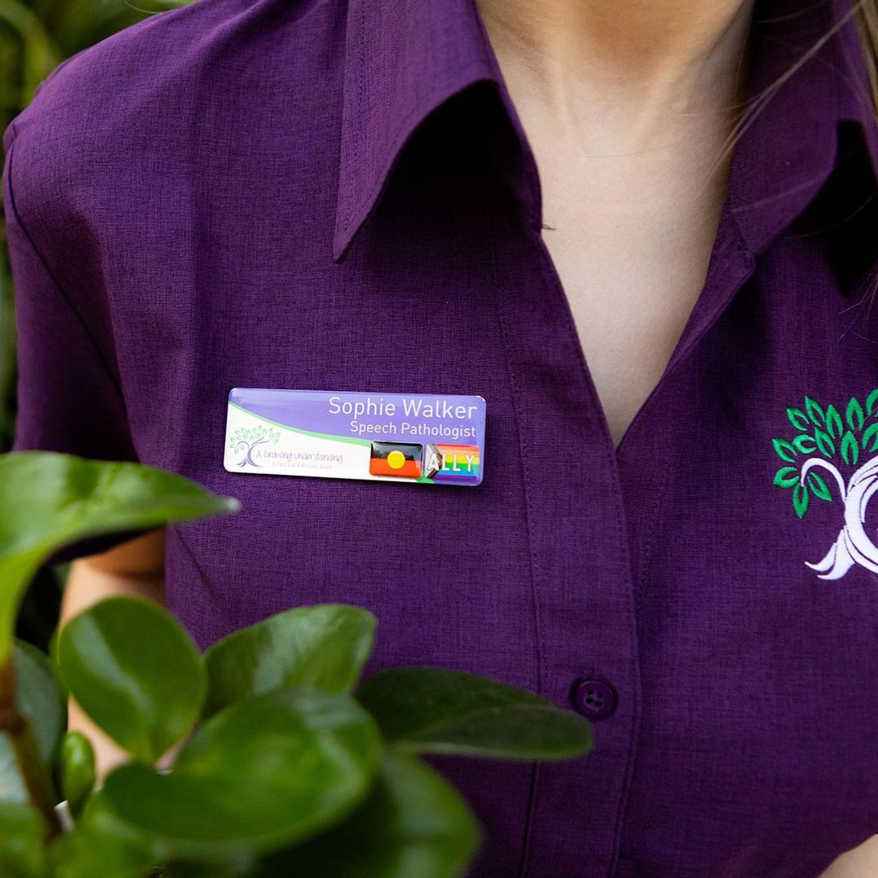
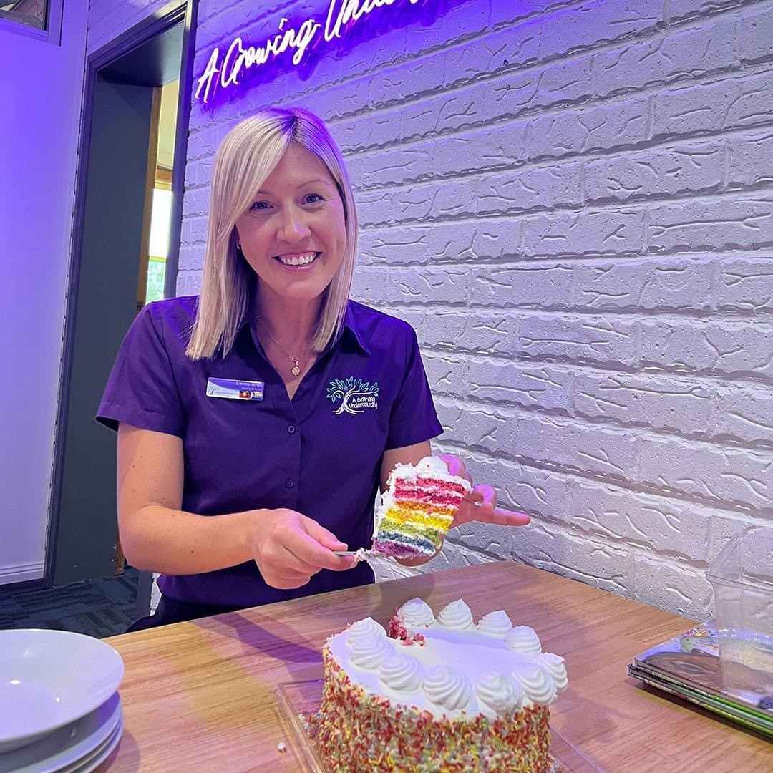
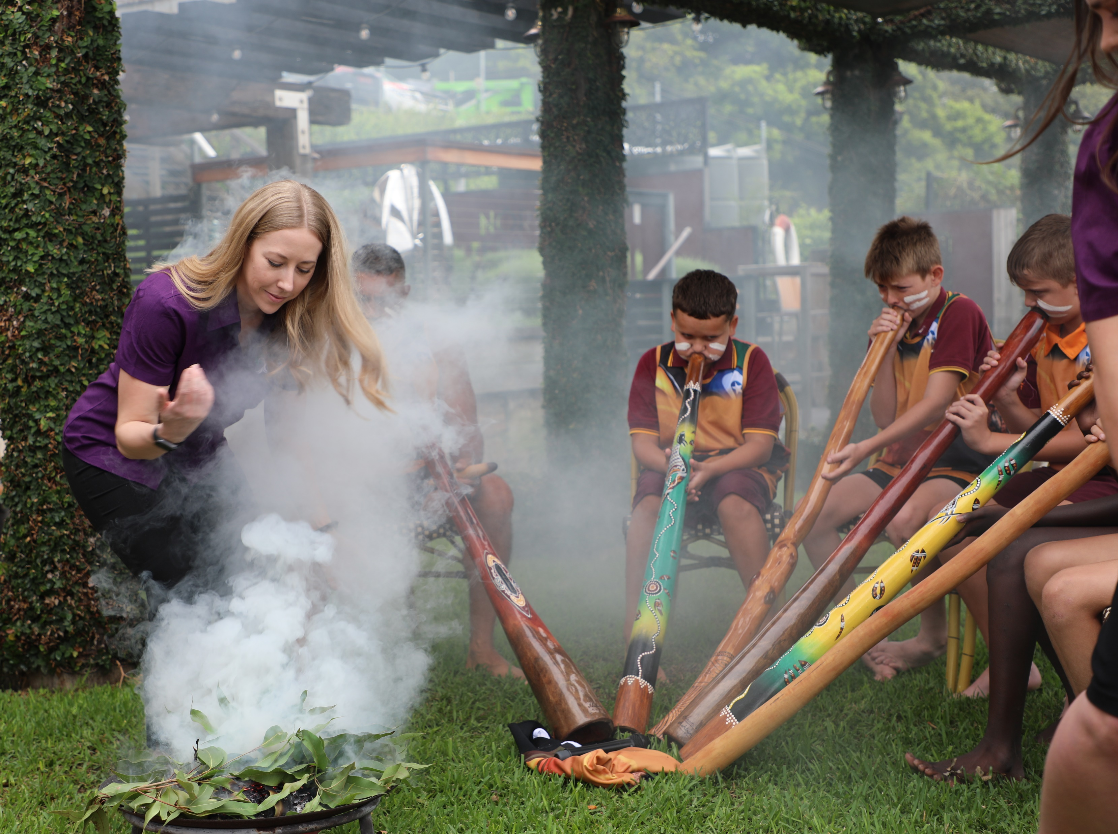
Our Approach
A documented strategy
Education, coaching and support to implement inclusive practice
Implementation
Accreditation
Sharing
Notes:
1. A documented inclusion strategy that is reflected throughout all of our business planning. Our journey is ongoing and dynamic. We believe that through a proactive approach, we can go beyond mere compliance and actively contribute to creating a more inclusive society. Through assessment and analysis of our processes, and having a documented strategy, we had a road map for the changes that we needed to implement as a service. We knew what we wanted to happen, but the strategy allowed us to know HOW to implement our changes.
2. One of the ways we started implementing our strategy was to undertake education, coaching and support to implement inclusive practice. Our team undertook LGBTQ inclusive care mentorship, provided by Pride in Health and Wellbeing. This mentorship provided education to our team to assist us in fostering an understanding that encourages the adoption of inclusive practices. We undertake individual and team learning on inclusivity including working with LGBTQ, First Nations and Neurodiverse communities.
3. As our understanding grew through these learning experiences, we were able to make tangible improvements to our internal systems (from signage, to client communication to agreed team terminology). We continue to make changes to foster inclusivity in everything we do. Our internal policies and procedures have been updated to reflect inclusive practices, as have been our intake and assessment processes.
The team participated in inclusive care training from Pride in Health and Wellbeing and attended education on working with Aboriginal and Torres Strait Islander children from an Aboriginal Speech Pathologist on our team. Our team have also completed Indigenous Allied Health Australia, Cultural Responsiveness Training.
Our recruitment processes and website have been reviewed and new documents have been created for team members outlining our commitment to inclusive care.
We have made updates to our clinic spaces to include inclusive imagery (ally stickers/badges) and resources (books, toys, resources) within the centre.
Additionally, we have established a language group specifically for Aboriginal and Torres Strait Islander children.
We remain motivated to strive to nurture individuals in an environment that celebrates difference, collective achievement and to continue our journey of learning. This process of implementation is and will continue to be ongoing.
4. Accreditation
Awards. RAP. Our goal is to achieve the Rainbow Tick of Approval, a recognition of our commitment to providing an inclusive and supportive environment for the LGBTQ community. Through the process of completing and having our Reconciliation Action Plan endorsed, we pledged to support and partner with Aboriginal and Torres Strait Islander Communities. We are working towards eradicating any barriers within our service and are actively seeking partnerships and meaningful relationships.
5. Learn through teaching and helping others (greater change)
We understand our responsibility to find ways to support and represent diverse needs. Through our learning and proactive initiatives. We have learned that invested leaders, team engagement and education is of the utmost importance in promoting a diverse and inclusive culture and in order to create a platform for the collective voice. Our learnings have led us to understand that increasing diversity and inclusion in our workforces is a significant opportunity for our entire industry to grow and become more impactful.

Slide 5
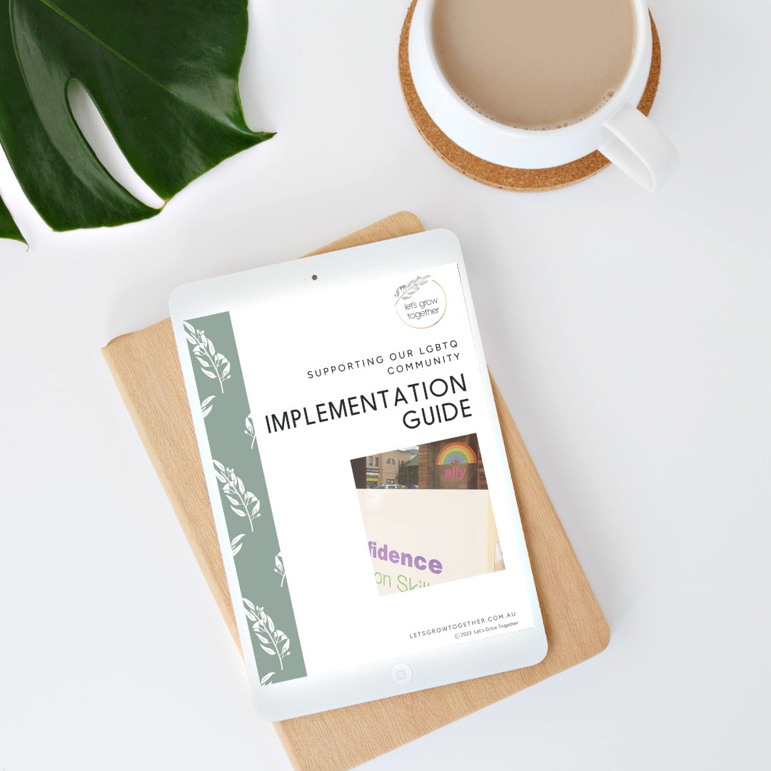
How you may integrate this into your settings
A documented strategy
Education, coaching and support to implement inclusive practice
Implementation
Accreditation
Sharing
Notes:
1. A documented inclusion strategy
2. Education, coaching and support to implement inclusive practice.
3. Implementation
4. Accreditation
Awards. RAP. Our goal is to achieve the Rainbow Tick of Approval,
5. Learn through teaching and helping others (greater change)

Slide 6
Questions & Contact Details
Emma Hyde- emmahyde@agrowingunderstanding.com.au
Lauren Haskins- lauren@agrowingunderstanding.com.au
www.agrowingunderstanding.com.au
www.letsgrowtogether.com.au

