Slide 1
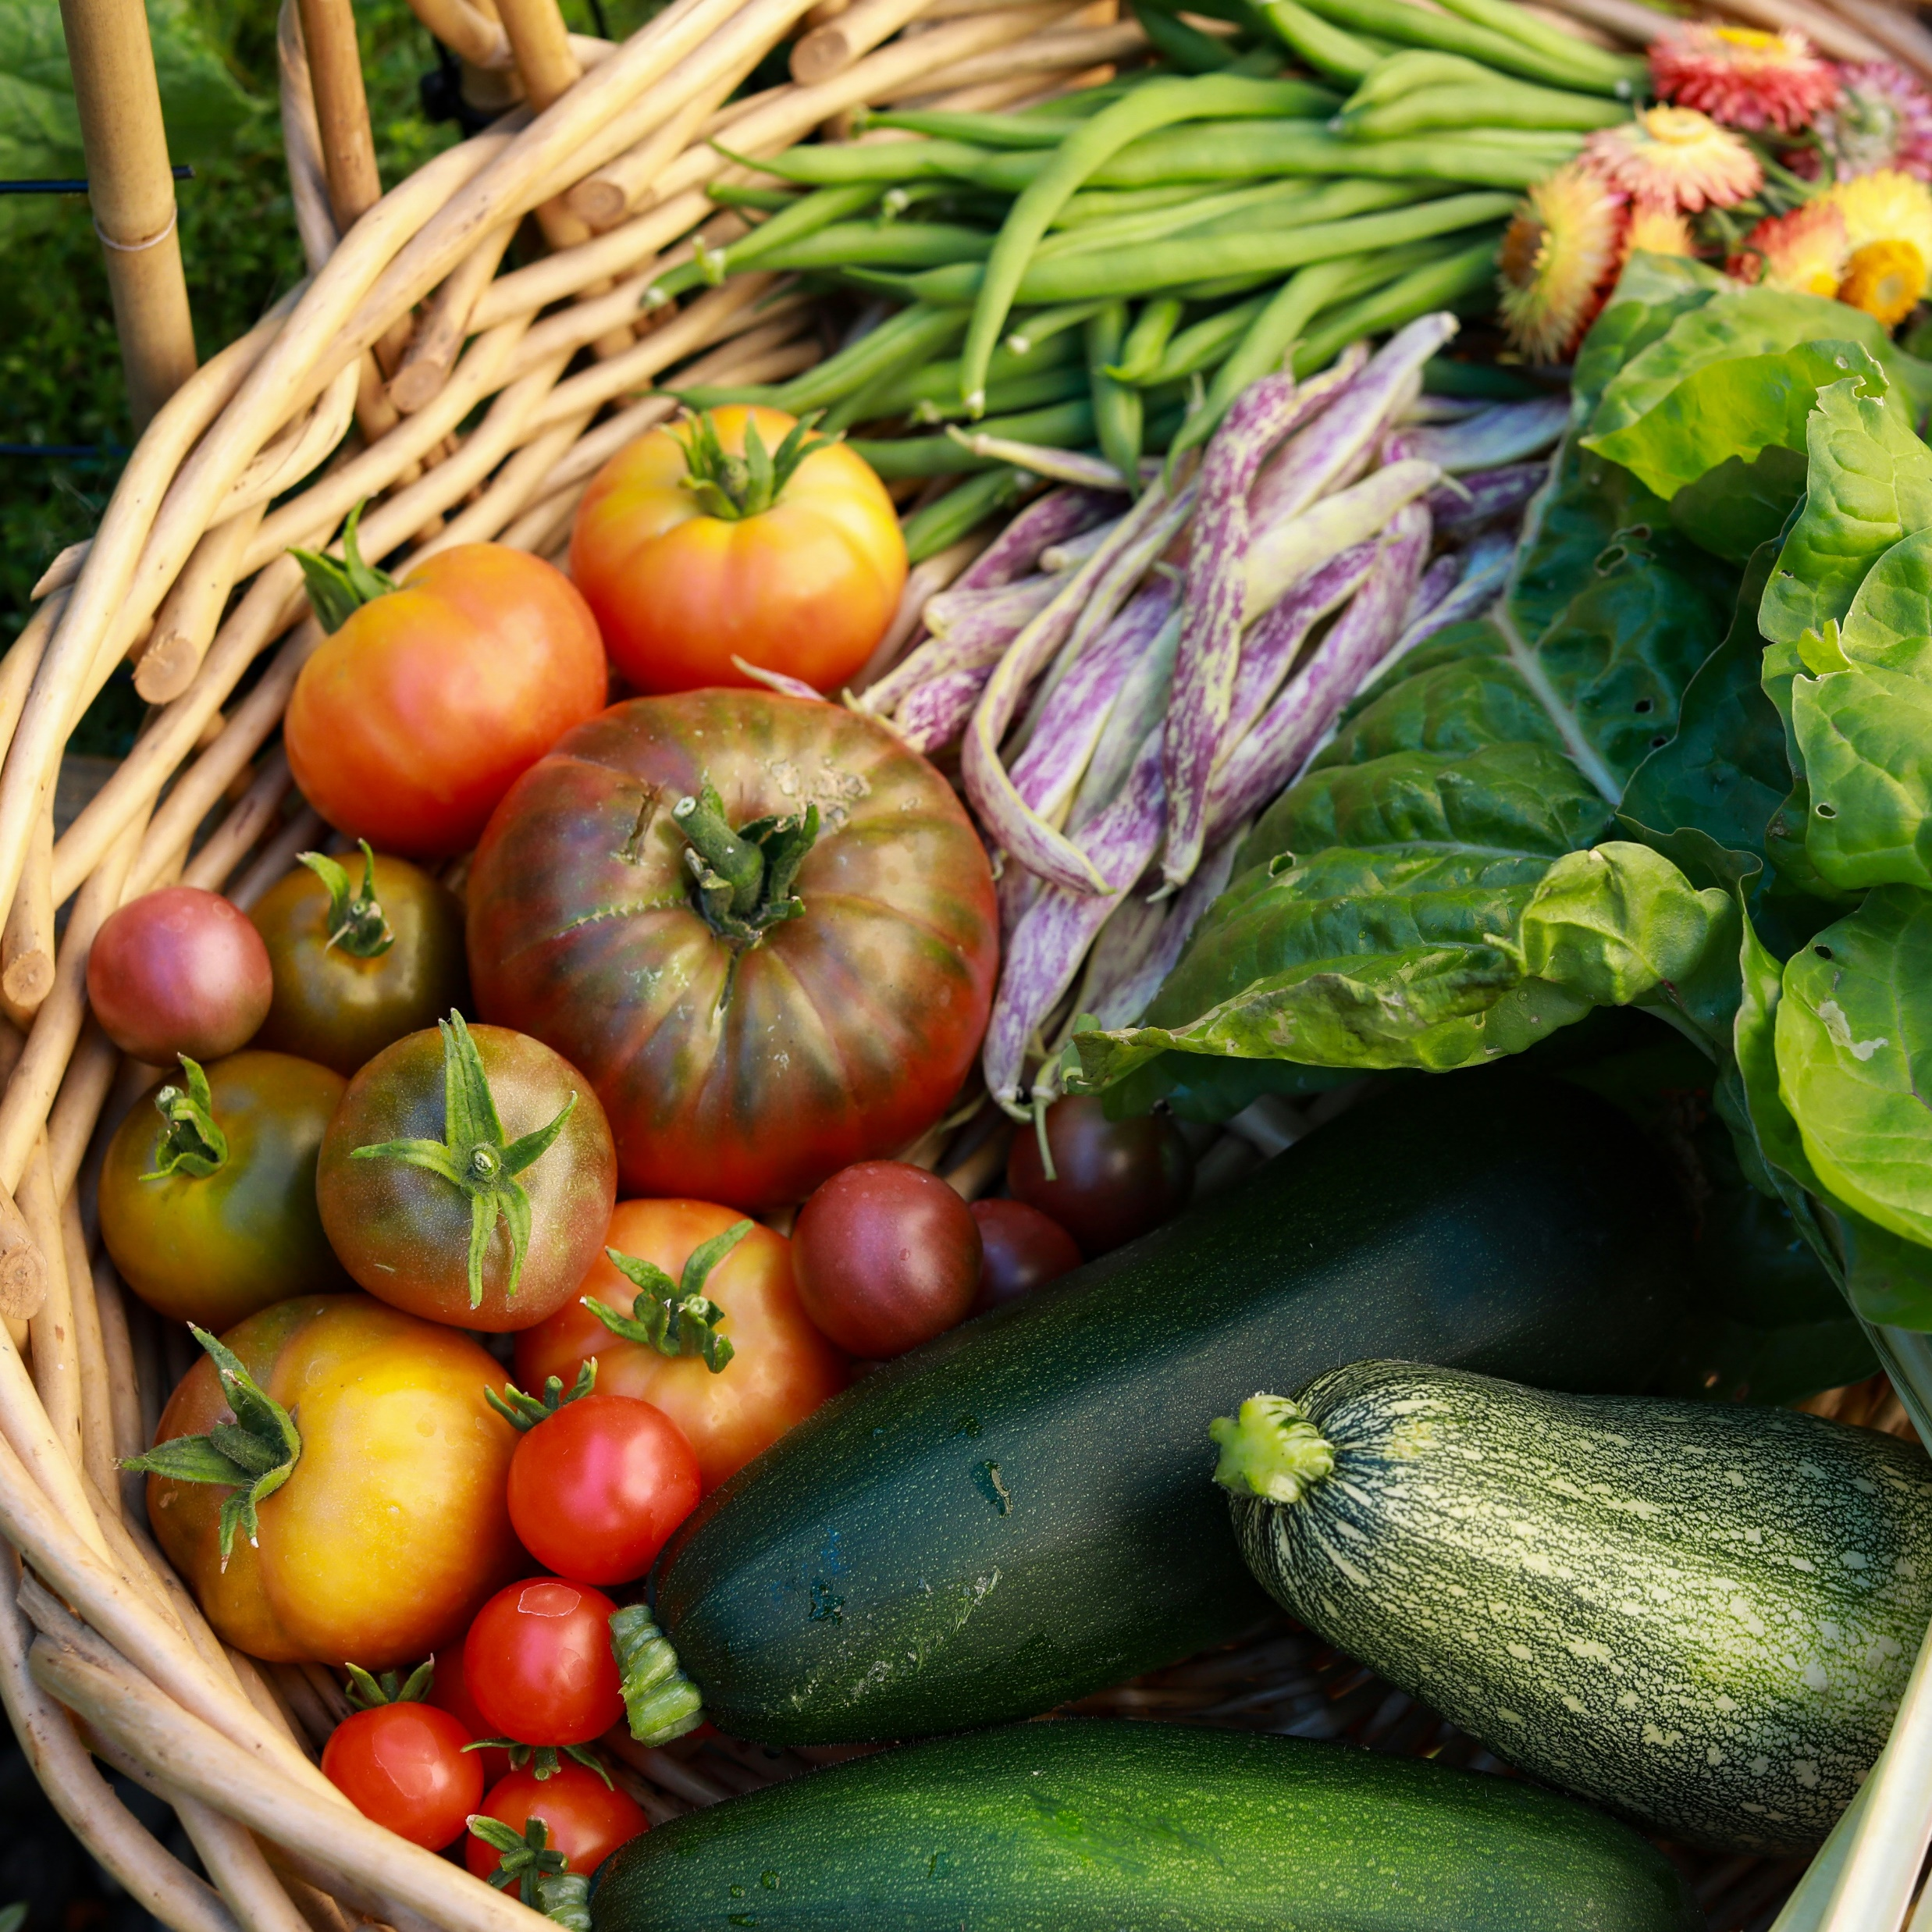
HealthWISE
Promoting food security across the HealthWISE footprint
Dr Amy Ashman
PhD Nutrition & Dietetics; Accredited Practising Dietitian
Photo by Nina Luong on Unsplash

Slide 2
Food insecurity is a public health crisis
According to the Foodbank Hunger Report 2023:
48% of the Australian population felt anxious about or actively struggled to consistently access food
3.7 million households experienced moderate to severe food insecurity (limiting food intake, skipping meals, or going days without eating)
56% of food insecure households in Australia did not receive any food relief support in 2023
Food insecurity exists in our communities
HealthWISE conducted a needs assessment in 2022 with 58 residents of Armidale, Uralla and Walcha completing an online survey and 12 stakeholders interviewed
50% of survey respondents had experienced some level of food insecurity in the preceding 12 months
Recommendations were made for programs to improve food security
HealthWISE projects to promote food security
HealthWISE has since implemented a number of ongoing programs that aim to improve i) knowledge and skills around accessing and affording food; ii) nutrition knowledge; iii) cooking skills; and iv) access to food relief services
Contact: amy.ashman@healthwise.org.au

