Slide 1

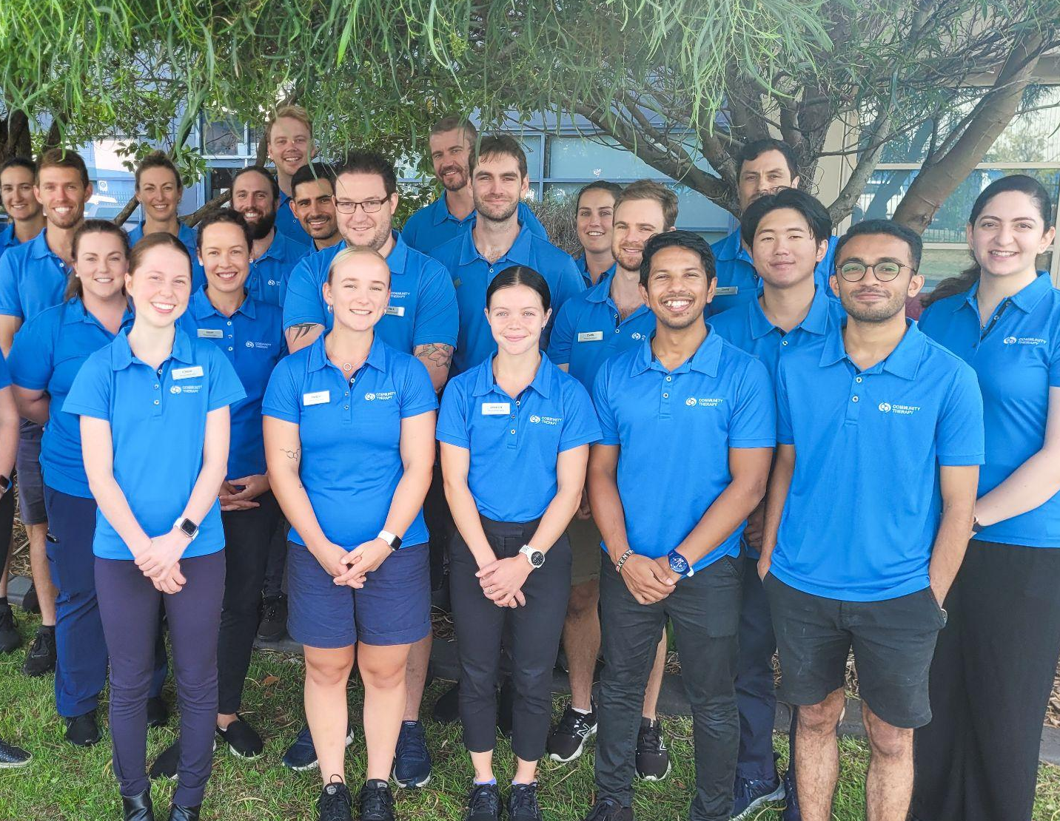
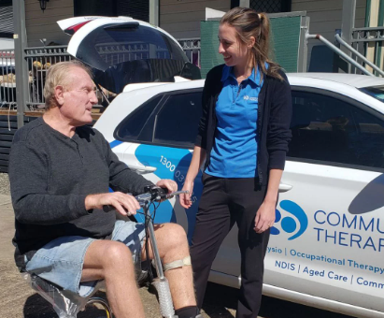
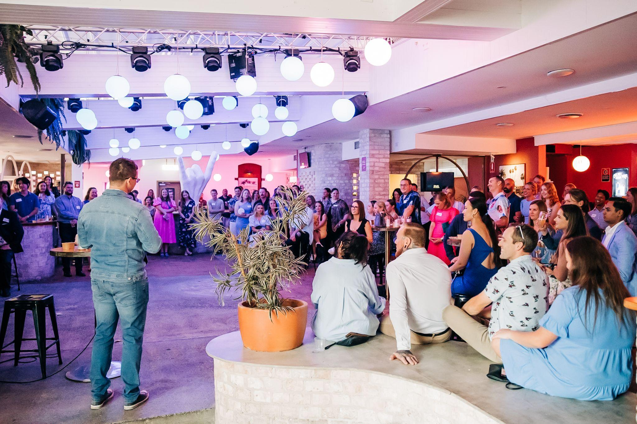
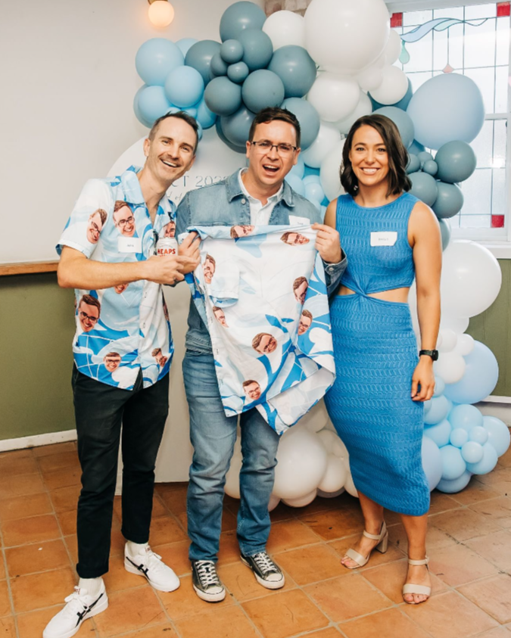
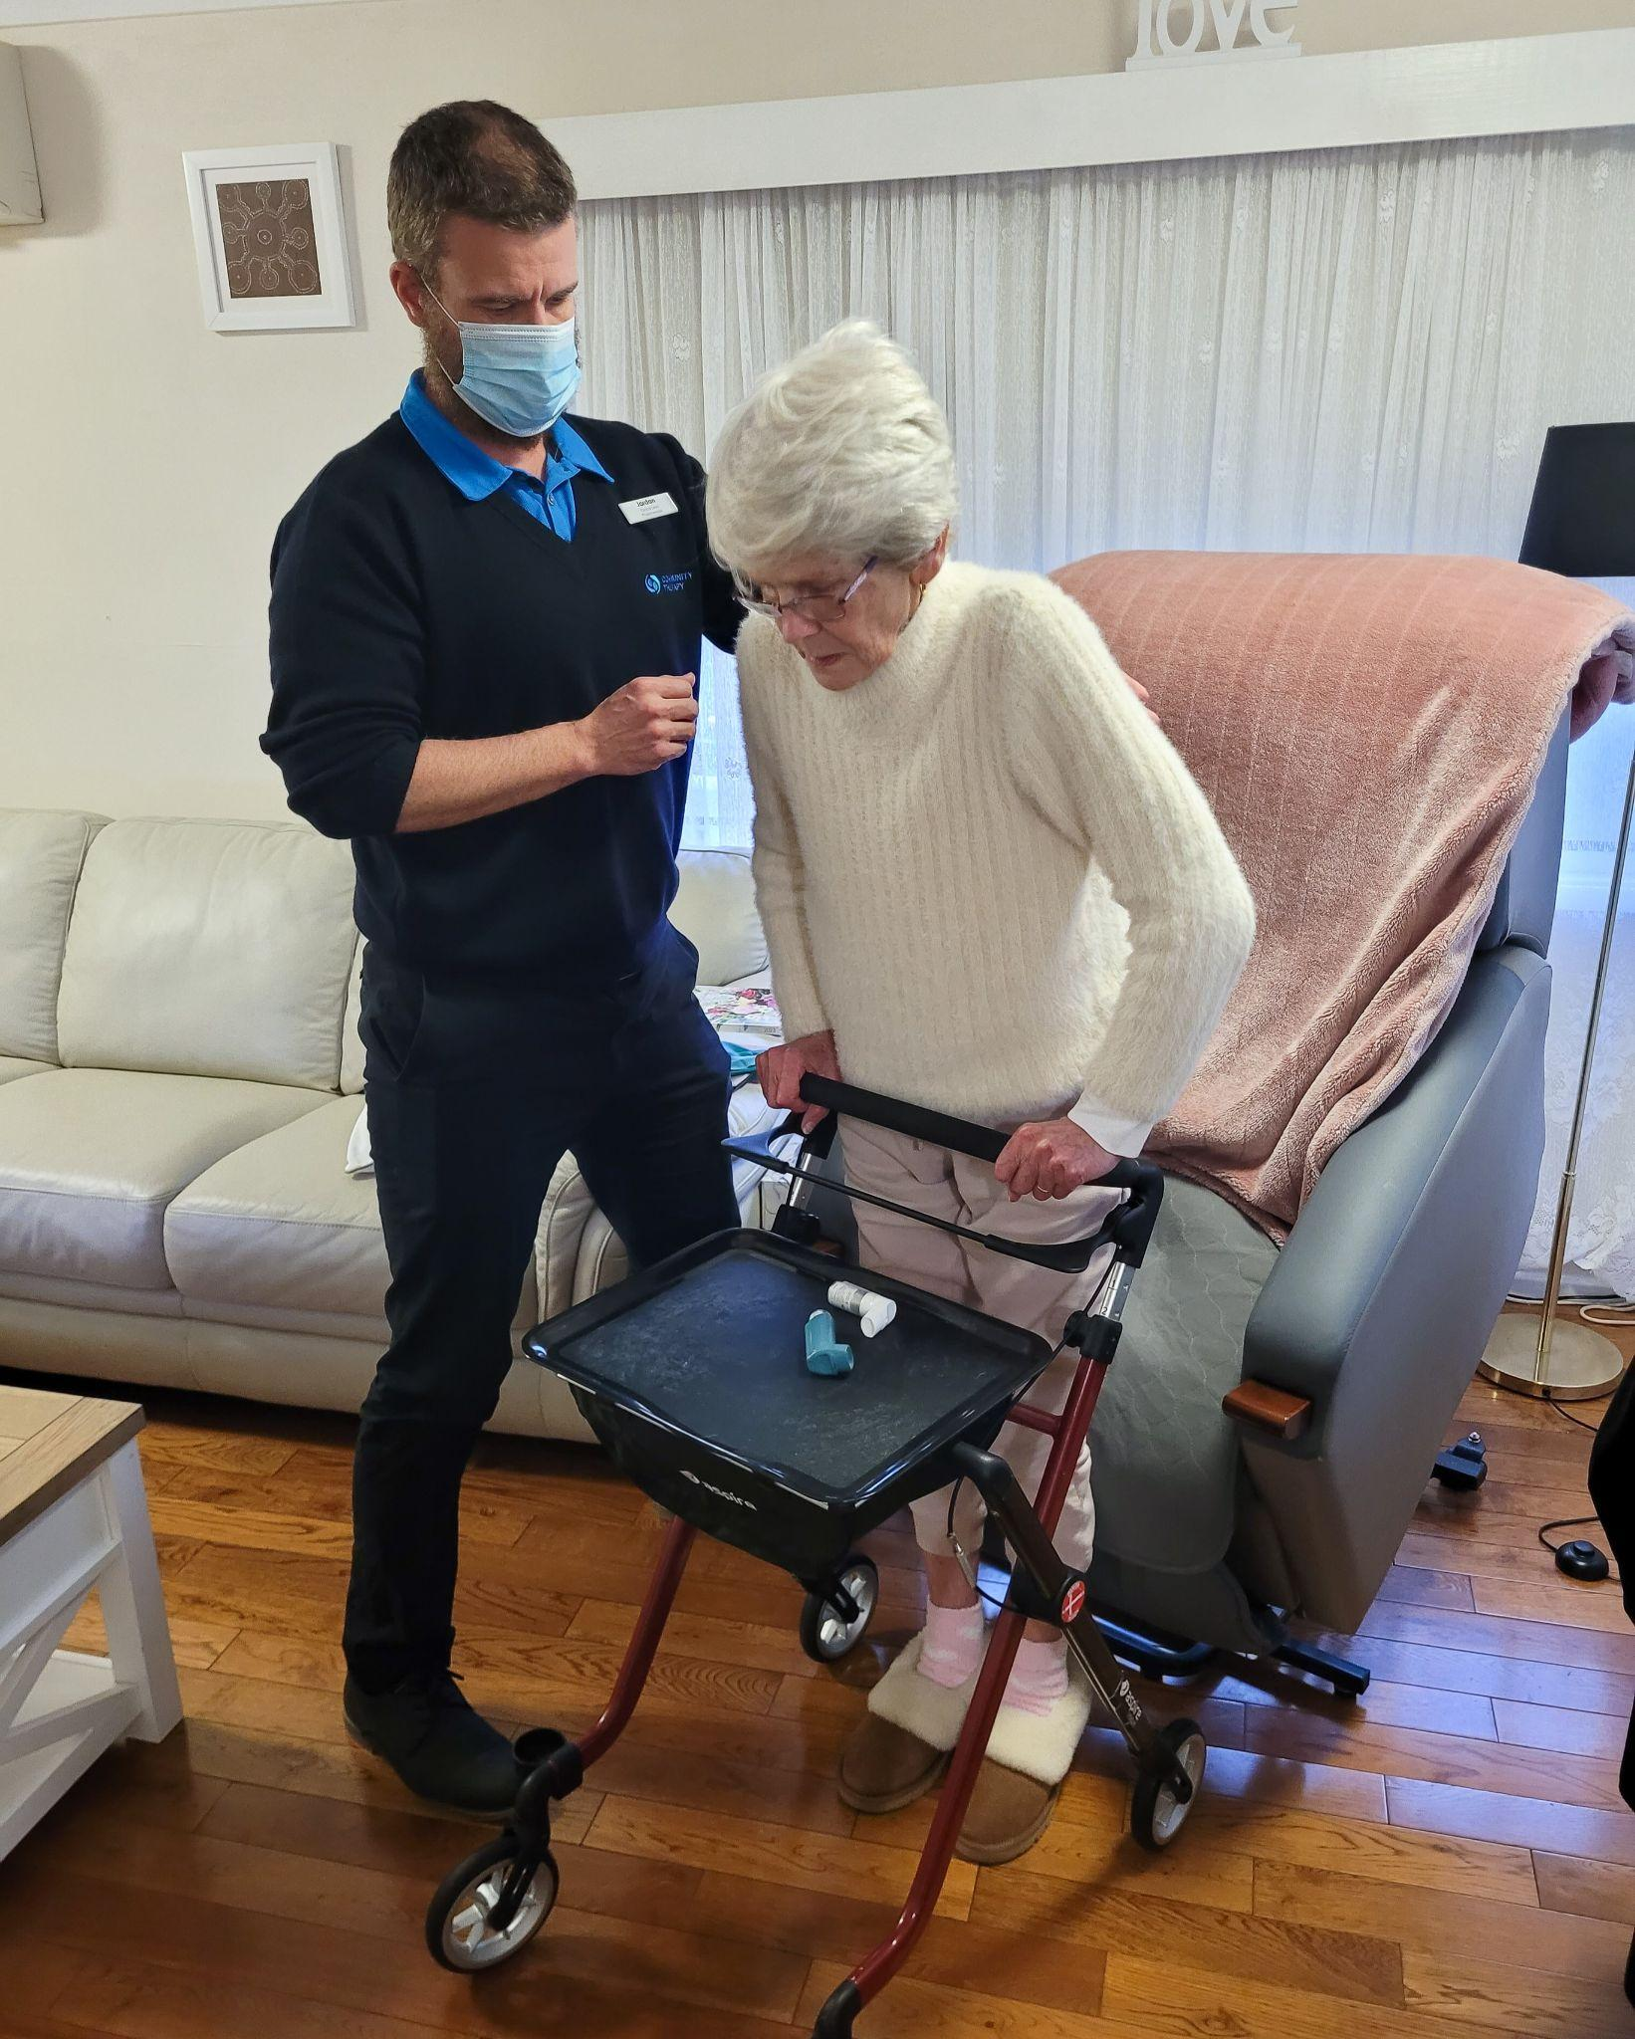
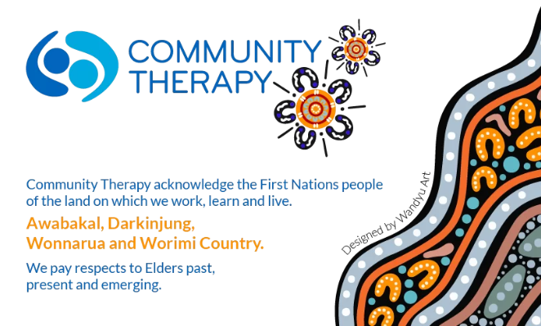
Building & Retaining an Engaged Multidisciplinary Allied Health Team
PHN Allied Health Conference 9.5.24
Scott Lynch APAM
Founder & Managing Director Physiotherapist
scott@communitytherapy.com.au
0423 664 431
Notes:
Anne - acknowledgment

Slide 2
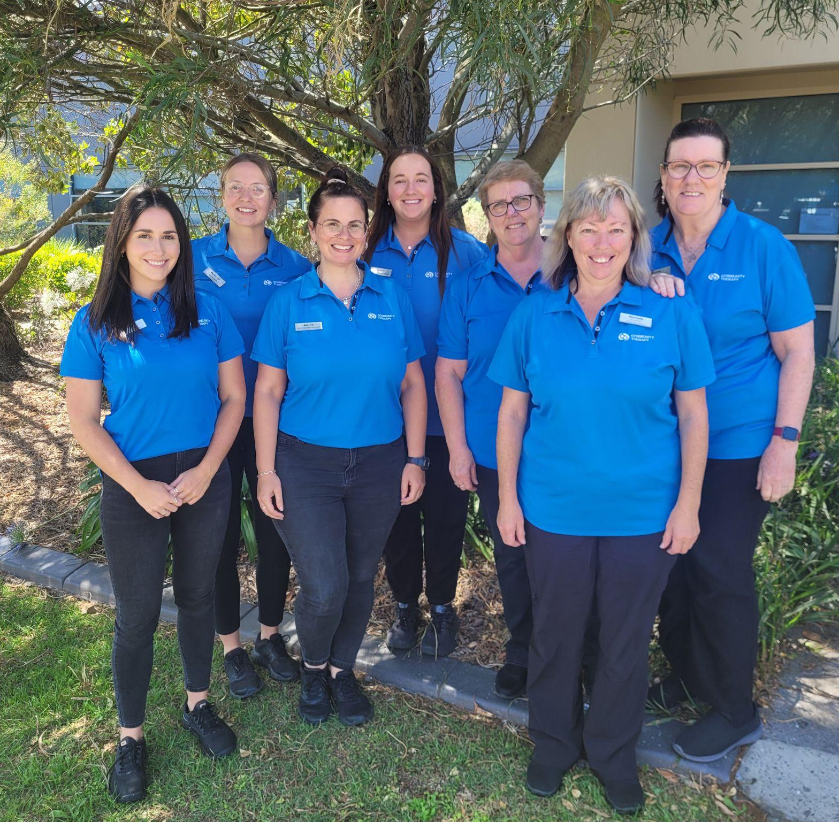
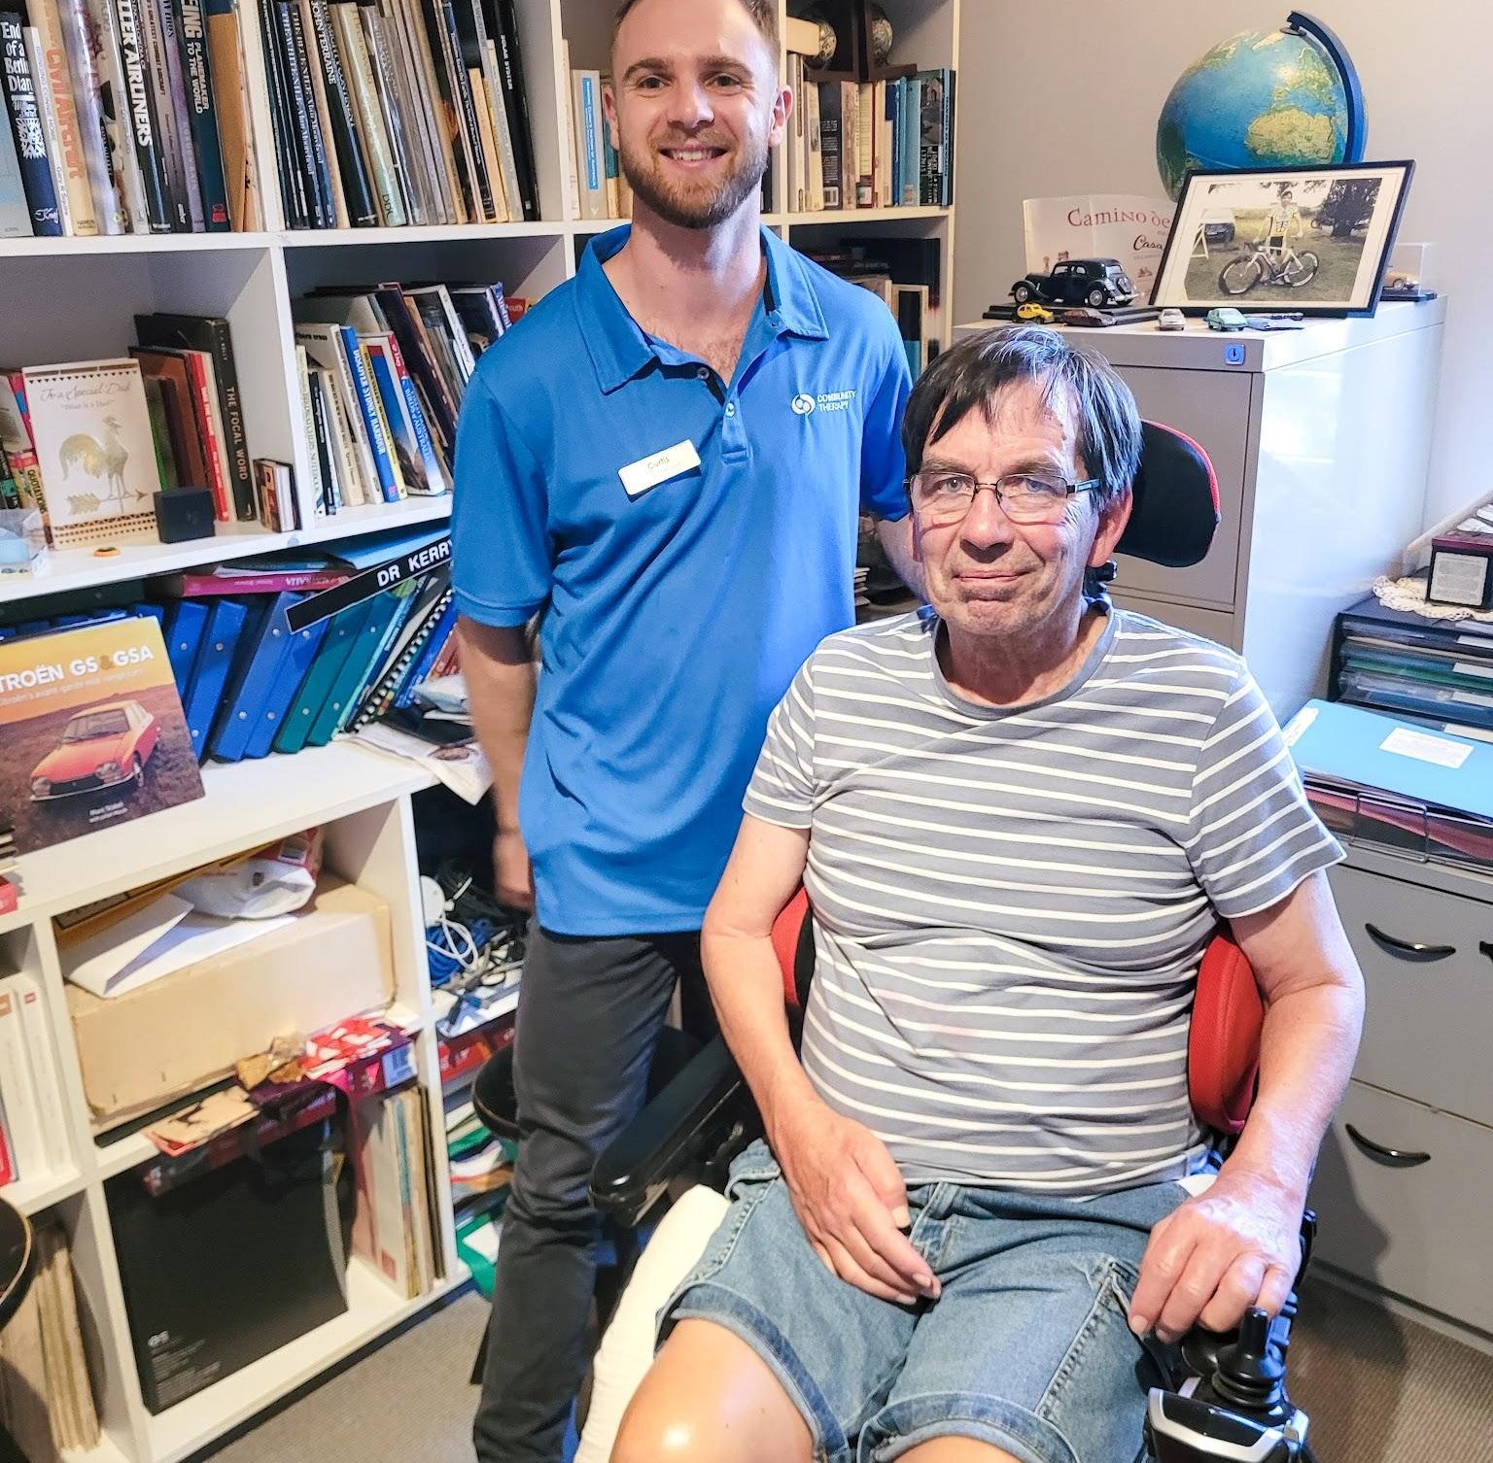

Building & Retaining an Engaged Multidisciplinary Allied Health Team
👉🏼 Introduction to Community Therapy - 5 minutes
👉🏼 Building a Multi-disc Team: “slow is smooth” - 5 minutes
👉🏼 Engagement & Retention: “all the small things” - 5 minutes

Slide 3
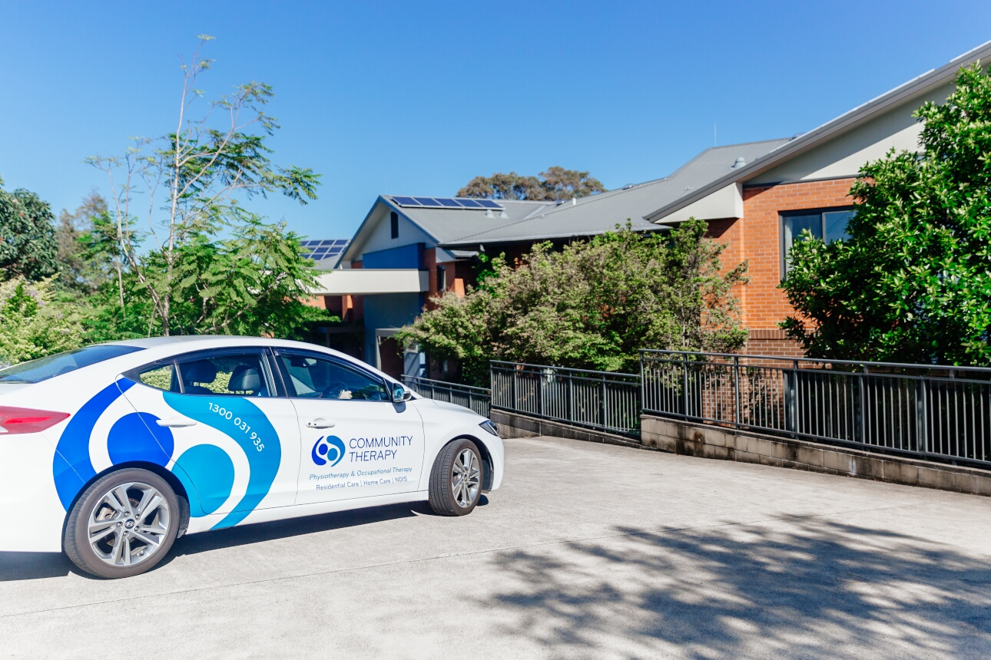
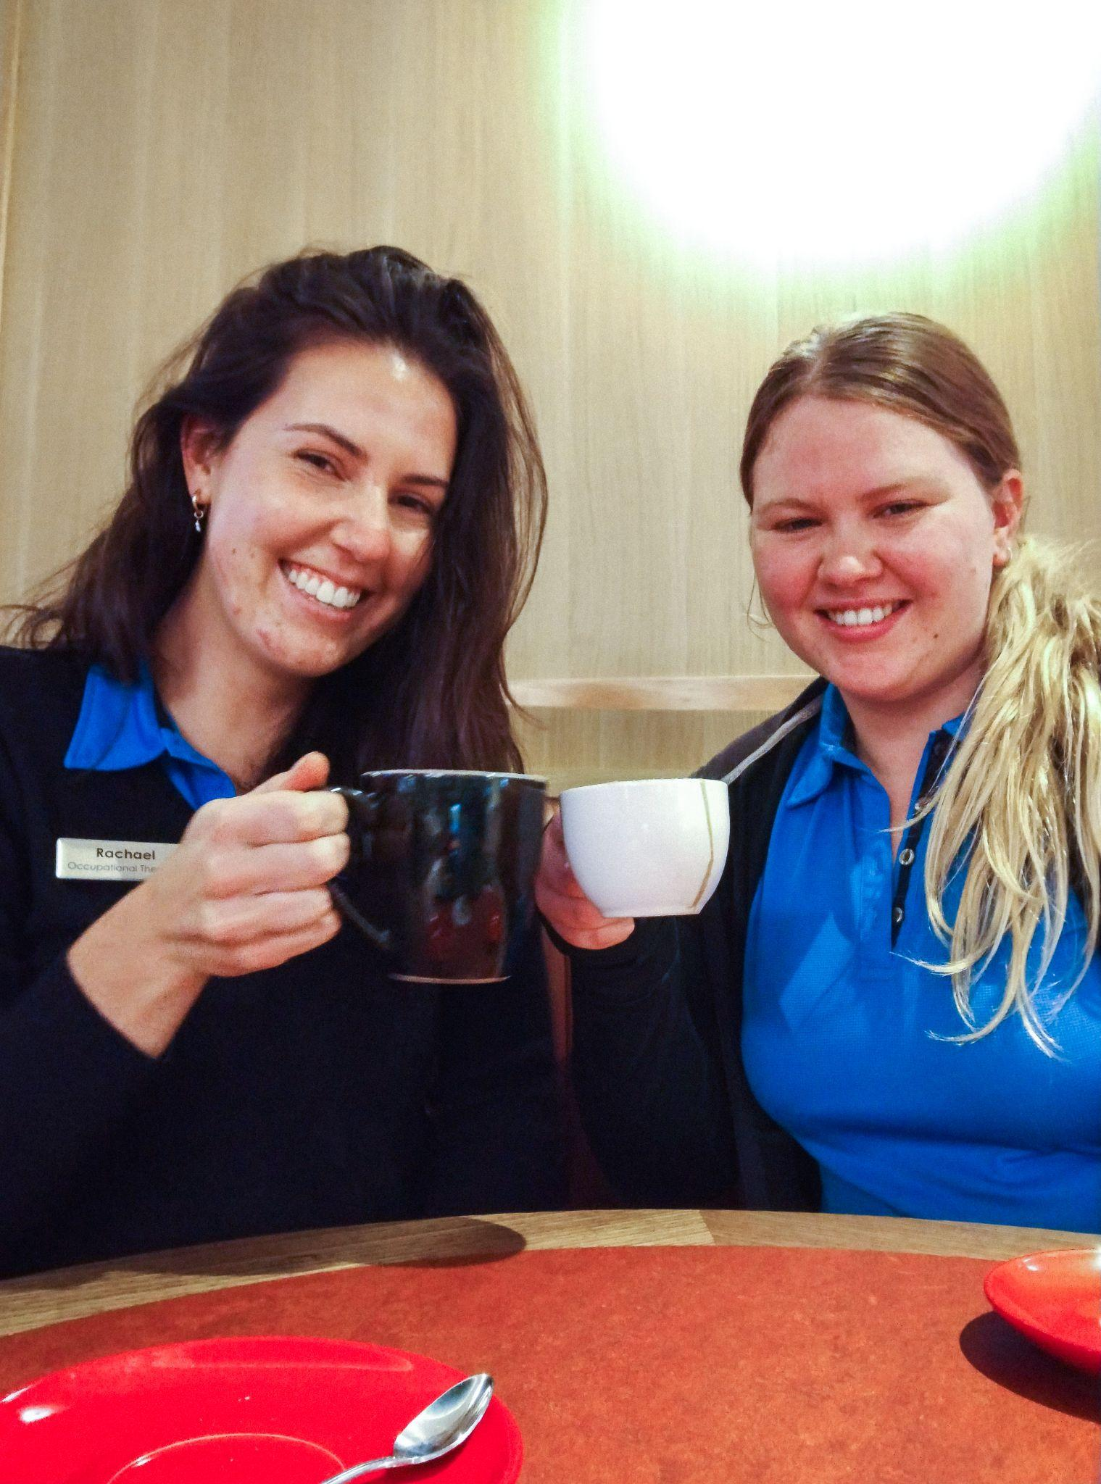
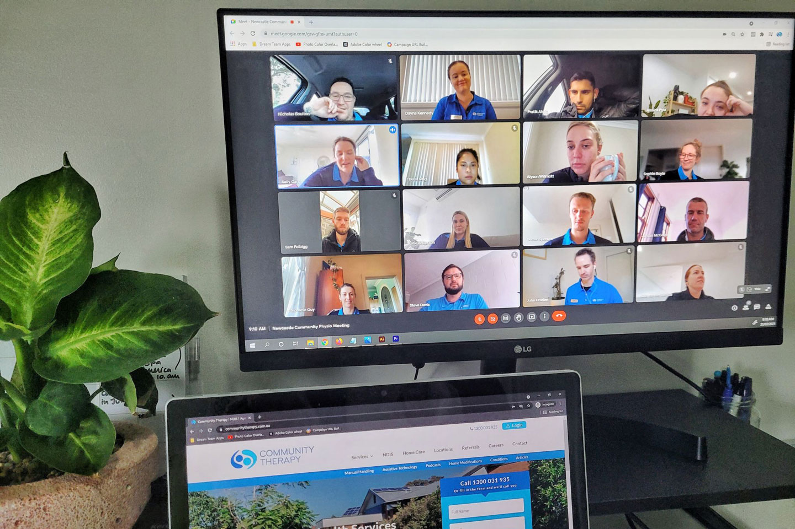
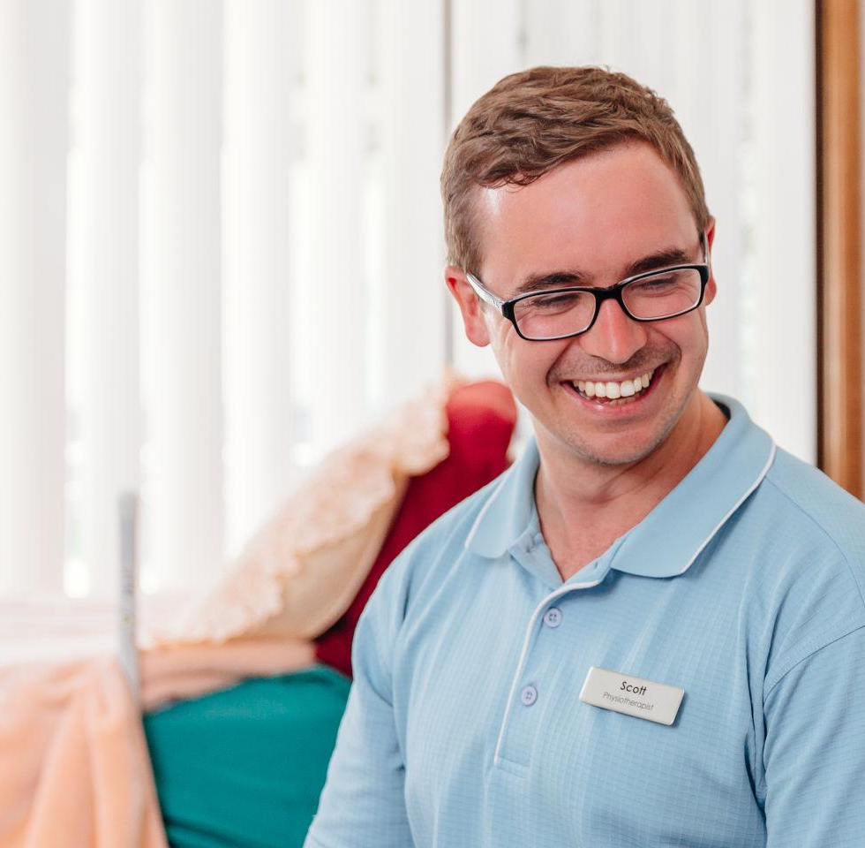
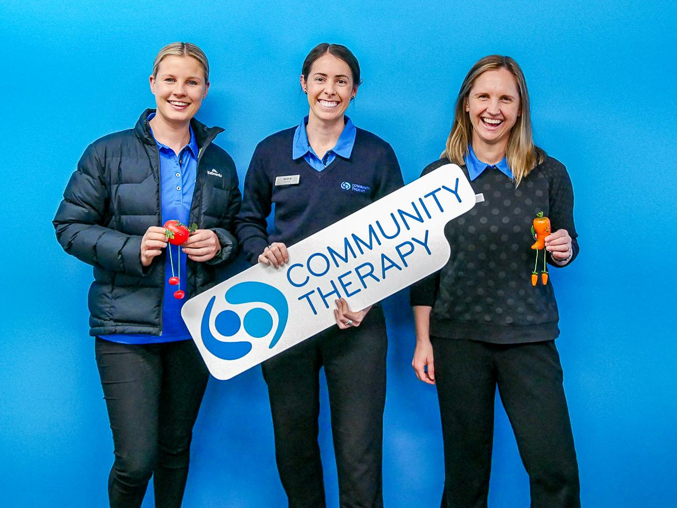
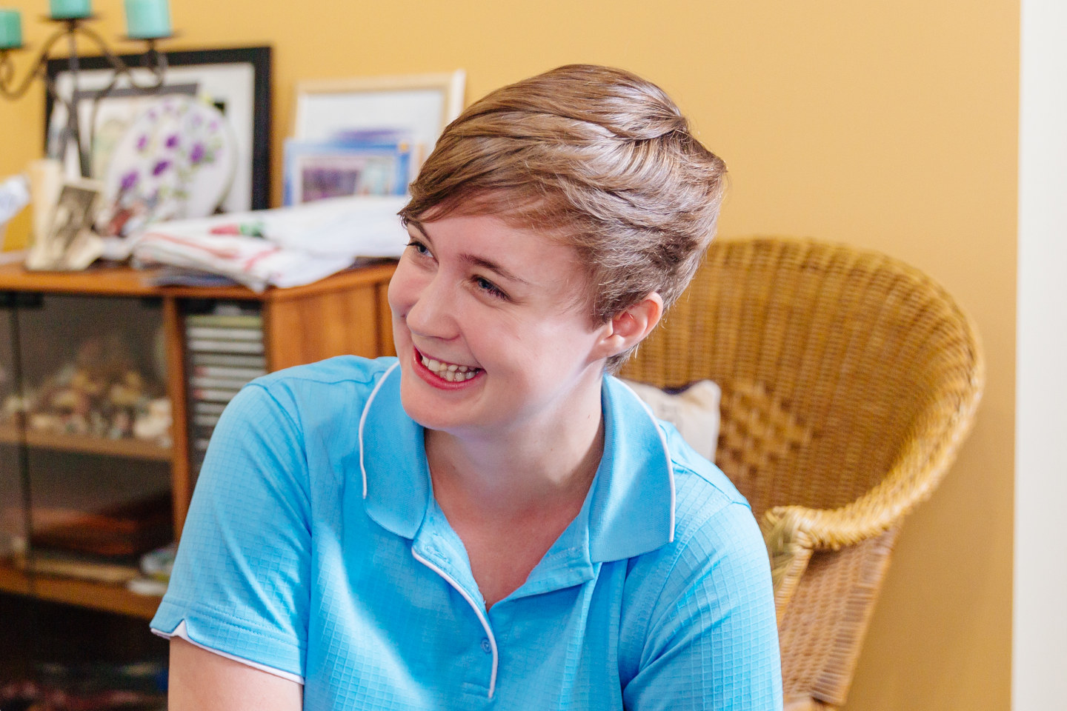
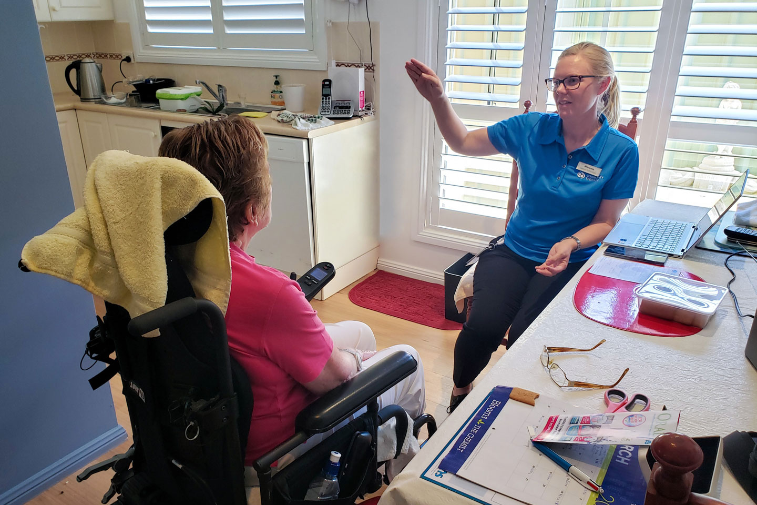
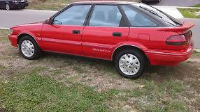
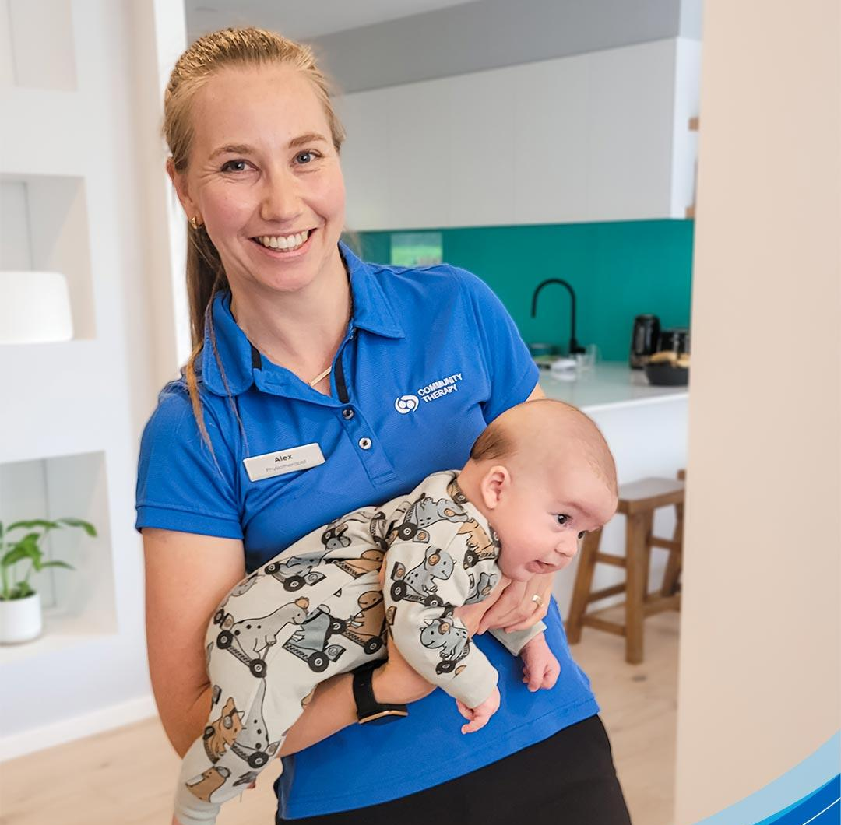
The Community Therapy Story
5 team members
Mayfield West & Erina Offices
Launch of CT Learning with more than 25,000 course sales
RACF Partnerships
Expansion to OT, Dietetics, Speech, Massage, AHA, EP, Admin, Accounts
Just the Beginning
Founded in 2016
Paeds Division launch Oct 2023
Transition from RACF to more HCP community and NDIS services
Community Visits
130+ team members
2017
2024

Slide 4
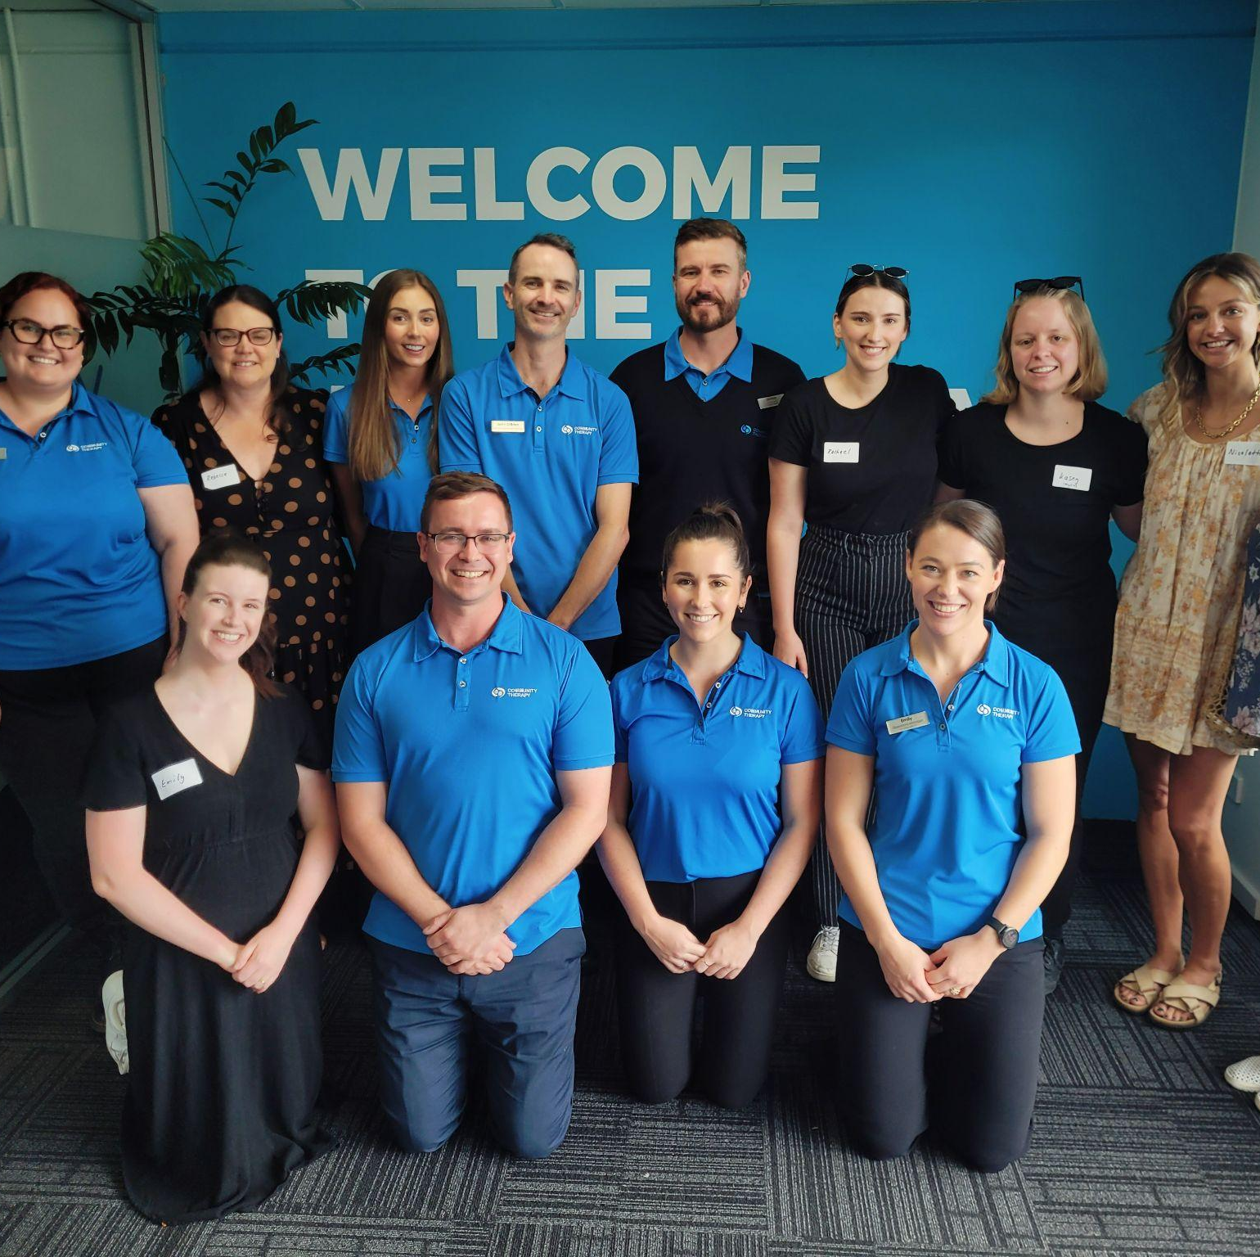
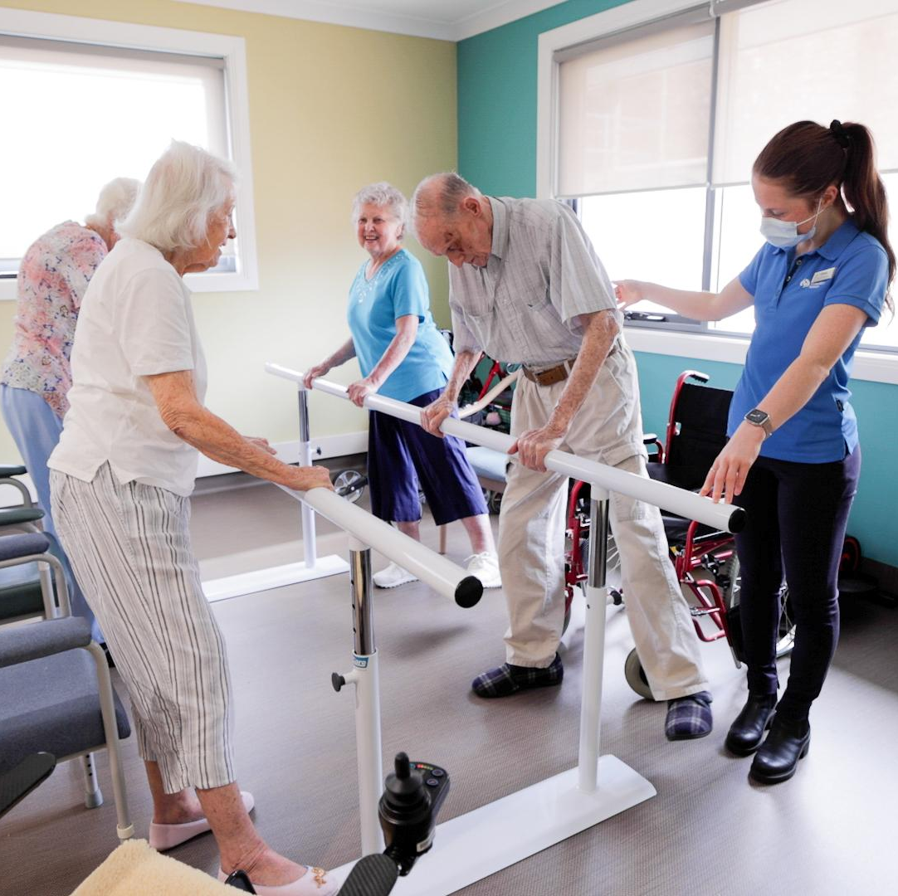
Community Therapy - Overview
👉🏼 130 team members
👉🏼 Hunter, Port Stephens and Central Coast
👉🏼 Physio, OT, Speech, Dietetics, EP, AHA, Massage Therapy
👉🏼 Community Aged Care, Disability and RITH
👉🏼 Residential Aged Care Partnerships

Slide 5
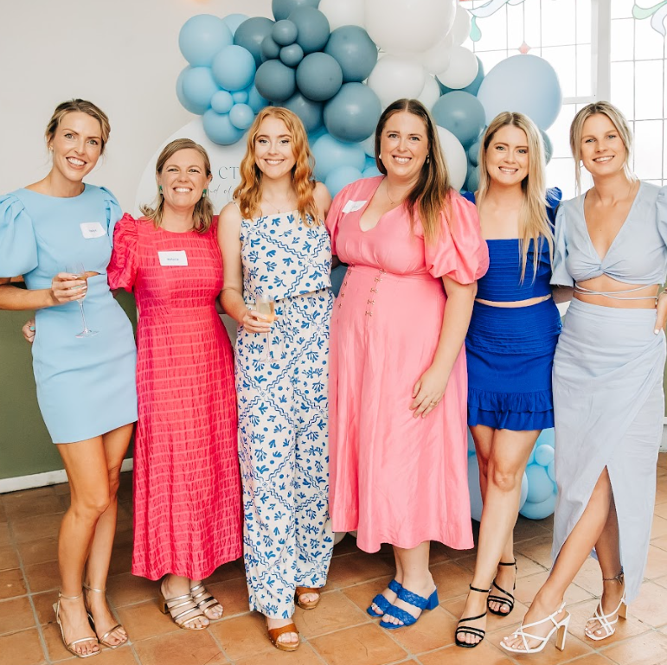
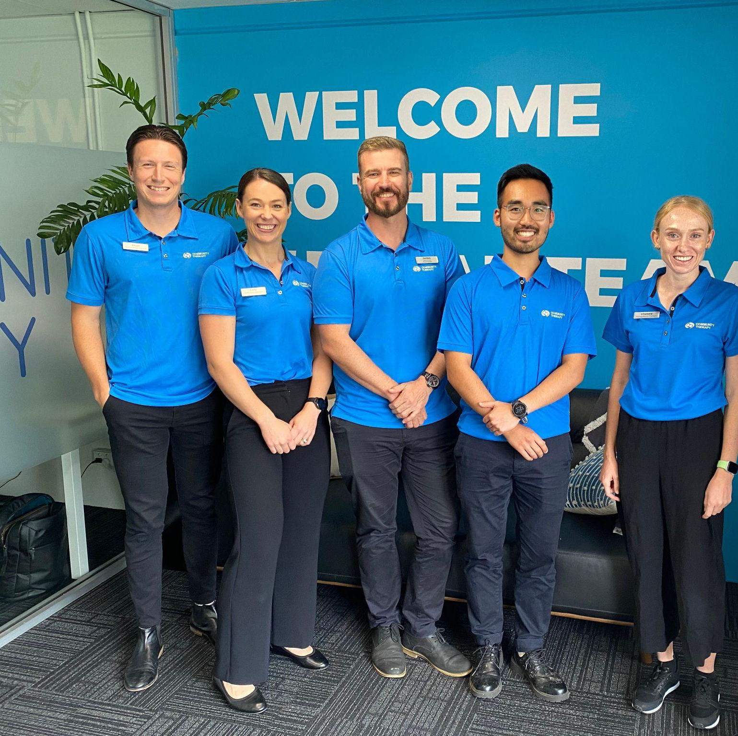
Building a Multidisciplinary Team
“slow is smooth, and smooth is fast”
👉🏼 Genuine & sustainable Employee Value Proposition
👉🏼 Early implementation of 1:1 support structure
👉🏼 Feedback Focus

Slide 6
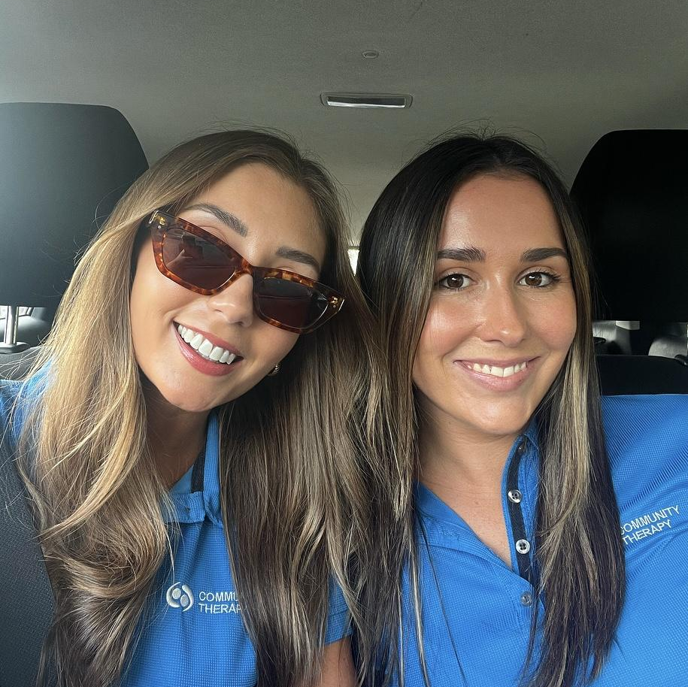
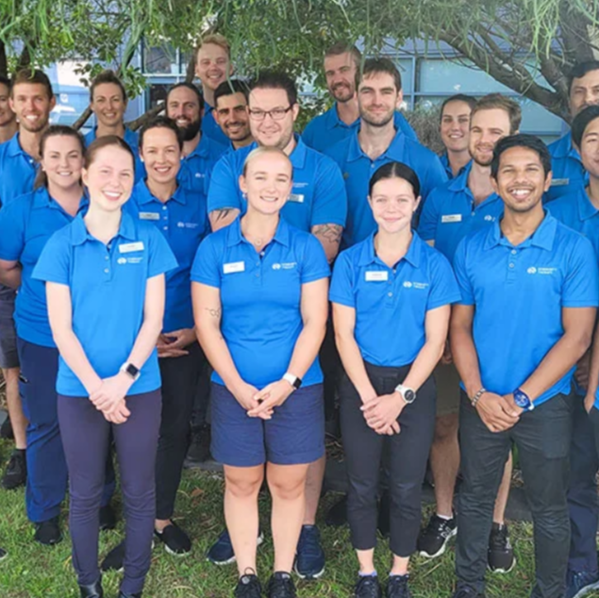
Engagement & Retention
“all the small things”
👉🏼 85 - 90 % retention (interstate / overseas travel main reason for moving)
👉🏼 Employee Net Promoter Score (NPS) +80
👉🏼 Client & Organisation NPS > +65

Slide 7
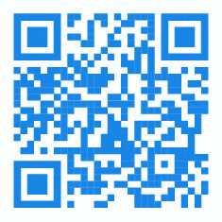
Questions?
Scott Lynch APAM
Founder & Managing Director Physiotherapist
scott@communitytherapy.com.au
0423 664 431

