Slide 1
People don’t know what we do
Notes:
Ankle sprain story. hospital crutches.
Intro.
Jody. EVIQ.

Slide 2
Create a resource
Content (educational) Marketing – answer as many questions/conditions as you can.
Prescribe, don’t dispense – Be the first contact practitioner.
Analyse – know what most people are asking or looking for.
Notes:
What are the patients, clients, conditions, therapies, treatments, procedures that you want to be involved with.
Concentrate information.
Be the “Go To” person with the best offering (without being negative towards others)
Use surveys, your own data, or web analytics to understand your market.

Slide 3
Notes:
Our response was a website for our professional referral network.
Contains Medical information
Printable Patient information resources.
Easy to use
3 click rule

Slide 4
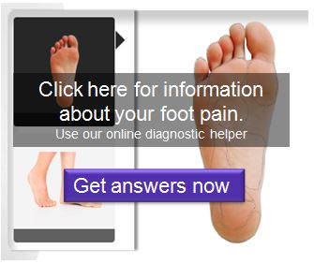
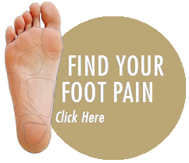
Notes:
The foot pain tool that we provide seeks to engage users al lead them quickly to the information they are looking for.
No medical information.
It shows them how they can help themselves, and what professional treatment may be required
With this tool embedded in your website, users can see the information they need in just 2 or 3 clicks.

Slide 5
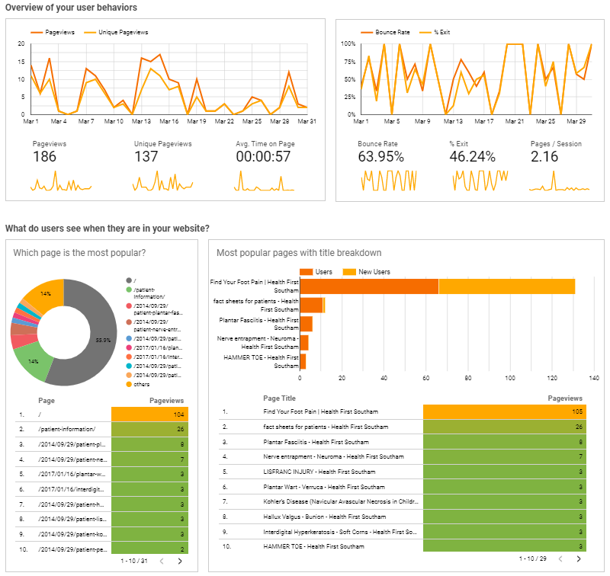
Analytics
Measuring your website use can provide valuable insights.
Notes:
You may be surprised at what people are actually searching for.
Knowing the most visited pages means that you can target those conditions in your advertising and marketing campaigns.
“Why do my feet get sore after walking on the beach?”

Slide 6
Get Started
Create a template
List of conditions or therapies
Create the content
Publish
Launch
Notes:
this formats each page of information. word/google docs
list everything you do or want to do
write yourself, use a student, use writer online or AI writers.
Website, book, app,
marketing and publicity.

