Slide 1
Pius X Diabetes Clinic – One Stop Shop
Pollyemma Antees – Credentialled Diabetes Educator (CDE)and Accredited Practicing Dietitian (APD)

Slide 2
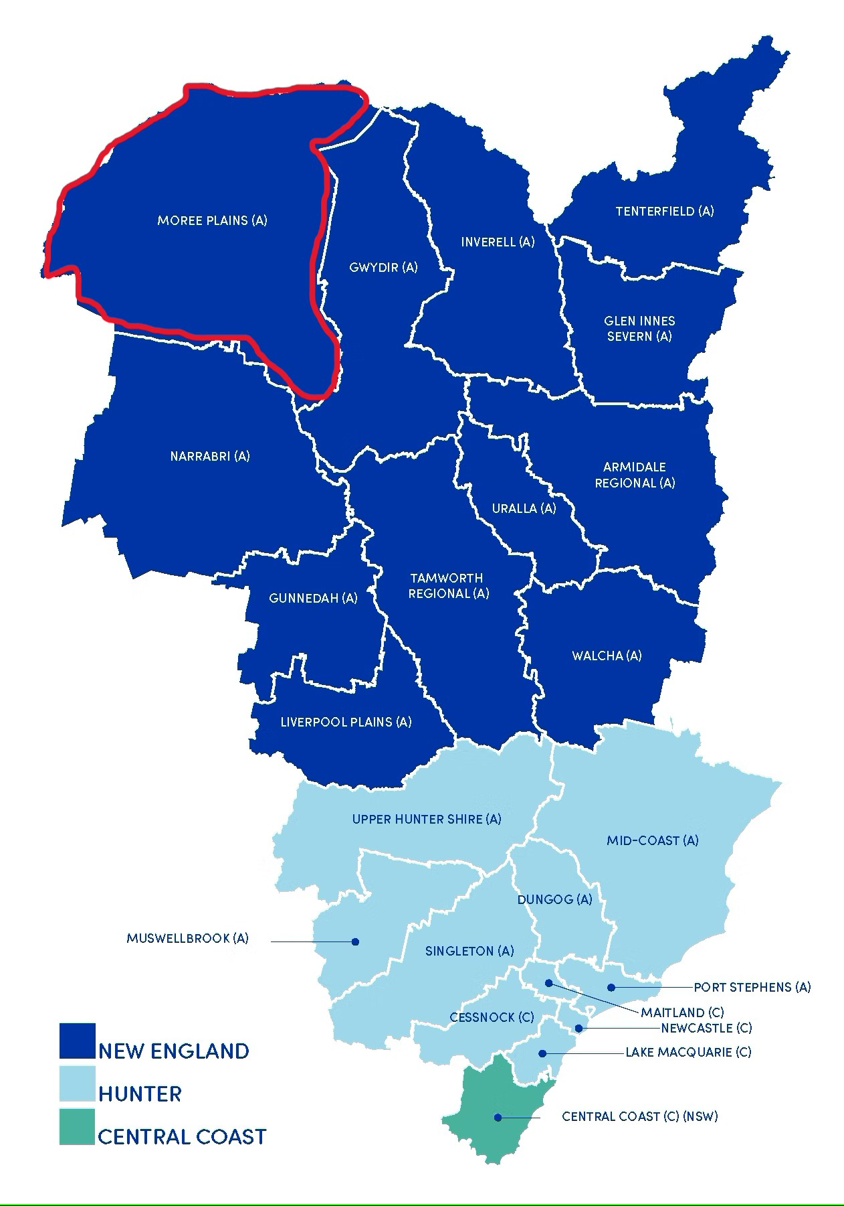
The One Stop Shop
Pius X is an Aboriginal Health Service in Moree NSW
4000 clients
8.1% have diabetes recorded in their chart.
6.4% of Moree people are registered as having diabetes through NDSS
Notes:
Pius X is a Aboriginal Health Service in Moree NSW. Moree is situated in Northern NSW. That is a five and half hour drive from were we are today. Out major hospital and diabetes clinic is in Tamworth. This is a 3 hour drive from Moree.
The First Nations population of Moree is X%
Moree’s Population is 7000 people. 4000 people attend the Pius X clinic. As Pius X has the only CDE in the town non indigenous people are allowed to see the diabetes educator with a EPC referral.
NDSS Diabetes map is for only people registered with the National Diabetes Services Scheme. A GP , practice nurse or CDE can complete the registration process. Therefore the percentage of people with Diabetes may be higher.

Slide 3
Pius X Diabetes Clinic
Administration team
General Practitioners x 3
Aboriginal Health Practitioners x 3 including Chronic disease coordinator
Nurses x 4
Dietitian x 2 – 2 days a week
Diabetes Educator x 1 – 2 days a week
Optometrists – once a month
Podiatrist – one week every seven weeks
Psychologist – 2 days monthly Child Psychologist 5 days a month
Ophthalmolist – one day every two month
Audiologist – 5 days once a month
Exercise Physiologist – once a week
Pathology – 5 days a week
Dentist - 5 days
Notes:
Pius X has a well resource clinic. This includes permanent staff. The GP’s, nurses, AHP, AHW and pathologist.
Administration staff are related to a lot of people in town. They know the issues of what is happening in a person life. They also spread the good word that the visiting services are worth meeting
Visiting Staff include;
Dietitians once a week
Dietitian and CDE twice a week plus fortnightly visits to Mungindi
Optometrist once a month
Podiatrist 5 days a week every 7 weeks (also visit Mungini and Toomelah clinics in that week)
Ophthalmolist -
Exercise Physiologist once a week for group exercise. Able to refer for individual appointments at her clinic. Funding for appointment is through PHN.
Pathology – open daily.
Dental – 5 days a week. Locum dental services
Social and Emotional Health team has counsellors and drug and alcohol workers available 5 days a week.
Psychologist and Child Psychologist

Slide 4
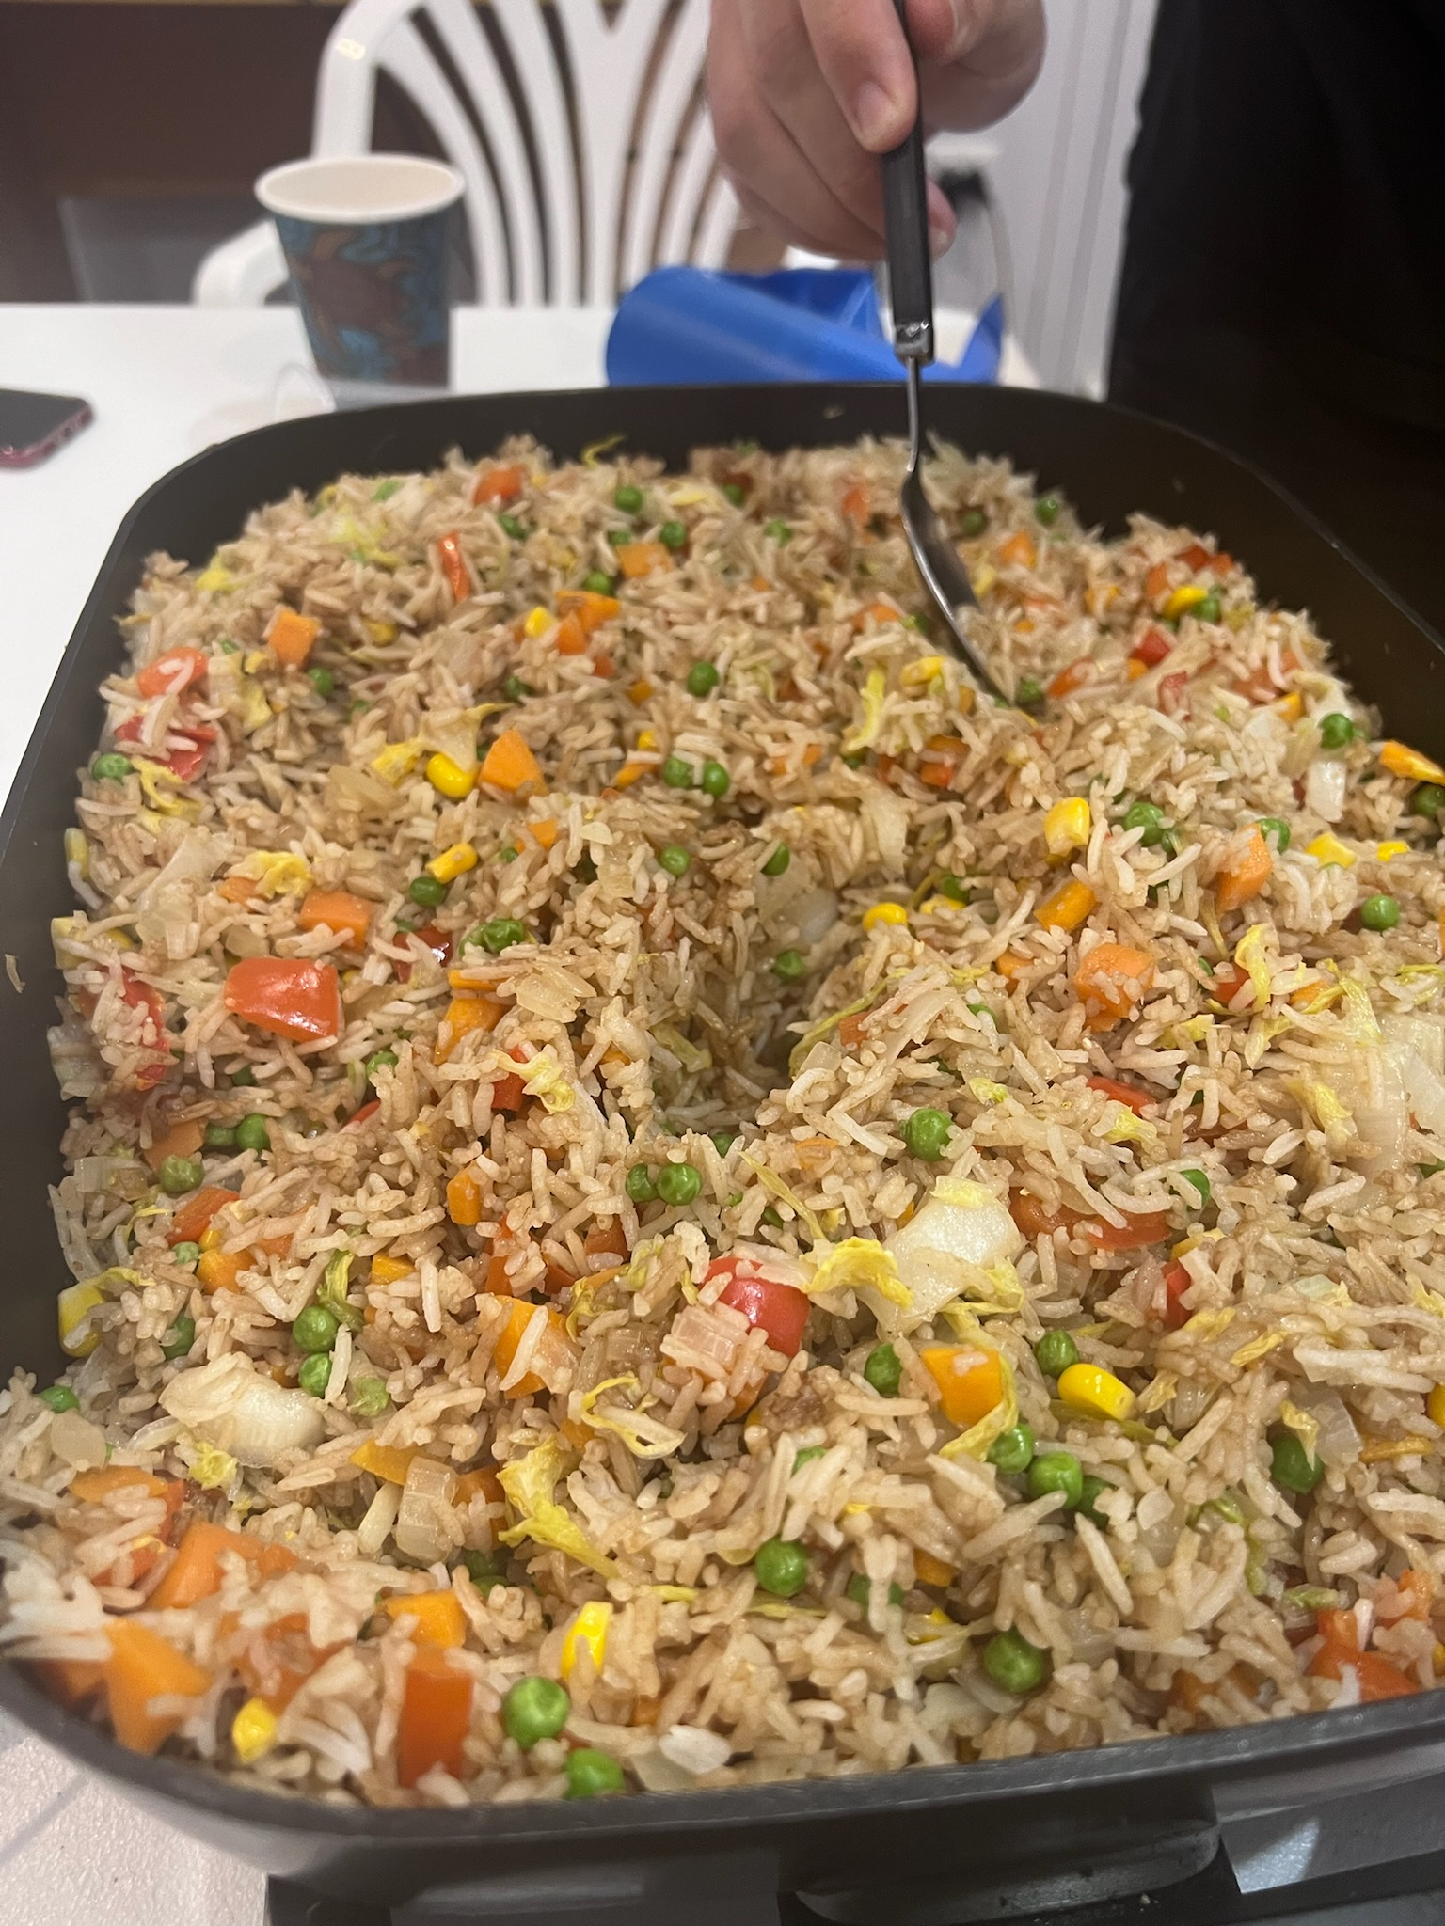
How it works
1. Referrals from GP, nurse or aboriginal health worker
2. 715 completed
3. Referral to Dietitian, Diabetes Educator, Podiatrist, Optometrist, Dentist.
All staff notes are in Communicare electronic notes. GP is kept in the loop with
Transport is available to assist with attending appointments
Notes:
Referrals come from GPs nurses and aboriginal health workers. EPC not essential for allied health. Walk in.
715 Health checks
Referrals back to GP if required for referral to specialist or medication review
Communicare is a electronic medical record system. All visiting health professionals have access to notes and add there own notes. Everyone in the clinic knows what he other health professional is doing in regards to a clients care. Able to remind clients of up coming appointments and what the other health professional does.
5. Pius X organises transport to and from the clinic. Also a weekly blister pack delivery is available. All medication changes are sent to the pharmacies.

Slide 5
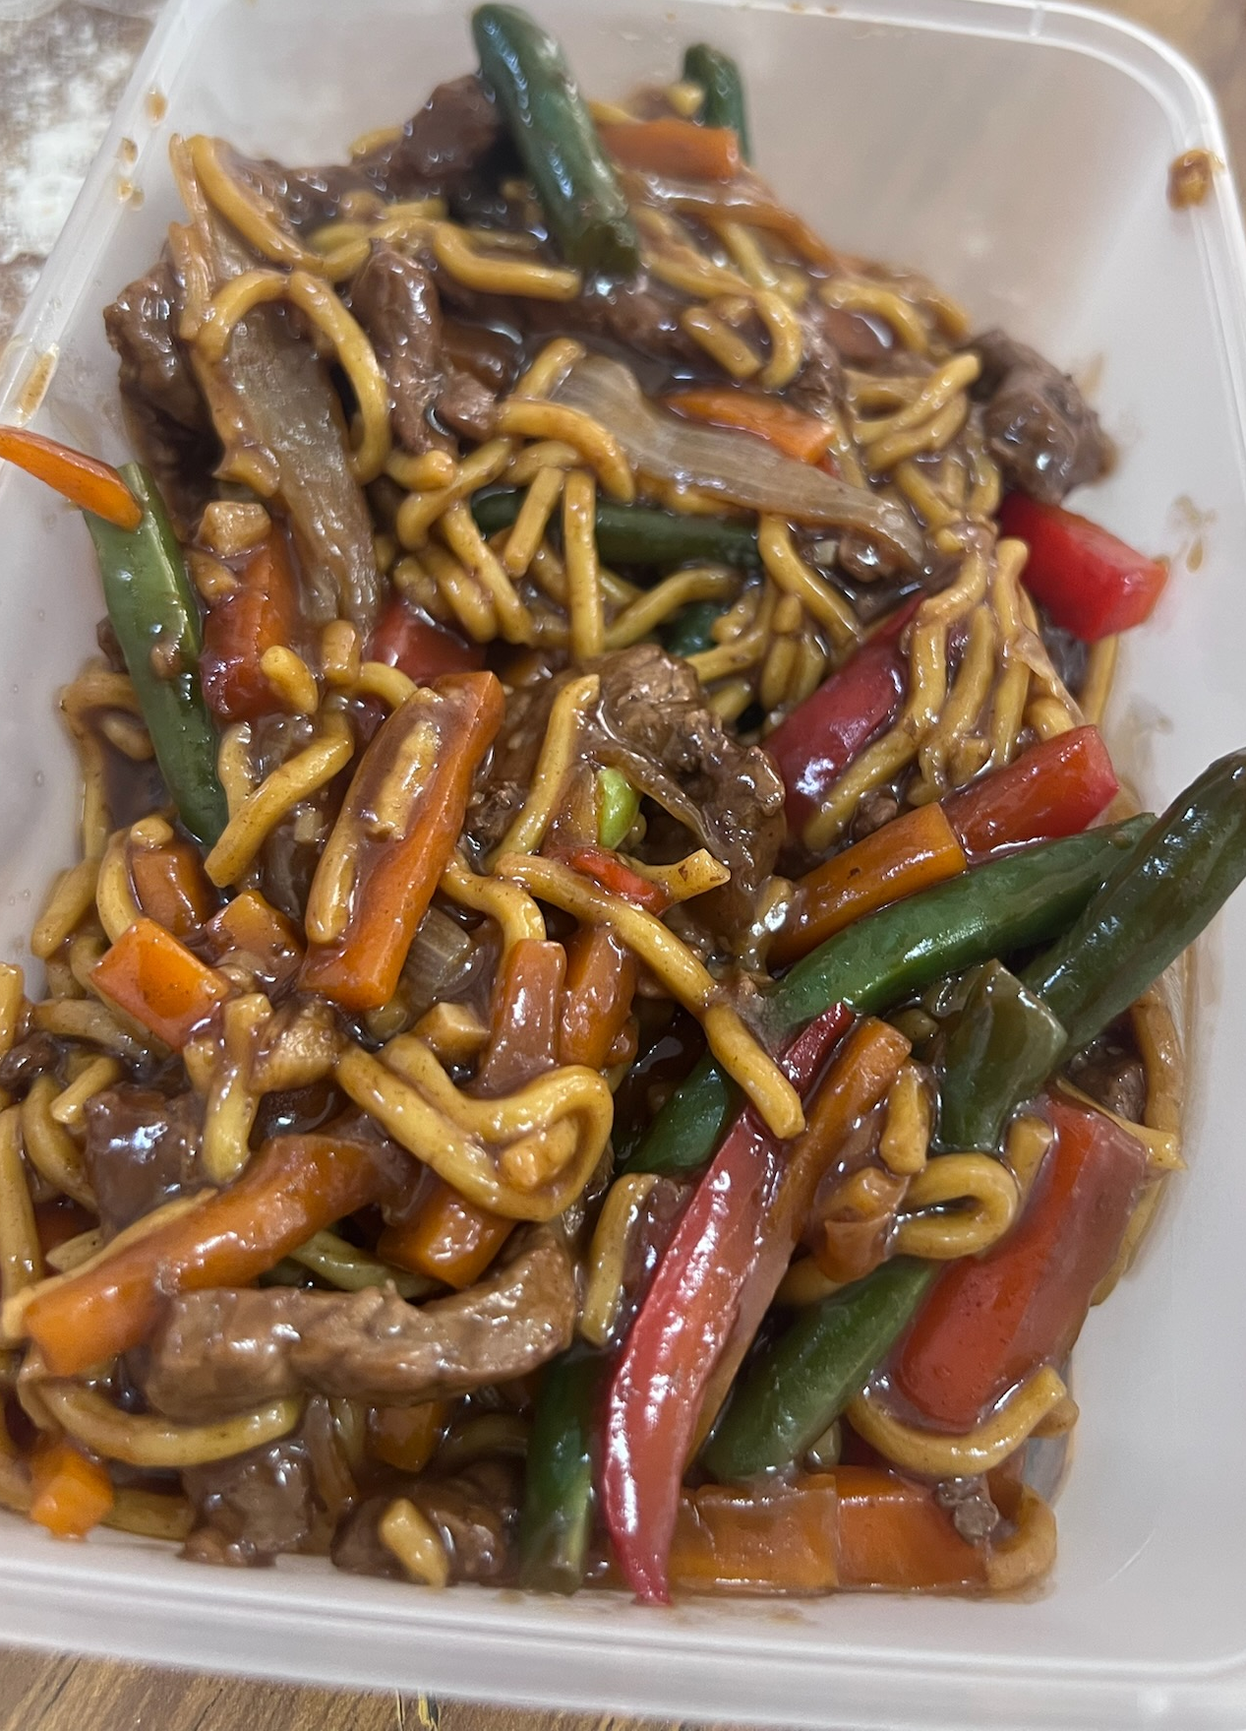
Stories
Male 47 years, Diabetes for 20 years. Maximum oral medication and insulin HbA1C 17.5% (May 2023). Trigs 43.4 mmol/L Ulcers on leg. Cared for by parents. Development delay and autism.
Ryzodeg70 25 units b.d.
Referral to Diabetes Educator.
Libre sensor trail to insulin review
Insulin titrated with the use of Libre sensor and GP self-management insulin titration plan.
Referral to podiatrist, dentist
Family plan regarding meals
Fortnightly appointments for nine months.
Notes:
Long term client of Pius X. Developed Type 2 diabetes 20 years. Has autism and cared for by his parents. Has 7 siblings that live in the house or visit. SP spends all day in the kitchen and requests food from his siblings.
Refused blood glucose monitoring and made insulin injection time difficult for parents.
Libre sensor trail to monitor BGL’s and determine if medication needs reviewing. Insulin was able to be tirated up and bring BGL’s into range. Parents now longer had to do finger prick checks.
Family meeting in regards to feeding of SP. All siblings allowed to make him cups of tea however no food. Dad is the only one allow to give him food. This ensure he was not being over feed during the day.

Slide 6
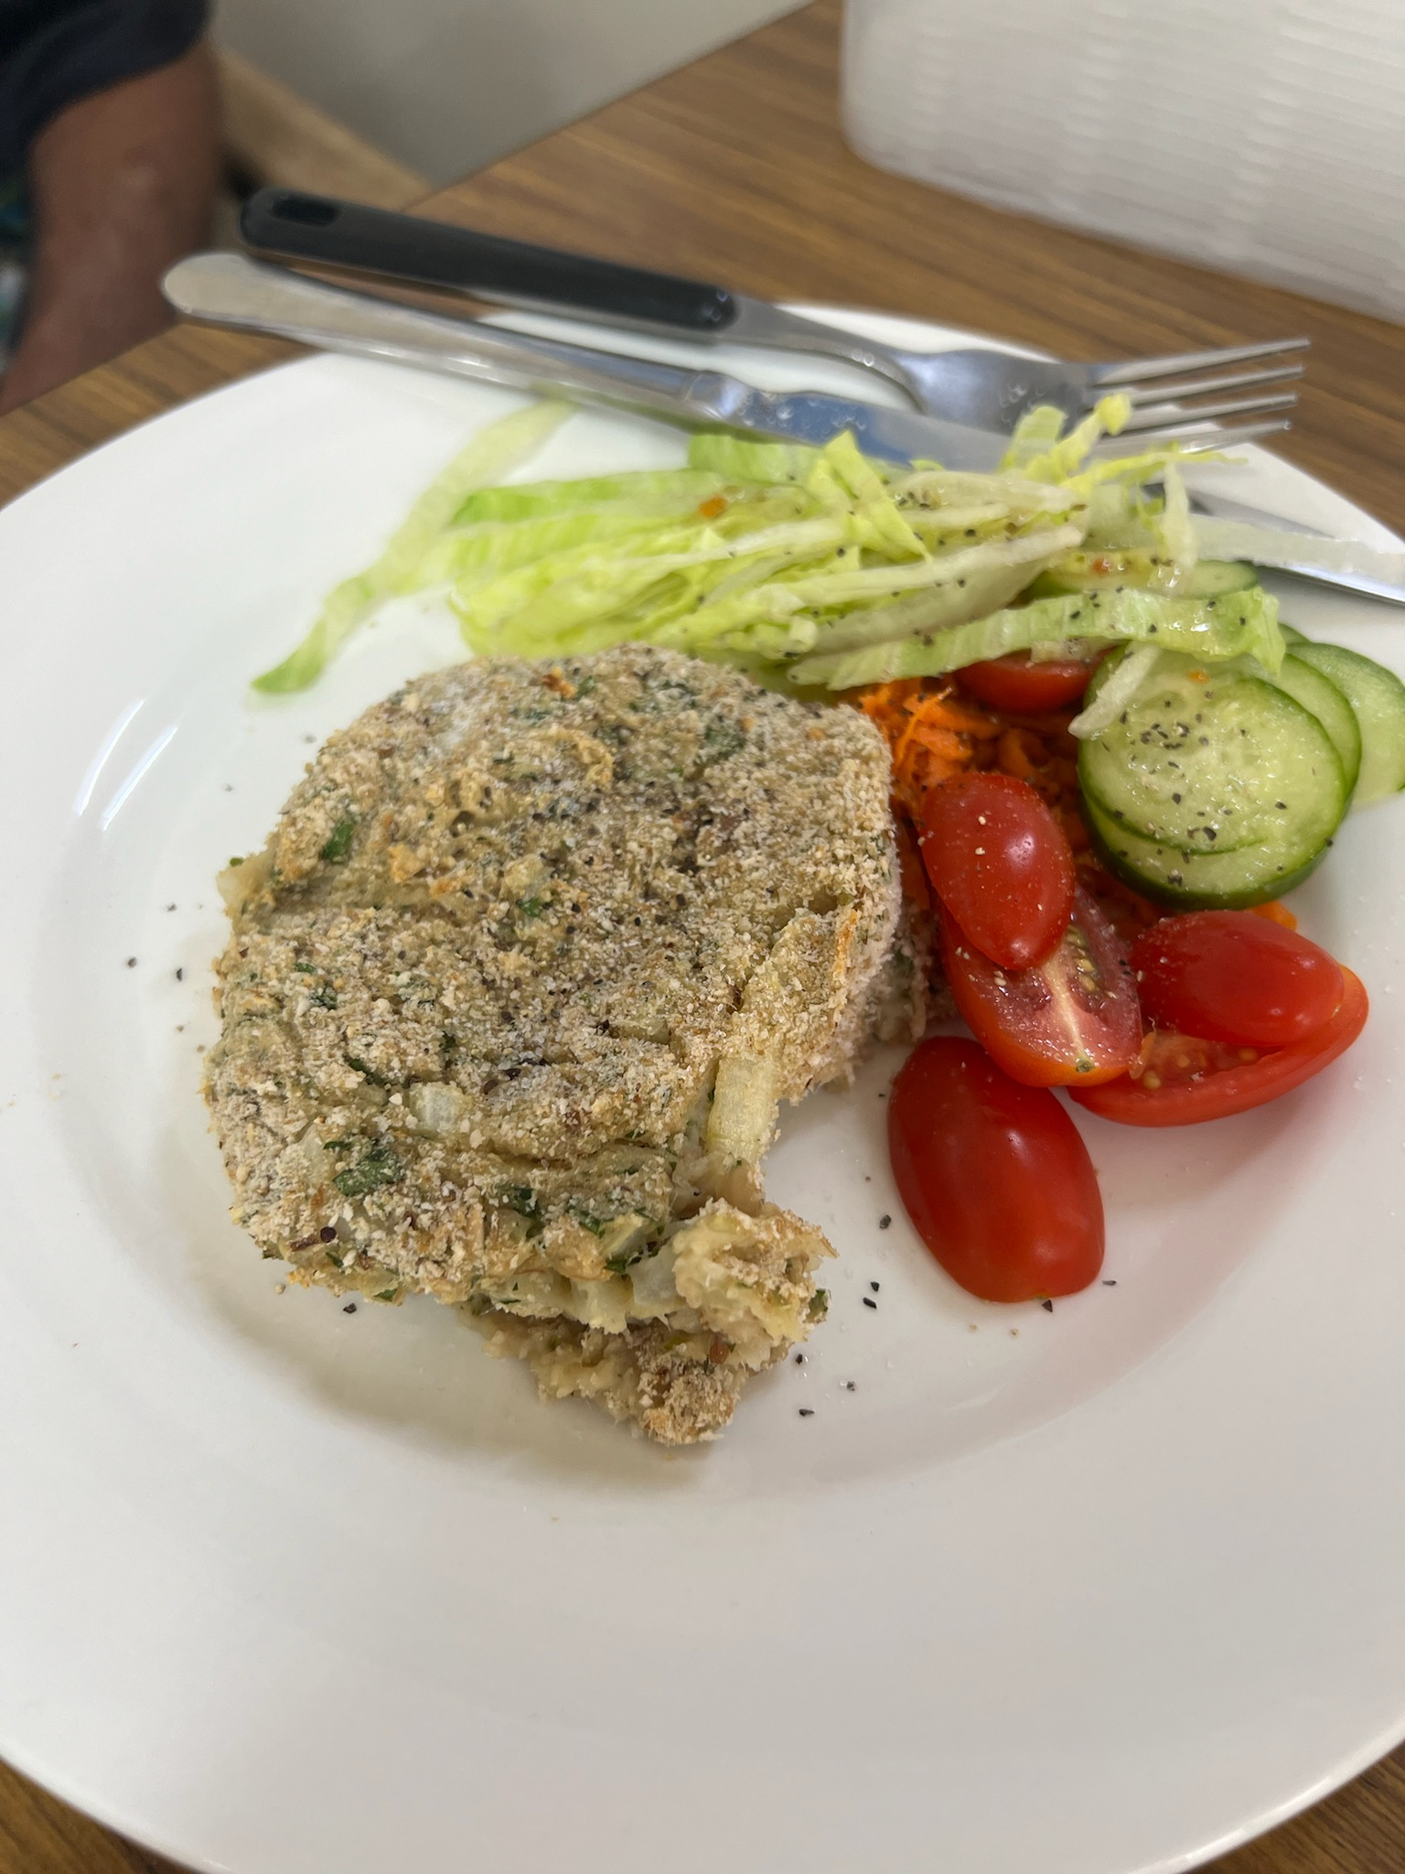
Nine months later
HbA1c 7.7% (March 2024) GFR 47 Trigs: 8.3mmol/L
Ryzodeg70 28 units in morning and 24 units at night.
Parents are more relaxed as child is now willing to have BGL checks, insulin injections and mood has improved.
Ulcers have healed and parents report behaviour has improved
Feet regular checked by Podiatrist
Client happyly comes to clinic as it is regarded a safe place
Goal to have retinal eye check.
Notes:
SP regularly comes to Pius X for all health checks.
Working on introducing him to the optometrist for a eye check.
Working on a NDIS application for the Libre sensor to ensure BGL continue to stay in range for 70% of the time

Slide 7
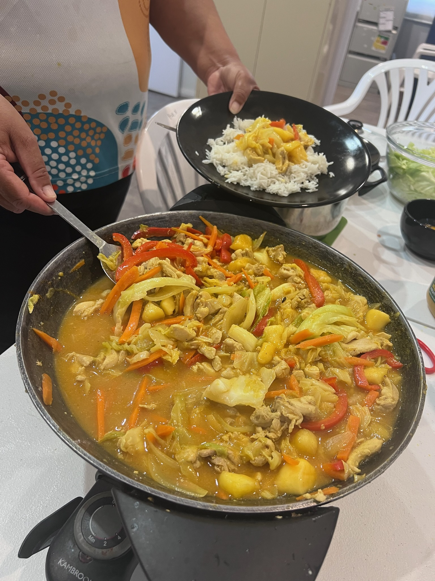
Story 2 Male 66yrs
Gentleman with Type 2 insulin requiring diabetes. Diagnose 20years ago.
HbA1c 9.1% (March 2023), retinopathy, peripheral neuropathy, GFR 71, Albumin/ Creatinine ratio 37.9 mg/mmol.
Maximum glucose oral medications and insulin.
Starts making lifestyle changes. My Age Care package for home gym equipment.
Eating healthy food choices and started on Ozempic.
Referred to Diabetes Educator for review.)

Slide 8
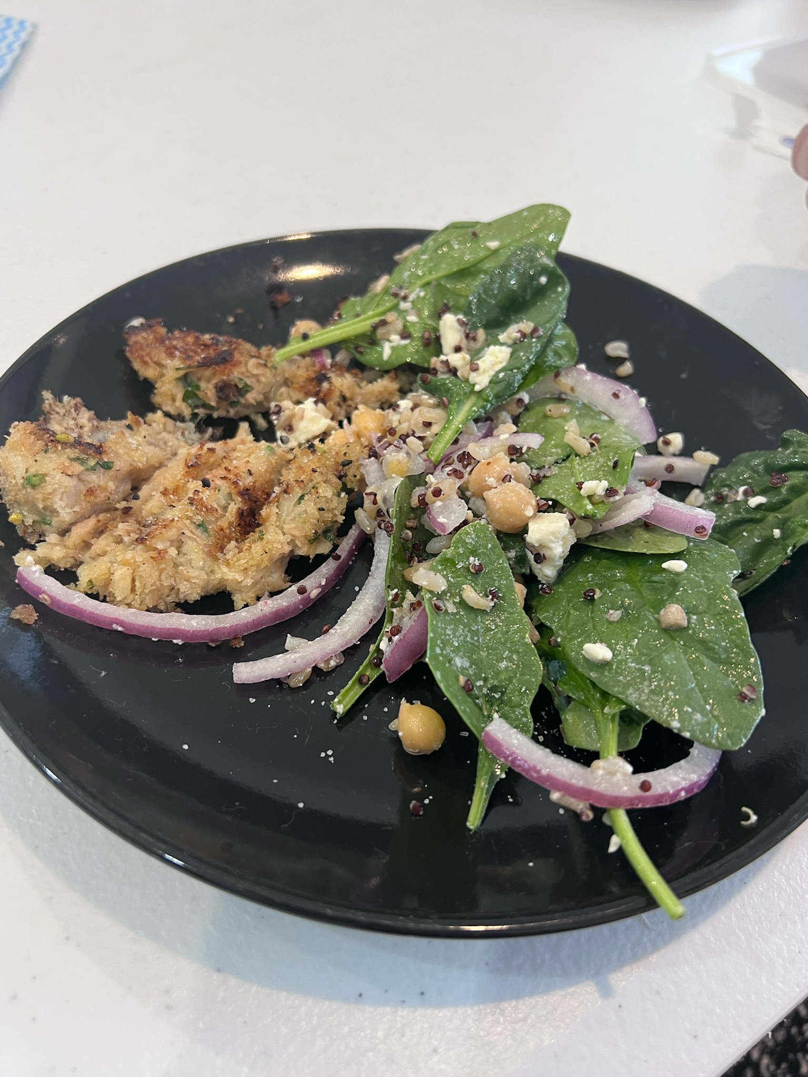
9 months later
HbA1c 5.7% (Feb 2024) Albumin/ creatinine ratio 17.1 mg/mmol and client reports having to eating to stop low glucose events.
Libre sensor applied for insulin review. 10% of the time BGL below target.
Insulin reduced and Sulfonylureas stopped.
Continual weight loss and reduction in insulin.
12 months later. 90kg, 10kg wt loss, nil insulin. Metformin reduce to 500mg a day. Still on Ozempic
HbA1C increased to 6.7%. Gentleman is now more active and not eating for his insulin.

Slide 9
Expanding to fill gaps. Men’s Cooking Class
Men’s Cooking class was started in conjunction with Correctional services and NDIS providers.
Now a weekly service for men to get a weekly cooked meal.
Rapport building with health service
Notes:
Aboriginal Health Practitioner noticed that the young men were missing out on health events if they did not play league.
Many of the young male clients with type 2 diabetes also had a mental health condition and limited cooking skills or access to cooked meals. These men were only accessing the service for their medication and not having regular health checks.
Men’s Cooking class was started in conjunction with Correctional services and local NDIS support services. Similar clients
Now a weekly service for men with a mental health condition to have a cooked meal and chat about food. All men take a spare meal home to have that night.
Repport building with health service to feel comfortable in coming to the service for health checks and regular attendance.
The men are now requesting new meal idea. This is butter chicken pasta bake. In that sauce is pumkin and chick peas.

Slide 10
Mums and Bubs: Gestational Diabetes
All pregnant women at Pius X are screen for gestational diabetes before 12 weeks.
They are provided with Libre sensors
Fortnightly appointments with the Diabetes Educator to monitor BGL’s.
Midwife does checks and appointments to high risk clinic
Notes:
All pregnant women at Pius X are screen for gestational diabetes before 12 weeks. Thus we can identify women with gestational diabetes early and start monitoring and provide lifestyle modification support.
They are provided with Libre sensors and fortnightly appointments with the Diabetes Educator to monitor BGL’s. BGL’s above target are notified to the GP who then starts them on glucose lowering medication. I provide them my mobile so if BGL’s spike they can contact me so I can inform GP. GP they provides obestrics in Moree Hospital is not at Pius X clinic. Obsertics GP then prescribes medication. BGL monitoring is able to be access by GP.
Also discussed medications and planning for birth. In Moree if a mother start insulin they need to have the baby at Tamworth (3 hours) or Newcastle Hospital. Planning for delivery is part of the consults.
Mum send photos of their new babies and excited to say they ‘passed sugas”

Slide 11
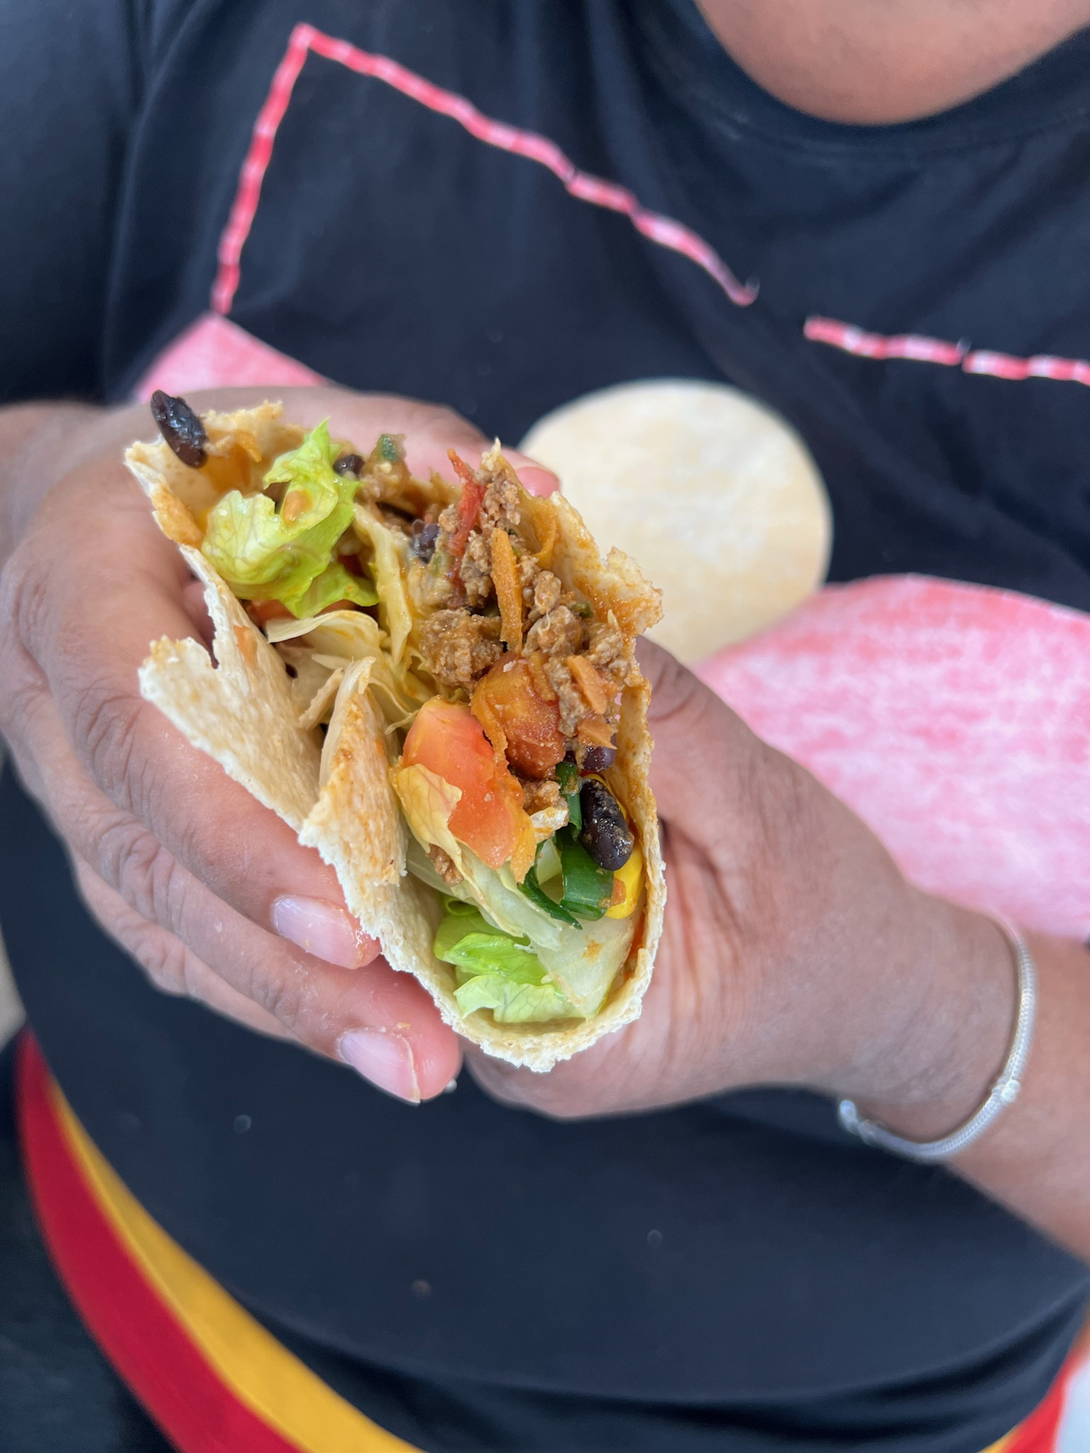
The future
Visiting Endocrinologist and Renal Specialist to Pius X Clinic.
Young Men coming to Pius X for insulin resistance screening
Funding for CGM for all people with insulin requiring Type 2 diabetes
Notes:
Would be fantastic to have an Endocrinologist attend Pius X. There is a visiting Endocrinologist to Moree however it is at an another organisation. This means the Endocrinologist is unable to access the Pius X Diabetes team notes for that client.
Earlier diagnosis of insulin resistance to ensure clients are supported to help preserve beta cells and reduce or postpone developing diabetes
More Aboriginal Health Practitioners becoming Credentialed Diabetes Educators.
More funding for continuous glucose monitoring so that all clients on insulin are able to increase time in range of their BGL’s.
CGM is only available for people with Type 1 Diabetes through NDSS
CGM funding via NDIS is very difficult to have approved.

Slide 12
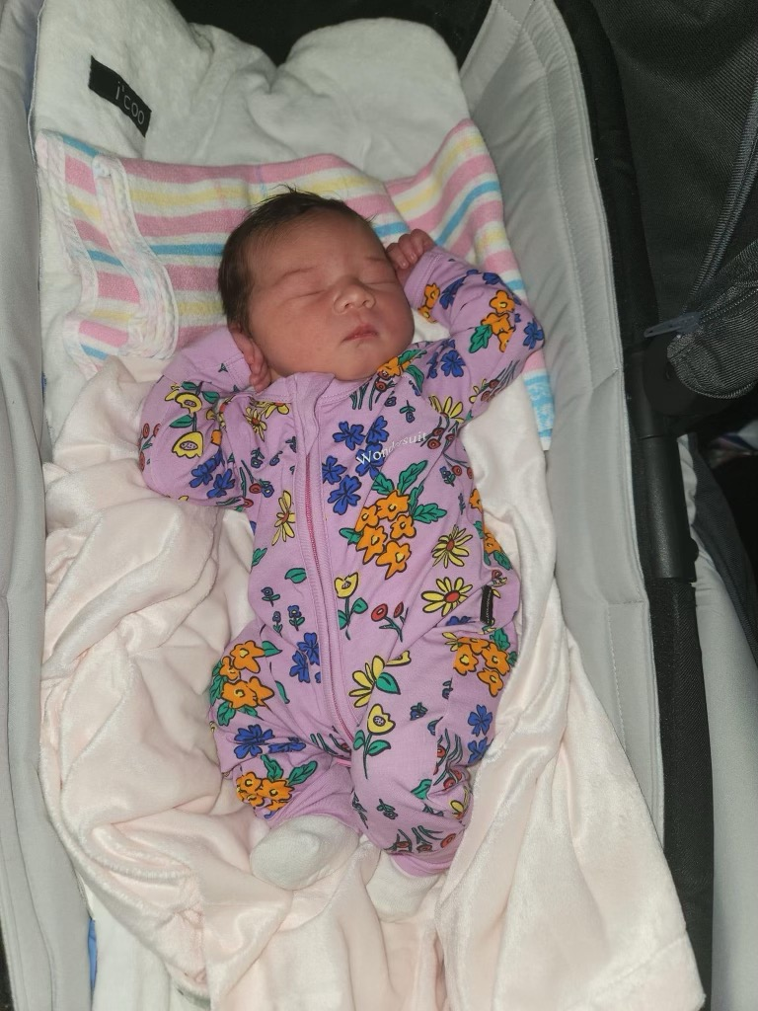
Questions
Email
polly@northwestnutrition.com.au or polly@piusx.com.au

