Slide 1


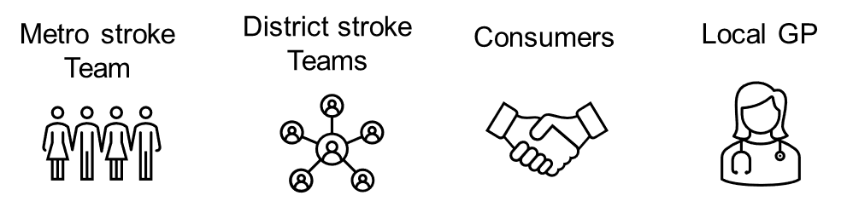
Project contact: Rebekah.pickering@health.nsw.gov.au
Virtual Outreach Pilot Project:
Healthy After Stroke Online
Improving access to a secondary prevention and self-management program for stroke survivors in rural and remote HNELHD​
​
  Stroke rate is 17% higher in regional and rural areas
  Stroke rate is 2.9 times higher in Indigenous peoples
  Inequity of access to post-stroke recovery programs across HNE

Slide 2
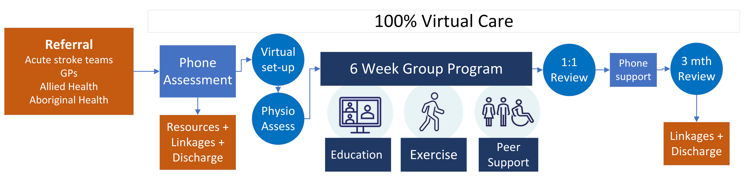
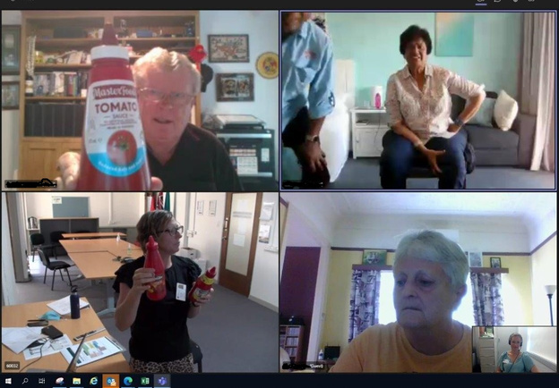
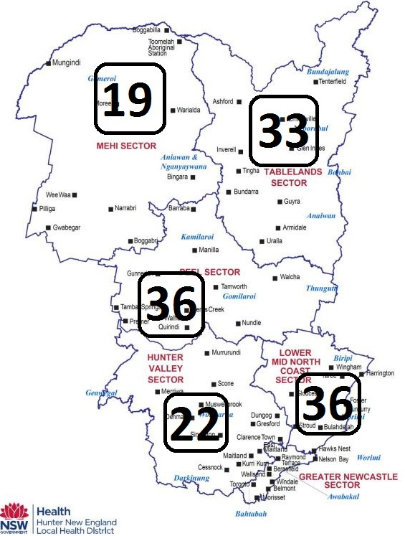
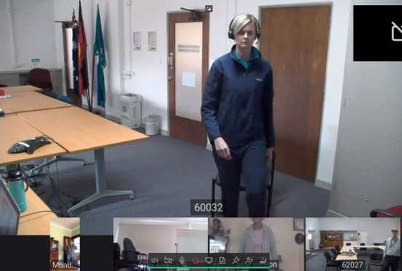
“This is a wonderful program to support people that are discharged with so little”
Outcomes over 9mth project:
  Referrals: 149 with broad reach
  Phone assessments: 97 clients
  Uptake of full 6wk program: 49 clients (51%)
  Completion rate of 6wk program: 78%
  Current waiting list: 45 patients
  Improvements in physical activity, mood, patient confidence/experience
  Nil adverse events
  Staffing equivalent of 1 person 2.5 days/week,
  Budget = $70, 000pa (+ on-costs)
“I feel more confident to start life again”
“Exercises were simple and you could work at your own pace”​
Project contact: Rebekah.pickering@health.nsw.gov.au

