Slide 1
A LOCAL MUSCULOSKELETAL NETWORK TRANSLATING RESEARCH TO CLINICAL PRACTICE
Andrew Delbridge
APA Titled Sports Physiotherapist
Regent Street Physiotherapy

Slide 2
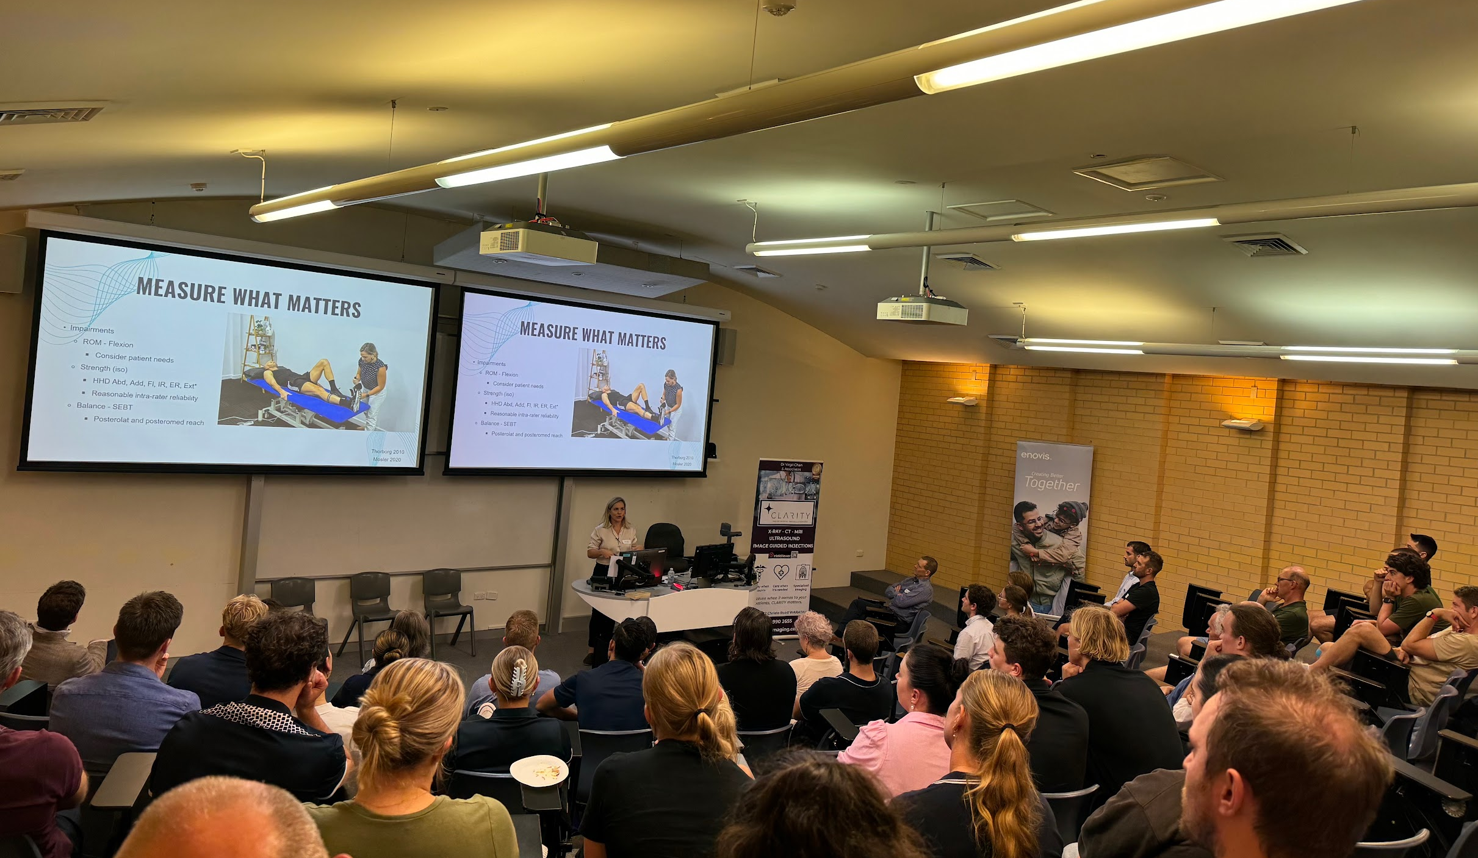
Agenda
Who are we, where did we begin?
Vision/mission
Our strategy
4
What have we done so far?
Notes:
Today we will cover
Who we are and where we began
Our vision and mission
Our original strategy and how that has changed
What have we achieved so far.

Slide 3
Who are we?
Multidisciplinary group of MSK clinicians
200+ Members
Physiotherapists - 147
50 practices
Orthopaedic surgeons - 12
Sports physicians - 3
Exercise physiologists - 7
General practitioners - 6
Podiatrists - 5
Nurse practitioners - 3
Radiologists - 2
Other - 8
Notes:
We are multidisciplinary group of MSK health practitioners.
Initially established primarily as a physiotherapy practitioner network. It remains physiotherapy led but has grown in its vision and mission and is now a multidisciplinary group.

Slide 4
RIPN’s vision
To enhance the delivery of high value care and create lasting improvements in outcomes for patients with musculoskeletal conditions in our local community
Notes:
Nikki – by you all turning up here tonight – share this vision.
All witnessed poor quality care in our area. RIPN wants to change this.
All want better care for our patients, all want improved outcomes

Slide 5
Where did we begin?
Private practice network
Improve delivery of quality care
Case presentation evenings
Mentoring and knowledge sharing
Est. 2019
Regional health partners
Facilitate research translation via networks
2020 - funding for concept network
Connor Gleadhill – PhD with A/Prof Chris Williams
Physiotherapy Network (RIPN)
Connect clinicians together with research
Notes:
The clinician led network concept started with collaboration between Connor Gleadhill undertaking his Phd collaborated and RHP.
RHP mandate to improve translation of research into practice via network concepts & targeted physiotherapy as an opportunity to establish a clinician led network.
At the same time as Connor was setting these early steps in motion, a smaller practice based network was hosting case presentation evenings in a social, casual setting that was growing in popularity.
Essentially a small network across 6-10 practices at this stage.
Step 1: Approach to Newcastle practices, largely through existing small case group network.
Survey: Local needs analysis
Surveyed members to find out how a Network would benefit them and what they wanted it to do. => Mission Vision
Problems facing physio’s & barriers to using research in practice - how a network may assist clinicians, what they wanted it to do.
Step 2: Establishment of a governance group and clinician led physiotherapy network.
Steering Committee and governance structure
Confirming vision and mission
Initial intention was to facilitate connections between researchers and clinicians leading to more relevant and meaningful research outputs that could be readily applied in clinical practice.
Connect researchers and clinicians together
Create meaningful and relevant research outputs
Overcome barriers with social networking, mentoring opportunities and professional development events
Step 3: Problem mapping and research agenda creation (survey and workshop)
Most clinicians were interested in the Network hosting social networking events with mentoring opportunities and professional development education.

Slide 6
Organisational structure
Steering committee
Clinicians
Private & public practitioners
Academics
RIPN Admin (0.2 FTE)
2 Chairpeople
Steering committee
Working groups
Working groups
Working groups
200 Members
Multidisciplinary
MSK clinicians
Notes:
Current structure.

Slide 7
Our strategy 2024-2025
Doing Research
Research translation
Host events
Summarise evidence
Identify & solve local implementation barriers
Disseminate findings
Build partnerships
Evaluating effects
Communicating Research
Implementing Research in practice
Notes:
RIPN then developed a new Strategy for 2024-2025 to target research translation. TRAFFIC light colours used to show whats go and what’s not at the moment.
Moved away from “doing research” in red to communicating research findings and implementing best evidence based care (green)
Next moving to evaluating effects (yellow)
Possibly after 2025 - explore using research to answer our own questions.

Slide 8
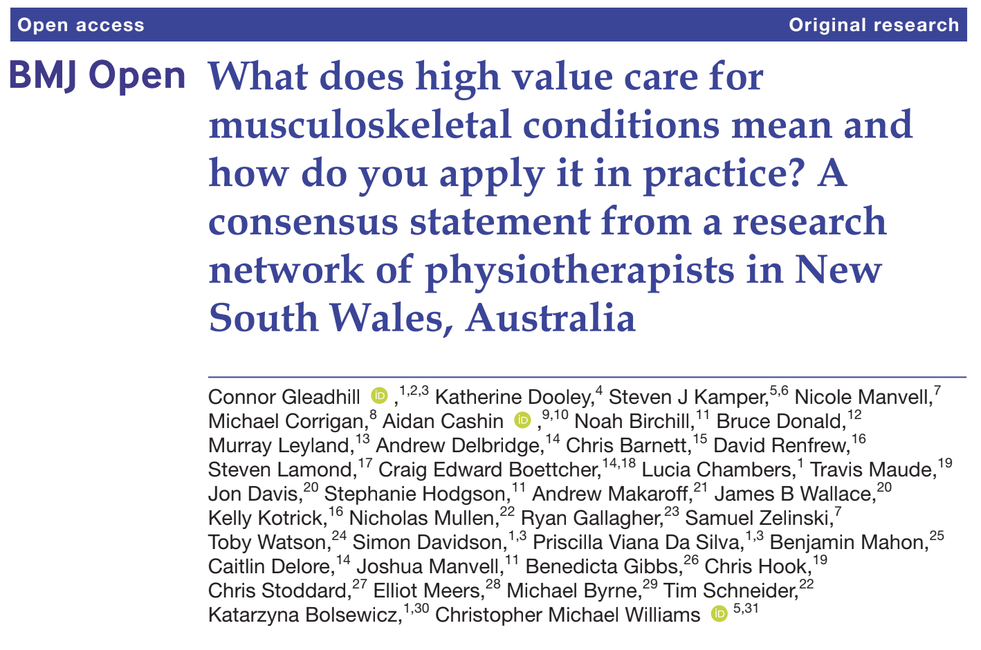
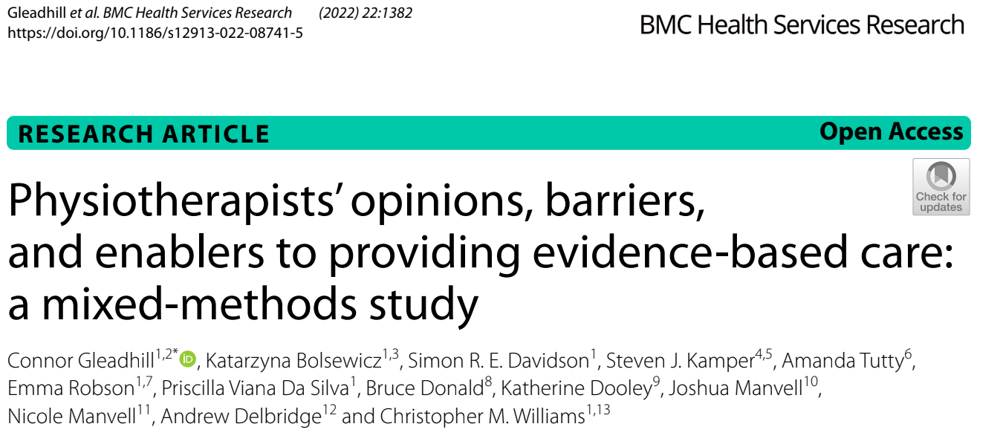
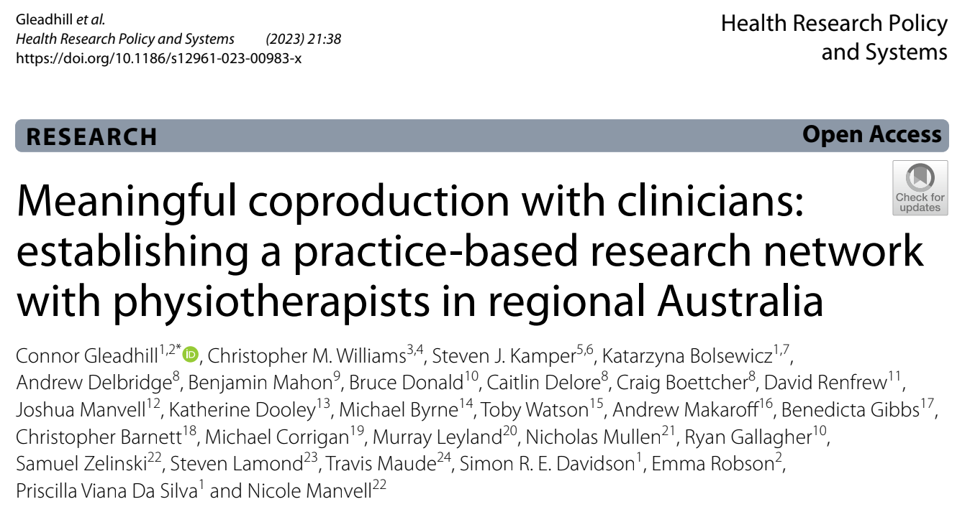
Doing Research
Notes:
QR code takes to to a google drive with the articles if you would like to read, all published in open access journals.
Network most proud of the consensus statement on high value care.
As a result of survey feedback showing Members were more interested social forums to share evidence and knowledge so the steering committee changed focus to provide a forum aimed at communicating research and implementing it into practice.
As a result we have had significant boost in membership via this strategy

Slide 9
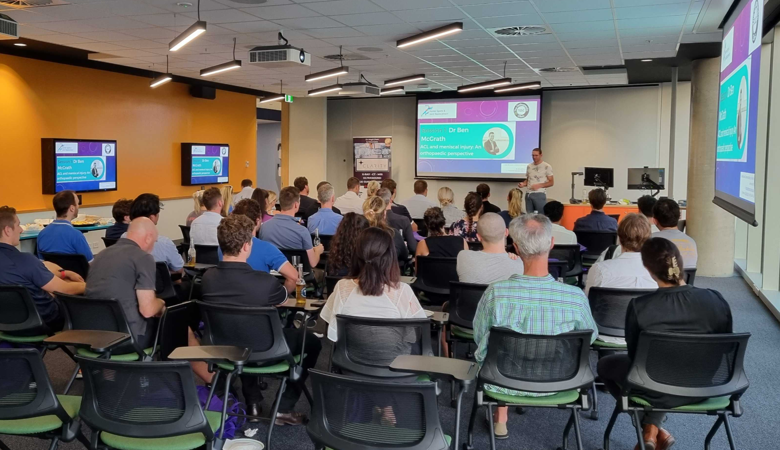
Communicating research
Musculoskeletal insight sessions
Sponsor funded - free for attendees
Knowledge gaps
Multidisciplinary presentations
Q&A panel discussion - highlight local barriers
Addition of expert academic on panel
Dissemination plan
Case presentation evenings
3 presenters per session
20 min case with evidence-based takeaways
Theoretical knowledge
Clinical skill
Critical appraisal
Doing Research
Evaluating effects
Communicating Research
Implementing Research
Notes:
In Green in the strategy slide
Stages to communicating research
Identify the knowledge gaps
Collaborate to summarise evidence
Present content at events
Identify local barriers to implementation - eg Frozen shoulder, RCRSP
Find solutions, produce outputs and disseminate findings
Evaluate impact of network and outputs

Slide 10
Evaluation
Evaluate impact of activities
Change in knowledge
Change in practice
Patient outcomes
Other impacts to consider
Change in policy
Return on Investment
Doing Research
Evaluating effects
Communicating Research
Implementing Research
Notes:
In yellow in strategy slide
Early stage work being conducted but an area we are increasing our focus.
Event Surveys pre and post - to assess knowledge uptake
Care pathway evaluation - impact on practice
Impact on Patient outcomes - big question
Nicki Manvell - Phd
Knowledge (publications and presentations)
Practice (care pathways)
Social (patient outcomes, connection, comms, collaboration)
Currently evaluating impact by surveying members
Yet to be determined - impact on patient outcomes (much bigger process).

Slide 11
Where are we now & what's next?
Membership - 200 members
Multidisciplinary
Free access - Sponsorship
MIS session
Topics identified by members
Addressing knowledge gaps
Expert academics - Q&A panels
Dissemination
Within members and external networks (PHN)
Evaluation - potential research project
Research – University of Newcastle
Under/Post-graduate

Slide 12
Find out more
Become a member
Contact us:
support@researchinpracticenetwork.com.au

