Slide 1








Innovative Hyperacute Stroke Training
Prof. Rohan Walker, Dr Steve Maltby, Dr Murielle Kluge
A collaboration between:

Slide 2
Background: TACTICS VR Training
The Problem: Rural, regional and remote (RRR) sites have challenges accessing regular high-quality training and are recognised to have greater clinical variability in the application of best practice
There are several reasons for this. RRR sites:
  Have a more transient workforce (esp. physicians)
  Have a greater chance of having a less experienced staff member responding to stroke
  Treat fewer cases of stroke relative to tertiary sites
  Have limited access to high-quality training
  Specialists rarely available to travel for regular training
  Training has typically used passive paper-based knowledge transfer

Slide 3
Survey Data – Existing Training

Slide 4






Hyper-acute Physician Management
Hyper-acute Nurse Management
Hyper-acute Tele-stroke Management
Hyper-acute Paramedic Management
30 NSW Hospitals + 1000hrs of training
50 US Hospitals
National Institute of Health Stroke Scale (NIHSS) Training
Transcranial Colour Doppler Training for Detection of Patent Foramen Ovale
Hyper-acute Endovascular Management?
Hyper-acute experience from the patient perspective

Slide 5
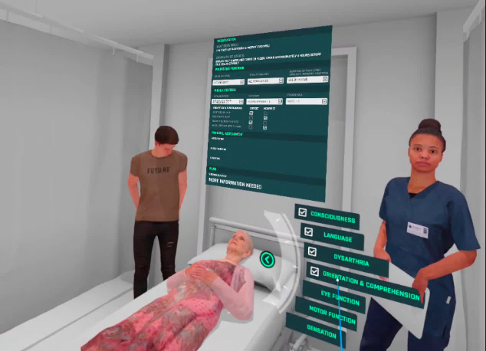
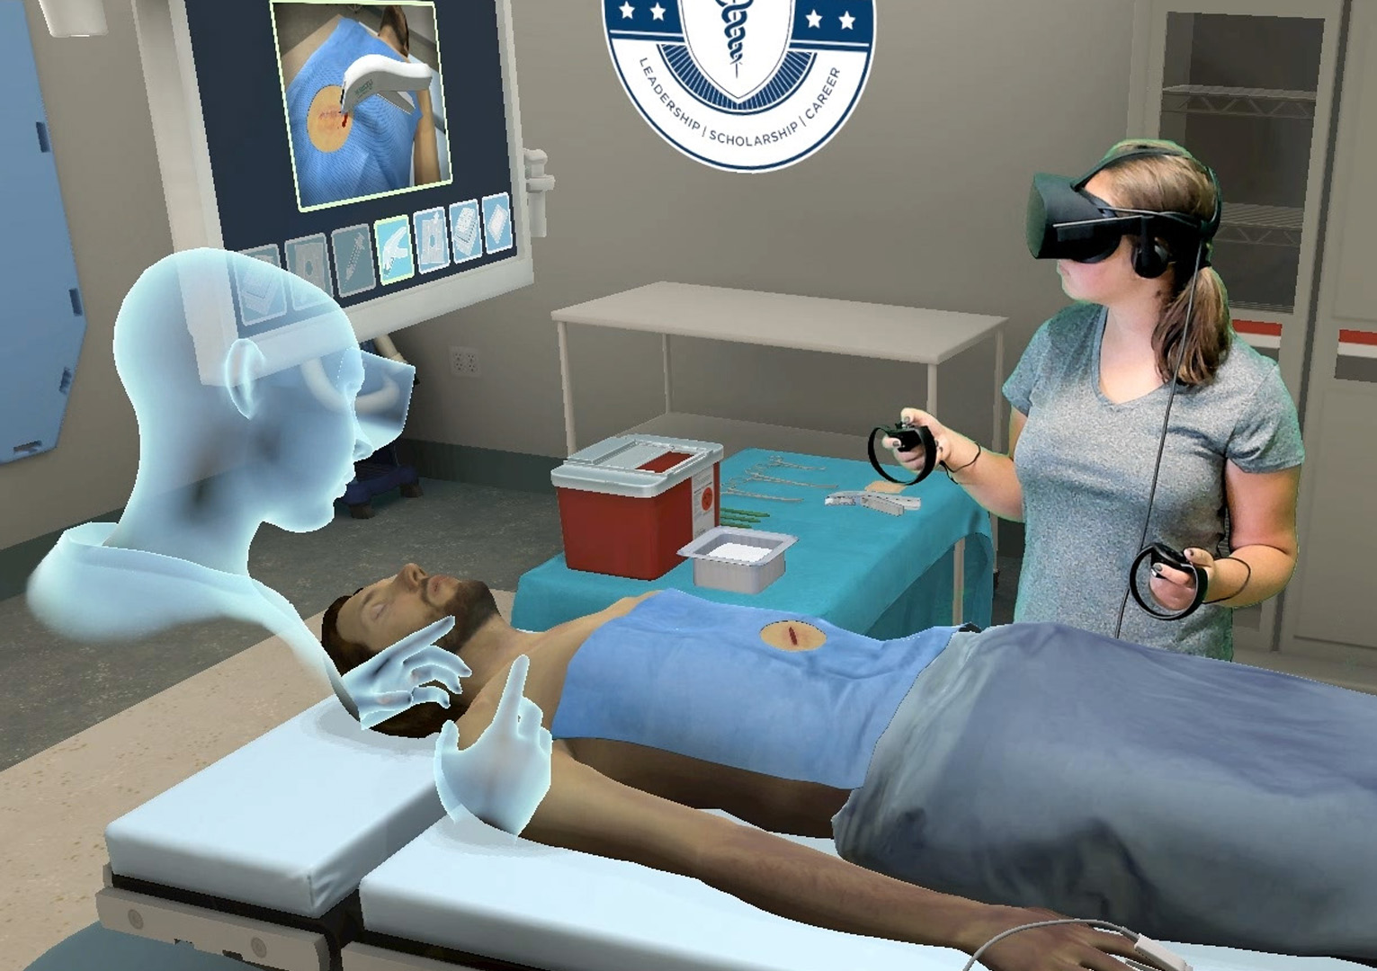
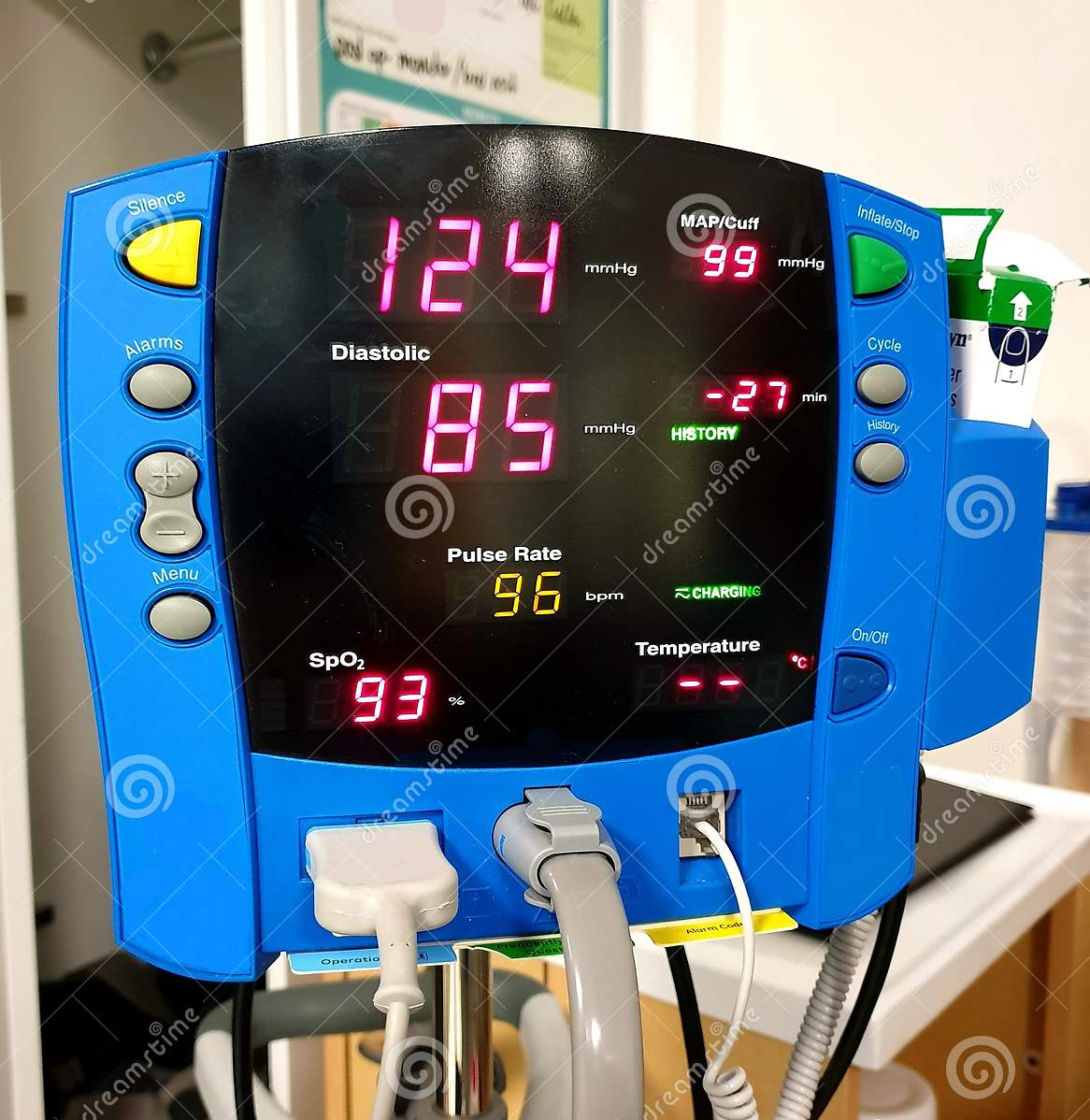
TACTICS VR: Multi-User Training
Multi-user / Team members
Visualisation of VR users and/or team avatars
Virtual Environment
Generalised clinical environment
1.
Getting to the hospital
Trainer View
Training prompts
Modifiable elements
Scene progression controls
Trainee performance
Trainee View
Overview context
Interactive elements (patient, equipment, checklists, questions)
Structured feedback (text, audio, video)
Patient
Representation clinical symptoms
User interactions for defined tasks (e.g. assessing vision, range of motion)
Relevant Equipment
Visualisation of equipment
Interactions for defined tasks (e.g. BP monitoring)

Slide 6






Acknowledgements
TACTICS VR Team (Modules 1 -3)
TACTICS Clinical Trial & TACTICS VR Module 1
TACTICS Trial Steering Committee:
Prof Christopher Levi
Dr Andrew Bivard
L/Prof John Attia
Prof Chris Bladin
Prof Stephen Davis
Prof Chris Paul
A/Prof Bruce Campbell
Prof Mark Parsons
Dr Rohan Grimley
Prof Craig Anderson
Prof Geoffrey Donnan
A/Prof Tim Kleinig
Prof Neil Spratt
Dr Andrew Wong
Dr Candice Delcourt
Contact:
Tacticsvr.com.au
ATS@Newcastle.edu.au
NSW Agency for Clinical Innovation:
Kate Jackson
Rimen Lim
Briony Van Galen
Courtney Dixon
Skye Russell
Natalie Wilson
NSW Telestroke Service:
Prof Ken Butcher
Dr James Evans
Dr William O’Brien
HNELHD Stroke Service:
Dr Carlos Garcia-Esperon
Prof Neil Spratt
Advanced Training Systems:
Prof Rohan Walker
A/Prof Eugene Nalivaiko
Dr Steven Maltby
Dr Rebecca Hood
Dr Angela Keynes
Dr Murielle Kluge
Funding Organisations:
NSW Agency for Clinical Innovation
NSW Agency for Clinical Innovation:
Natalie Wilson
Kate Jackson
Briony Van Galen
Local Health Districts:
Kylie Tastula
Sheila Jala
Elizabeth O’Brien
Amanda Buzio
Cecelia Duley
Emily Kershaw
Kirsty Page
Jacci Watson
Michelle Russell
Sally Ormond
Prof. Neil Spratt
Dr. Carlos Garcia-Esperon
Prof. Christopher Levi
Advanced Training Systems:
Prof Rohan Walker
Dr Steven Maltby
Dr Murielle Kluge
Funding Organisations:
NSW Agency for Clinical Innovation
TACTICS Trial Management Team:
Prof Christopher Levi
Dr Andrew Bivard
Prof Chris Paul
L/Prof John Attia
Sarah Kuhle
Martine Cox
Annika Ryan
Olivia Whalen
Dr Candice Delcourt
Alejandra Malavera
Luke Hatchwell
TACTICS Trial Funding Organisations:
The University of Newcastle
National Health and Medical Research Council
Queensland Department of Health
Apollo Medical Imaging Technology Pty Ltd
Boehringer Ingelheim
Hunter New England LHD
TACTICS Trial Supporting Organisations:
Hunter Medical Research Institute
Centre for Advanced Training Systems
The George Institute for Global Health
University of New South Wales
Support from the users, site coordinators & clinical staff

Slide 7

TACTICS VR Team (Stroke Paramedic Module)
Chief Investigators:
Prof. Neil Spratt
Dr. Carlos Garcia-Esperon
Prof. Rohan Walker
Prof. Christopher Levi
Prof. Jennifer Majersik
Dr. Andrew Sutherland
Dr. Christopher Oldmeadow
A/Prof. Kenny Lawson
Prof. Christine Paul
Dr. Rosemary Carney
Associate Investigators:
Dr. Sarah Edwards
Steven Faddy
Jordan Emery (-> Stewart Clarke / Susan Dorahy / Philip Walker)
Dr. Lisa Dark
Dr. Steven Maltby
Kate Jackson (-> Natalie Wilson)
Prof. Mark Parsons
Prof. Ken Butcher
Allan Loudfoot
Dr. Matthew Shepherd
Michelle Russell
Support from the users, site coordinators & clinical staff
VR Content Input:
Philip Walker
Dylan Snape
Martin Nichols
Michael Suen
Trent Crosdale
Karli Perry
Alecia Saladine
Joel De Zuna
Funding = Hunter New England Local Health District Telehealth Research Initiative (2021 – 2023)

Slide 8
TACTICS VR: Co-development Process
TACTICS VR – Development Process
INITIATION
SCOPING & DESIGN
VR DEVELOPMENT & TESTING
IMPLEMENTATION & MONITORING
Project Conception
Project Scoping
Macro Level Design
Detailed Script
VR Scoping & Storyboard
VR Coding
Internal Testing (Alpha / Beta Versions)
Final Module
Roll-out
Training module development via a structured step-wise process to ensure content is evidence-based and fit-for-purpose
Extensive expert input informs content development / priorities:
  Clinical Stroke experts – perspectives of stroke identification, screening & assessment
  Paramedic / Ambulance experts – perspectives on pre-hospital workflow & processes; transport decision-making; training / education integration
  Technology Experts – VR developers, videographer

Slide 9

TACTICS VR: Training Solution
High-quality procedural training guided by national health experts
Place this into an immersive virtual learning environment
Flexible delivery of training technology to rural, remote and regional sites
A package that is affordable, simple to use, simple to access and can be on site all the time

Slide 10

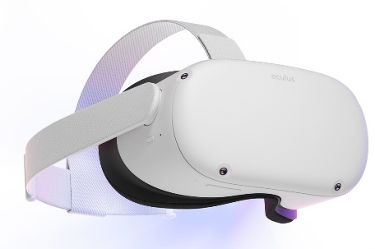
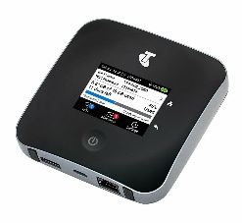

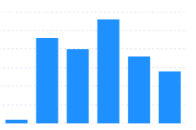
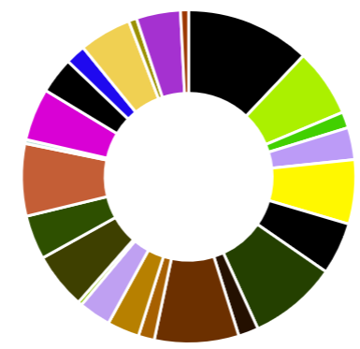
TACTICS VR: Data Workflow
Standalone on-site training
Cloud-based server
Usage, demographics & training performance data
VR headset + WiFi router
Customised data storage
Feedback & continuous practice improvement
Automated data collation
Research & Implementation Teams
Reporting Portal Website
Collation, analysis & reporting
Data visualisation & export

Slide 11
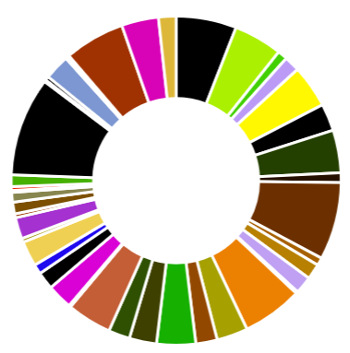

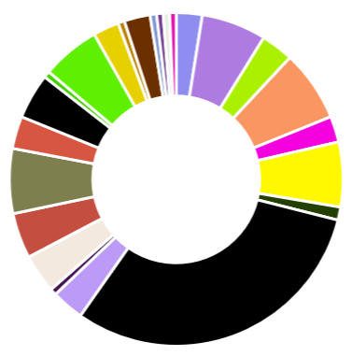

TACTICS VR: Usage Data (updated Mar 2023)
TACTICS VR Hyper-Acute Management:
  Hospitals = 36 in NSW / SA / QLD
  Sessions = 537 since October 2019
  Total training time = 199 h 46 min
  Time per session = 22 min 32 sec
TACTICS VR Telehealth:
  Hospitals = 23 in NSW / SA
  Sessions = 166 since April 2021
  Total training time = 47 h 10 min
  Time per session = 17 min 03 sec
  Would recommend = 4.6 / 5 stars (n=115)
TOTAL USAGE = 703 sessions by healthcare professionals in clinical setting
Sessions per site

Slide 12
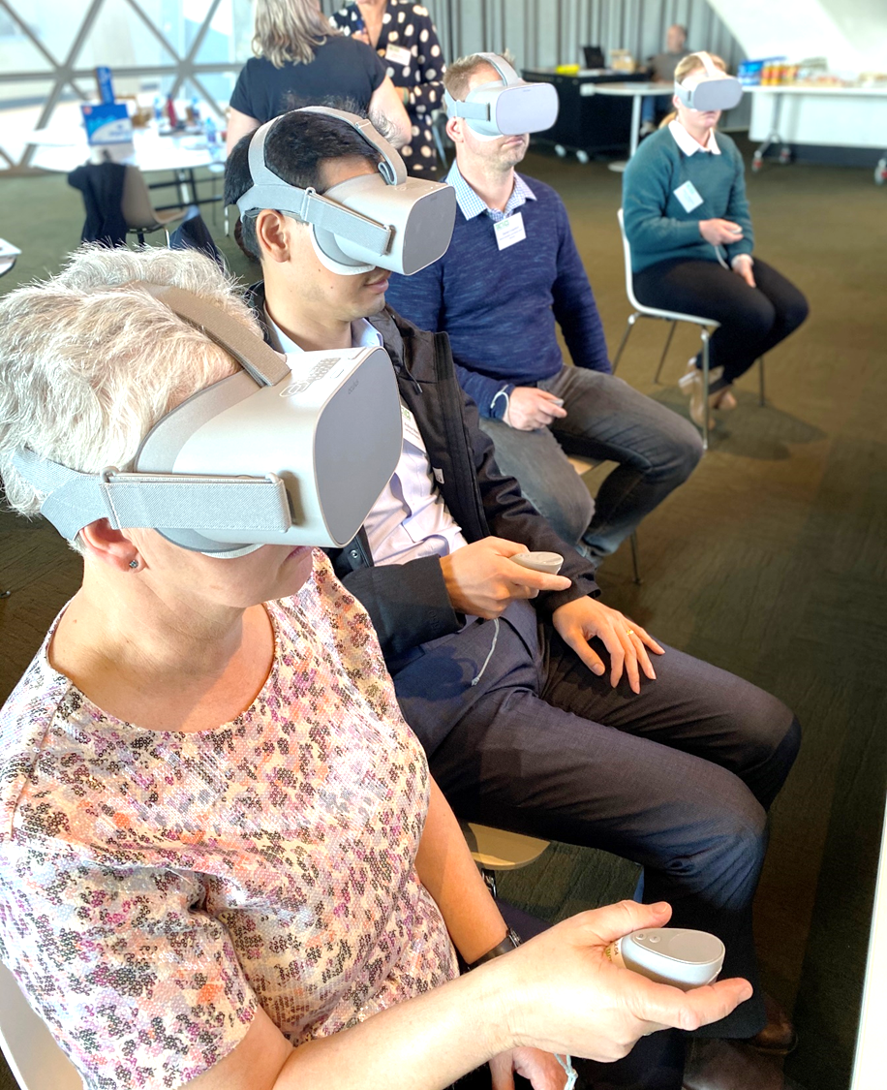
TACTICS VR: Flexible Implementation
TACTICS VR
Flexible implementation via train-the-trainer sessions face-to-face and/or remote

Slide 13
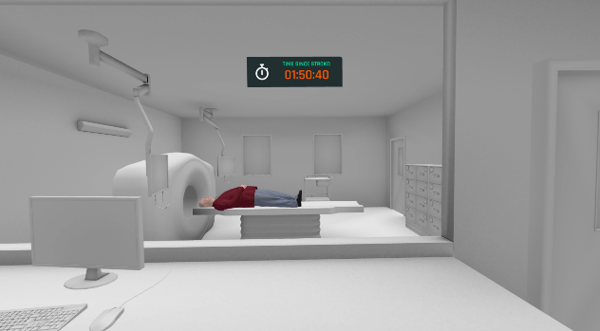
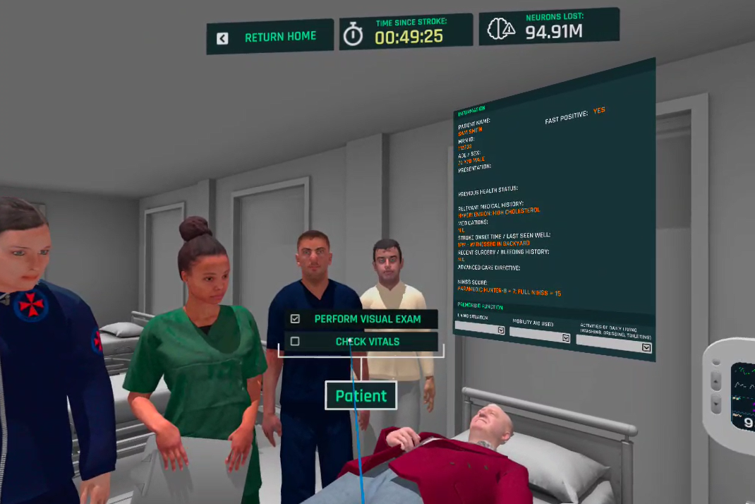
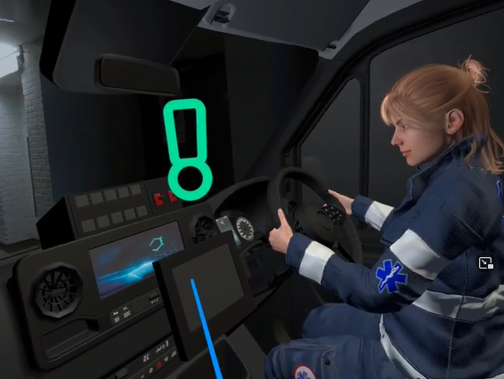
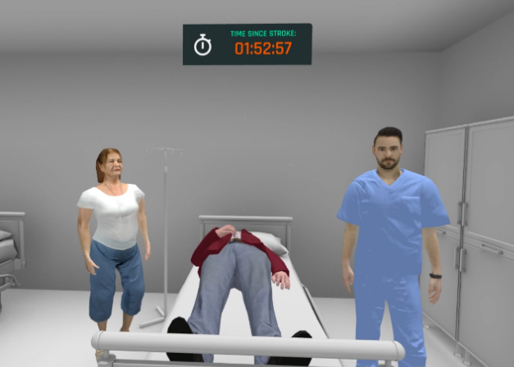
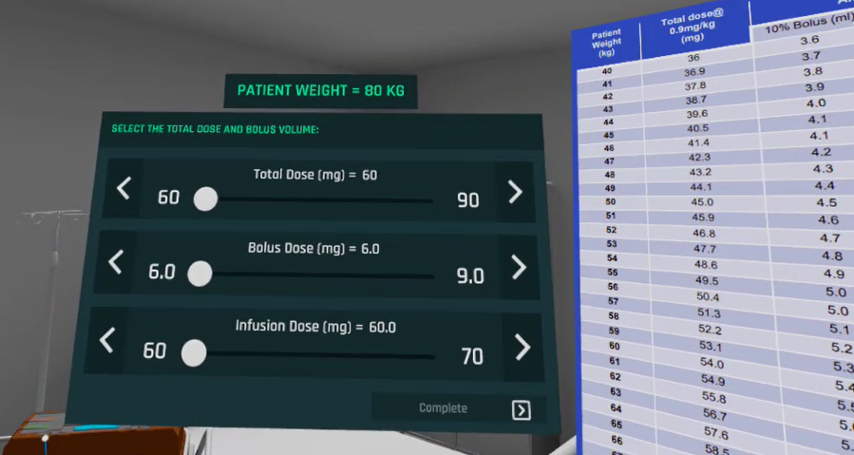
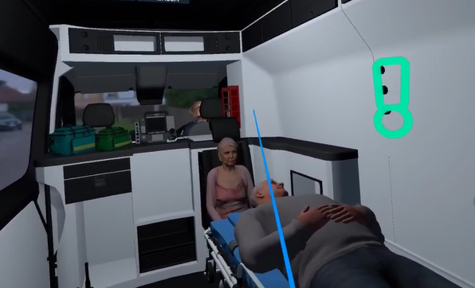
Hyperacute management for physicians

Slide 14
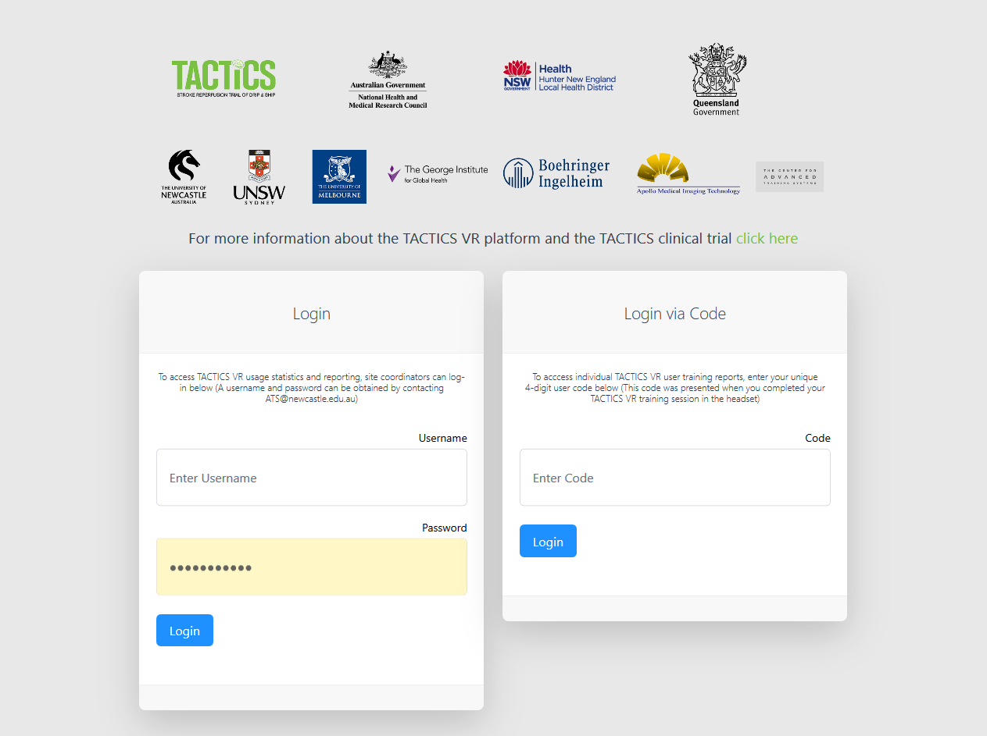
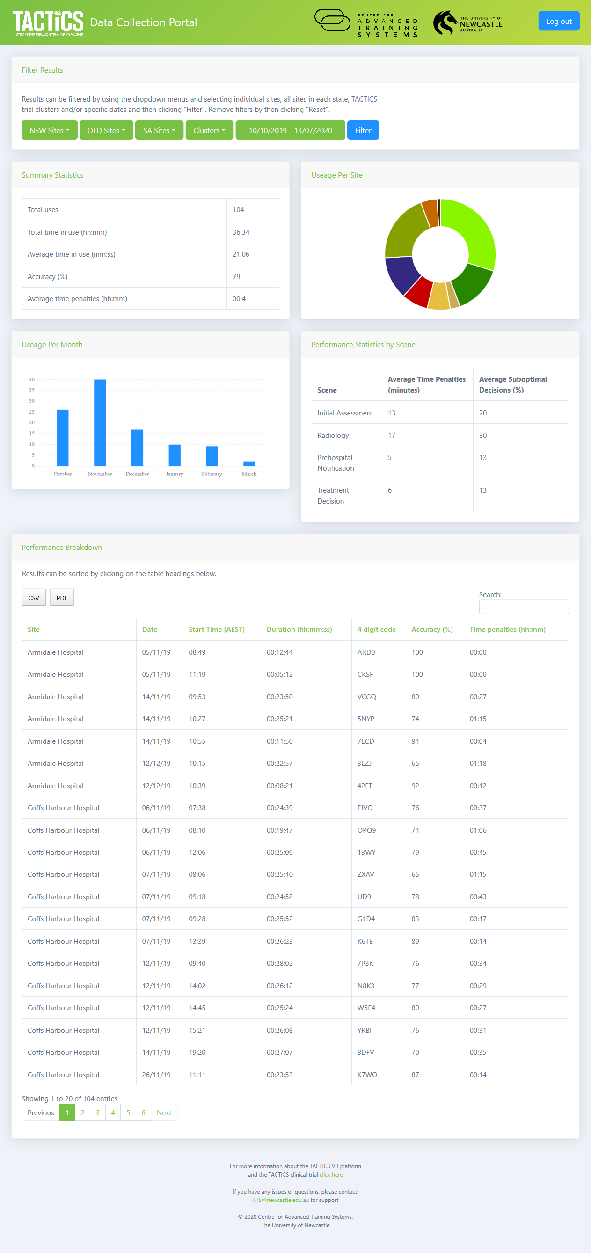
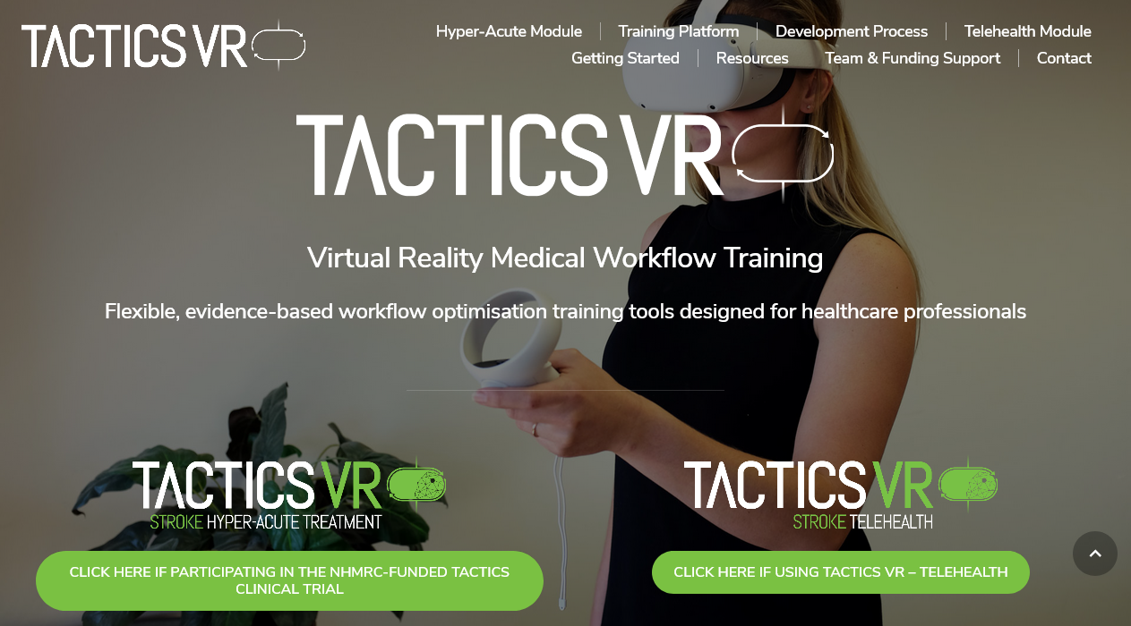
TACTICS VR: Reporting Environment

Slide 15

TACTICS VR: Module Feedback
User survey responses from TACTICS trial (n = 224)
Positive feedback on overall suitability and application features
Improved confidence in understanding stroke workflow and ability to make improvements in acute stroke care
  Particularly users with lower previous experience managing stroke (<10 patients; n=34)
Hood, Maltby et al. 2021 Frontiers in Neurology & unpublished

Slide 16
TACTICS VR: Publications
TACTICS Trial Protocol
Ryan et al. 2022 BMJ Open
TACTICS VR Implementation
(Cluster 1 Only)
Hood et al. 2021 Frontiers Neurology

Slide 17
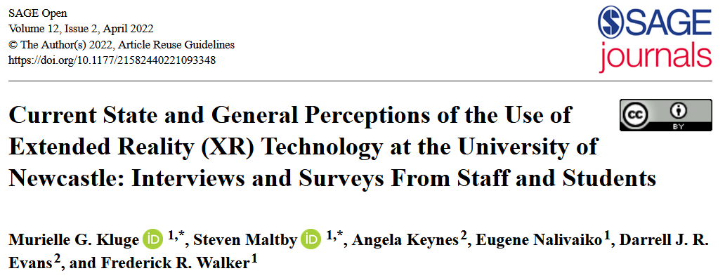
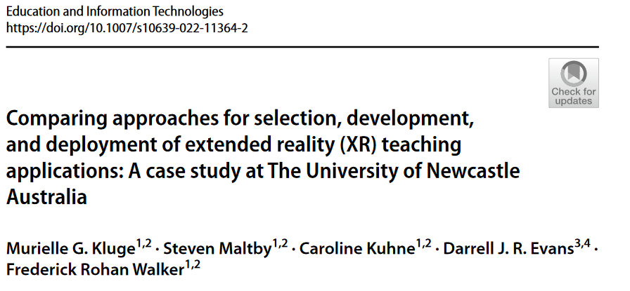
Virtual Reality @ UoN: Publications
UoN University-Wide Student & Staff Experiences & Attitudes to VR
Kluge, Maltby et al. 2022 SAGE Open
UoN Test Case for Development & Implementation of 4 VR Modules
Kluge, Maltby et al. 2022 Education & Information Technologies
Contact: Professor Rohan Walker rohan.walker@newcastle.edu.au

