Slide 1
How to access the AIR
Kaycee Wisemantel
February 2021
E: kwisemantel@hneccphn.com.au
M: 0409 148 062
WE ACKNOWLEDGE THE TRADITIONAL OWNERS & CUSTODIANS OF THE LAND THAT WE LIVE & WORK ON AS THE FIRST PEOPLE OF THIS COUNTRY.
Notes:
Thanks for the intro Mel. It’s absolutely pouring up here on the Mid North Coast where I am coming to you from the land of the Biripi people, I can hear the frogs singing. Welcome everyone, today I am going to have a chat to you about how you can get AIR access via PRODA. I’ll also discuss a couple of reports that you can generate to follow up on people who are overdue for an immunisation. My contact details are here if you need them but of course you can also contact your PCIO for assistance. Ok so let’s get started…..

Slide 2
MANDATORY REPORTING OF VACCINES TO THE AUSTRALIAN IMMUNISATION REGISTER (AIR)
Australian Immunisation Register Amendment (Reporting) Bill, entered Parliament on December 3, 2020
The Federal Government has made it mandatory to record COVID-19 vaccinations in the AIR and will gradually extend the new rule to all vaccines.
Note: Penalties apply if the vaccine provider fails to comply.
Notes:
Let’s start of with this bit of information
MANDATORY REPORTING OF VACCINES TO THE AUSTRALIAN IMMUNISATION REGISTER (AIR)
On December 3, 2020 The Australian Immunisation Register Amendment (Reporting) Bill, entered Parliament The effect of the amendments in the bill is to ensure that all vaccination providers report all vaccines given to the AIR.
This means that in the near future every Australian will be able to access their vaccine history through a safe and secure register
Whilst the Bill includes the COVID-19 vaccine from 1 March 2021, from 1 July 2021 it will be mandatory for all other vaccines to be entered
The civil penalty is 30 penalty units (equates to $6660). IF YOUR SOFTWARE IS TRANSMITTING INFORMATION TO THE AIR, IT’S IMPORTANT THAT YOU PERFROM QUALITY CHECKS TO ENSURE THAT IT’S HAPPENING. What do I mean by quality checks?? I’m so glad you asked me that question….

Slide 3
QUALITY CHECKS TO ENSURE THAT YOU ARE SUCCESSFULLY TRANSMITTING TO THE AIR
Some suggestions are:
Extract a list of vaccinations given via practice software and check those encounters against AIR, or do a random selection and check status on AIR
Extract a 10A report and compare against a list of vaccinations given via the practice software.
If THE practice receives calls from families about AIR not being up to date and they have received a letter from Centrelink then YOU CAN check YOUR practice software to ASEE whether there was an error when the vaccine was recorded or transmitted
Encourage patient to download the Medicare App and check their immunisation statement or log into MY Gov
Anyone have any other suggestions??
Notes:
Some suggestions for quality checks to ensure transmission to the AIR are:
You could extract a list of vaccinations given via your practice software and check those encounters against AIR, or you could do a random selection and check status on AIR
Extract a 10A report and compare against a list of vaccinations given via the practice software. And I’ll talk about these reports later
If you receive a call from families about AIR not been up to date and they have received a letter from Centrelink then you can check your practice software to see if there was an error when the vaccine was recorded or transmitted
Encourage patient to download the Medicare App and check their immunisation statement or log into MY Gov
Does anyone have any other suggestions??

Slide 4
NEW “SERIAL NUMBER” FIELD IN AIR SITE TO TRACK COVID-19 VACCINE
Australian A new field to capture vaccine serial number was added to the AIR site on 16 December 2020.
The addition of this field will support the rollout of COVID-19 vaccines across Australia and assist Commonwealth, State and Territory governments to track all vaccines administered to the public as outlined in the Australian COVID-19 Vaccination Policy.
At this current time, it is not mandatory for vaccination providers to record vaccine serial numbers, however further advice about recording COVID-19 vaccines on the AIR will be provided soon.
Notes:
Just as a little aside….In case you haven’t seen it, there’s now a new field to capture vaccine serial numbers. This was added to the AIR site on 16 December 2020.
This field will support the rollout of COVID-19 vaccines across Australia and assist Commonwealth, State and Territory governments to track all vaccines administered to the public as outlined in the Australian COVID-19 Vaccination Policy.
At this current time, it is not mandatory for vaccination providers to record vaccine serial numbers, however further advice about recording COVID-19 vaccines on the AIR will be provided soon.

Slide 5
WHY ACCESS THE AIR?
1. It WILL BECOME MANDATORY FOR ALL VACCINE ENCOUNTERS TO BE RECORDED ON THE AIR
2. RECORD AN ENCOUNTER
3. Update an encounter
4. view a patient’s immunisation history
(IMMUNISATION HISTORY STATEMENT)
RESOURCES to improve air data quality:
Enhancing data quality of vaccination encounters - NCIRS
Data Quality user guide - Services Australia
Notes:
WHY IS IT SO IMPORTANT THAT YOU BE ABLE TO ACCESS THE AIR and ensure that information is transmitting correctly?
The AIR is a national register that records all vaccines that are given to people in Australia
Like I’ve previously said, the Federal Government has made it mandatory to record COVID-19 vaccinations into the AIR and this will be extended to include all vaccines
. 2. RECORD AN ENCOUNTER
3 Update an encounter
4. With AIR access you have the ability to view a patient’s immunisation history. This is important as it will support your clinical decision making to ensure a person is properly vaccinated. Individuals can get a copy of their Immunisation History Statement from the Australian Immunisation Register (AIR). This can be obtained through the myGov website using their Medicare online account (Medicare linked service), or by calling the AIR on 1800 653 809 (note that it may take up to 14 days to be sent in the mail). For privacy reasons, anyone aged 14 or older can get their own immunisation history statement
The data that the AIR contains is used for a range of purposes, including:
Measuring immunisation coverage
Monitoring the effectiveness of vaccines and vaccination programs
Informing research and policy
Identifying parts of Australia at risk during disease outbreaks
Assessing eligibility for Family Tax Benefit and Child Care Subsidy payments
Facilitating entry to childcare and school, for employment and travel
There are some great resources you can use to ensure that the data you submit is correct or to clean up any errors you may find in the AIR. These resources will be available to you via the links in the presentation. The links are here on this slide.

Slide 6
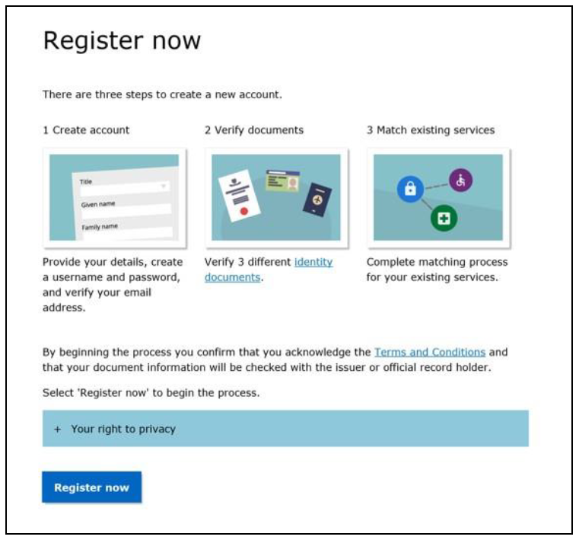
WHAT IS PRODA?
Provider Digital Access (PRODA) is an online identity proofing and authentication system that provides secure access to government online services such as Health Professional Online Services (HPOS) and Child Care Provider Entry Point (CCS).
WHAT IS HPOS?
Health Professional Online Services (HPOS) is a fast and secure way for health professionals and administrators to do business with Services Australia.
Notes:
Authentication files are being decommissioned. This means that the only way you will now be able to access the AIR is through a PRODA account and logging onto HPOS. Because I’m not sure of everyone’s understanding about what I’m talking about today I’ll just go over what PRODA and what HPOS are. (PRODA) Provider Digital Access is an online identity proofing and authentication system that provides secure access to government online services such as Health Professional Online Services (HPOS) and Child Care Provider Entry Point (CCS). PRODA enables secure access to a range of government online services. It verifies an individual’s identity and verifies an organisation against information on the Australian Business Register (ABR).
HPOS is the acronym for Health Professional Online Services and it’s a fast and secure way for health professionals and administrators to do business with Services Australia.

Slide 7
DO YOU HAVE A PRODA ACCOUNT?
Go to servicesaustralia.gov.au/PRODA to start the PRODA registration process
RESOURCES:
More information about PRODA and how to register is available on the Services Australia website.
Adding and linking to HPOS for AIR
Notes:
Last year, on the 7th December the PHN hosted an Immunisation Update in conjunction with the Immunisation Team at the Public Health Unit. In the update Lauren Dalton from NCIRS provided participants with an analogy that a PRODA account is similar to the OPAL Card that you use to get onto public transport and I totally agree. I liken PRODA to being a key that gets you into the door which holds HPOS (which is where AIR sits)
If you haven’t already created a PRODA account, it takes about 20 minutes and you need 3 forms of identification.
Please note that when proving your identify you need to :
Create your account using your current legal name, as shown on your identity documents. The names you input will be used to verify your identity documents at a later step and inconsistencies will result in verification failure.
If your current name is different to the name on any of your documents you will need to provide either an official marriage certificate or a change of name certificate (issued by state or territory Registry of Births, Deaths and Marriages).
Once your identity has been confirmed an Registration Authority (RA) number will be issued to you via email– you need to keep this number as it is used to link and access services
GPs (and Nurse Practitioners and Midwives who have a provider number) can now access Australian Immunisation Register (AIR) with their Provider Digital Access (PRODA) account through Health Professional Online Services (HPOS). So under resources on this slide theres a link to the Services Australia website that links you to a page on how to do the linking
Nurses and other support staff working within general practice need to be a “Delegate” of a GP to have access to the Australian Immunisation Register (AIR), among other delegation functions. The AIR can then be accessed by the delegate to act on behalf of the health care professional
Once you’ve created an individual PRODA account as a GP: Link provider number to services to show in HPOS (initial set up). AIR tile will now appear
Nominate a delegate OR
If you’re a Nurse/practice manager/Support Staff: Login to PRODA –HPOS and you can then Request delegations to AIR
If a nurse or another staff member is delegated access by the GP or Practice then that person is still logging in as an individual and acting on behalf of the GP or organisation. As such, any action on the AIR by this person can be traced. The delegations can be removed at any time and do expire after 12 months and need to be re-established.

Slide 8
PRODA FOR INDIVIDUAL V PRODA FOR AN ORGANISATION
PRODA INDIVIDUALS
Easy to set up (GP’s already have access)
Access to air10a reports
Nurses and support staff ARE DELEGATED TO act on behalf of an individual gp
PRODA ORGANISATION
Need to register business with proda
Need to set up each gp and other staff against the business
No access to air10a reports
Resources:
Accessing AIR using PRODA for individuals - Services Australia
Accessing AIR using PRODA for organisations - Services Australia
Supporting and understanding delegations in HPOS to access AIR - NCIRS
Notes:
So there’s 2 types of PRODA accounts that you can set up to use in general practice one is for an individual and the other is for an organisation
individual delegations are easier if you’re working in general practice;
Easy to set up (GP’s already have access)
Access to air10a reports
Nurses and support staff can act on behalf of an individual gp
THE BENEFITS
Delegating access to the AIR for nurses and support staff will enable them to access the AIR on a providers behalf.
Delegates have access to a range of HPOS functions and information held by Services Australia. Access is controlled by the healthcare professional .
And PRODA for an ORGANISATION
Need to register business with proda
Need to set up each gp and other staff against the business
No access to air10a reports
At the bottom of the page here I’ve added some resources that you can use to help you with this process

Slide 9
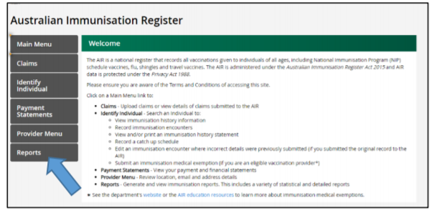
Generate Reports:
PRODA INDIVIDUALS AIR OVERDUE IMMUNISATION
AIR10A due and overdue report – services Australia
National due and overdue rules – services Australia
Notes:
The AIR produces statistical and identified reports for recognised vaccination providers, when you have Individual PRODA access to the AIR via HPOS you can request reports one of these that we recommend is the Overdue AIR10A report. The AIR010A report identifies patients due/overdue for immunisation, for all providers linked to the one PIP practice ID. You can use this report to identify and recall patients due/overdue for immunisation or identify transmission errors and missing information from AIR. . The information can be broken down by MBS service date range. Only accredited practices can access the 10A report. All other practices can use the 11B report which will list all overdue patients linked to one specific provider. I have provided links available from Services Australia regarding the AIR10A due and overdue report and the National Due and Overdue rules however I also have some “cheat sheets” available to guide you through all that we’ve discussed today that we can send out with the presentation or they can also be sent to you from your PCIO.

Slide 10
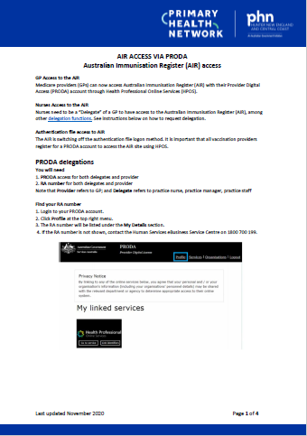
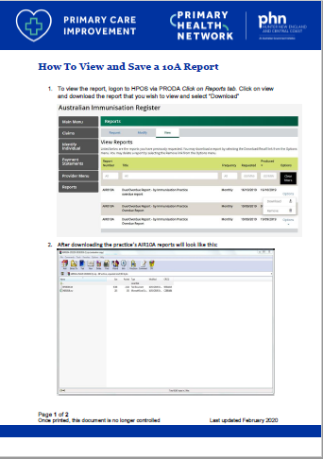
CHEAT SHEETS
Notes:
Here’s an example of some of the cheat sheets we have available to help you through everything we’ve discussed today

Slide 11
EDUCATION MODULES
ELEARNING PROGRAM
AUSTRALIAN IMMUNISATION REGISTER FOR VACCINATION PROVIDERS
Notes:
Elearning Modules are available through the Services Australia website to help you understand how to access and record information on the AIR
The program covers:
accessing the AIR for the first time
submitting information to the AIR
overseas immunisations
immunisation medical exemptions.
I suggest you take a look at the submitting information to the air module

Slide 12
QUESTIONS??
Notes:
A few questions have been emailed to me
One nurse asks: Do you think nurses will ever be able to go on AIR without having to be delegated by a GP? Can be frustrating getting then to set it all up.
The answer to this is Unfortunately no. Nurses and support staff are unable to access the AIR site without being a delegate as they do not have a Medicare provider number.
Another question sent in was from a Practice Manager: If I register my organisation and link my RN’s to that do I still need to get my GP’s to set up individual PRODA accounts and delegate to staff ?
Once you register the business with PRODA, you do not need to get the individual GPs to create their own PRODA accounts unless they wish to access HPOS themselves. You can then set the nurses and any other support staff linked to the practice against the business.
As I said earlier; The AIR suggests that individual delegations are much easier as:
the GPs already have access
there’s access to the 10A reports and
individuals are delegated to act on behalf of an individual GP.
Q. Should practice nurses and practice managers acquire delegation from each GP in the practice they are working?
Yes. The delegate logs on to AIR via PRODA and selects the GP they are acting on behalf of.
Q. How can I send a secure email to AIR if I am a GP, Practice Nurse or Practice Manager?
Use the HPOS Messages tile. Documents can be attached to the message. The medical practitioner needs to tick “My mailbox” in the HPOS delegations options to delegate access to the practice nurse.

Slide 13
SAVE THE DATE!!
Notes:
Thanks for joining me to day and I certainly hope you feel a bit better about how you can get access to the AIR.
Don’t forget to save the date from Friday 10th to Saturday 11th September for our 2021 Immunisation Conference – “Coast to Country” hopefully we will be able to get together but if not we are also looking at an online forum with world renowned presenters. Please don’t hesitate to get in contact with me or your PCIO who will be more than happy to provide you with assistance.

