Slide 1
Child & Adolescent
Mental Health Services
Referral Pathways
20th May 2021

Slide 2
Over 12 years of age
Referral Pathway for GP’s
GPLO: Olivia Gregg
Available Monday to Friday 8am to 4:30pm
Consultation and Liaison is available via 0458 786 186
Referrals to be faxed to 4304 7800
Only referrals that meet CAMHS criteria will be offered a Mental Health Assessment
A triage will be completed over the phone with young person/carer
GP will be informed of assessment date and time
Following the assessment GPLO will inform GP of outcome of assessment

Slide 3
Over 12’s Referral
Mental Health Triage Access Line 1800 011 511
A trained clinician will answer the call take details of young person
The young person will be contacted and a triage completed
Referrals that are Triaged as Category E will then be forwarded to the Assessment team at CAMHS
A assessment will be scheduled within 14 days of the referral being received
Post the assessment GPLO will inform the GP of the outcome (if the referral has been made by the GP)

Slide 4
Over 12’s Referral
Referring the client to Gosford or Wyong ED
If there are serious and immediate risk concerns please advise young person and family to attend ED
The young person will be triaged, and a mental health assessment will be completed
The young person may be referred back to the GP, PAHCP, CMO or to CAMHS
If suitable for a CAMHS the young person will be allocated to a CAMHS Clinical Team

Slide 5
Under 12 years of Age Referrals
Please complete the Under 12 referral form available on Health Pathways and fax to 4304 7800
If unable to access the form please call CAMHS on 4304 7878 and an admin officer will fax or email a referral form
Referral will be discussed at the Under 12s Intake Meeting daily
If appropriate for a MH assessment the family will be contacted to arrange a MH assessment which will determine suitability for allocation to the Under 12s Team
If the referral is not accepted the GP will be provided with alternate recommendations for the family

Slide 6
Under 12’s Service
The GP will be informed re the assessment date and time for the young person
GPLO will liaise with the GP following the assessment to inform of the plan for the young person

Slide 7
Thank You

Slide 8
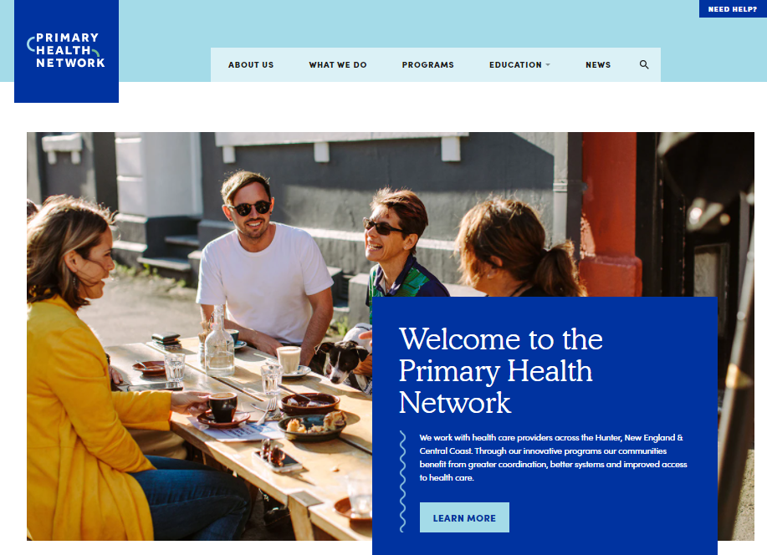
Central Coast HealthPathways
Erica Drew
20 May 2021
WE ACKNOWLEDGE THE TRADITIONAL OWNERS & CUSTODIANS OF THE
LAND THAT WE LIVE & WORK ON AS THE FIRST PEOPLE OF THIS COUNTRY.

Slide 9
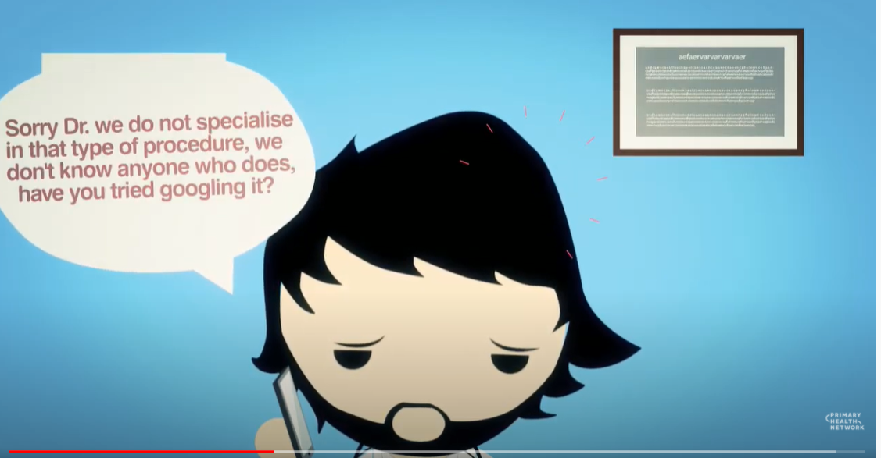
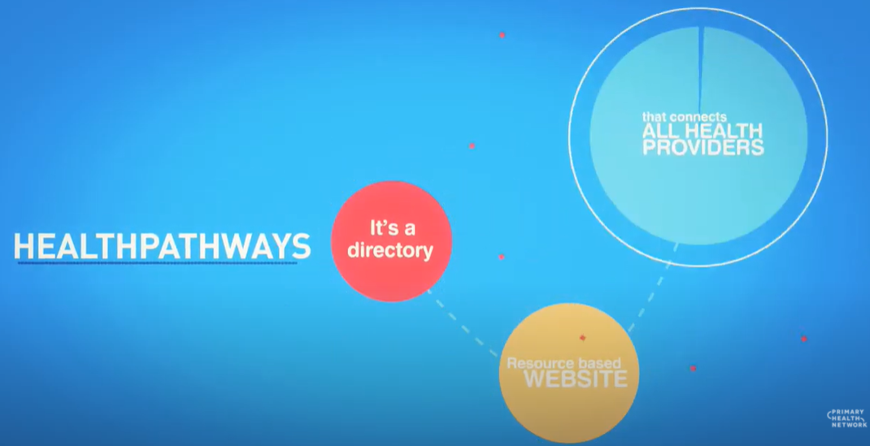
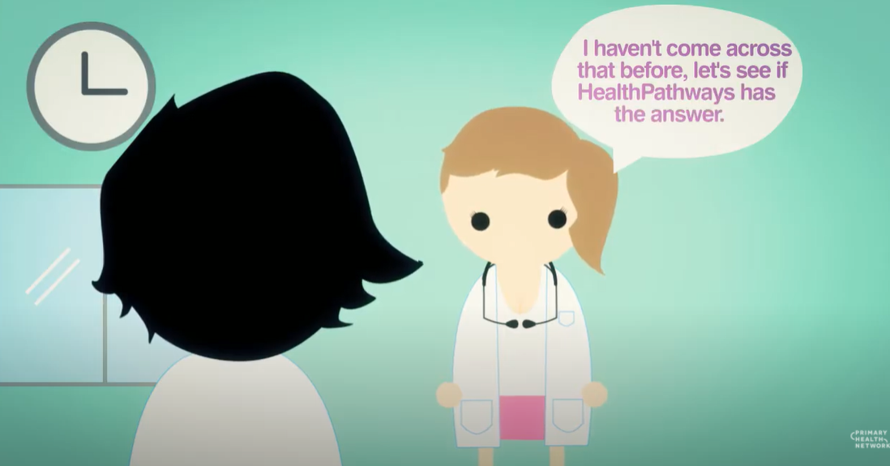
Online health information portal for clinicians to be used at the point of care
Provides information on how to assess, manage and refer patients to local specialists and services in the most appropriate and timely way.

Slide 10


http://ccpatientinfo.org.au
Open access
Notes:
HealthPathways is an online health information portal for GPs and other primary health clinicians to be used at the point of care. It provides information on how to asses and manage medical conditions, and how to refer patient to local services and Specialists.
The COVID-19 Initial Assessment and Management pathways provide the appropriate links and resources for supporting people with a disability during COVID.
The HealthPathways teams are currently finalizing the Intellectual disability suite of pathways and the referral pages to the Specialist Intellectual Disability Services.
In order to continue to support GPs working with patients in Residential Disability Care Facilities the PHN are setting up a Community of Practice for clinicians and led by clinicians. If you are interested in joining the COP please articulate this on the evaluation form or you can contact the PHN.

Slide 11
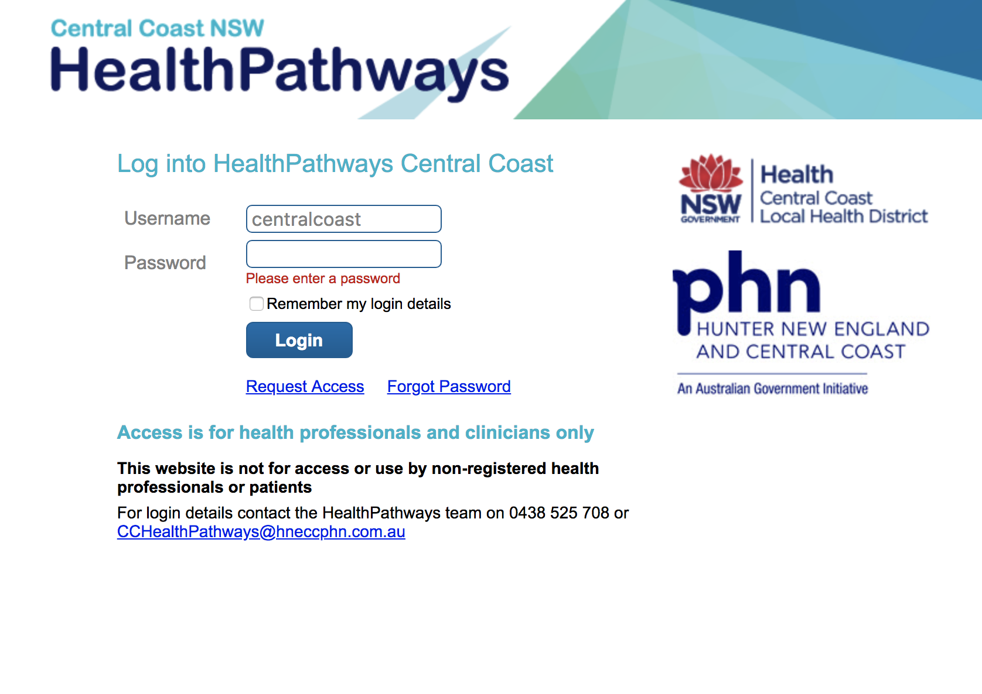
1connect
Notes:
So lets look at the site
Access to the site is simple - On your own device or desktop.
A search for CC HealthPathways, first time you’ll be asked for a login – request access and we will send you these.
Site is intended for Health Professionals.

Slide 12
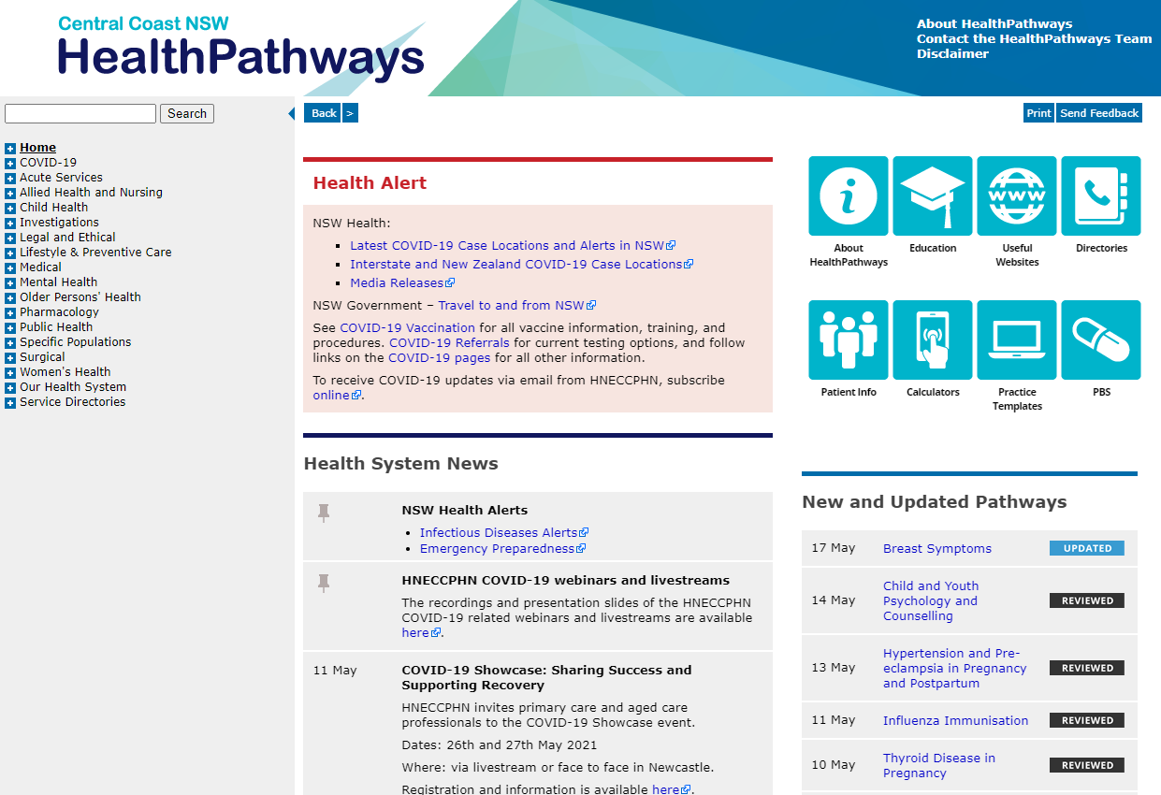
Notes:
This is our Home page
Full table of content and search function to find what you are looking for.
Health Alerts and a News feed.
Information on progress of work, we publish when new pathways have been added, what pathways have been reviewed and updated.
I have purposely opened the COVID-19 pathway section – as mentioned we have learnt from this experience and impacted on thinking for how we develop pathways in the future.

Slide 13
Relevant HealthPathways
Central Coast HealthPathways – https://centralcoast.healthpathways.org.au/
Username: centralcoast Password: 1connect
Clinical pathways
Behavioural Concerns in Children
Developmental Concerns in Children
Acutely Disturbed Young Person
Anxiety in Children and Youth
Depression in Children and Youth
Obsessive Compulsive Disorder in Children and Youth
Out-of-home Care for Children and Young Adults
Youth Mental Health
Deliberate Self-harm
Suicidal Ideation and Intent
Psychosis
            Antipsychotic Medication
        Comparison of Adverse Effects of Some Antipsychotics
Child Abuse and Neglect

Slide 14
Relevant HealthPathways
Central Coast HealthPathways – https://centralcoast.healthpathways.org.au/
Username: centralcoast Password: 1connect
Referral pages
Child Developmental and Behavioural Assessment
Child and Youth Mental Health Assessment
Child and Family Community Mental Health Support
Child and Youth Psychology and Counselling
Child Health Community Support Programs
Online Mental Health Therapy for Children and Youth
Psychiatrist Assessment
Mental Health Helplines
Scheduling a Patient
Child Protection Reporting
Allied Health, Nursing, Pharmacy, and Dental Directories

Slide 15
Relevant HealthPathways
Central Coast HealthPathways – https://centralcoast.healthpathways.org.au/
Username: centralcoast Password: 1connect
Clinical pathways – draft pathways soon to be published to live site
ADHD in Children and Youth
        ADHD Medications for Children
Autism Spectrum Disorder

Slide 16
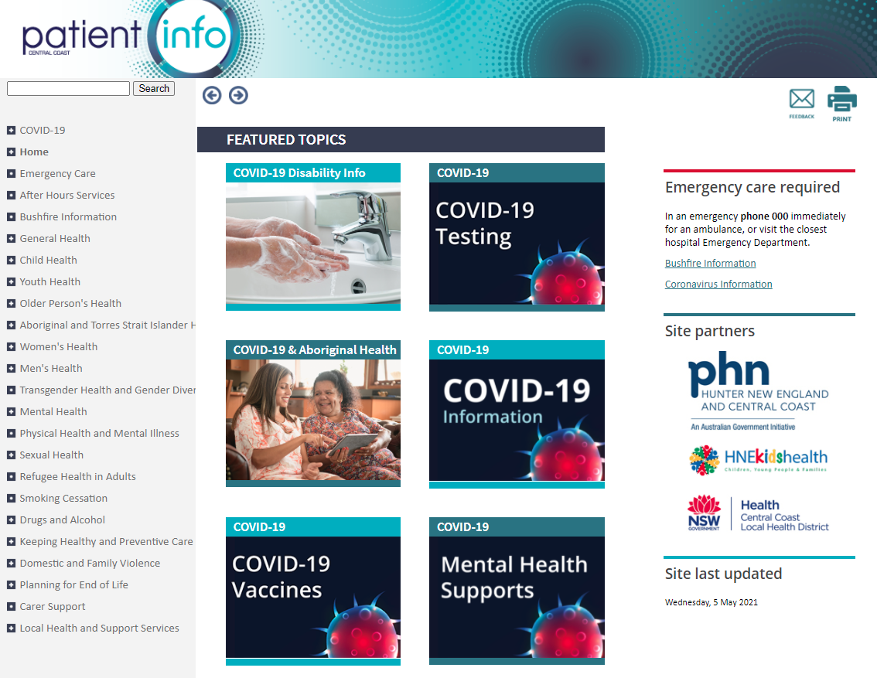
Central Coast PatientInfo https://www.ccpatientinfo.org.au/
Notes:
Patientinfo is a site for consumers to access information regarding a range of clinical conditions that have been assessed for appropriate health literacy. We have developed a number of feature topics during the COVID period notably the COVID-19 Disability Info topic which provides links to a range of resources, including ‘easy read’ and information for carers.

Slide 17
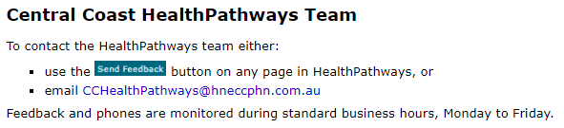
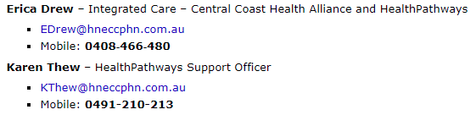
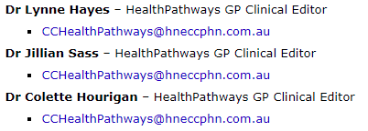
CONTACT US
Notes:
Patientinfo is a site for consumers to access information regarding a range of clinical conditions that have been assessed for appropriate health literacy. We have developed a number of feature topics during the COVID period notably the COVID-19 Disability Info topic which provides links to a range of resources, including ‘easy read’ and information for carers.

