Slide 1


Stronger Together
A Multidisciplinary Approach to
Virtual Reality

Slide 2

Who we are…
Multidisciplinary, neurological rehabilitation clinic
Offer conventional, evidence-based treatment modalities
Also incorporate technologies such as:
  Virtual and mixed reality
  Icaros Core
  Powerbreathe
  Neuroflex
Physiotherapy | Speech Pathology Occupational Therapy | Exercise Physiology

Slide 3

Virtual Reality and Mixed Reality
What exactly is it?
The use of computer technology to create a simulated environment
Able to interact with the environment via handheld controllers or hand-tracking technologies
Mixed reality combines the real world with computer generated content

Slide 4
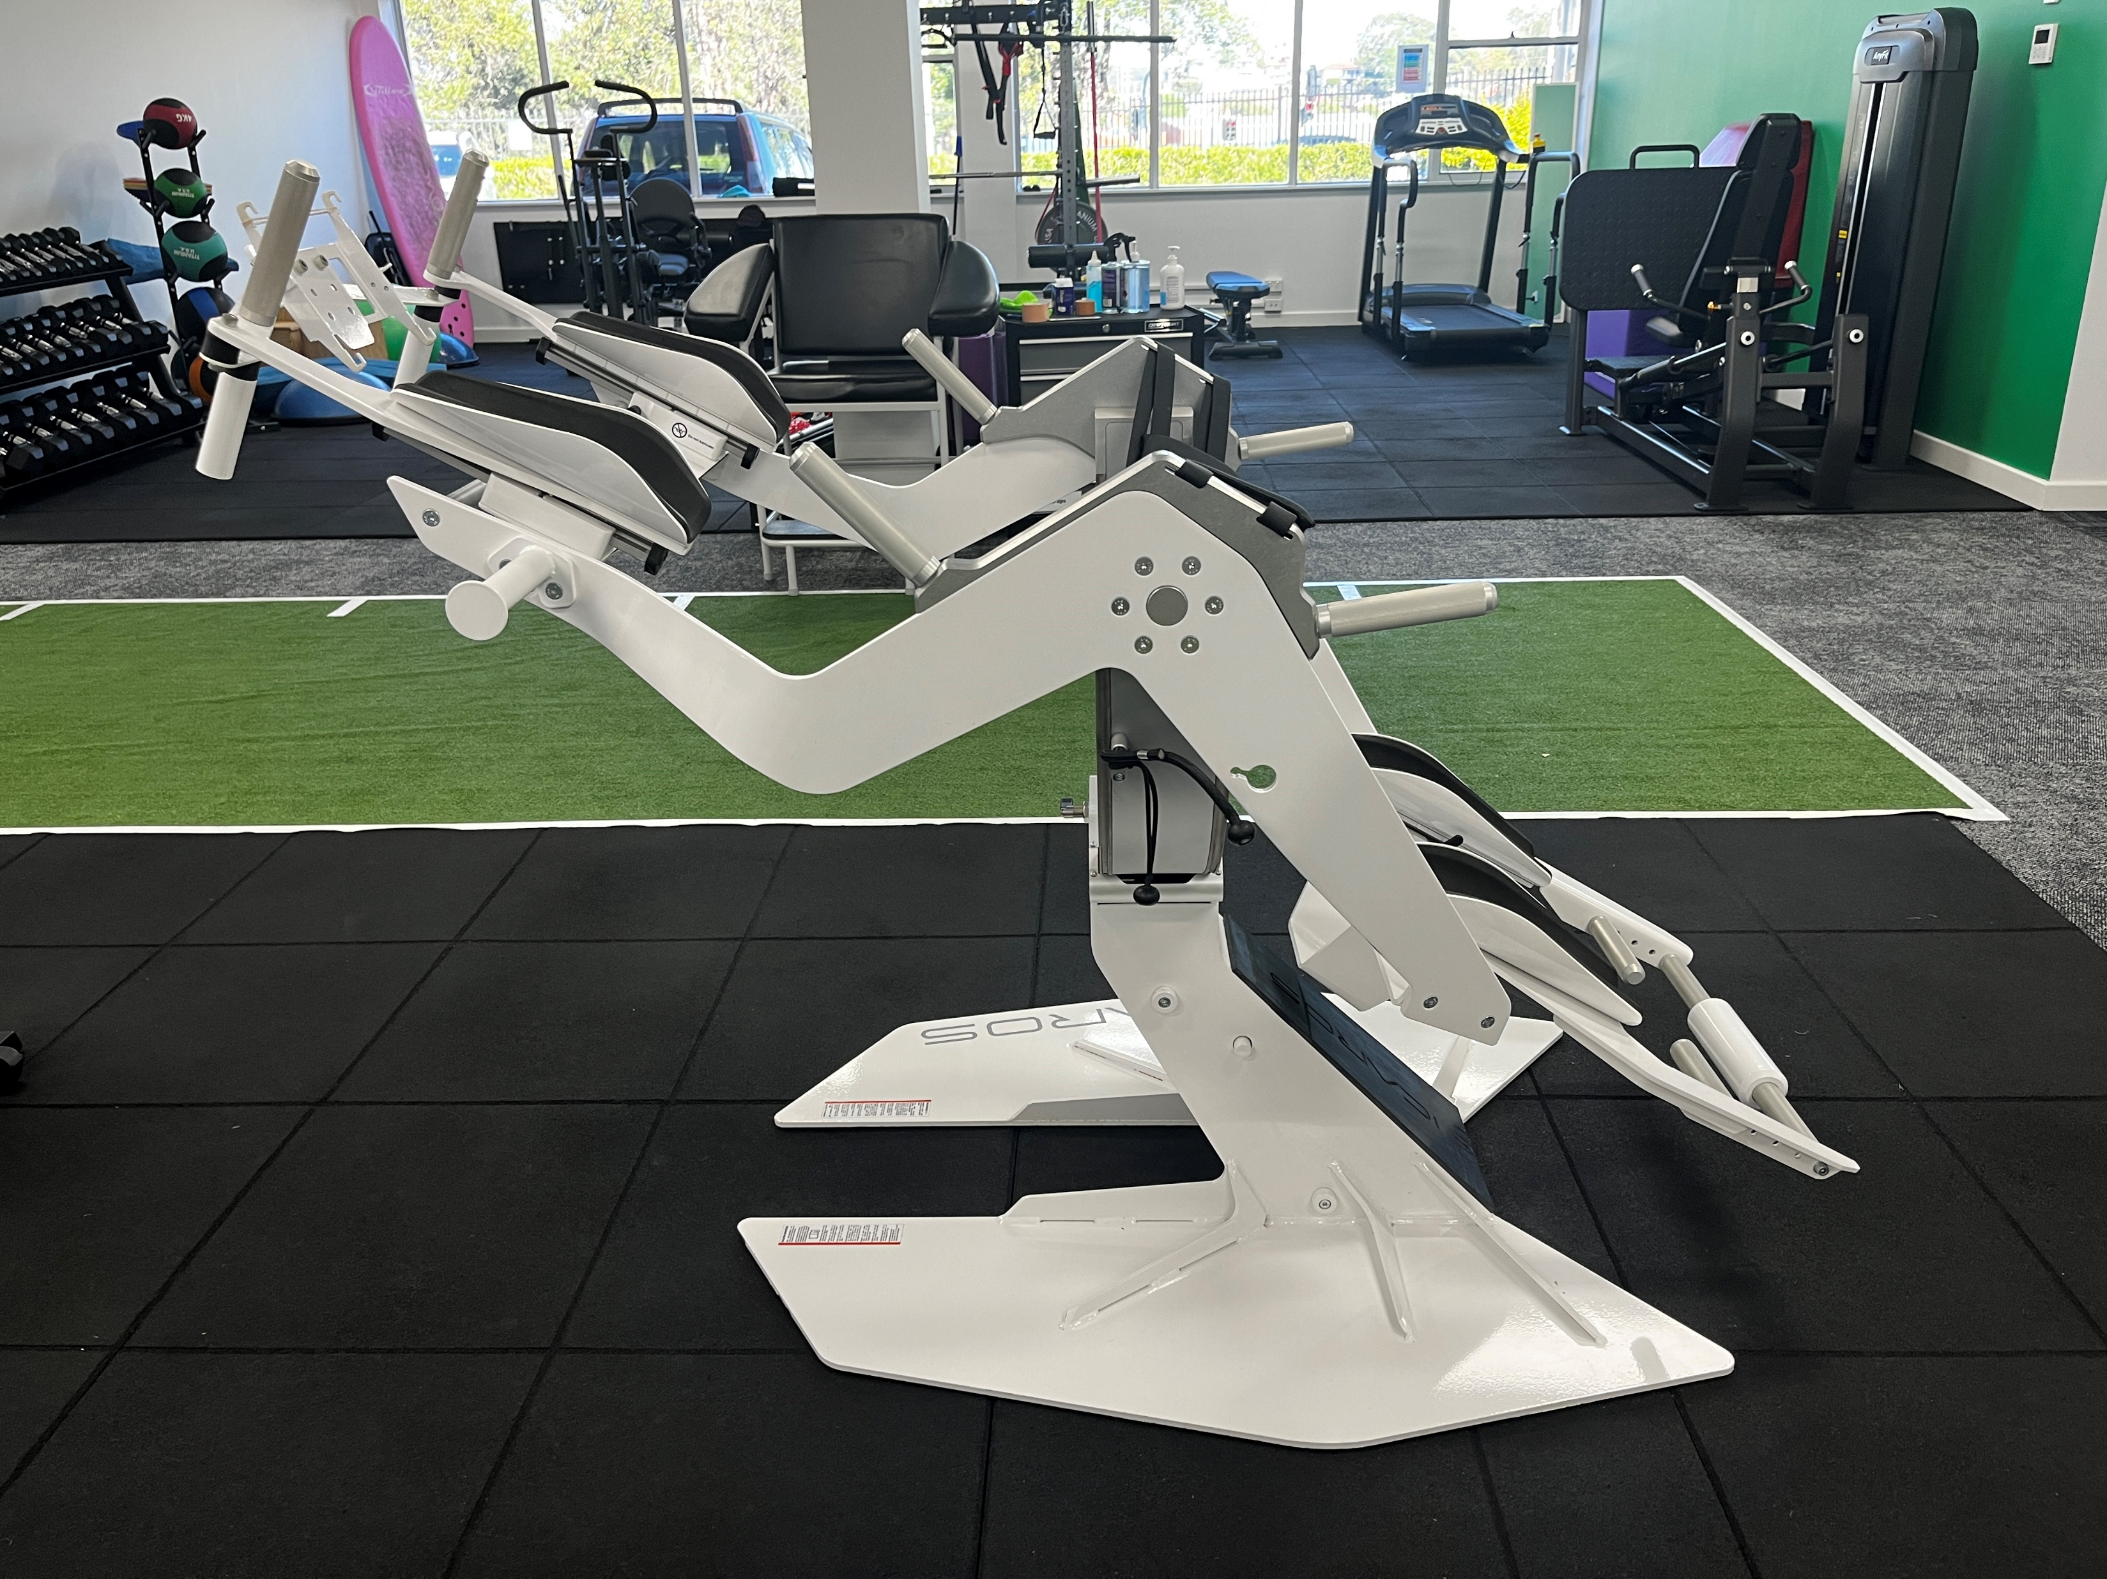
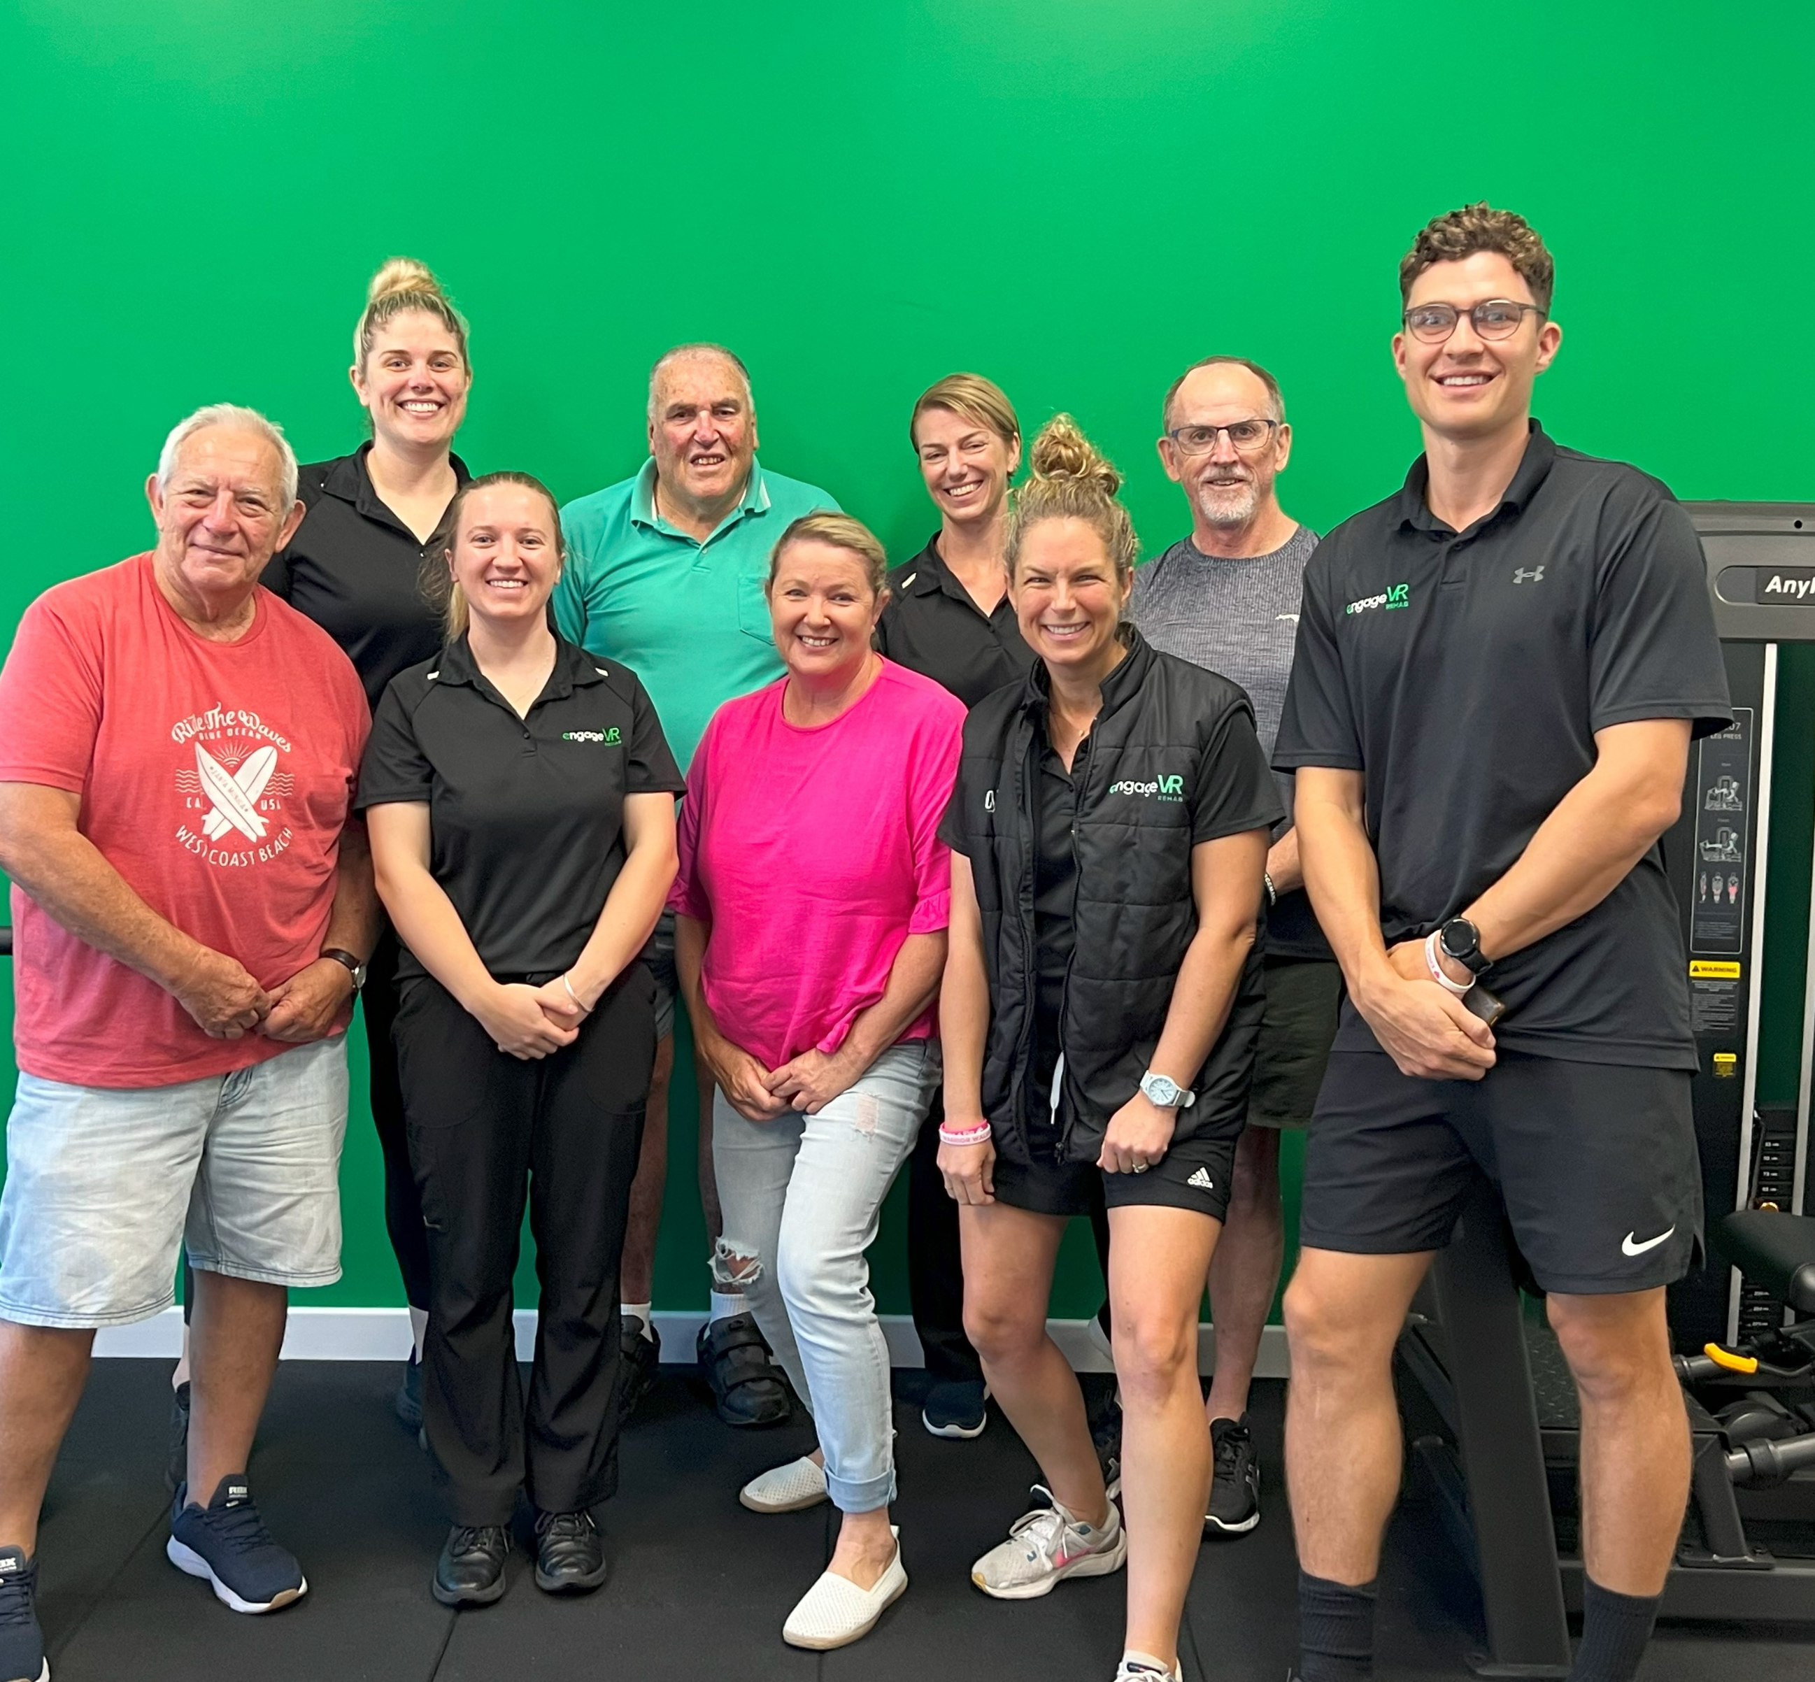
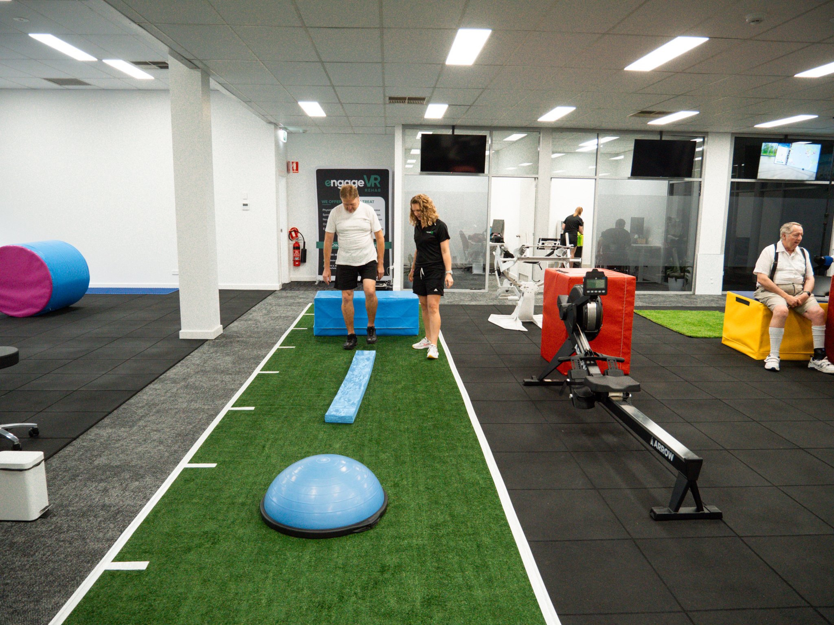
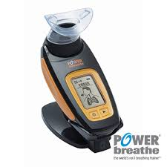
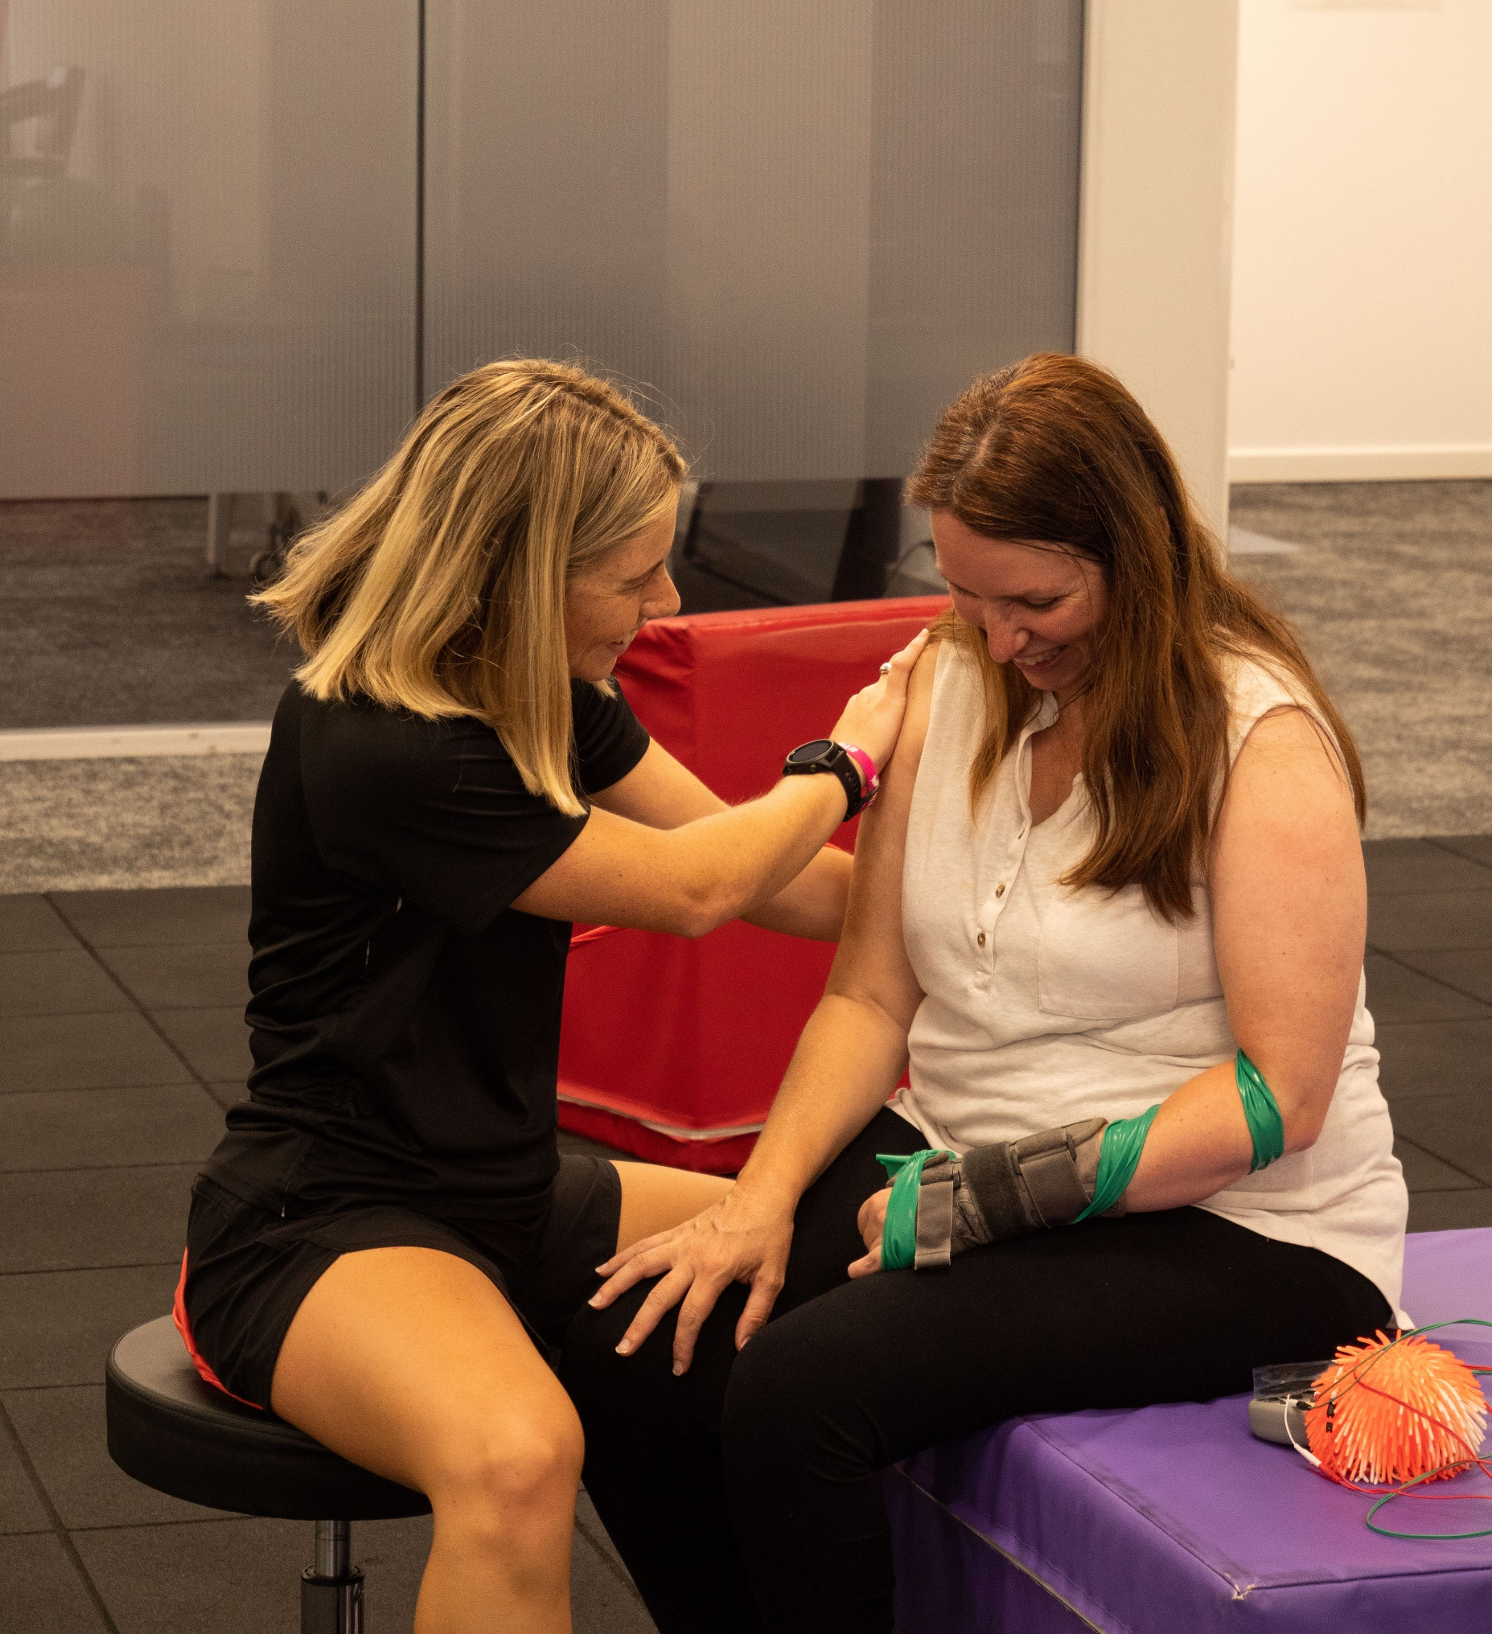
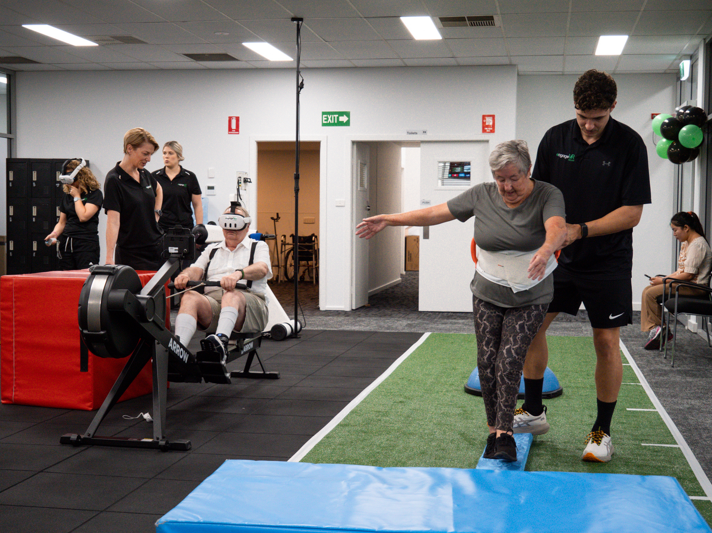
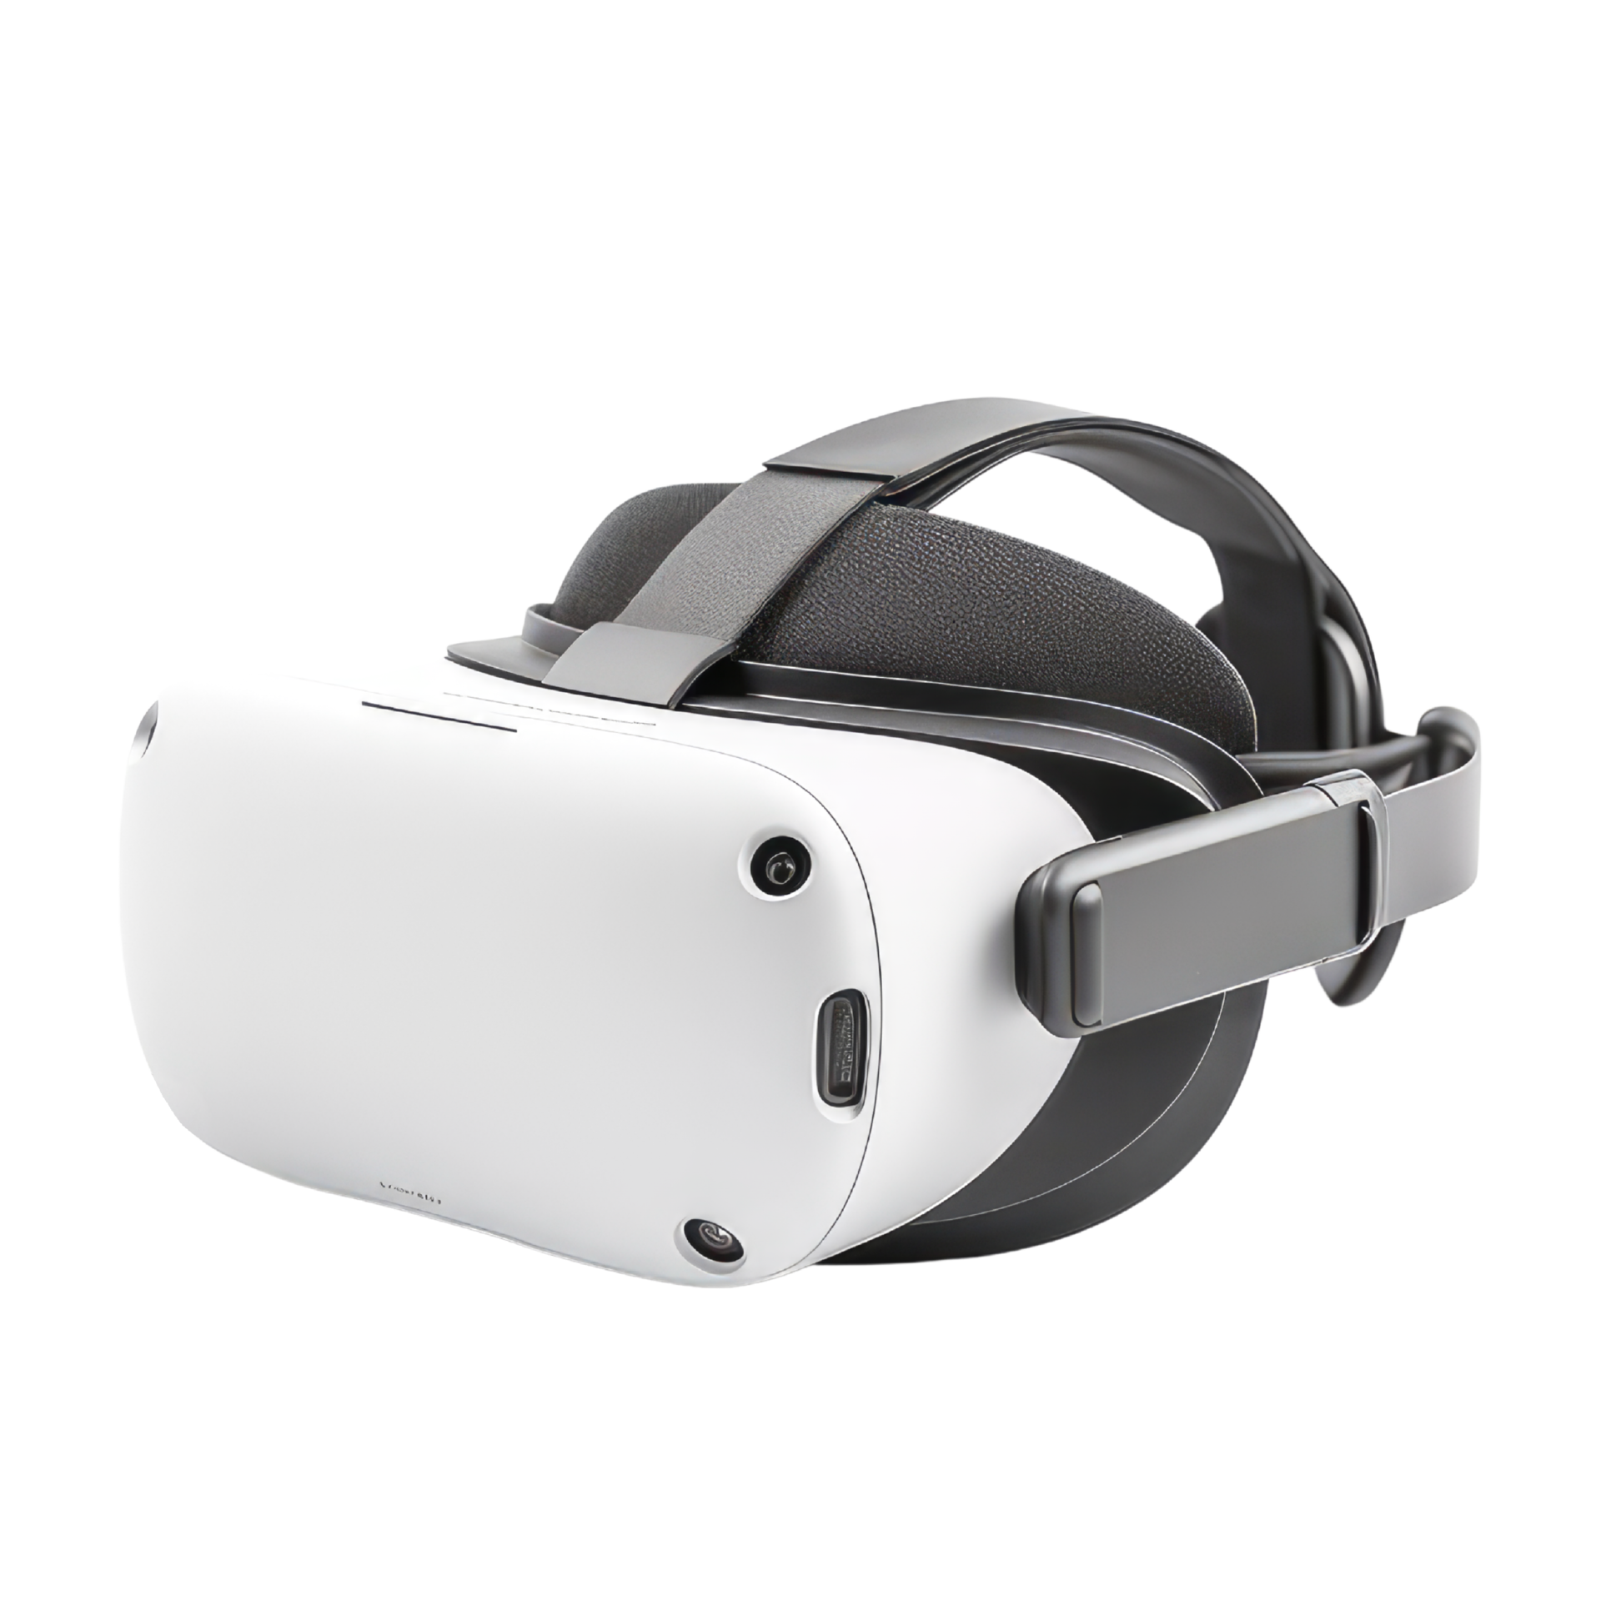
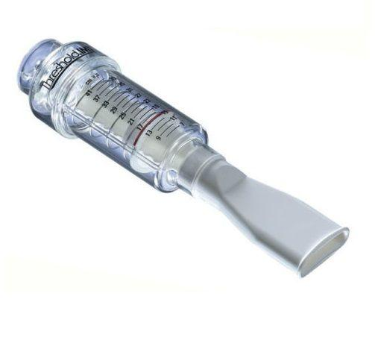
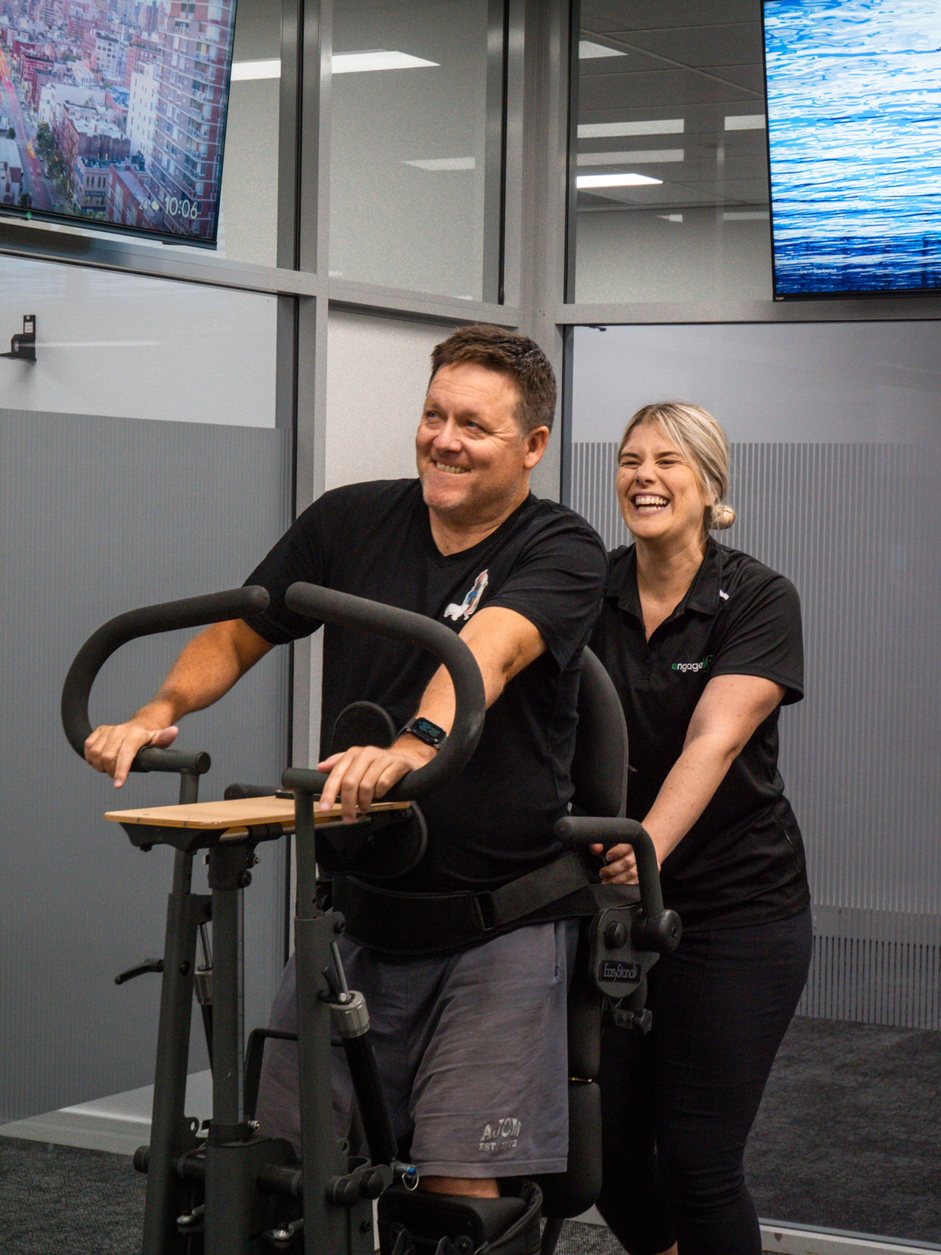
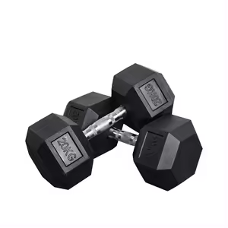
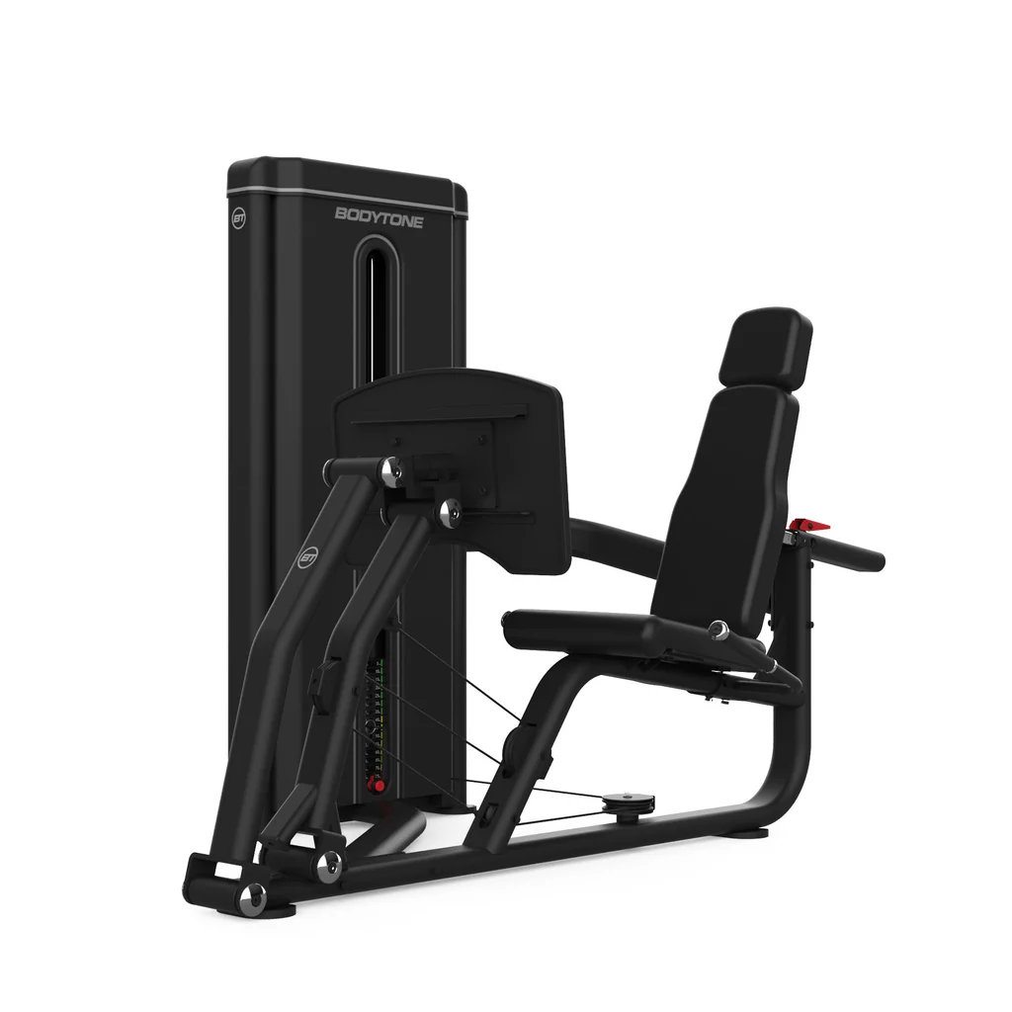

The Team
We are Stronger Together
PLATFORM

Slide 5
The Team
We are Stronger Together
Stronger together – harnessing the potential of advancing technologies, along with health professionals clinical experience, rather than using technology in isolation.
Stronger together – as a multidisciplinary team, working together to help achieve a client’s specific goals.
Stronger together as a community – enhancing social connections within the community.

Slide 6
Applications in Healthcare
Can be used in a variety of settings:
  Hospitals
  Outpatient care settings
  Acute and rehab settings
  Long-term living
  Palliative care
Education/training – enhance medical training using life-like simulations
Pain and anxiety management – immersive experience-based applications can reduce opioid use and patient reported pain and anxiety levels
Allied health clinical applications

Slide 7
Applications in Healthcare
Allied health clinical applications
Treatment tool – can be paired with devices such as a stationary bike or rower and can be used for multidisciplinary collaboration of client care
Interactive and immersive telehealth consultations
Accurate, objective assessments e.g. functional reach test, timed up and go
Data collected and reports generated on:
    - Cognition
    Vestibular and oculomotor function
    Balance
    Mobility and joint range of motion
Prescription of home programs

Slide 8

Benefits…
ENGAGEMENT
“Gamification” of exercise using VR can make exercises:
    Fun and exciting
    Provide distraction
    Add cognitive challenges to a task
    Give instantaneous feedback on performance
Enhances engagement between client and clinician through immersive telehealth consultations

Slide 9
Benefits…
SPECIFICITY
Specific issues identified
Accurate and reproducible assessments
Personalised therapy programs
Track and monitor compliance, performance and progress
Adapt and change program with changing needs
Exposure to environments/tasks specific to needs & wants

Slide 10
Benefits…
ACCESSIBILITY
To healthcare and the community
For people who :
  Live in Rural and remote communities
  Have reduced access to transport/health care services
  Are complex care clients
  Are Immunocompromised
  Mental health
  Low funding/income

Slide 11
Benefits…
NEUROPLASTICITY
VR enhances neuroplasticity
Exposure to new environments and challenges
Intellectual, social, physical and sensory stimulation

Slide 12
P: 1300 364 243
A: 1/60 Griffiths Road, Lambton, NSW 2299​
E: admin@engagevr.com.au
W: www.engagevr.com.au
.
CREATING NEW PATHWAYS For Our Clients, Our Practitioners,
Our Staff and Business Partners by Always Asking “WHAT’S NEXT”.

