Slide 1
Cancer Screening –
A Quality Improvement approach
Version 1| June 2021

Slide 3

Cancer Institute NSW
The Cancer Institute NSW is a pillar organisation of NSW Health, providing the strategic direction for cancer control in NSW.
Working across the health care system to promote:
cancer prevention
early detection
diagnosis, treatment and care.
The primary care sector is an important focus of the NSW Cancer Plan

Slide 4
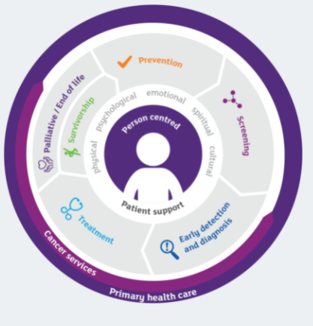
The role of primary health care across cancer control
Primary health care providers play an essential role in helping patients access timely, appropriate care.
They provide comprehensive ongoing care and connect the community with the rest of the health care sector.
In fact, 85% of cancers are diagnosed following symptomatic presentation to a primary care provider.

Slide 5

The role of primary care in cancer screening
60% of patients surveyed reported they were more likely to screen when reminded by their GP than when reminded by a registry only.
General practice is uniquely positioned, through both patient data and patient relationships, to identify, engage and encourage patient cohorts who are under-screened or who have never screened.
Reminders are the only patient intervention rated as ‘very effective’ in the RACGP’s Putting prevention into practice (‘The Green Book’)
Notes:
Research has shown That 60% of patients surveyed reported they were more likely to screen when reminded by their GP than when reminded by a registry only
It has also shown that Utilising patient data and relationships, to identify, engage and encourage those who are overdue for screening or who have never screened
And finally that Reminders are the only patient intervention rated as ‘very effective’ for engaging patients in screening (green book)

Slide 6

Cancer Screening in Primary Care
Participation in screening programs is the single most important factor in achieving reduction in illness and mortality.
Currently, Australia has three national cancer screening programs:
  National Cervical Screening Program
  BreastScreen Australia – BreastScreen NSW
  National Bowel Cancer Screening Program
Notes:
Population-based cancer screening programs focus on early detection of cancer and pre-cancerous lesions in asymptomatic individuals.
Participation in screening programs is the single most important factor in early stage diagnosis and reducing cancer-related morbidity and mortality.
Currently, Australia has three national cancer screening programs:
The National Cervical Screening Program
BreastScreen Australia (BreastScreen NSW at a state level)
The National Bowel Cancer Screening Program
Australian Institute of Health and Welfare (AIHW). (2015a). Authoritative Information and Statistics to Promote Better Health and Wellbeing. Retrieved from www.aihw.gov.au

Slide 7
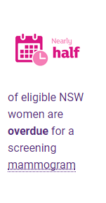

BreastScreen NSW
All women 50-74 years old are invited for a free screening mammogram every 2 years.
For more information/to order resources: breastscreen.nsw.gov.au
Notes:
Breast cancer is the most common cancer affecting women in NSW
75% of women diagnosed are over the age of 50
1in 7 women will develop breast cancer in their lifetime
All women between 50-74 years old are invited for a free screening mammogram every 2 years.
Women between 40 and 49 years or 75 years and older can also attend but do not receive an invitation
Women do not need a GP referral, but are more likely to screen when encouraged by their general practice.
A note about covid – can now make an appointment and book online
For more information/to order resources: breastscreen.nsw.gov.au

Slide 8
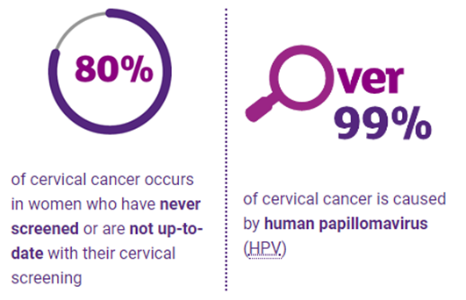

Cervical Screening Test
A Cervical Screening Test prevents cervical cancer by detecting the human papillomavirus (HPV).
Cervical Screening Test is for:
  Women aged between 25 and 74
  Have ever been sexually active
  HPV-vaccinated or not
Notes:
The Cervical Screening Test is for women aged 25 to 74 who have ever been sexually active.
The Cervical Screening Test is for women who have had the HPV vaccination and those who have not been vaccinated.
Women are invited to take an exit screen from age 70 to 74. If the result is normal and there is no HPV, then the woman can exit the program.
80 % of cervical cancers occur in women who have never screened
4 in 10 overdue for screening
The Cervical Screening Test is recommended every five years if the results are normal (i.e. negative for oncogenic human papillomavirus (HPV)).
The Pap test used to look for cell changes in the cervix; while the new test looks for HPV, which can lead to cell changes in the cervix.
HPV causes 99% of cervical cancer.¹⁵
The National Cancer Screening Register. sends invitation and reminder letters when tests are overdue, has a safety net function the register notifying participants and their health care providers when information has not been received by the Register to indicate the person has been followed up It also provides a history of cervical screening results

Slide 9
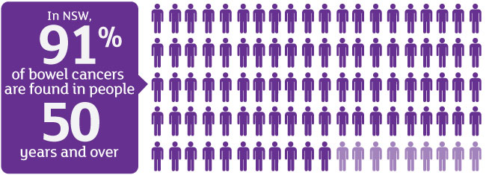
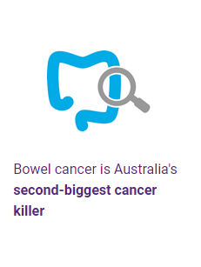
National Bowel Cancer Screening Program
The NBCSP sends a free bowel cancer screening tests to eligible Australians aged 50–to 74 every two years.
DoTheTest.com.au
Notes:
Bowel cancer is the second-most common cause of cancer death in Australia and, if detected early, can be successfully treated in more than 90% of cases.
1 in 13 men and 1 in 16 women in NSW will be diagnosed with bowel cancer during their lifetime
The NBCSP sends a free bowel cancer screening tests to eligible Australians aged 50–to74 every two years in the mail.
The program was in transition, which meant that GPs recommending pharmacy bought kits or ordering pathology tests 2nd yearly as the national program was 5 yearly
With the National program now aligned with the recommended 2nd yearly testing there is no reason for screening outside the program
If people receive a positive result they are notified along with their nominated GP. If people do not follow up with their positive test the Patient Follow up Function Team call them to discuss the importance and strategies to do so. They can also discuss follow up with patients’
The Patient Follow up Function undertaken by CINSW on behalf of the Commonwealth has proven a significant safeguard for practices ( the team make approx. 20,000 calls per annum)
PRIMARY CARE has an important role-
Promoting participation –sending a reminder letter.
understanding those that are at greater risk and will be managed differently by utilising family history template (RACGP) and applying clinical guidelines found in Health Pathways
Managing and ongoing monitoring for those with a positive result and refer them for further examination as clinically indicated, for example a colonoscopy.
The risk of bowel cancer is higher if you:
are aged 50 years and over
have an inflammatory bowel disease, such as Crohn disease or ulcerative colitis
have previously had special types of polyps, called adenomas, in the bowel
have a strong family history of bowel cancer or polyps

Slide 10
Bowel Cancer screening participation by sex
https://www.aihw.gov.au/reports-data/health-welfare-services/cancer-screening/data
Notes:
This year, more XXX people in XXX PHN will be told they have bowel and XXX will die from of the disease.(data found in point 2 for your PHN)
Prevention is key improving those numbers. Screening can often help detect pre-cancerous polyps that can be treated before cancer develops.
Only 40.8 per cent kits are returned each year - more people need to participate in the National Bowel Screening Program.
We can encourage our patients aged 50-74 to make their health a priority by doing the bowel cancer screening kit as soon as it arrives in the mail.
For more information, head to www.cancer.nsw.gov.au/dothetest
Further information and resources:
Cancer Institute NSW – we have encouraged the community not to ignore the bowel screening test when they receive it in the mail. The article below highlighting the importance of early detection and that bowel cancer screening can often help detect pre-cancerous polyps that can be treated before cancer develops. You may wish to check with your local LHD contact for local data or information.
ARTICLE: Community urged not to ignore potentially lifesaving screening test
Do The Test – CI Website that has the new campaign and testimonial videos
Social Media content for Bowel Cancer Awareness can be found via the following. Please feel free to follow us and share on your own channels
Facebook​
Twitter​
LinkedIn​​​
Data that may inform your communications
Cancer incidence and mortality rates - available by PHN (2017), the get bowel cancer data you must select “bowel” in the “clinical cancer group” dropdown box
National Bowel Cancer Screening Program participation rates by PHN – AIHW
National Bowel Cancer Screening Program general Website
Aboriginal specific resources
Translated resources for Multicultural communities
Primary Care
National Cancer Screening Register for HealthCare providers

Slide 11
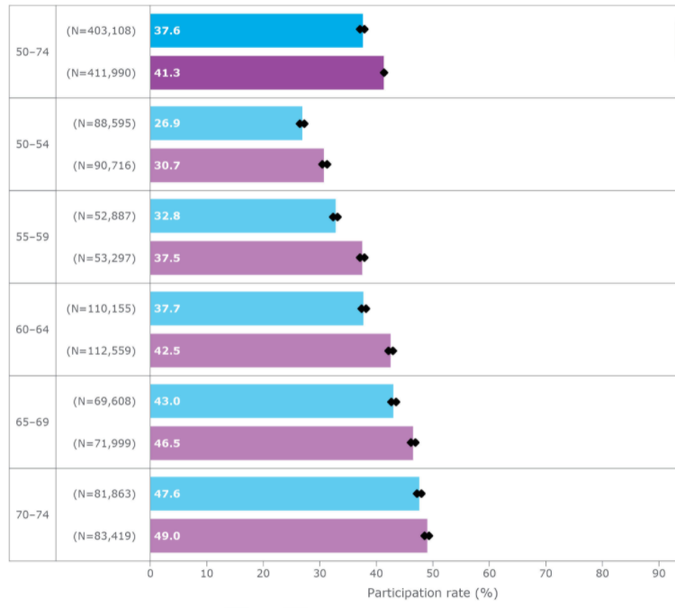
Bowel Cancer screening participation by age and sex
50 -54 Years
Notes:
This year, more XXX people in XXX PHN will be told they have bowel and XXX will die from of the disease.(data found in point 2 for your PHN)
Prevention is key improving those numbers. Screening can often help detect pre-cancerous polyps that can be treated before cancer develops.
Only 40.8 per cent kits are returned each year - more people need to participate in the National Bowel Screening Program.
We can encourage our patients aged 50-74 to make their health a priority by doing the bowel cancer screening kit as soon as it arrives in the mail.
For more information, head to www.cancer.nsw.gov.au/dothetest
Further information and resources:
Cancer Institute NSW – we have encouraged the community not to ignore the bowel screening test when they receive it in the mail. The article below highlighting the importance of early detection and that bowel cancer screening can often help detect pre-cancerous polyps that can be treated before cancer develops. You may wish to check with your local LHD contact for local data or information.
ARTICLE: Community urged not to ignore potentially lifesaving screening test
Do The Test – CI Website that has the new campaign and testimonial videos
Social Media content for Bowel Cancer Awareness can be found via the following. Please feel free to follow us and share on your own channels
Facebook​
Twitter​
LinkedIn​​​
Data that may inform your communications
Cancer incidence and mortality rates - available by PHN (2017), the get bowel cancer data you must select “bowel” in the “clinical cancer group” dropdown box
National Bowel Cancer Screening Program participation rates by PHN – AIHW
National Bowel Cancer Screening Program general Website
Aboriginal specific resources
Translated resources for Multicultural communities
Primary Care
National Cancer Screening Register for HealthCare providers

Slide 12
The role of general practice in bowel cancer screening
The NBCSP provides excellent information, links, resources and templates about the role of primary care in bowel cancer screening:
How general practice can support increased participation in the NBCSP including
  reminder letter and SMS templates
  Online training and clinical resources
  Clinical guidelines and screening pathways
Understanding the test and explaining it to patients.
Bowel screening rates
If bowel screening participation rates in the National Bowel Cancer Screening Program increased to 60%, almost 83,800 lives could be saved from bowel cancer over 25 years.
https://www.health.gov.au/initiatives-and-programs/national-bowel-cancer-screening-program
Notes:
This year, more XXX people in XXX PHN will be told they have bowel and XXX will die from of the disease.(data found in point 2 for your PHN)
Prevention is key improving those numbers. Screening can often help detect pre-cancerous polyps that can be treated before cancer develops.
Only 40.8 per cent kits are returned each year - more people need to participate in the National Bowel Screening Program.
We can encourage our patients aged 50-74 to make their health a priority by doing the bowel cancer screening kit as soon as it arrives in the mail.
For more information, head to www.cancer.nsw.gov.au/dothetest
Further information and resources:
Cancer Institute NSW – we have encouraged the community not to ignore the bowel screening test when they receive it in the mail. The article below highlighting the importance of early detection and that bowel cancer screening can often help detect pre-cancerous polyps that can be treated before cancer develops. You may wish to check with your local LHD contact for local data or information.
ARTICLE: Community urged not to ignore potentially lifesaving screening test
Do The Test – CI Website that has the new campaign and testimonial videos
Social Media content for Bowel Cancer Awareness can be found via the following. Please feel free to follow us and share on your own channels
Facebook​
Twitter​
LinkedIn​​​
Data that may inform your communications
Cancer incidence and mortality rates - available by PHN (2017), the get bowel cancer data you must select “bowel” in the “clinical cancer group” dropdown box
National Bowel Cancer Screening Program participation rates by PHN – AIHW
National Bowel Cancer Screening Program general Website
Aboriginal specific resources
Translated resources for Multicultural communities
Primary Care
National Cancer Screening Register for HealthCare providers

Slide 13

The Primary Care Toolkit
  Current focus Breast, Bowel and Cervical Screening
  Principle of Integration
  Includes Data and systems info and resources
    Data cleaning and analysis - links to software providers own ‘how to’ guidance
    Implementing sustainable recall and reminder systems
  Quality Improvement
  Applies a whole of practice approach and
  Person Centred approach
Smoking Cessation Module coming soon
Notes:
highlighting the important role of primary care in improving screening participation, many PHN’s worked independently to develop programs and resources to support general practice. HNEPHN were no different in this.
Seeing the importance of a coordinated approach and to reduce duplication CINSW developed a very comprehensive QI toolkit.
The toolkit Consolidates learnings from work with and by PHNs

Slide 14
Person Centred Approach Who is at increased risk?
Know your patient population
Aboriginal and Torres Strait Islander
Multicultural and Refugee
People with a disability
People who identify as LGBTIQ
People living remotely
People in lowest SES group
https://www.cancer.nsw.gov.au/getmedia/80486c08-e6d1-4a4c-a4f7-e4f7df5c888f/M4-Who-is-at-risk-of-under-screening-CI-0248-10-19.pdf
Notes:
Participation rates and access to services is a barrier to participation for many people in the community and so it is important to know your patient population.

Slide 15
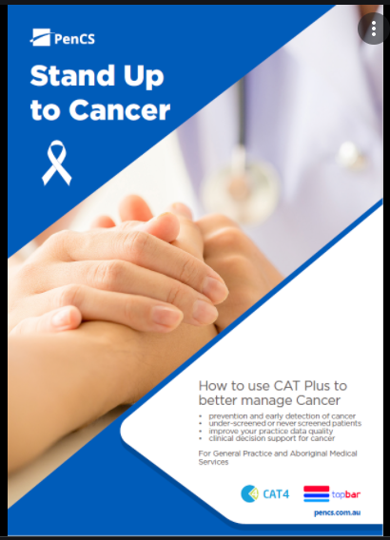
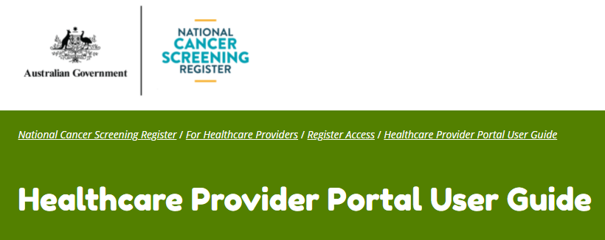
Recourses to assist you
https://www.ncsr.gov.au/content/ncsr/en/healthcare-providers.html
https://www.pencs.com.au/wp-content/uploads/2020/02/20200123_Cancer-Toolkit-CatPlus-and-Cancer.pdf
Notes:
highlighting the important role of primary care in improving screening participation, many PHN’s worked independently to develop programs and resources to support general practice. HNEPHN were no different in this.
Seeing the importance of a coordinated approach and to reduce duplication CINSW developed a very comprehensive QI toolkit.
The toolkit Consolidates learnings from work with and by PHNs

Slide 16




Evidenced based approach
Notes:
Evide
QI1.1
A Our practice has at least one team member who has the primary responsibility for leading our quality improvement systems and processes.
QI1.3 B
Our practice uses relevant patient and practice data to improve clinical practice (eg chronic disease management, preventive health).
C4.1
A Our patients receive appropriately tailored information about health promotion, illness prevention, and preventive care.
GP2.1 B
Our practice provides continuity of care and comprehensive care.
Must have a process for recall.
Could have a Policy for reminders and recalls
GP 2.2
GP2.2 A Pathology results, imaging reports, investigation reports, and clinical correspondence that our practice receives are:
reviewed; notated, acted on where required incorporated into the patient health record.
GP2.2 B Our practice recalls patients who have clinically significant results.
GP2.2 C Our patients are advised of the practice’s process for follow-up of tests and results.
GP2.2D Our practice initiates and manages patient reminders.
nced based guides important in making changes and inform team decisions and putting prevention into practice

Slide 17
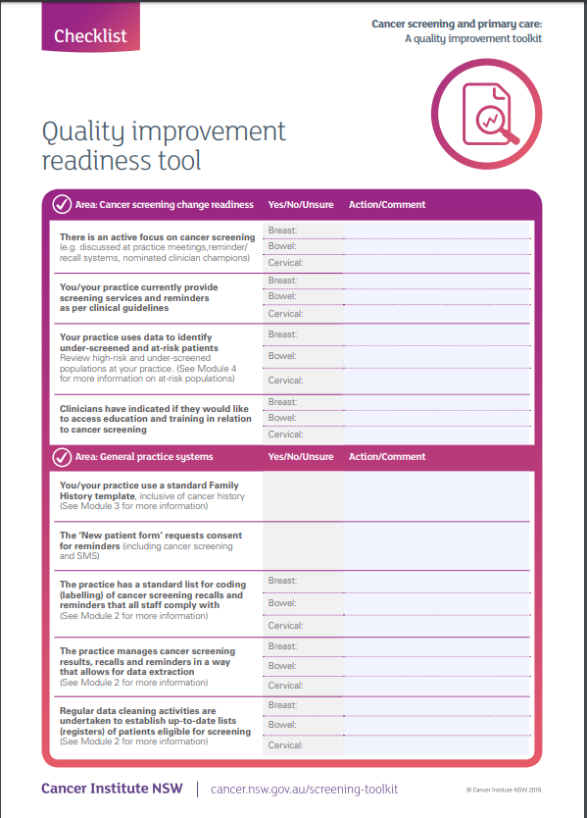
Readiness Checklist
The readiness checklist used to activities that meet practice needs
Link to checklist
Notes:
So how to get started with cancer screening QI

Slide 18
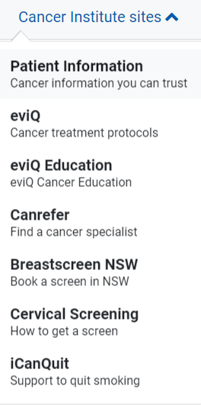

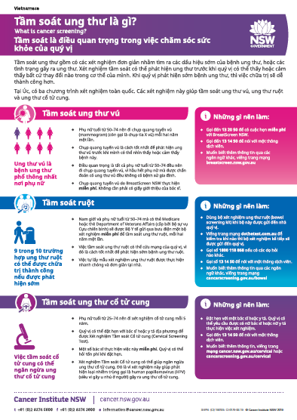

Resources - Patient and Clinician
www.cancer.nsw.gov.au
Notes:
What is screening brochures – 15 languages plus plain English and an Aboriginal design
Flip Charts [with facilitator manuals] designed to be used by health or community workers/educators talking with community members about cancer screening for use with groups or with an individual
*Note different language translations reflect the participation by different communities
Bowel Health and Screening Flipchart – 9 languages – https://www.cancer.nsw.gov.au/how-we-help/reports-and-publications/bowel-health-and-screening-facilitator-manual
Section 1 explains how bowel cancer develops, the risk factors for bowel cancer, ways to reduce the risk and the signs or symptoms of bowel cancer.
Section 2 describes the National Bowel Cancer Screening Program and the bowel screening test (why it is so important and how to do it).
BreastScreen - pdf or PowerPoint - -8 languages https://www.cancer.nsw.gov.au/how-we-help/screening-and-early-detection/breast-cancer-screening/breast-screening-educational-resources
Cervical Screening – pdf or PowerPoint https://www.cancer.nsw.gov.au/cervical-screening-nsw/cervical-screening-community-education-resources
Section 1 Cancer and cervix – overview of cancer and the female reproductive system, including the cervix.
Section 2 Cervical screening – information on cervical screening including the procedure, who should get it done, how often and where to get it done.

Slide 19

Primary Care webpage
https://www.cancer.nsw.gov.au/what-we-do/working-with-primary-care

Slide 20
Thank you
Kath Duggan
Primary Care Strategic Advisor
Cancer Institute NSW Kathryn.Duggan@health.nsw.gov.au
CINSW-PrimaryCare@health.nsw.gov.au
0434 387 468

