Slide 1


Welcome to
Central Coast Health@Home
Dr Elly Warren
Dr Catherine Palmqvist
Medical Directors, GP Staff Specialists

Slide 2
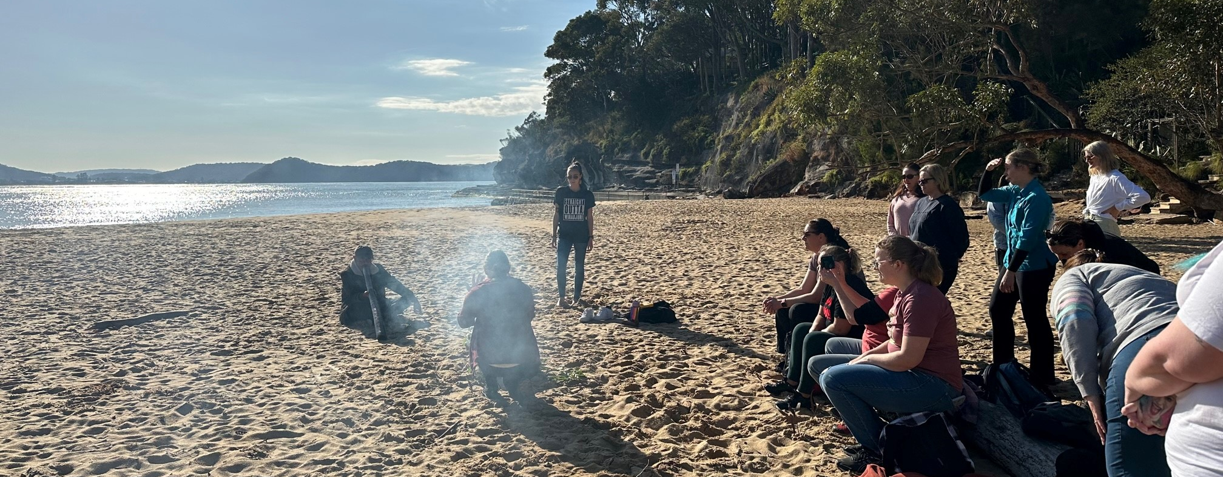
Acknowledgement of country
Notes:
I’d like to acknowledge the traditional owners of the land, the beautiful Darkinjung Country on which we live and work, and pay my respects to elders, past and present. I’d also like to acknowledge the lasting traumatic impact the referendum result will have on our First Nations community, who’ve been told they don’t have a right to constitutional recognition or self-determination. We’ll need to support our Aboriginal colleagues, friends and fellow Coasties, as they regain strength after this blow. It’s our responsibility to create culturally safe spaces in our workplaces to encourage access and improve health outcomes.

Slide 3
Central Coast Health@Home Team
Gosford and Wyong Hospitals
  HITH
  RACE
  VCaT
  UCC
0800-2030 7 days a week
40 HITH beds, 20 RACE, 20 VCaT, Long Jetty Urgent Care Clinic
Medical Directors (GPs)
HITH Senior Medical Officers (5 GPs, 1 geriatrician)
Extensive nursing team (36FTE)
  Nurse coordinators
  Nurse Educator, Clinical Nurse Consultant
  36 Registered Nurses, Hospital Liaison Officers and Continuing Care Assistants
  Soon to be Nurse Practioner
Pharmacist
Allied Health
  RACE coordinator
  PT/OT/SW
Admin and data team

Slide 4
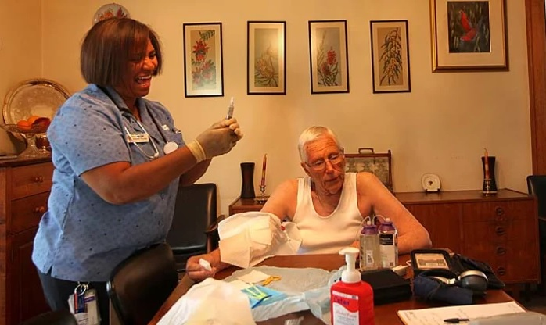
What is HITH?
40 virtual hospital beds
An admitted model, hospital-level care at home
To facilitate early discharge and hospital/ED avoidance
Must meet the following criteria:​
Would otherwise need a hospital admission​
Have a safe environment for staff to visit / or review in clinics​
Deemed medically suitable and stable
Be >16 years old​
Live within the CCLHD​ area
Not require 24-hour personal care or observation
Can give consent (or have a carer who can) ​

Slide 5
Common conditions for HITH
Short term IV antibiotics
  Cellulitis
  UTIs and pyelonephritis
  Pneumonia
Long term IV antibiotics
  Bone and joint infections
  Endocarditis, bacteraemia
Hyperemesis gravidarum
Diverticulitis
DVT and Clexane bridging / INR monitoring
Surgical drain management: eg breast drains
Heart failure
New programs: Day 1 post-op hip and knee surgery

Slide 6
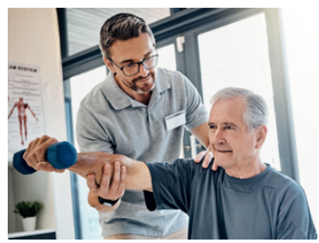
RACE
Rapid access to care and evaluation (RACE) program for >70yo and First Nations >50yo
20 beds (10 admitted, 10 non-admitted)
5-day intensive allied health intervention
  RACE coordinator
  Physio
  OT
  Social worker
Helps maintain independence
  Access to home care packages and support
  ComPacks / TRANSPAC
Patient story

Slide 7
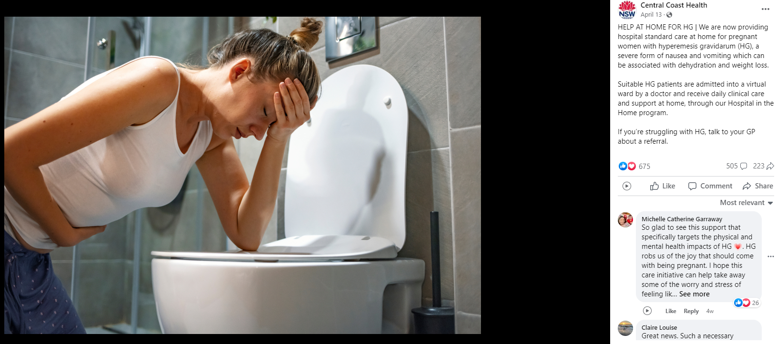
Hyperemesis gravidarum
!!

Slide 8
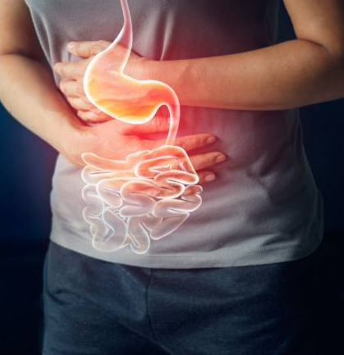
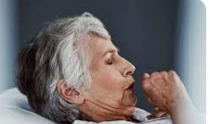
Virtual Care and Triage team (VCaT)
An evolution of the COVID Community Support Team (CCST)
Non-admitted model
Highly-skilled nurses providing daily support to avoid ED
Remote patient monitoring (O2 sats, temps, BP/HR/RR)
MyCareManager app daily
RNs perform daily phone calls and escalate to GP
  or HITH SMO if usual GP unavailable
Alternative pathways for referrals from NSW000, GPs, RACFs
Common conditions for VCaT
  Viral illnesses (resp/gastro), resolving infections, exacerbation COPD, heart failure, early discharge from hospital with extra medical oversight

Slide 9
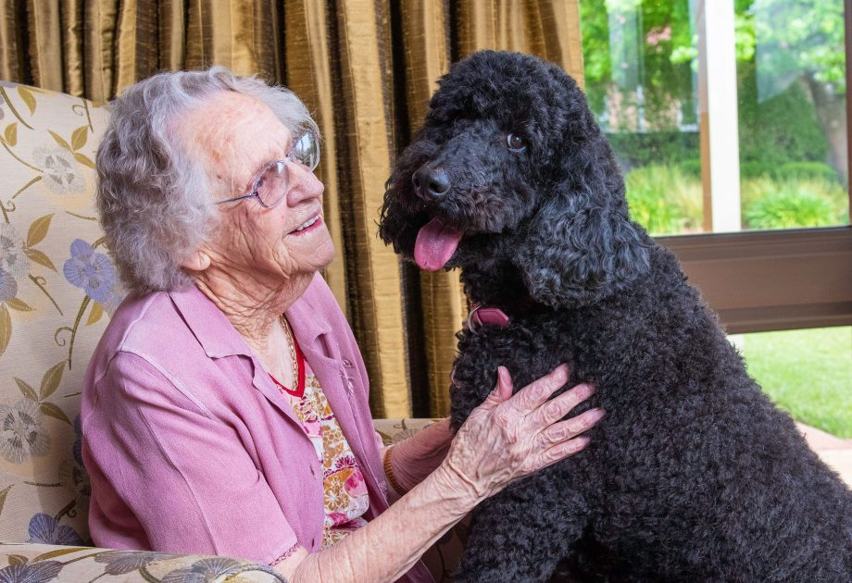
Why use us?
Prevent hospital admissions
Prevent ED presentations
Better outcomes for patients
Reduced hospital acquired complications
High patient satisfaction
Social engagement, work and appts
Home food, bed, family
Pets!

Slide 10

HOW TO REFER
HITH (and RACE)
  HITH intake Ph: 4320 3482
  Senior Medical Officer Ph: 0474 190 352 or via switch
  Email a referral:
  CCLHD-HITH-intake@health.nsw.gov.au
VCaT
  VCaT intake Ph: 4320 2460
  Email a referral:
  CCLHD-CCH-Home@health.nsw.gov.au
HealthPathways
  Username: centralcoast
  Password: 1connect

Slide 11
Long Jetty Urgent Care Clinic
NSW Health funded, non-Medicare
An extension of ED for triage category 4/5
GP-led
At least 25% musculoskeletal
Projected opening Jan 2023, limited opening prior
  CCLHD UCC Steering Committee and Project Officer guiding implementation; PHN rep
Triage and appts booked by HealthDirect, no walk-ins
Possible alternative referral pathways via GP, ED, NSW Ambulance
Collaborative model, direct access into CCLHD services
  ED, fracture clinic, specialist wound CNCs, radiology/pathology, HITH, outpatient clinics
  Communication back to usual GP with summary of care

Slide 12
ATS triage category 4
Category 4 Assessment and treatment start within 60 mins
  Potentially serious The patient's condition may deteriorate, or adverse outcome may result, if assessment and treatment is not commenced within one hour of arrival in ED. Symptoms moderate or prolonged or
  Situational Urgency There is potential for adverse outcome if time critical treatment is not commenced within hour or
  Significant complexity or Severity Likely to require complex work-up and consultation and/or inpatient management or
  Humane practice mandates the relief of discomfort or distress within one hour
Mild haemorrhage Foreign body aspiration, no respiratory distress Chest injury without rib pain or respiratory distress Difficulty swallowing, no respiratory distress Minor head injury, no loss of consciousness Moderate pain, some risk features Swollen “hot” joint Non-specific abdominal pain | Vomiting or diarrhoea without dehydration Eye inflammation or foreign body – normal vision Minor limb trauma – sprained ankle, possible fracture, uncomplicated laceration requiring investigation or intervention – Normal vital signs, low/moderate pain Tight cast, no neurovascular impairment Behavioural/Psychiatric: - Semi-urgent mental health problem - Under observation and/or no immediate risk to self or others

Slide 13
ATS triage category 5
Category 5 Assessment and treatment start within 120 minutes
  Less Urgent The patient's condition is chronic or minor enough that symptoms or clinical outcome will not be significantly affected if assessment and treatment are delayed up to two hours from arrival or
  Clinico-administrative problems Results review, medical certificates, prescriptions
Minimal pain with no high risk features Low-risk history and now asymptomatic Minor symptoms of existing stable illness Minor symptoms of low-risk conditions Minor wounds - small abrasions, minor lacerations (not requiring sutures) | Scheduled revisit e.g. wound review, complex dressings Immunisation only Behavioural/Psychiatric: - Known patient with chronic symptoms - Social crisis, clinically well patient
GUIDELINES ON THE IMPLEMENTATION OF THE AUSTRALASIAN TRIAGE SCALE IN EMERGENCY DEPARTMENTS, Australasian College of Emergency Medicine, July 2016

Slide 14
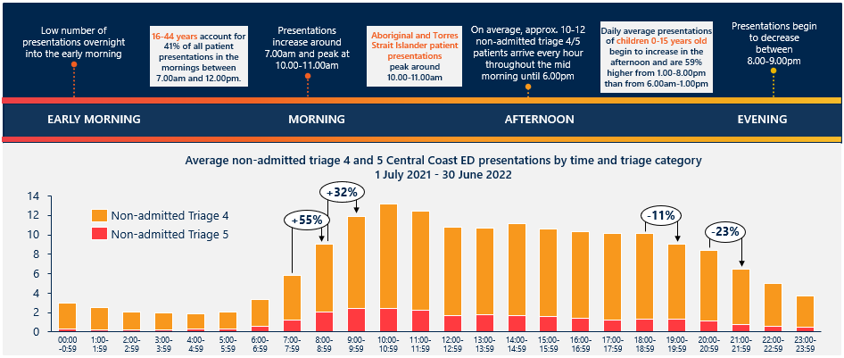
0800-2000, 7 days a week

Slide 15
Long Jetty UCC staffing
12 hours, 0800-2000, 7 days a week
  One GP (multiple shifts)
  One Physio (8 hrs)
  4 RNs (2 morning and 2 evening shifts)
    One clinical and one care coordinator per shift
  Nurse Unit Manager
  Admin
Medical likely to be blended model
  GP VMOs, GP Staff Specialists, ED VMOs, ED Staff Specialists, ED CMOs, ?GP Registrars
Possibly mobile X-ray and US with on-site radiographer
Point of care testing and pathology courier to Gosford Lab (Pathology North)
Careful collaboration to ensure LJ UCC supports GP core business

Slide 16

QUESTIONS???
Dr Elly Warren
Medical co-Director
Central Coast Health@Home
Eloise.Warren@health.nsw.gov.au
HITH intake Ph: 4320 3482

