Slide 1
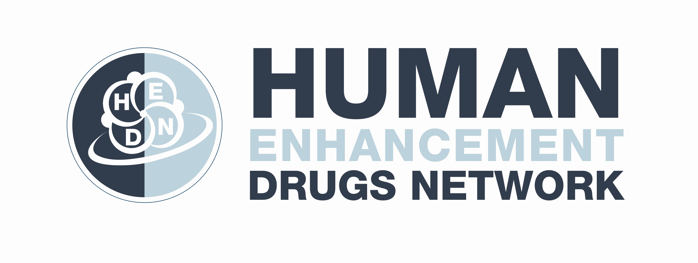
A Performance & Image Enhancing Drugs (PIEDs) Webinar Introduction to PIEDs
Prevalence, what, why, and how
Dr Katinka van de Ven
8 February 2023
Notes:
Hello everyone and thank you for joining today.
Today’s presentations will focus on how to manage and minimise harm for people who are contemplating, currently using or wanting to stop non-prescribed anabolic-androgenic steroid and other performance and image enhancing drug use.
I will kick of which a general introduction on performance and image enhancing drugs, Dr Esther Han will then talk more about the management of this patient group and Kay Stanton will talk about steroids and harm reduction.
We will each talk for 20 minutes and then have 30 minutes at the end for a discussion and questions.
Anyway, I am Dr Katinka van de Ven and I am a Senior Lecturer at the Centre for Rural Criminology at the University of New England, and a Visiting Fellow at the Drug Policy Modelling Program at the University of New South Wales.
I have over 10 years of research experience in the field of performance and image enhancing drugs (PIEDs) and alcohol and other drugs more broadly. I have led the development of the GP PIED Guide to Harm Minimisation that relatively recently was released.
I am also the Editor-in-Chief of Performance Enhancement & Health and the Director of the Human Enhancement Drugs Network (HEDN).

Slide 2
Learning aim & outcomes
Learning Aim
Have a general understanding of the non-prescribed use of AAS and other PIEDs
Learning Outcomes
Identify commonly used PIEDs and their use in the community.
Understand prevalence of PIEDs, reasons for use, adverse effects, and commonly used substances.
Understand mode of action, and how they are administered.
Notes:
The main learning aim of this presentation is…
After this webinar you should:
- Be able to…

Slide 3
GP Guide to harm minimisation for patients using non-prescribed Anabolic-Androgenic Steroids (AAS) and other Performance and Image Enhancing Drugs (PIEDs)
The Guide is available HERE on the Sydney North Health Network (SNHN) website.
Notes:
Most of the information I am presenting today is based on the Guide to harm minimisation for patients using non-prescribed Anabolic-Androgenic Steroids (AAS) and other Performance and Image Enhancing Drugs (PIEDs) I developed with several colleagues including Dr Esther Han and Kay Stanton.
This Guide is freely available on the Sydney North Health Network website.
It covers aspects such as red flags, background, assessment, management tips, referral sources, information for health professionals and patients, and gives access to several webinars.

Slide 4
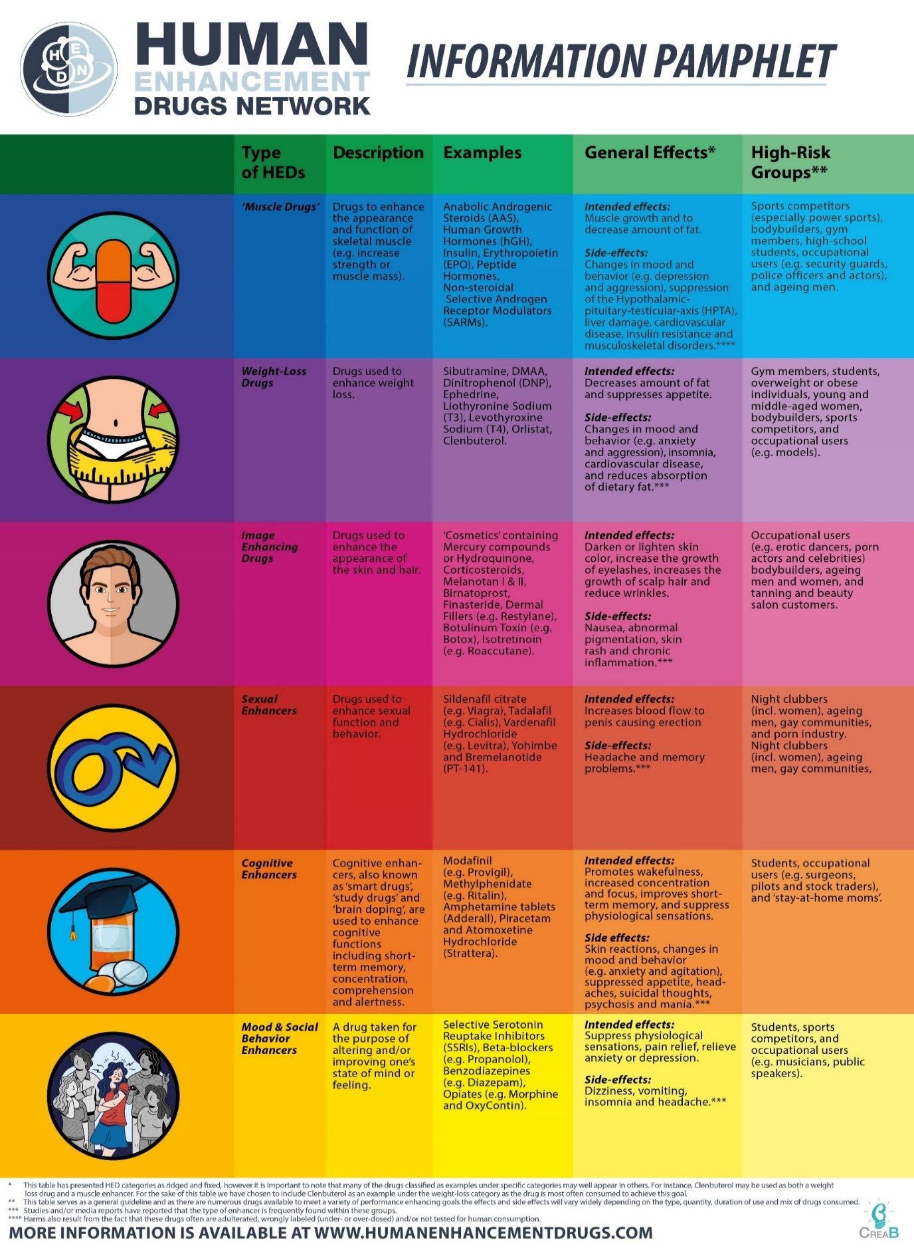
What are PIEDs?
Performance and image enhancing drugs (PIEDs) are drugs used to enhance the appearance of a person and/or to improve their physical capabilities such as strength or endurance.
The term represents a wide range of substances, but the oldest and largest group used are non-prescribed anabolic-androgenic steroids (AAS)
The term PIEDs is generally used as people who use non-prescribed AAS commonly use other enhancement substances.
Source: Human Enhancement Drugs Network
Notes:
So, let’s start of with what PIEDs actually are.
Performance and image enhancing drugs (PIEDs) are drugs used to enhance the appearance of a person and/or to improve their physical capabilities such as strength or endurance.
The term represents a wide range of substances, but the oldest and largest group used are non-prescribed anabolic-androgenic steroids (AAS). They have been used since the at least the late 1940s.
The term PIEDs is generally used as people who use non-prescribed AAS commonly use other enhancement substances.

Slide 5
What are PIEDs?
Drug | Trade/other names | Purported reasons for use (by patients)
Tamoxifen | Nolvadex® | Tamoxifen (oral) is used as an oestrogen blocker. This is used to prevent gynaecomastia (growth of glandular breast tissue in males)
Anastrozole | Arimidex® | Anastrozole (oral) is used as an oestrogen blocker. This is used to prevent gynaecomastia
Human chorionic gonadotrophin (HCG) | Pregnyl® | HCG (injected) is used to minimise depressive symptoms upon AAS cessation/withdrawal, to improve testosterone production, to prevent weight-loss, to stop testicular atrophy, and to increase strength.
Clomiphene citrate | Clomid | Clomid (oral) is taken to ‘kick start’ the endogenous production of testosterone during an ‘off cycle’, as testosterone production is often shutdown due to high-levels of exogenous AAS.
Human growth hormone (HGH) | Somatropin® | HGH (injected) is used for its anabolic effects and strength, to burn fat, and for weight loss.
Ephedrine |  | Ephedrine (oral) is used to increase energy and boost training, and to enhance weight loss
Number 1 is anabolic androgenic steroids (AAS): e.g. boldenone, nandrolone, stanozolol and testosterone.
Other types of PIEDs are often used to:
Achieve augmented effects;
Minimise adverse effects of AAS use; and
For recreational purposes.
Examples (see table)
Notes:
So what types of PIEDs are typically used?
The main substance used, at least by men, is as already said anabolic-androgenic steroids, which is typically used in combination with other PIEDs.
People who use non-prescribed AAS often use other types of PIEDs and illicit substances to (1) achieve augmented effects, (2) to minimise adverse effects of AAS use, and (3) for recreational purposes.
The table of the right just shows some examples of other substances used.
For example, Tamoxifen is used to prevent gynaecomastia, human growth hormones are used for its anabolic effects and strength, to burn fat, and for weight loss., and ephedrine is used to increase energy and boost training, and to enhance weight loss.
For more information on this, I would like to refer to the Guide we developed which gives a more comprehensive overview of the different types of PIEDs being used, and why they are being used.

Slide 6
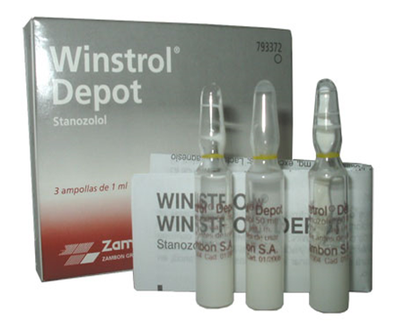
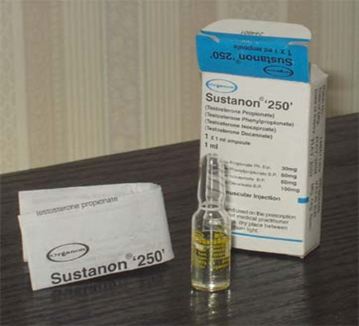
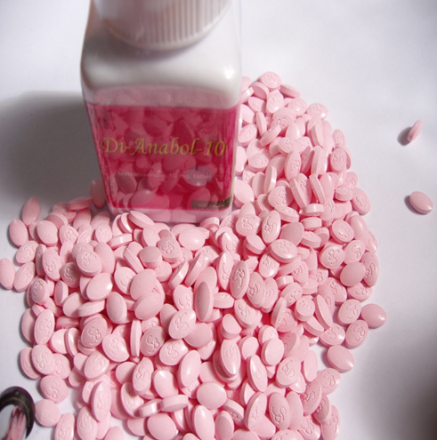
Examples of AAS
Stanozolol or Winstrol: Water-based injectable AAS.
Sustanon or sust: Oil based AAS (mix of 4 types of testosterone)
Dianabol or Dbol: oral AAS
Notes:
Just to give some examples of steroids. So in this slide, you can see three different types.
Mention the ones in the slide.
Oral tablets seems to be more popular amongst younger consumers. An particular issue with oral steroids however is that they are more toxic to the liver.

Slide 7
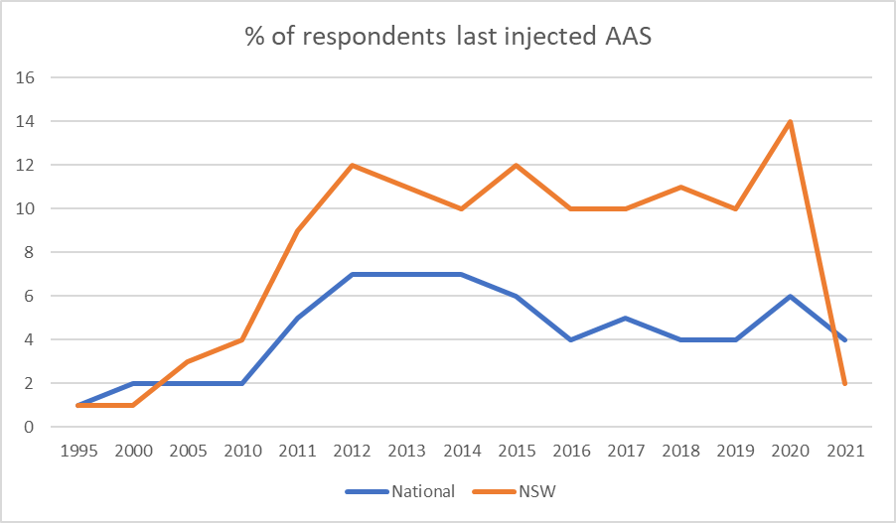
Prevalence
Prevalence:
Population studies show that PIED use in Australia is relatively low.
NDSHS: <1 in 100 people aged 14+ reported steroid use for non-medical purposes in 2016 (0.3% in 2001, 0.6% in 2016, 0.8% in 2019)
BUT there are indicators that PIED use is rapidly growing over the period 2005-2015, then stabilised or declined in recent years.
ANSPS: significant increase in PIEDs as ‘last drug injected’ over the period 2010-2014 (7%), followed by small decline to 2021 (4%)
NSW: 10-12%
Source: Australian Needle Syringe Program survey National Data
Notes:
Let’s now have a look at the prevalence rate in Australia.
When we look at population studies we see that the use of PIEDs for non-medical reasons in relatively low.
The National Drug Strategy Household Survey shows despite the overall number being small, there has been a growing trend in non-medical steroid use in the previous decade. Only 0.3% of people had done so in their lifetime from 2001 to 2007, but the proportion rose to 0.6% by 2016 and increased again to 0.8% in 2019.
However, these numbers are much higher when looking at studies that specifically target high-risk environments such as bodybuilding gyms. For example, one Australian study showed that the 51% of male gym users used non-prescribed steroids and other PIEDs.
This is however very targeted and does not give a good overview of the use in the general population. There are also some methodological issues with most population studies. So, the true prevalence rate in Australia in unknown.
But there are indicators that PIED use is rapidly growing, particularly in the time period 2005-2015.
For example, the Australian Needle Syringe Program survey National Data Report shows a significant increase in PIEDs as ‘last drug injected’ over the period 2010-2014, being 7 per cent, followed by small decline in 2021 (4%).
Interesting though, NSW is one of the states where last drug injected is higher than the national average, with numbers remaining stable at between 10% and 12%. Although it in 2021 all of the sudden dropped to 2%. It unclear what the reason for this is. It could be that less people used these services due to COVID.

Slide 8
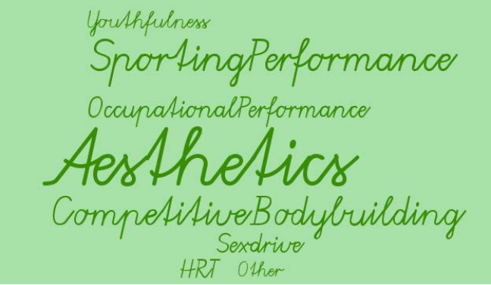
Why do people use non-prescribed AAS?
At what age do people usually start using?
Between the ages of 20 and 24 years old
Older men (40 and over)
Source: IPEDInfo
Notes:
At what age do people start using?
Between the ages of 20 and 24 years old - use can start as early as 14 years of age (rare).
We also see a group of older men (40 and over) who start using non-prescribed AAS mainly for anti-aging purposes.
But motivations for using non-prescribed AAS and PIEDs vary but the most common reported reason is for aesthetic purposes; so changing their body image or for cosmetic purposes.
Other reported motivations are:
For recreational and competitive bodybuilding;
To enhance sport performance;
To enhance occupational performance (e.g. security staff who uses AAS to become stronger);
Hormone replacement therapy
Retaining youthfulness
For anti-aging purposes.
To aid injury pain/anxiety/increase confidence

Slide 9
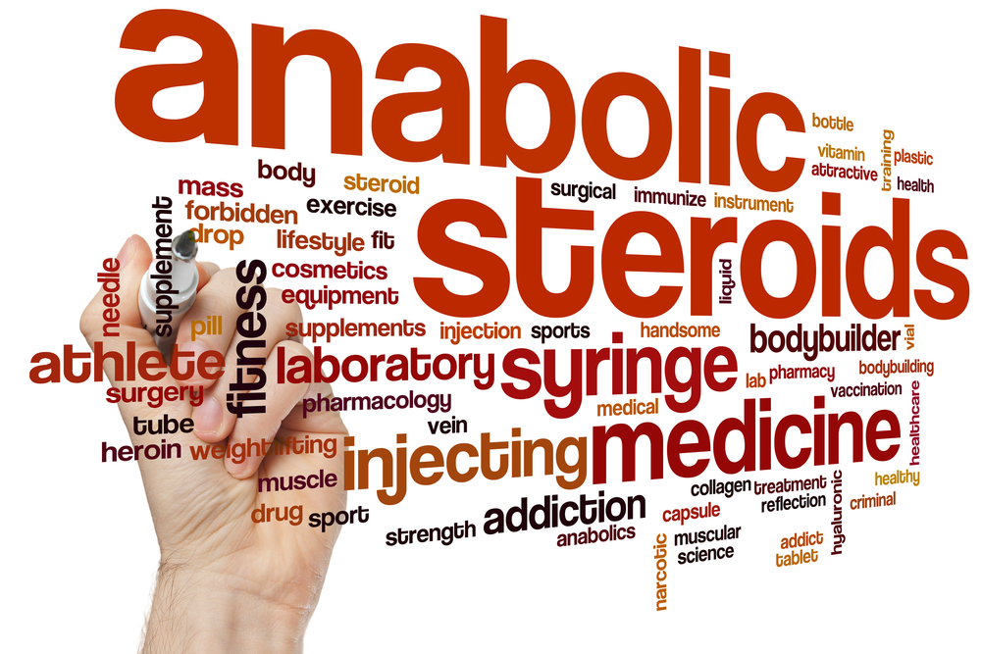
AAS Terminology
What are on and off cycles?
AAS are mostly used in cycles with a duration between 6 and 18 weeks, termed an ‘on cycle’. This is usually followed by a similar period of AAS-free training termed the ‘off cycle’.
Blast and cruise
‘Blast and cruise’ is the continuous use of AAS involving a higher dose – the blast – for a set period, followed by a lower dose – the cruise – for a set period
Post-cycle Therapy (PCT)
A primary concern of AAS use is its potential to supress natural testosterone production. In response, some consumers will use other pharmaceutical substances during or after cessation of use of AAS (i.e. off/post cycle) to help restart natural testosterone production.
Notes:
When engaging with patients who use non-prescribed steroids it might be good to be aware of some common terminology used by people who use these substances.
A common terms you might hear is using steroids in “cycles”.
• Steroids are mostly used in cycles with a duration between 6 and 18 weeks, termed an ‘on cycle’. This is usually followed by a similar period of AAS-free training termed the ‘off cycle’.
• The rationale behind this strategy is to gain muscle mass and strength during an on cycle, allowing the body to recover between on cycles.
So, the idea is that you minimise the risk of adverse effects by taking these breaks and maximise the effects of steroids when you start using again.
However, we increasingly see that people who use non-prescribed steroids either take a very short or no break at all. An example of this is called a “blast and cruise” approach.
• ‘Blast and cruise’ is the continuous use of AAS involving a higher dose – the blast – for a set period, followed by a lower dose – the cruise – for a set period.
• This rotation can continue for an extended period, up to several years, and due to the lack of any off-cycle this approach may potentially increase health risks associated with testicular shutdown.
Finally, something you might also commonly hear is the use of post-cycle therapy.
• A primary concern of AAS use is its potential to supress natural testosterone production. In response, some consumers will use other pharmaceutical substances during or after cessation of use of AAS (i.e. off/post cycle) to help restart natural testosterone production
• There is limited empirical evidence to support the effectiveness of current PCT approaches

Slide 10
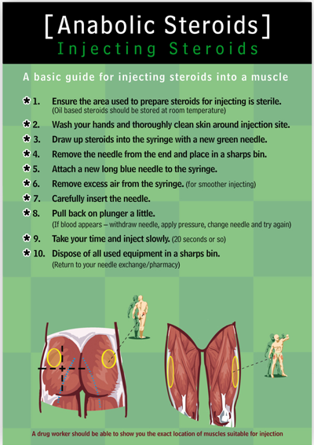
How do people administer non-prescribed AAS?
AAS are mainly injected or taken orally, depending on the product, and it is common to see people using a mixture of both injectable and oral products.
Both routes of administration carry risks, either via the injecting process (e.g. infection), or from extra strain on the liver caused by oral products.
Injectable AAS are injected intra-muscularly, typically into the gluteus (i.e. buttocks), outer thigh or shoulder.
Source: Exchange Supplies
Notes:
So, how do people administer non-prescribed steroids?
AAS are mainly injected or taken orally, depending on the product, and it is common to see people using a mixture of both injectable and oral products.
For example, in a global study involving more than a 1000 men who used steroids, around 30% reported using both injectables and oral steroids in their lifetime.
Both routes of administration carry risks, either via the injecting process. For example, one Australian study showed that 56% of people who injected steroids reported experiencing at least one injection-related problem in their lifetime, such as abscesses, scarring and hard lumps, and swelling of arm and leg.
But then there is also the risk of liver dysfunction caused by using oral products.
When injected, steroids are generally administrated intra-muscularly, typically into the glute, outer thigh or shoulder.
I would recommend having a look at the PIED guide, as there are several resources for health professionals and patients which discuss the safest techniques for reducing AAS injecting related harm, including a video.

Slide 11
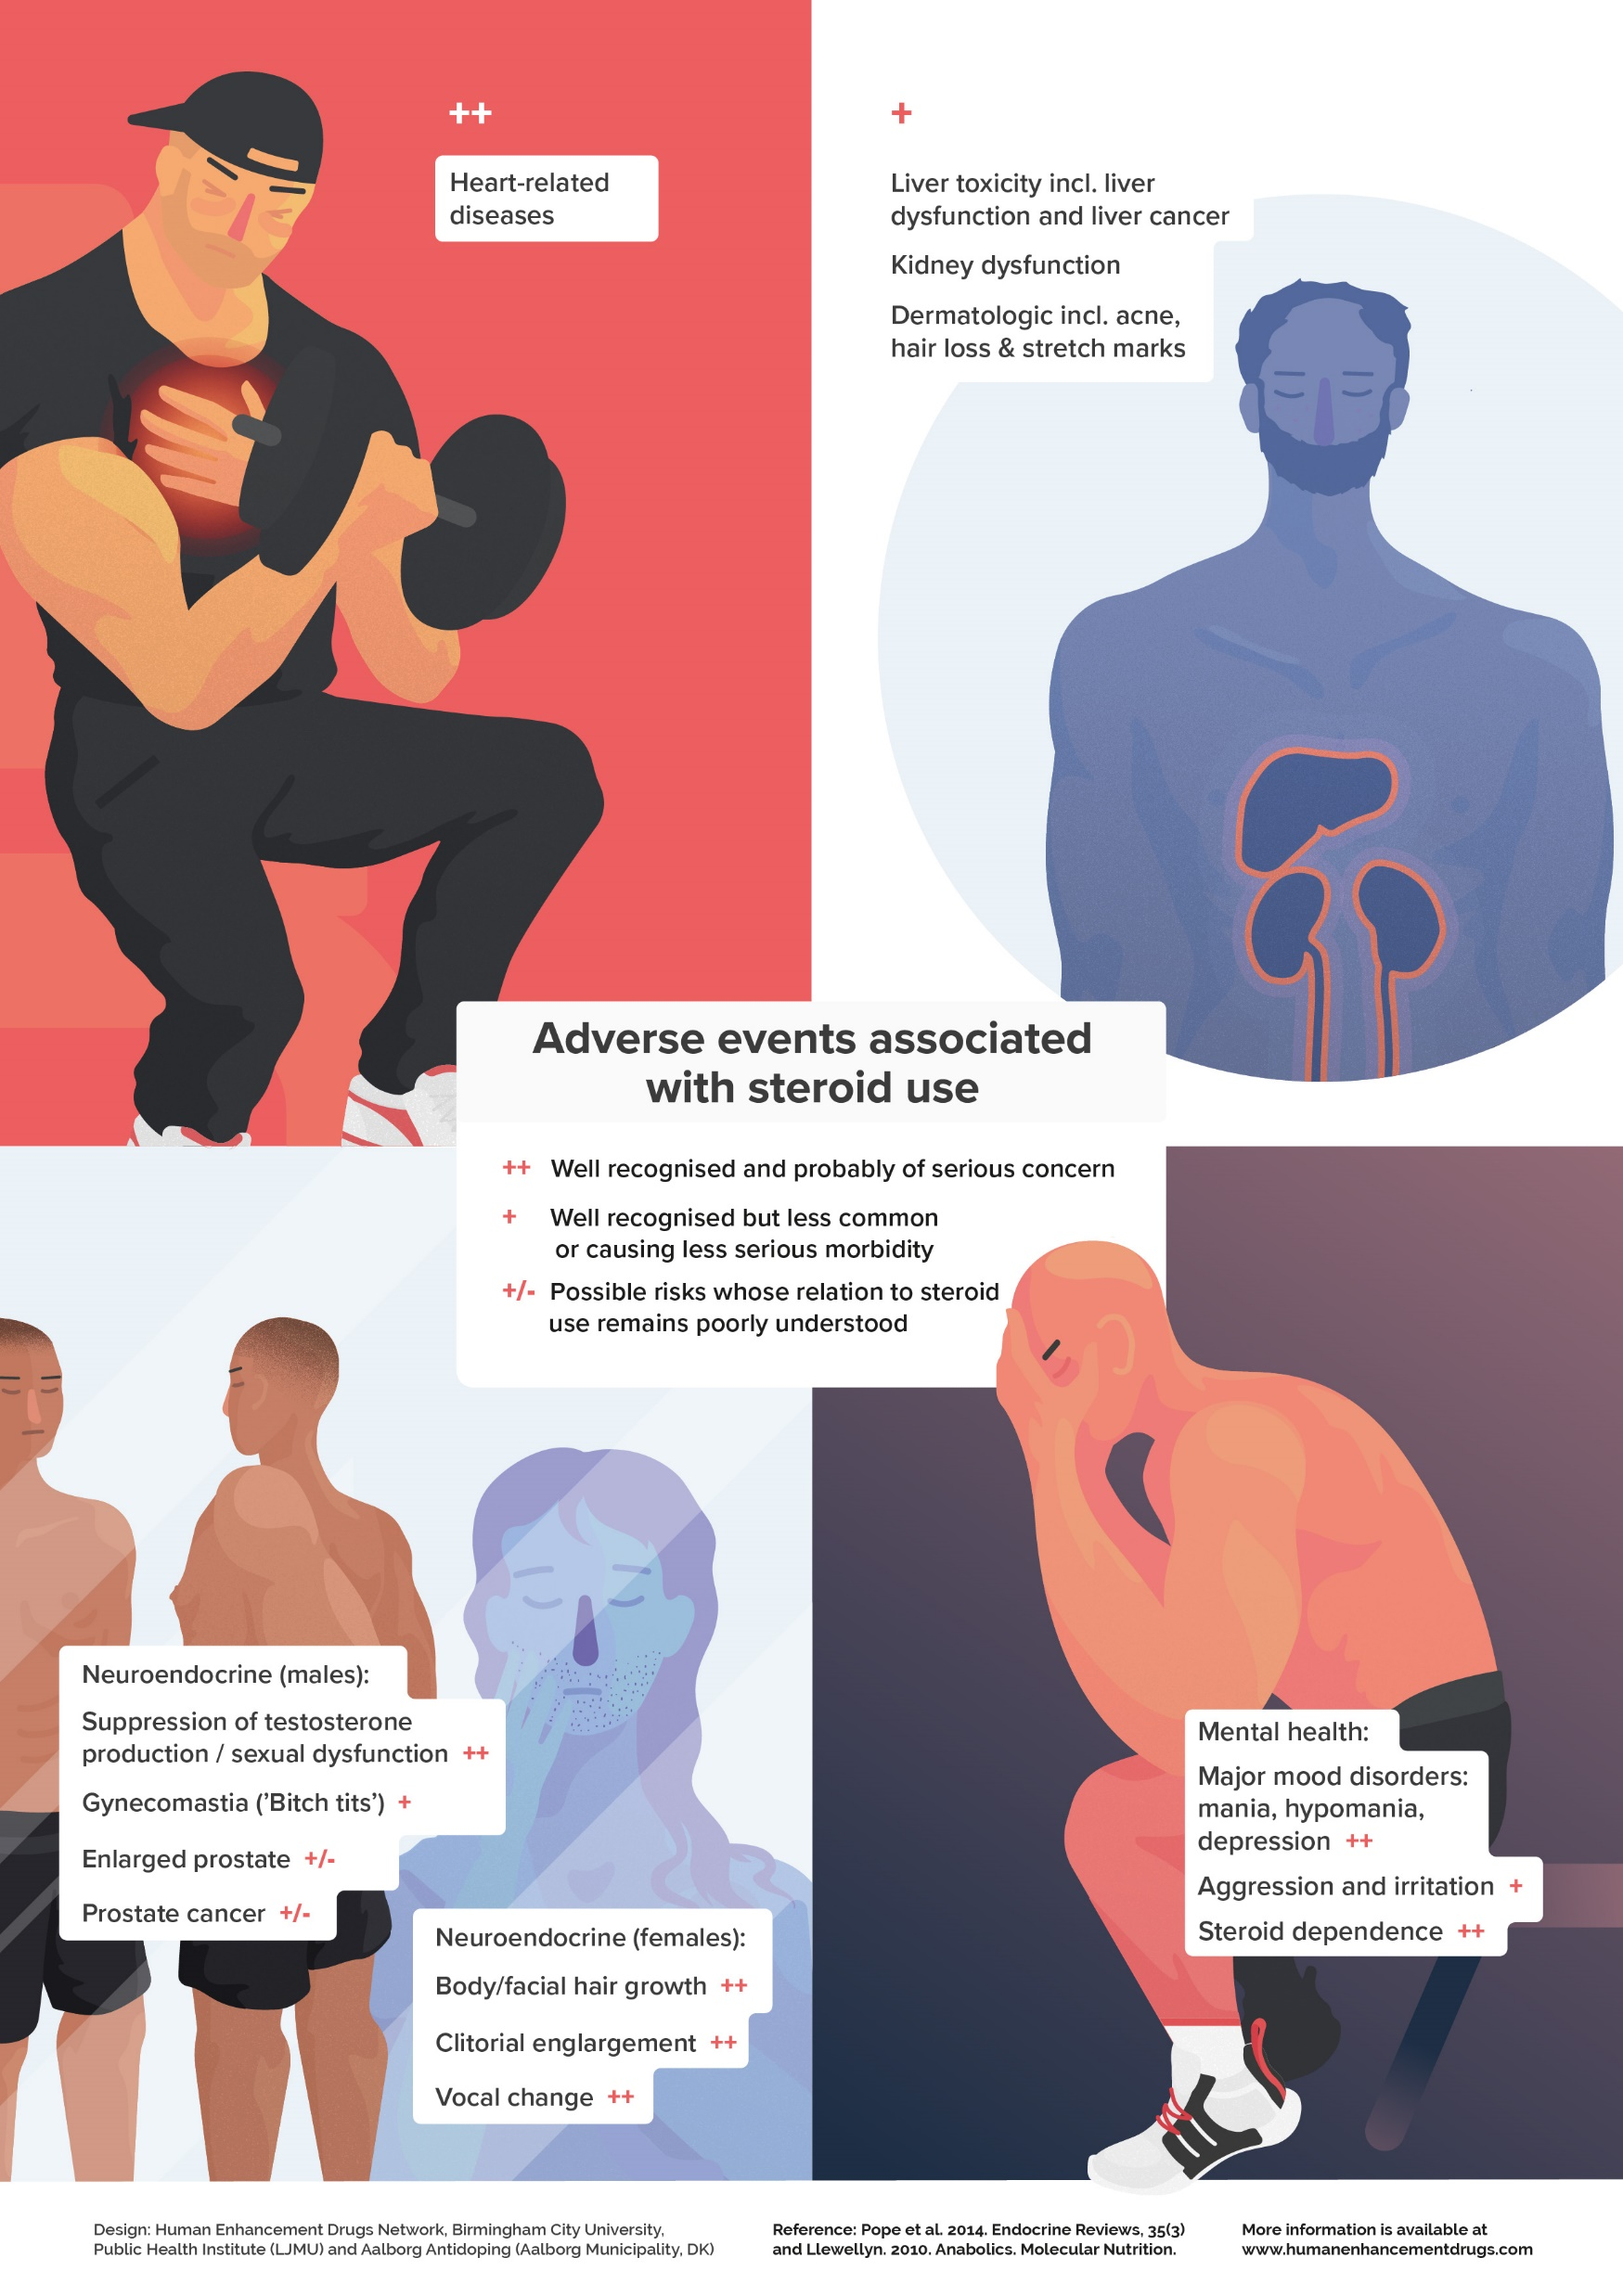
What adverse effects are reported?
Health harms are related to:
The substances themselves
Physical harms
Psychological harms
Related to their mode of administration
Oral
Injecting
Other harms: e.g.
The quality of black market steroids
Source: Human Enhancement Drugs Network
Notes:
There are a wide range of health harms that are related to:
READ SLIDE
Note that Kay will say more regarding injecting-related harms.
Adverse effects that have been well-established in relation to steroid use are cardiovascular issues, cognitive deficiencies, and steroid dependence and depression.
In my work with health professionals something that is often noted as a reason for which patients present are symptoms related to steroid withdrawal, such as decreased libido, being tired, feeling depressed, which often related to hypogonadism. I believe my colleague Dr Han will come back to this.
It is however important to remember that not everyone will experience adverse effects, that many are reversible when stopped, for example hair loss and acne, and that people also experience pleasurable effects.
Pleasurable effects, for instance, that have been reported are increased body image satisfaction, increased sex drive, increased confidence and increased muscularity.
Someone is also more or less likely to develop adverse effects depending on their duration of use, the amount used, the type of substances used, and so on. For example, steroids can impact your cholesterol which does not necessarily carry an immediate threat. However, long term disturbances may increase the risk of cardiovascular incidents.
And when we then think of the blast and cruise approach I mentioned earlier we do see in research that this group is more likely to report adverse effects due to not halting their use.
We particularly see that younger consumers are adopting this blast and cruise approach. But outside of not stopping, we also see that they tend to use high quantities, more different steroids at once, and other PIEDs. This is concerning as this increases the risk of developing adverse effects.

Slide 12
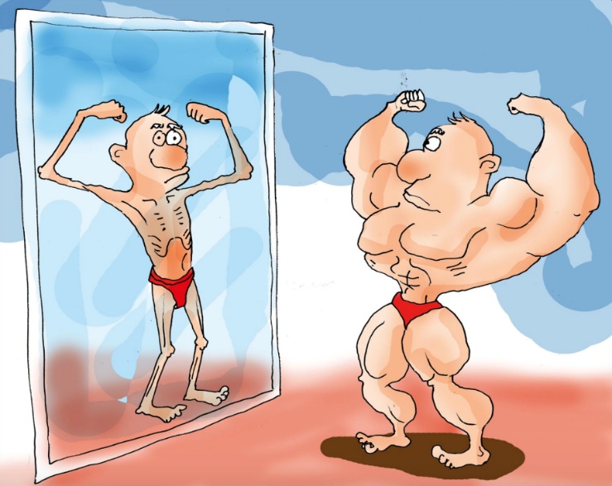
AAS Dependence
Steroid dependence
Muscle dysmorphia (i.e. “bigorexia”)
Notes:
I just want to talk a little bit about steroid dependence.
In terms of steroid dependence, it is important to note that research is pointing to two pathways into dependence.
Dependence is characterized by long-term use of steroids, often for many years, and frequently in spite of side effects.
Steroid dependence may be part of a larger pattern of dependence on PIEDs, involving other substances in addition to steroids, such as human growth hormone, insulin, and weight-loss drugs such as clenbuterol, amphetamines, and thyroid hormones.
Physical appearance concerns are uniquely associated with the severity of steroid dependence and depression in steroid consumers.
There appears to be a “body image” pathway into dependence, in which the individual becomes preoccupied that he will lose muscle size when he stops taking steroids and becomes reluctant to stop his use even for a short interval. This is also referred to as muscle dysmorphia, or as the media would like to call it ‘bigorexia’, in which a person is muscular and trained but sees himself as really small.
Another way is when consumers stop using steroids and their natural testosterone production stays suppressed and does not start naturally. The medical term for this is what I referred to earlier as hypogonadism. This can lead to a loss of sex drive, being tired, and in some cases serious depression. Instead of going to a GP, consumers will just start a new cycle to avoid these feelings. This seems to be a more common pathway to steroid dependence as opposed to the body image pathway.
Research and my work with GPs generally see little steroid consumers who meet the diagnosis for a body image disorder. Although it is good to be mindful of potential underlying body image disorders, it seems that for many patients this is not necessarily an issue. So, it is important to remember that most people who use steroids do not have a body image disorder, but what we do see is that if people have a body image disorder that they have an increased risk of using steroids.

Slide 13
Summary
Although population studies show that PIED use in Australia is relatively low, there are others indicators which indicate that their use is growing.
The most common type of PIEDs are anabolic-androgenic steroids;
Other PIEDs are often used to achieve augmented effects; minimise adverse effects of AAS use; and for recreational purposes.
AAS are mainly injected or taken orally.
AAS are used by both younger and older people.
Motivations for use vary but the main driver is for aesthetic purposes.

Slide 14
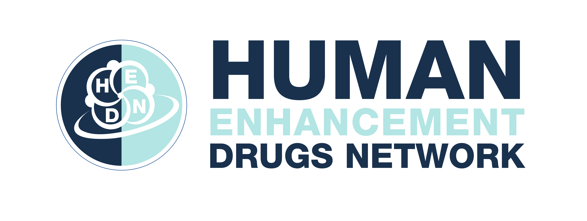
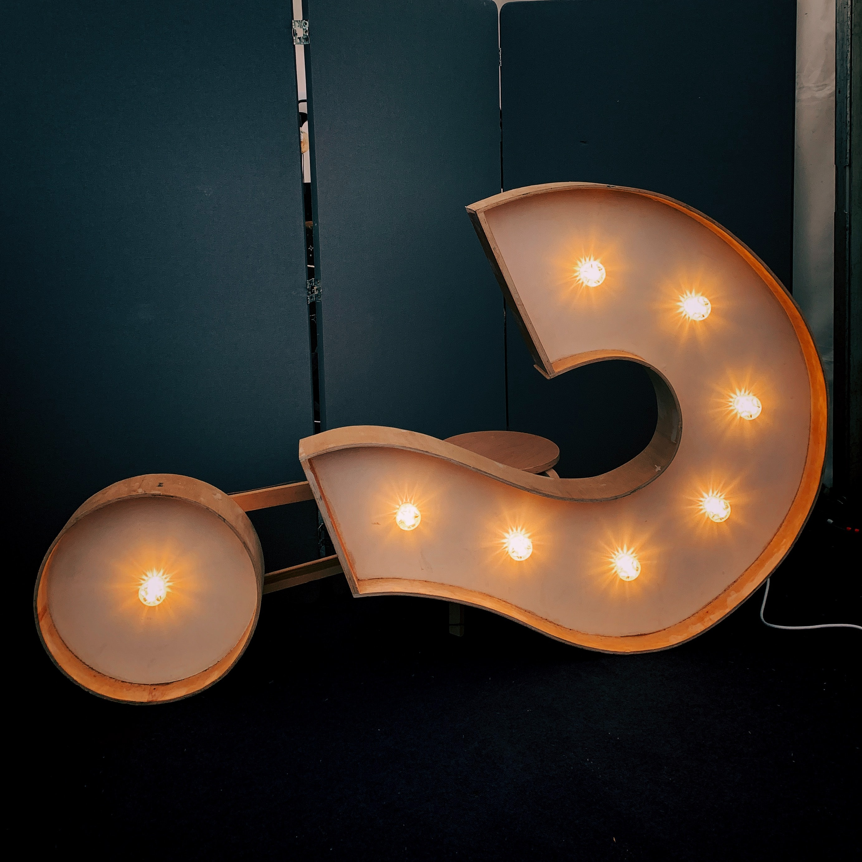
Questions?
Contact details:
Dr Katinka van de Ven
Email: K.vandeVen@une.edu.au
Twitter: @KatinkavandeVen & @EnhancementDrug
Image by Jon Tyson from Unsplash

