Slide 1

The National Cancer Screening Register
  TIPS AND TRICKS TO ACCESSING THE NATIONAL CANCER SCREENING REGISTER
    Amy Callinan
    September, 2023
      WE ACKNOWLEDGE THE TRADITIONAL OWNERS & CUSTODIANS OF THE
      LAND THAT WE LIVE & WORK ON AS THE FIRST PEOPLE OF THIS COUNTRY.

Slide 2










What is the national cancer screening register?
Send invitations and reminder letters
Provide a “safety net” for at risk persons
Provide a history of screening results
Integrated clinical software
Healthcare provider portal
Access your patient’s bowel and cervical screening results and histories online
Submit forms electronically
Manage your patient’s details and preferences
Order Bowel Screening Test Kits

Slide 3


National Cancer screening register
What to know before you get started
The National Cancer Screening Register is not an option under “My Programs” but located under "Available services" on the PRODA home page.
HPOS and NSCR delegation are two separate processes for nurse and non-clinical staff.
Once you have gained access and have logged in to the Register via the Healthcare Provider Portal there is no functionality to go “back” and access other services under PRODA such as HPOS.
Consider setting up access to the Register via the Healthcare Provider Portal prior to integrating software.
The NSCR software integration process and initial registration needs to occur be done under the organisations PRODA not your practice Responsible Officer (RO) PRODA.
If a patient has “aged out” of the National Cancer Screening Program/s you will need to advise the relevant Program.
You are accessing patients clinical information RACGP Position Statement: non GP initiated testing
Username: centralcoast
Password: 1connect
Username: hnehealth
Password: p1thw1ys

Slide 4

THE Healthcare provider portal
Requires access via PRODA
2. Registration to be completed by General Practitioner
3. Delegation can be provided clinical and non-clinical team members

Slide 5
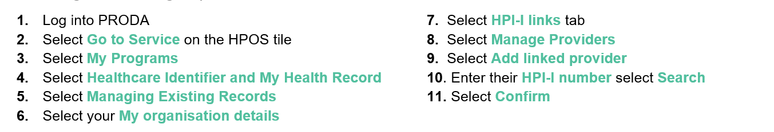

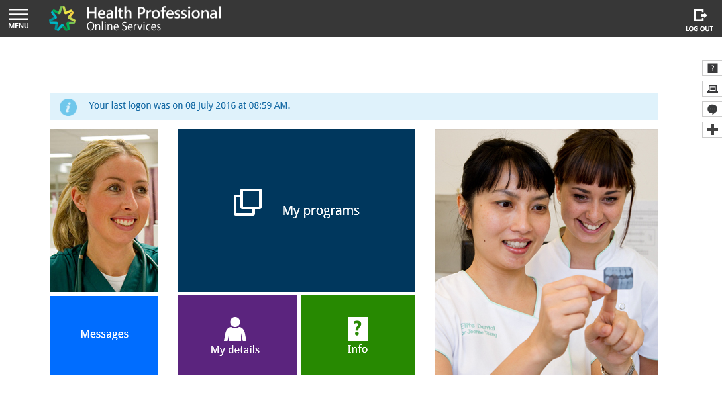
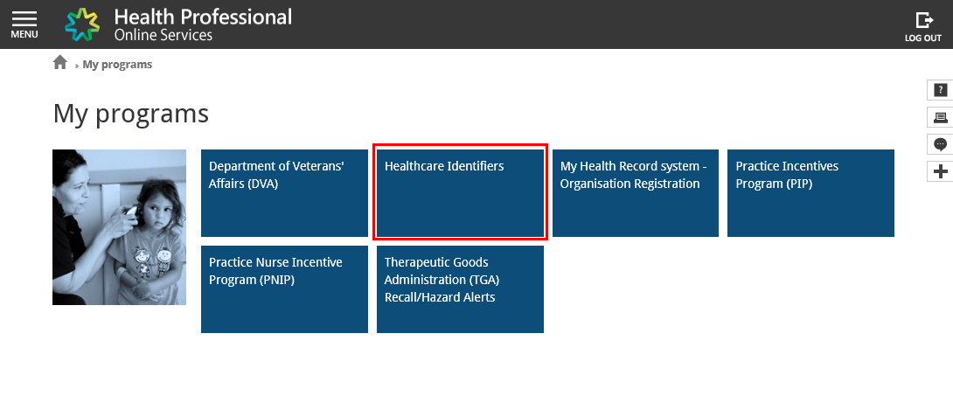
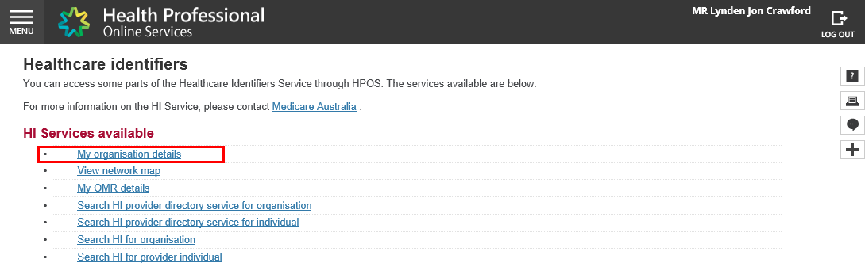
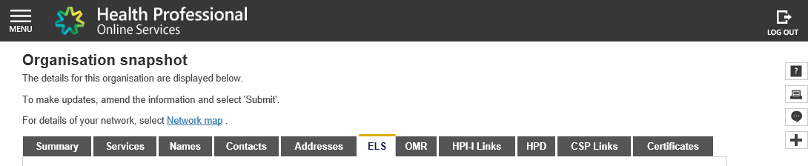
National Cancer screening register: access via the healthcare provider portal
Pre-registration Process
General Practitioners will need to ensure their Health Provider Online Service (HPOS) account is linked to the General Practice Healthcare Provider Individual Organisation (HPI-O) number. The General Practice Responsible Officer (RO) or Organisation Maintenance Officer (OMO) can verify this link has occurred via undertaking the following steps:

Slide 6
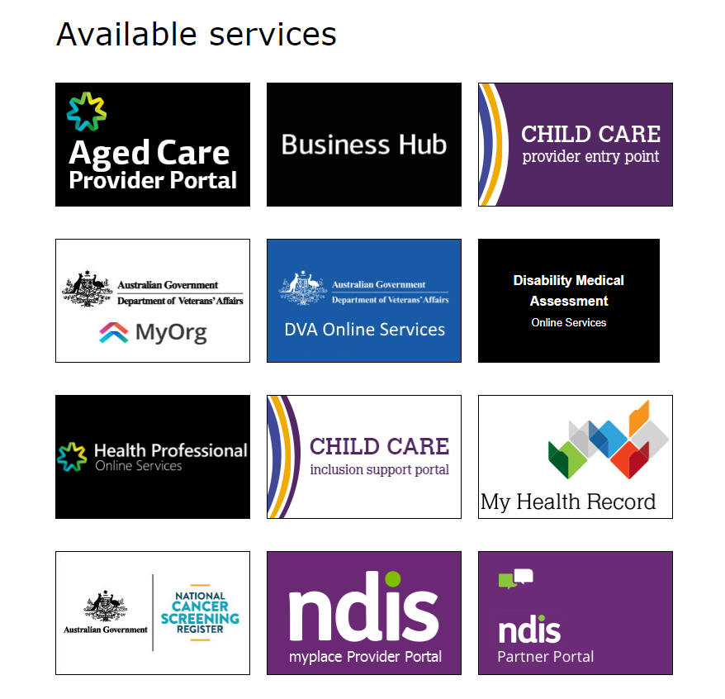
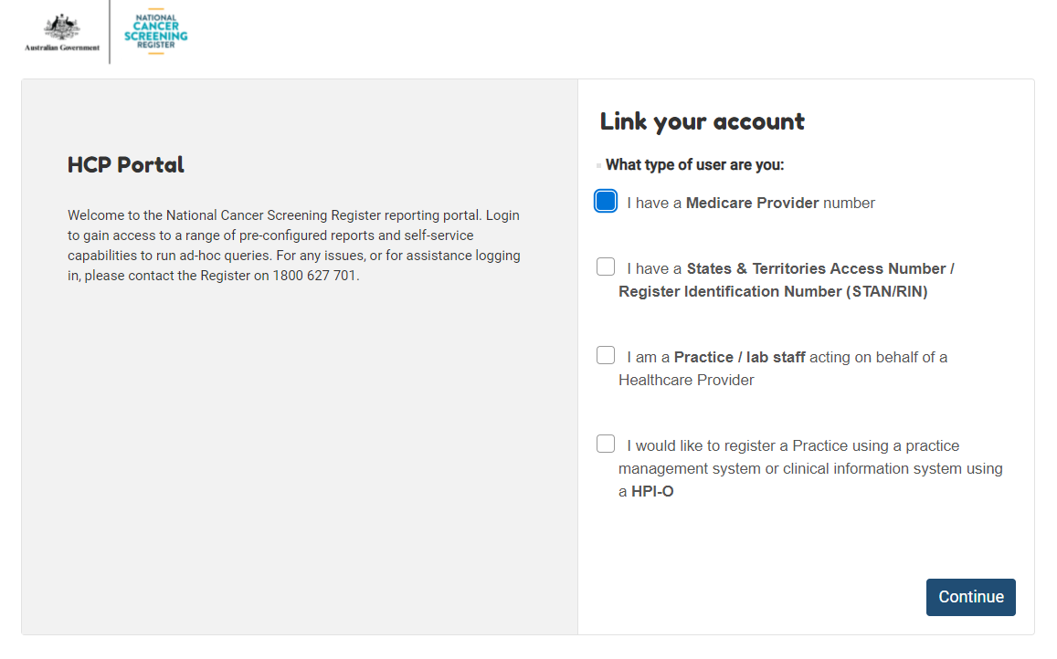
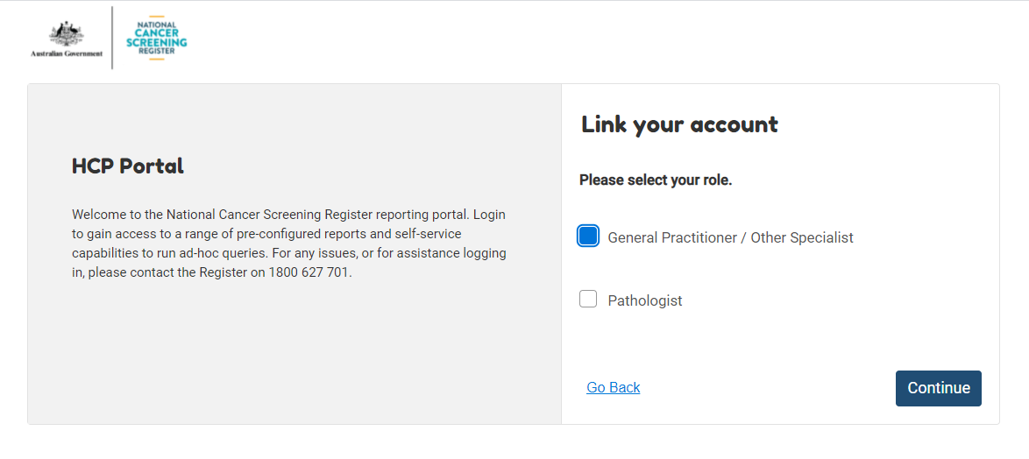
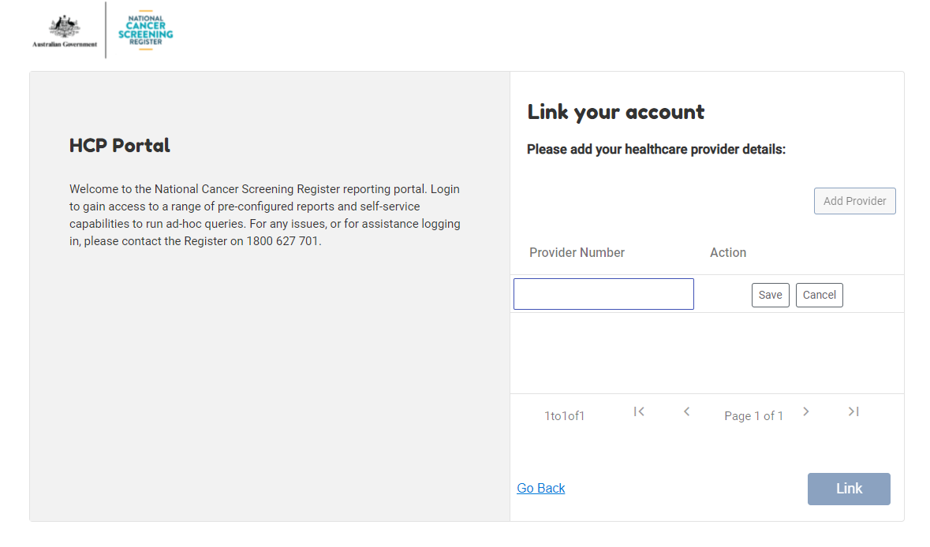
National Cancer screening register: access via the healthcare provider portal
Registration Process for General Practitioners

Slide 7
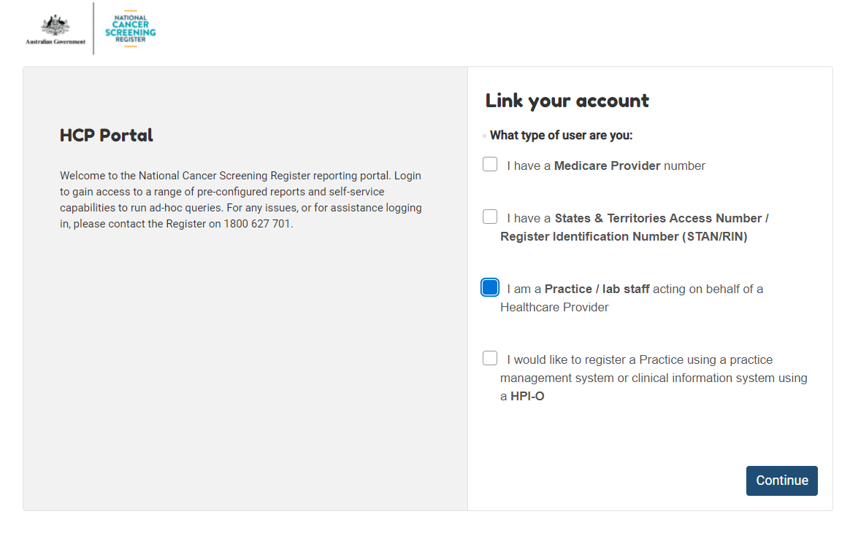
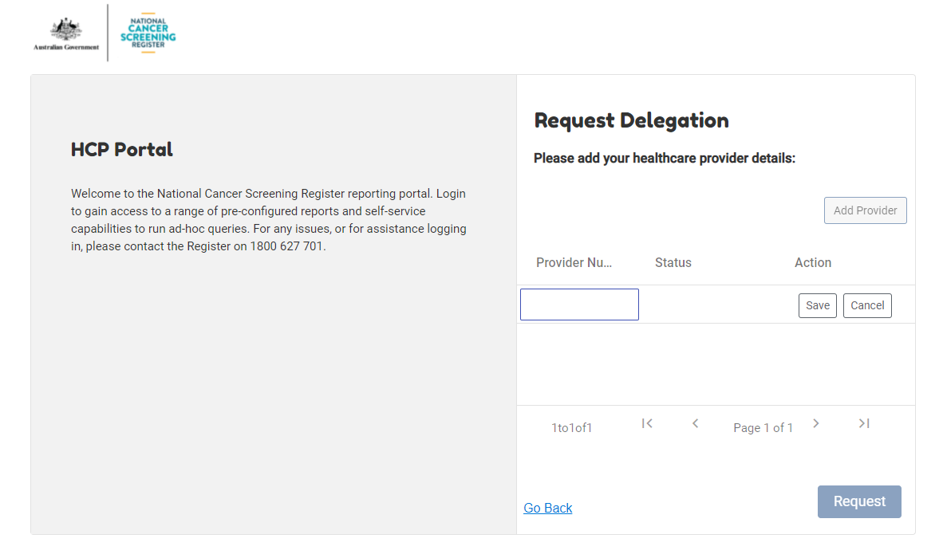
National Cancer screening register: access via the healthcare provider portal
Requesting Delegation Process for Clinical and Non-Clinical Staff
Administration and other clinical staff i.e. Practice Nurses require delegation by a General Practitioner to access the National Cancer Screening Register via the Healthcare Provider Portal.

Slide 8
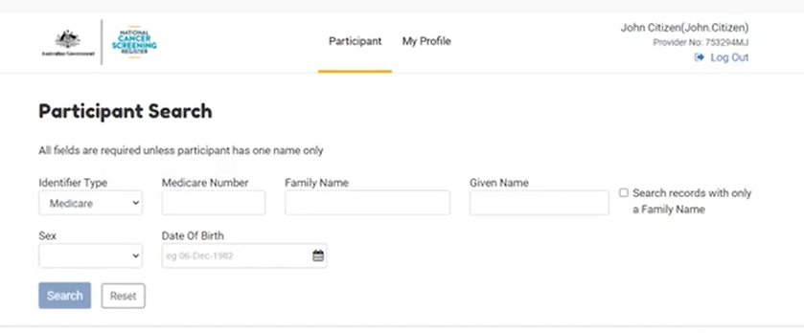
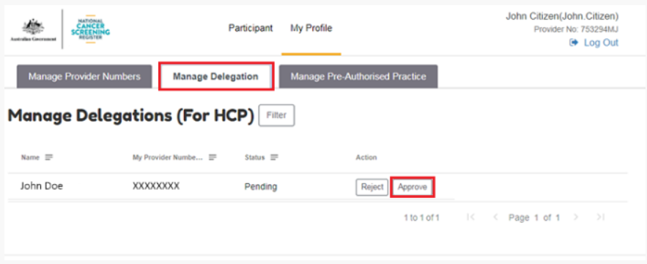
National Cancer screening register: access via the healthcare provider portal
Approving Delegation Process for Clinical and Non-Clinical Staff

Slide 9
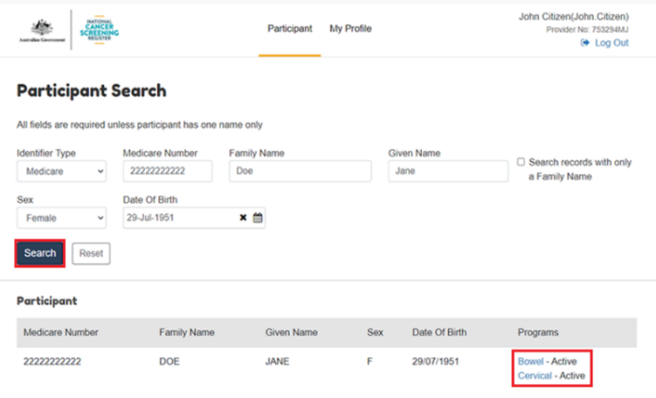
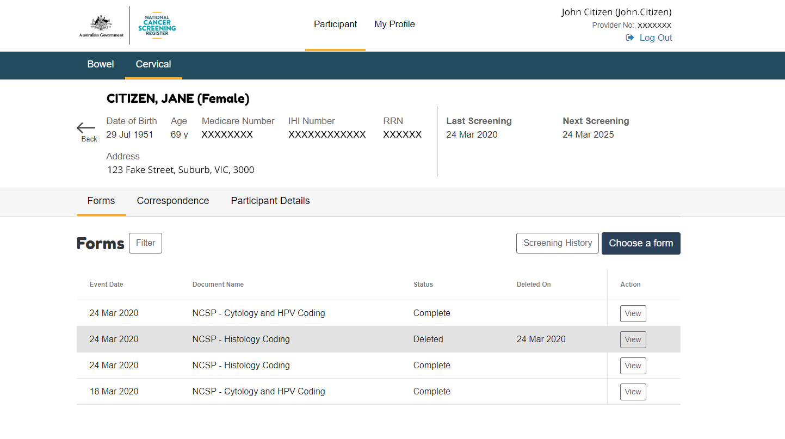
National Cancer screening register: access via the healthcare provider portal
Viewing a Participant Dashboard

Slide 10
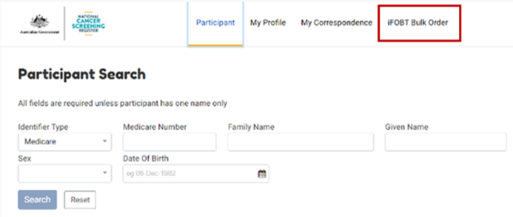
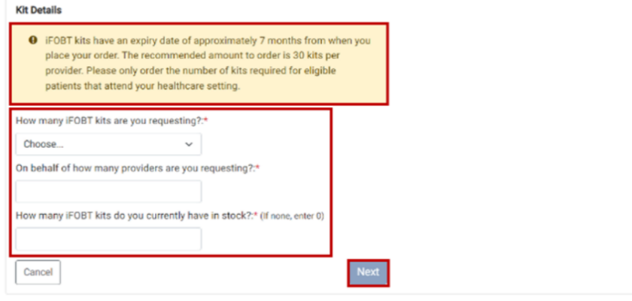
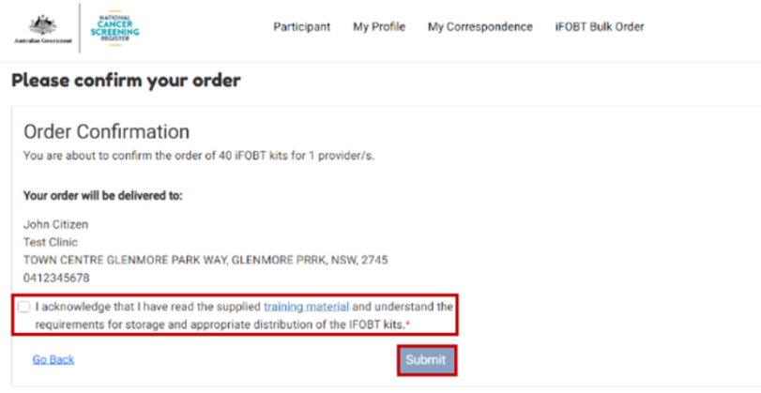
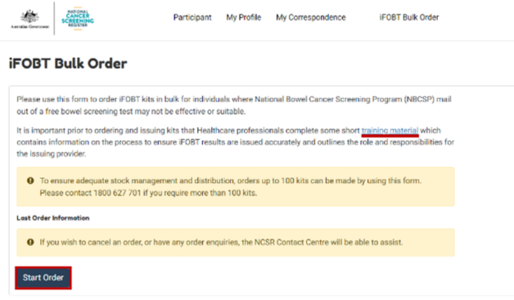
National Cancer screening register: ALTERNATIVE ACCESS TO kits model
Bulk ordering of iFOBT Kits
The Alternative Access to Kits Model allows health professionals to give bowel screening kits to their patients directly. General Practices can submit a bulk order of bowel screening kits via the Healthcare Provider Portal.
When issuing bowel screening kits, print a copy of the Participant Details Form for the patient to include with their samples in the reply-paid envelope.
Prior to ordering kits for the first time, training must be undertaken to understand the alternative access to kits model and your General Practice role it in. For further information visit: https://www.health.gov.au/our-work/alternative-access-to-bowel-screening-kits-guide

Slide 11

Software integration
Ensure your software is up to date
Register your General Practice for Clinical information System Integration
Enable the National Cancer Screening Register function with your clinical software
Refer to your IT Provider and technical information available from your clinical software provider.
Software integration
Clinical Software | Software Version
Best Practice Premier | Saffron (January 2021)
Medical Director Clinical | V 4.0 (August 2021)
Communicare | V 21.3 (December 2021)

Slide 12
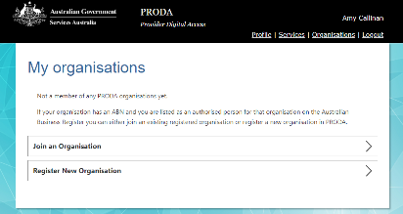

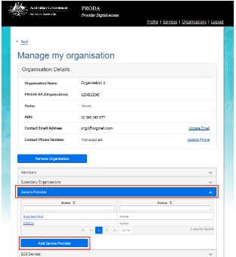
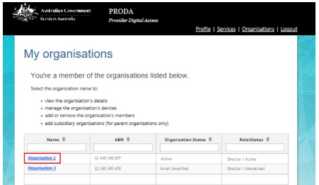
National Cancer screening register: access via integrated software
Pre-registration Process completed by the Responsible Officer
The Responsible Officer:
is either an Associate or Authorised Person on the Australian Business Register (www.abr.gov.au).
Please note personal details listed on an individual PRODA must reflect those recorded with the Australian Business Register.
has registered the General Practice as an organisation in using their PRODA.
is listed as a member the organisation within PRODA such as “Director”.
has linked the National Cancer Screening Register as a Service Provider.
Needs to complete registration under the Organisation

Slide 13
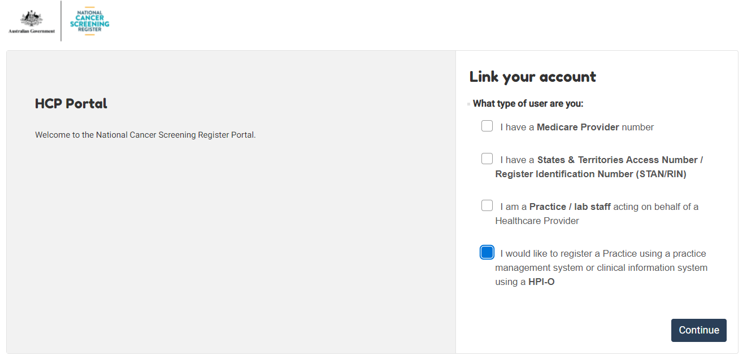
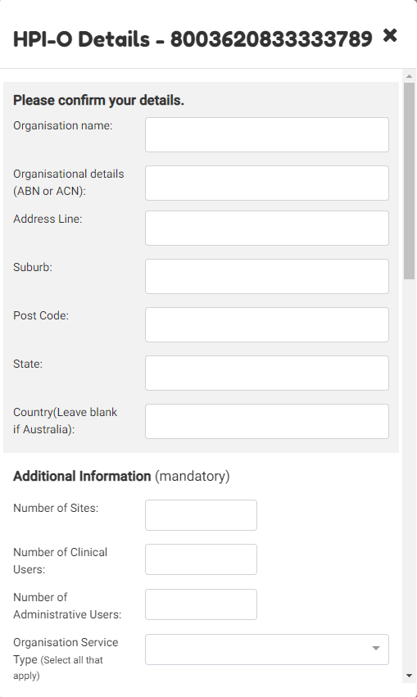
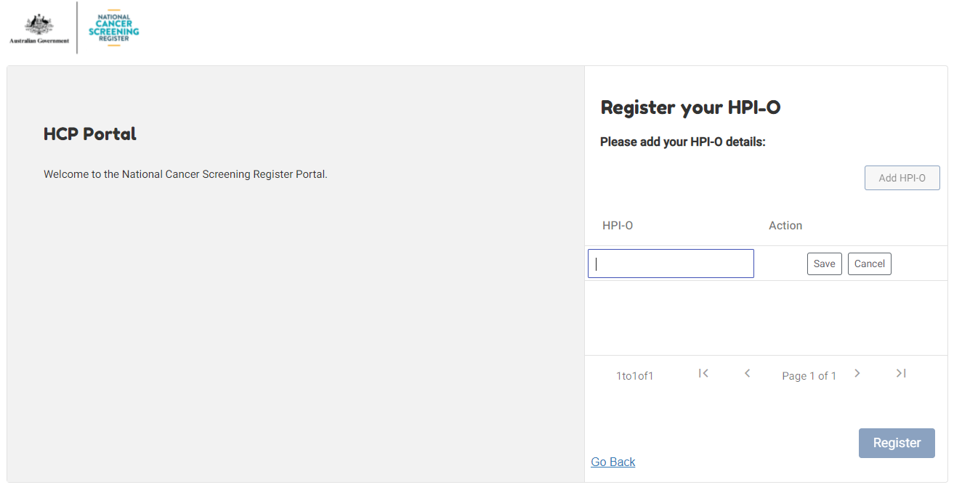
National Cancer screening register: access via integrated software
First time Healthcare Provide Portal Users

Slide 14
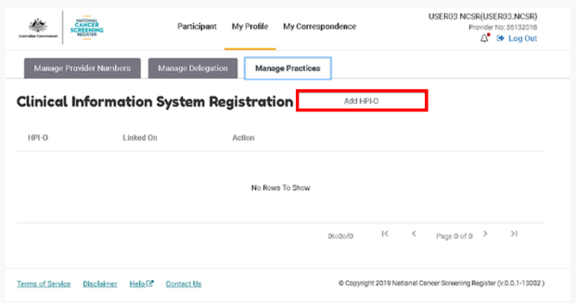
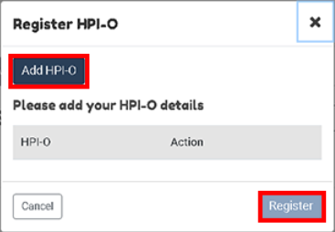
National Cancer screening register: access via integrated software
Existing Healthcare Provider Portal Users

Slide 15



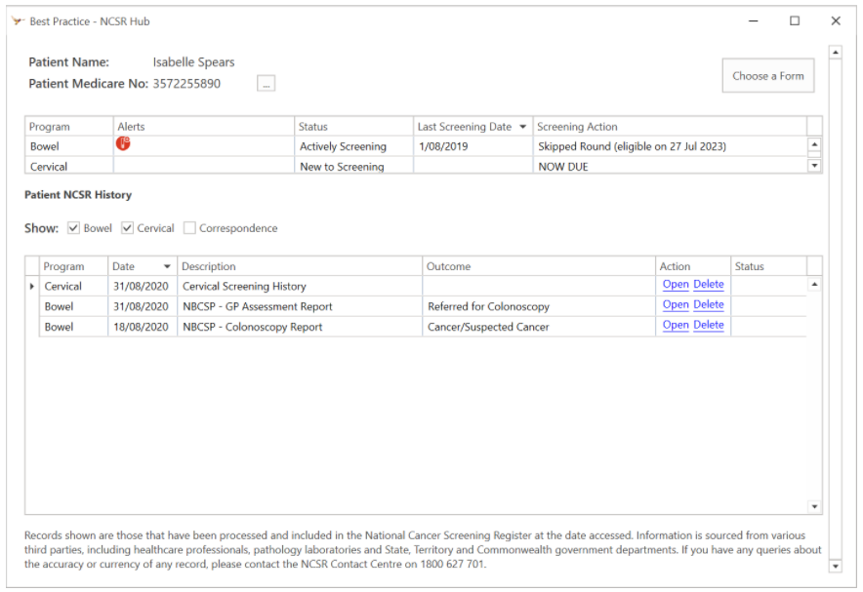
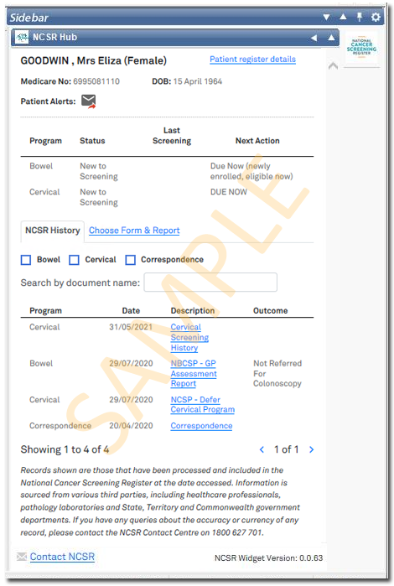
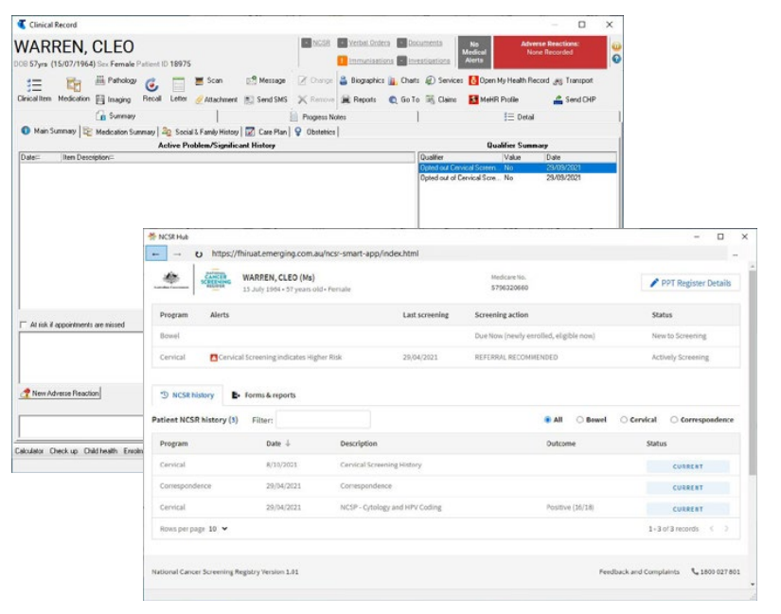
National Cancer screening register: access via integrated software
Functionality in clinical software
BP Premier Saffron
Search: Set up > Clinical Integrations > Set up NCSR Integration
Note: prior to enabling NCSR Integration, ensure that FHIR API has been installed first on your General Practice server.
Medical Director Online Help
Search: User Guides > Clinical > eHealth > Widgets > Telstra Health NCSR Widget
Communicare Knowledge Centre
Search: Integrations > National Cancer Screening Register
Note: prior to enabling NCSR Integration, ensure that your administrator/IT provider has enabled NCSR access.

Slide 16


National Cancer screening register
Utilising the Register in General Practice
Opportunistic: Real-time
Systematic: Data cleansing
New patient forms and consults
Health assessment inclusions
715 Health assessments
GPMP inclusions
Actions/Alerts
PEN CS/CAT 4
Identify underscreened patients
Discuss your patients of focus
Effective reminders
  Quality Improvement Practice Incentive Program
      QIM9: proportion of female patients with an up-to-date cervical screening
  RACGP Standards for General Practice (5th edition) Accreditation
      Core Standard 6: Information Management
      GP Standard 2: Comprehensive Care
      QI Standard 2: Clinical Indicators
  My Health Record Practice Incentive Program
      Requirement 3: Data Records and Clinical Coding and secure messaging

Slide 17







National Cancer screening register
Technical Support
Healthcare Identifier Service: 1300 361 457
PRODA Hotline: 1800 700 199
National Cancer Screening Register Assistance: https://outlook.office365.com/owa/calendar/TelstraHealthNCSR@health.telstra.com/bookings/
P: 1800 627 701
W: https://www.ncsr.gov.au/
M: National Cancer Screening Register
Reply Paid 90964, SUNSHINE VIC 3020
W: thephn.com.au
Contact your Primary Care Improvement Officer

Slide 18
Don’t stress; we’ve got you covered!
  Amy Callinan
  acallinan@thephn.com.au
  0438 545 986

