Slide 1
PIEDS Webinar
8th Feb 2023
Dr Esther Han BMedSci MBBS DCH FRACGP FAChAM
GP – Brellah (Health Collaboration)
Drug & Alcohol Staff Specialist – Royal North Shore Hospital
Clinical Lecturer – Discipline of Addiction Medicine, Northern Clinical School, Faculty of Medicine and Health, The University of Sydney

Slide 2
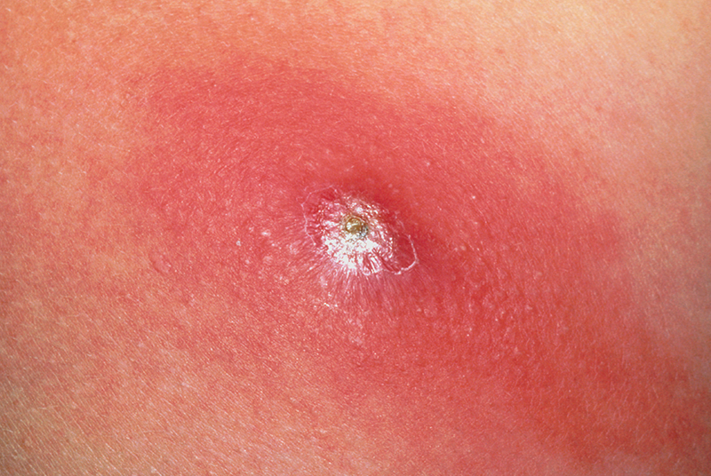
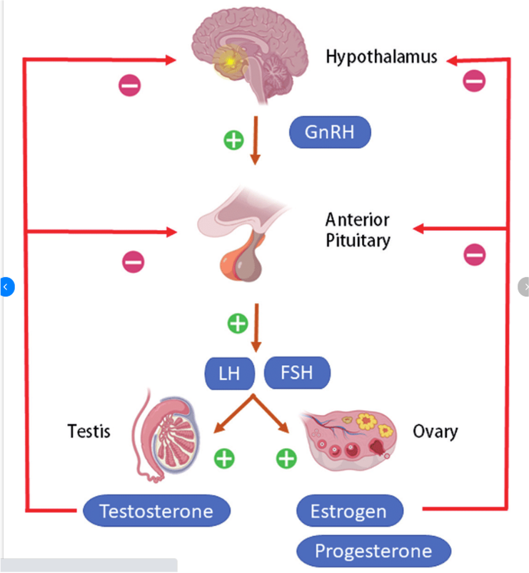
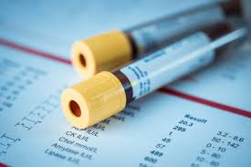
Common Presentations
Notes:
- Adverse side effects from using PIEDS, e.g. acne, gynaecomastia, blood derangements, complications related to injecting, e.g. abscesses, cellulitis
- Adverse effects stopping using PIEDS - testosterone withdrawal symptoms, depression, low libido, erectile dysfunction, fatigue, hypogonadism
- Proactively for monitoring blood tests on and off cycle, pre-cycle
- Requesting medications, e.g. PCT, or testosterone replacement

Slide 3
Assessing for AAS/PIEDS use
Do you use or take anything to help with your workouts or muscle gain?
Can you tell me about supplements you are using, including any pills, powders or injectables?
I’m asking these questions to see if we need to check for any other related health issues
Notes:
Reassure confidentiality - won’t disclose to others, e.g. family members or police
Routine part of D&A history taking - Do you use or take anything to help with your workouts or muscle gain?
Can you tell me about supplements you are using, including any pills, powders or injectables?
I’m asking to see if there are any other health related issues I need to check for
Non-judgemental - take a balanced approach, I can see that you’re hoping or gaining some benefits from using and yet I’m concerned about possible bad health effects

Slide 4
Remember it may not be obvious

Slide 5
Red Flags
Young person <21yo and women
Comorbidities
Abnormal examination or Ix results
Mental health and/or substance use
Notes:
Use by a young person (<21 years) and women – high risk of irreversible complications, even with short-term use
Comorbidities (e.g., cardiovascular disease, hypertension, hypercholesterolemia, polycythaemia)
Abnormal test results (e.g. blood tests, electrocardiogram, blood pressure)
Mental health disorders and/or other substance use disorders

Slide 6
Investigations
FBC
UEC
LFTs
LH, FSH, testosterone, oestradiol, SHBG
PSA
Lipid profile
B-HCG

Slide 7
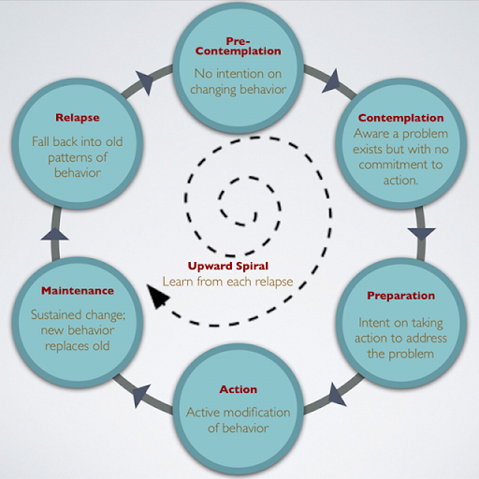
Motivational strategies for each stage of change
Notes:
What might you do with your patient in this stage?
Precontemplation
Establish rapport, ask permission, build trust
Raise concern in the patient about behavioural patterns (feedback)
Harm reduction
Contemplation
Normalise ambivalence (reflect)
Elicit change talk, self-motivational statements of commitment
Preparation
Clarify goals and strategies for change (affirm)
With permission, offer information and guidance

Slide 8
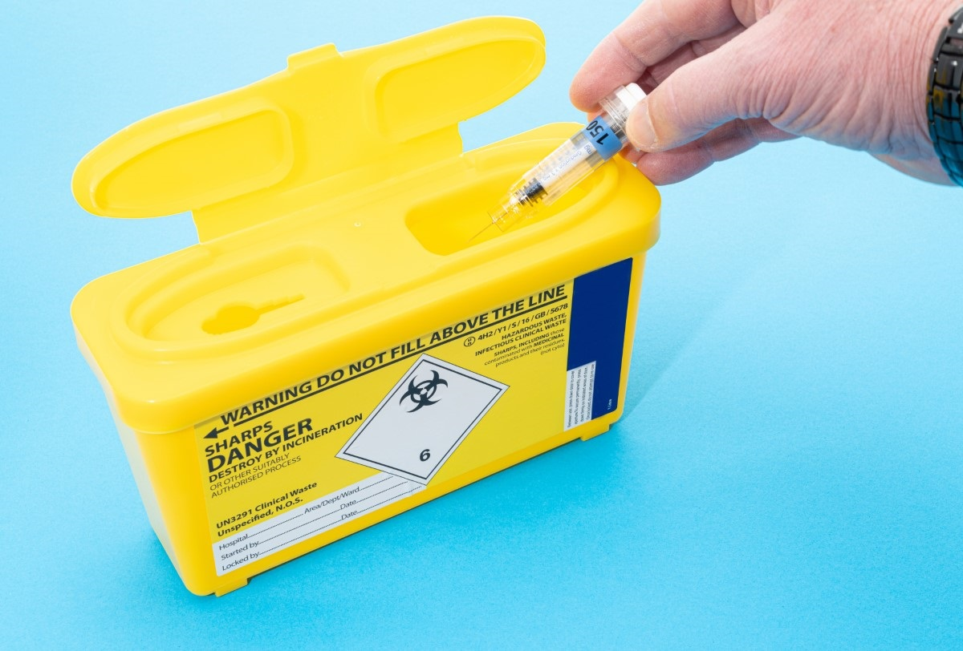
Management Tips
Meet person at THEIR stage of change
Provide education & balanced information
Harm reduction ++
Treat health issues, e.g. acne, gynaecomastia
Refer as needed
Elite athletes
Notes:
Ask about their goals - refer to nutritionist/dietitian and certified trainers to try reach goals
NSPs, injecting information, safe disposal, blood monitoring
Mixing PIEDS with other drugs, alcohol + oral steroids - liver damage, more aggression with AAS + stimulants
Quality and safety of black market PIEDS is unreliable, seek medical help immediately if experiencing bad effects, reassurance they won’t get in trouble
GPs & HCPs treating elite athletes need a basic understanding of anti-doping rules and violations

