Slide 1
Working together to improve OUTCOMES on ORT
We can make a difference

Slide 2
A little about me
Newcastle Knights Rugby League Player (1995-2001)
Dietitian (2001 to current)
Grad Cert Diabetes Education
Pharmacist 2012 to current
My Community Pharmacy owner 2018 to current, focus on being a healthcare destination.
‘My passion is not just preventing disease but improving well-being’

Slide 3
We can make a difference
“You can't understand someone until you've walked a mile in their shoes.”
Meet Darren
- Spent most of his life in prison, from a regional NSW town who was trying to deal with childhood trauma, almost stabbed to death and had undiagnosed mental health conditions

Slide 4
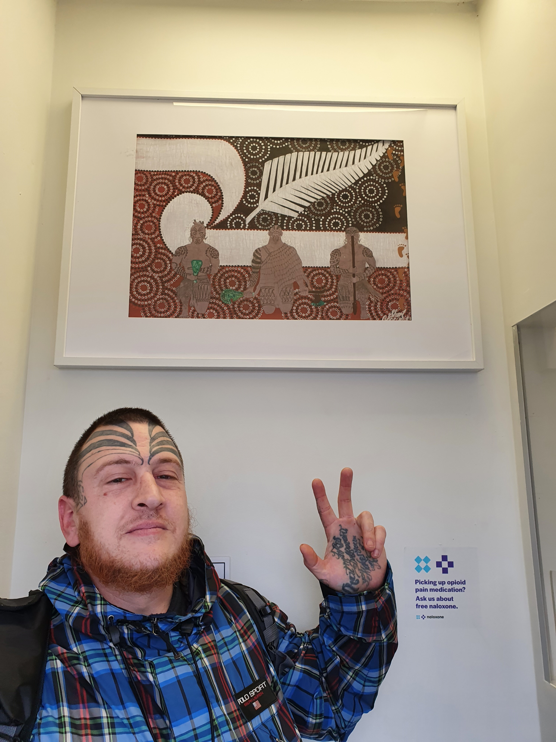
WHAT WE WILL COVER TODAY
Navigating the regulatory framework for opioid dispensing
Working collaboratively as part of the team to improve patient outcomes
What is the future for the role of the Pharmacists in Opioid Treatment
Meet Sharl, grew up living in Western Sydney and a Maori village in New Zealand from a Lebanese father and Maori mother.

Slide 5
Regulation
Prescriber Regulation
Pharmacy Regulation
Patient Considerations
Training
Prescribing
Monitoring
Approvals
Training
Dosing
Observation
Fitness to Drive
Safety

Slide 6
Authority to prescribe ORT
An Authority to prescribe must be obtained prior to prescribing
The pharmacy is not responsible for your authority to prescribe.
Prescribers must apply for an NSW authority from PRU before prescribing any other S8 drug
Notify PRU of locum arrangements when you go on leave
Notes:
- Prescribers must obtain authority to prescribe methadone or buprenorphine form before prescribing
Prescribing other S8s is a problematic because the patient can obtain them from other Drs… importance of real time monitoring.

Slide 7
CRITERIA FOR ISSUING NON-HANDWRITTEN (COMPUTER GENERATED) PRESCRIPTIONS
Substance name or the preparation containing it.
Strength when more than one strength is available
Quantity prescribed in both words and figures (numerals)
Adequate directions for use
Repeats authorised if the prescription is to be dispensed more than once and
Time interval for repeats.

Slide 8
Buprenorphine script
Can include multiple strengths of the same drug on the one script to clarify daily dose.
Include the number of Takeaways doses allowed
Specify public holidays and pharmacy closures
Number of consecutive takeaways should be specified.

Slide 9
Other considerations
Prescriptions ordered by phone, email or fax must be sent immediately to the pharmacy.
Pharmacists are required to notify the PRU if the prescription is not received within seven (7) days
Confirm in writing any verbal orders to change the number of takeaway days or the prescribed dose of medicine.
Notes:
Any changes to the takeaway schedule or changes to dosage must be confirmed with a signed and dated order by the prescriber on the prescriber’s official letterhead or new prescription sent to the pharmacy

Slide 10
Initiation of OTP in pharmacy
Contact Pharmacy
Prescriber should contact the pharmacy and notify them of new patient to discuss availability
Documentation
Recent photograph.
Prescription
Valid S8 prescription
Date of birth
Dose details
Additional information required
DO NOT HAND TO PATIENT.

Slide 11
What does a PHARMACY need to dispense OTP
Overseen by the Pharmacy Regulatory Unit (PRU) NSW Health.
New Pharmacy Approvals required to be - Section 90 Approved Pharmacy (PBS Approval)
There are older pharmacies that are methadone dispensing only pharmacies
The maximum number of patients in supervised OTP dosing at any one community pharmacy is 65.
Notes:
Max number of patients does not include patients who are receiving unsupervised doses once a week or less

Slide 12
Funding and supply
Commonwealth Department of Health provides methadone and buprenorphine preparations free of charge to the pharmacy under Section 100 of the National Health Act 1953 for the treatment of Opioid Dependence.
Requires similar monitoring to other S8s
Fee to patient ranges from $28 to $50 a week
Pharmacists time (dosing, compliance and monitoring/follow-up with prescribers)
Cost of consumables (bottles, dispensing equipment)
Software
Equipment, compliance with quality control

Slide 13
STEPS IN DOSING AT THE PHARMACY
Identification of patient
Assessing fitness to dose
Signs of intocixation
Takeaway doses
Missed doses
Observe Dose
Methadone completely taken
Buprenorphine films/tablets completely dissolved
Negotiating takeaway and documentation

Slide 14
Missed doseS and intoxication
If 1-3 doses have been missed
Pharmacist able to dose if clinically appropriate
If 4-5 doses missed
Pharmacist can contact the prescriber to recommence dose at reduced dose if no contraindication.
If >5 days
Reinduction to OTP.
Intoxication
Patients should not be dosed and referred to the prescriber.

Slide 15
Takeaway doses
No takeaway during induction and stabilisation phase (3 months)
No TA for high risk clinical patients
Limit to 4 Takeaways, this has been increased during Covid
Changes to Takeaways can only be made by the prescriber.
Dilution with water is not recommended as per the APF

Slide 16
WORKING collaboratively
Patient
Pharmacist
Prescriber
Psych/Social Worker
Nurse/Case Worker

Slide 17
OUTCOMES of effective collaboration
Patient safety
Take home naloxone
Overdose
Withdrawal
Other drugs prescription and non-prescription
Staff safety
Reducing aggression toward staff
Community safety
Fitness to drive
Aggregation and public nuisance
Diversion
Notes:
Patient safety
Take home naloxone program
Intoxication
Common issues that require prompt communication
Script expired
Takeaways not discussed/interpretation of closures or public holidays
Missed doses and retitration of the dose
Dosing adjustments
Patients can and do become aggressive
How we communicate

Slide 18
Keeping patients connected
Social issues
Work issues
Relationship issues
Mental health
Accommodation
Police/Legal

Slide 19
The future of pharmacY – looking beyond the dose
Creating professional service areas to provide professional services.
Advanced practice training for pharmacotherapy.
Enabling depot buprenorphine injections to be administered by suitably trained and accredited pharmacists.
Removing the stigma associated with Opioid replacement therapy
Counselling services delivered in community pharmacy setting.

Slide 20
References
Community pharmacists’ role in preventing opioid substitution therapy-related deaths: a qualitative investigation into current UK practice,
Reducing Opioid-related Harm, The Society of Hospital Pharmacists of Australia 2018
Treatment of patients with opioid dependence NICHOLAS LINTZERIS, Medicine Today, 2015
NSW Health Opioid Treatment Program Community Pharmacy Dosing Point Protocol
Assessing Fitness to Drive, National Transport Commission 2016
National Guidelines for Medication-Assisted Treatment of Opioid Dependence, 2016

Slide 21
Thanks for Listening

