Slide 1

Supporting Success for Registrars in General Practice
  Strategies, tips, A GP’s perspective
    Allison Leys
    1st September 2021
      HNECC PHN ACKNOWLEDGES THE TRADITIONAL OWNERS & CUSTODIANS OF THE
      LAND THAT WE LIVE & WORK ON AS THE FIRST PEOPLE OF THIS COUNTRY.

Slide 2

Learning outcomes
How to maximise your outcomes and experience working in General Practice
Understand benefits of working in General Practice, a GP’s perspective
Learn where to access the local health referral pathways you are looking for
Learn how to access the latest education and navigate to the PHN’s Education library for the health topics you are interested in
Gain confidence in understanding MBS billing and item number descriptors
Gain resources to access specialised mental health and wellbeing support for you, your family, and patients through the PHN

Slide 3


Local health referrals & health information
online health information portal for point of care
provides information on assessment and manage medical conditions
referral pathways to local specialists and services in the timeliest way.
GP’s and clinicians only, password access required
Hunter New England Health Pathways
www.hne.healthpathways.org.au
Username:hnehealth
Password: p1thw1ys
Central Coast Health Pathways
https://centralcoast.healthpathways.org.au
Username: centralcoast
Password: 1connect
For patients and community members
http://www.patientinfo.org.au/
No password required

Slide 4

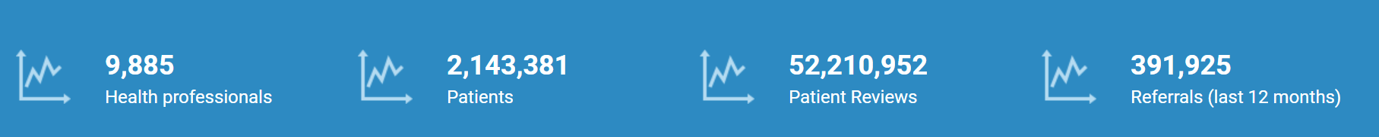

SeNT eReferral
“Online eReferrals are the way to go and certainly the way of the future”
Dr Guy Streeter-Smith
Secure electronic referrals to public and consenting private specialists allied health.
SeNT eReferral supports General Practitioners safely deliver the required information to the right service and enable accurate and prompt patient triage.
SeNT eReferrals use locally agreed referral criteria and service information sourced from HNE Community HealthPathways.
The PHN supports General Practice by funding the purchase and installation of software and provide initial training for eligible users.
For factsheets, contact details for relevant Digital Health Team member, more training, information on updates, …access DH page on website here …..installation; BPAC website, enter practice details, a member of the team will make contact with you.
Training and updates on using the program, contact The PHN's Digital Health Page
For technical IT support contact BPAC 1800 247 544

Slide 5


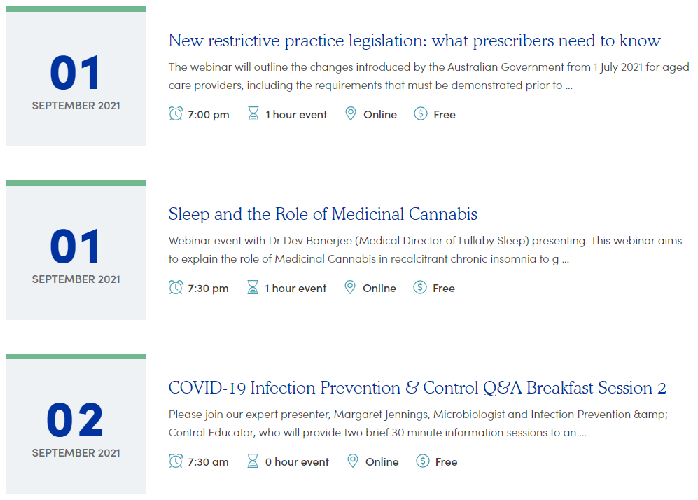
Make accessing the latest education easy for registrars
www.thephn.com.au/education-events
* TIP: save this page as a favourites for your registrar during their orientation to your practice

Slide 6

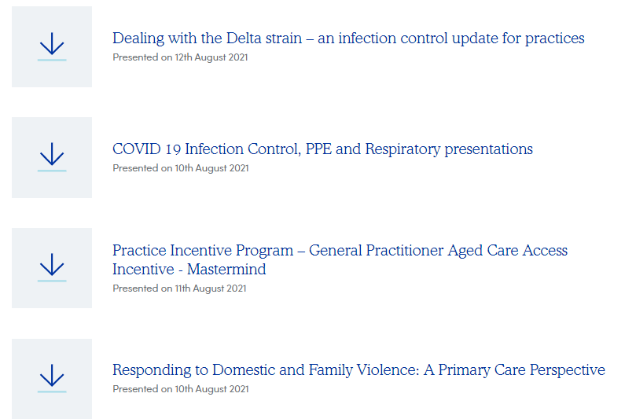
The phN’s education library
www.thephn.com.au/education-resources

Slide 7
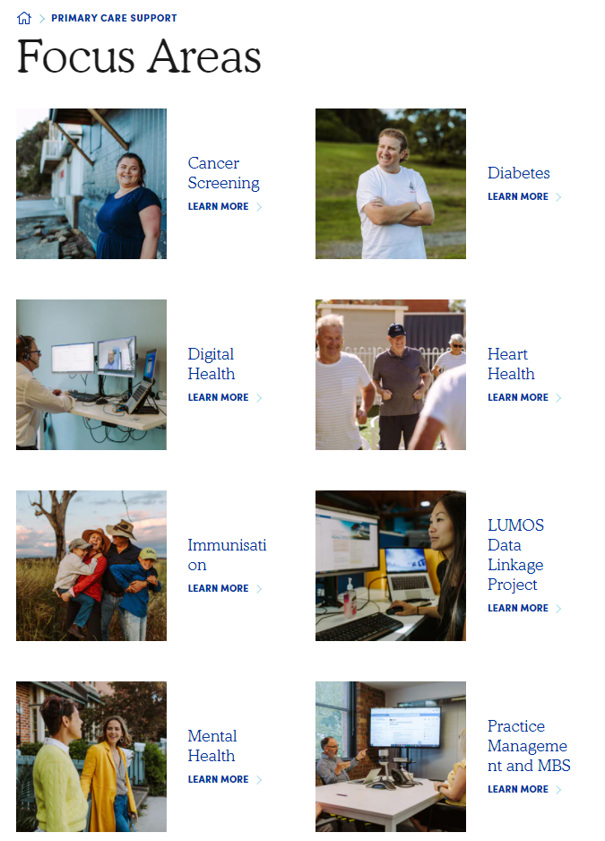
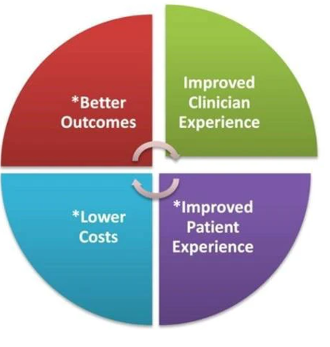
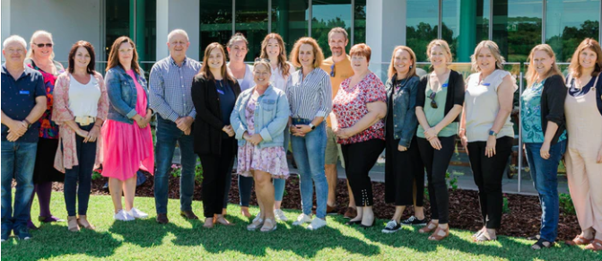
Primary care support
Focus Areas
Communities of Practice

Slide 8


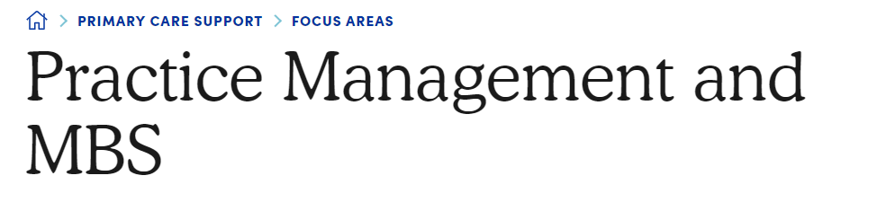
confidence in MBS billing and mbs item number descriptors
Good ideas for how Practice managers can support registrars can be found in the Practice Managers toolkit
Tips:
Use item number on appointment type to help with familiarity of MBS item numbers
Save MBS online in favourites
Provide education about rejected billings and how this impacts the practice

Slide 9
specialised mental health and wellbeing support for you, your family, and patients
ORGANISATION | DESCRIPTION | CONTACT
CranaPlus | Provide 24/7 personalised care for remote health work­ers and their families. | 1800 805 391
Phoenix Australia | Provide trauma related training and programs to teach the skills required to provide practical, effective support and treatment. | 03 9035 5599
 | Tips for supporting medical centre staff
RDN | Wellbeing Grants to support practitioners, their partners and family. | 02 4924 8000
Members Assistance Program through AccessEAP | Currently provide 3 free counselling sessions for practice staff in the HNECCPHN region | 1800 818 728
Safe Work Australia - Workplace Mental Health Resources | Provides a range of information and resources to support business and employees prevent or minimise risks to psychological health. | 13 10 50
LIFELINE | A national charity providing all Australians experiencing emotional distress with access to 24-hour crisis support and suicide prevention services. | 13 11 14
 | For bushfire affected areas: | 1300 152 854
Health Direct | The Symptom checker guides you to the next appropriate healthcare steps, whether it’s self-care, talking to a health professional, going to a hospital or calling triple zero (000) | 1800 022 222
Doctors Health Advisory Service | DRS4DRS promotes the health and wellbeing of doctors and medical students across Australia. A telephone call-back help line, providing independent and confidential advice for practitioners and students, and for colleagues and family members in NSW and the ACT. | 02 9437 6552

Slide 10

Proven strateigies
Use of interviews with applicants to;
Promote that GP’s are offered a flexible work schedule
Promote the benefits of being a GP
lifestyle,
variety of work
better balance for family and relationships less on-call commitments
Screen for applicants who indicate their interest to stay in your area or in rural/remote areas long term.

Slide 11
Proven Strategies - Identifying and minimising barriers & chellenges
Common Challenges & Barriers
Accommodation
Issues short term leases can be hard to find and registrars often have a lack of rental history
Looking beyond real estate rental to the Airbnb market, purchase accommodation
Income
Employee vs Contract
Help GP’s minimise tax debts – look into trained medical accountants
Consider paying a higher percentage as an incentive for doctors to remain at the practice
Lifestyle
Look at ways to you support registrars/GP’s/locums enjoy the lifestyle that your area offers - day trips/weekend trips/ local attractions/ sporting groups and clubs/ restaurants and so on. Consider what might be relevant and appealing for a registrar’s / doctor’s partner and family if they have one.
And
Info from RACGP….
https://www.racgp.org.au/afp/2014/september/starting-off-in-general-practice-%E2%80%93-consultation-skill-tips-for-new-gp-registrars/

Slide 12
Proven strategies
Teaching Model
    Practice Management
    Office operations
    MBS claiming
    Practice and Business establishment
    Tax
    Nursing home and home visits
    Whole team approach to patient care
    Other ideas
    Networks, Connections and Presence

Slide 13


Ideas to Welcome registrars and doctors
Share with registrars, stories and history about your town and area
Main shopping areas
Radio frequencies
Exercise, sport and recreation opportunities
Out of town adventures – day and weekend trips from your town
Dining in and out
Coffee, hair salons etc.

Slide 14

Questions
&
Comments

